Slide 1
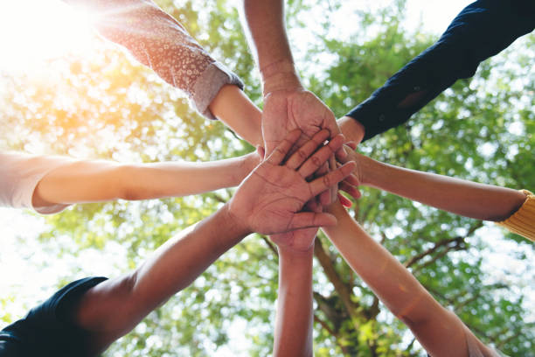

The Student Connectedness Project
Co-creating safe, accessible & community-focused spaces where every student is connected to adults, peers, and purpose
Designed by Students, for Students
Notes:
Maria

Slide 2

Welcome
The Student Connectedness Project is an invitation for students to become learners, leaders, and designers of school connectedness.
Together, you will explore how to ensure that every students is connected to adults, peers, purpose, and a welcoming space.
Notes:
Maria

Slide 3

Connection Circle
Please share your name,
school/organization,
and
when thinking about connection, what comes to mind?
Notes:
Maria

Slide 4
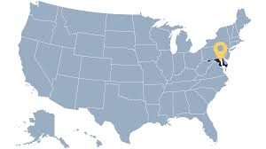
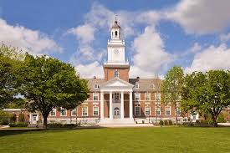
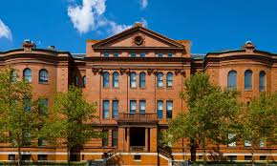
Who Are We and What Do We Do?
Maryland & other world locations
Johns Hopkins University
School of Education
Everyone Graduates Center
Notes:
Maria Introducing ourselves and the university - The EGC Team and the focus regarding research and co-designing

Slide 5

The Why
When students don’t feel connected to school, it can lead to things like:
Missing a lot of days
Having trouble focusing
Feeling stressed or unmotivated
But when students feel like they belong and are supported, great things happen:
Attendance goes up
Well-being improves
Learning and achievement get stronger
Notes:
Michelle

Slide 6
Part of a Greater Good – When You Share Your Ideas, You Help Us…
Understand what really helps students feel connected
Find out what gets in the way of learning or feeling supported
Create changes that actually make school better for everyone
Notes:
Michelle

Slide 7
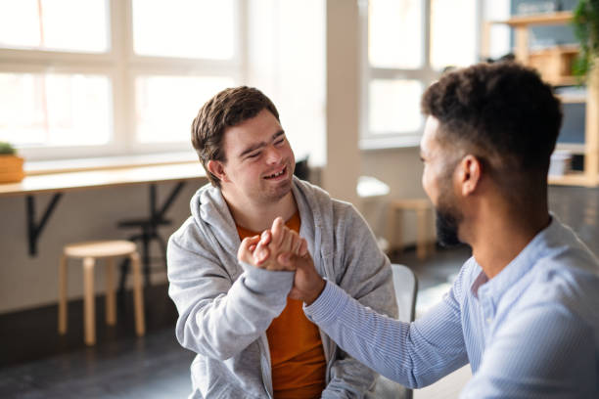
What You Will Do
Co-create actionable strategies that strengthen connectedness in your school
Explore what connectedness looks like
Use design thinking process to co-create and test new ideas
Collaborate with other students and mentors to solve real challenges
Launch a student design sprint for your school/classroom, grade level, community
Notes:
Jeri

Slide 8
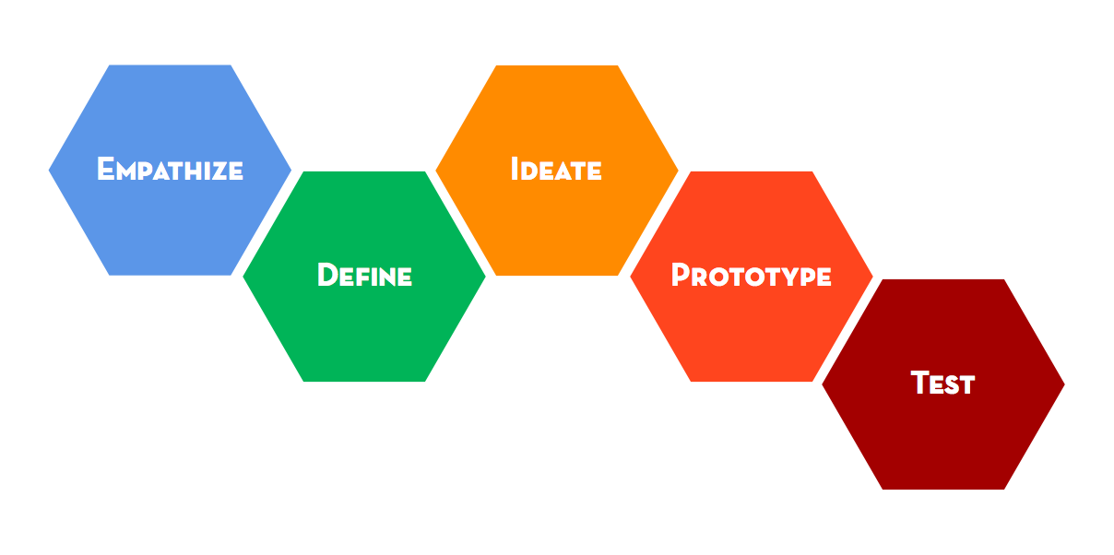
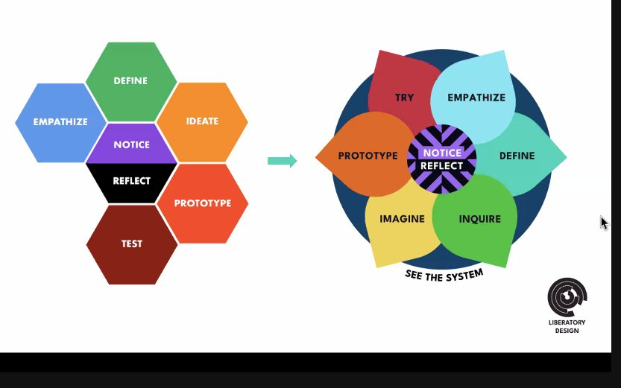
Human Centered Approach to Design for Co-Creation
Notes:
Jeri

Slide 9
01
02
Connected to Adults
Connected to Peers
03
04
Connected to Purpose
Connected to a Welcoming Place
The Four Connectedness Components
Caring adults at school can make a big difference in your school experience
Supportive friendships empower you to feel safe, understood, and encouraged
Making a difference lets you feel connected to something bigger than yourself
Clear academic expectations and a welcoming school make you feel motivated and like you belong
Notes:
Jeri Each session will be designed in three parts:
Discovery - research -Design Thinking
Dream - what is possible
Design - sprint design / strategies

Slide 10
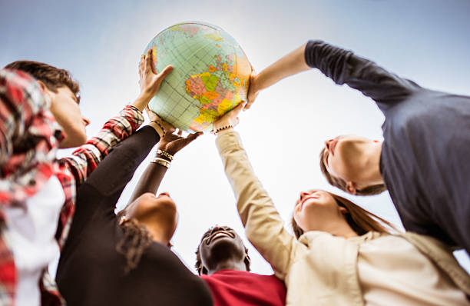
Who
Should Participate?
Students take the lead in creating ideas and strategies to make school a place where everyone feels welcome, supported, and motivated
Teachers, counselors, and other staff are there to guide, support, and provide resources, making sure students’ voices shape the changes that matter most
Notes:
Maria

Slide 11
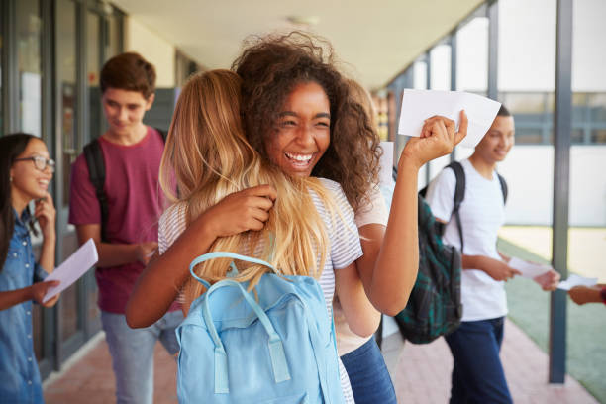
Why it Matters
When you have caring adults, supportive friends, meaningful activities, and a welcoming school, you can do your best.
Together, students can help design schools where connections lead to success and everyone feels like they belong.
Notes:
Maria

Slide 12
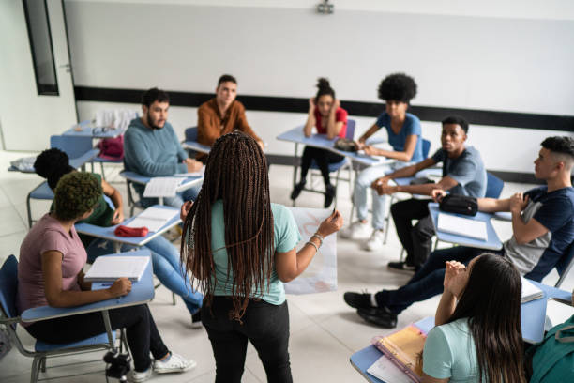
Student voices have the power to shape positive change for everyone!
Notes:
Maria

Slide 13
The Project Timeline
Information Session
Create a team
Virtual Showcase
Attend Virtual Sessions and Co-Creation
Office Hours
January 14
Connected to Adults January 28
March 25
April 29
Connected to Peers February 11
Connected to Purpose
February 25
Connected to a Welcoming Place
March 11
Notes:
Michelle

Slide 14
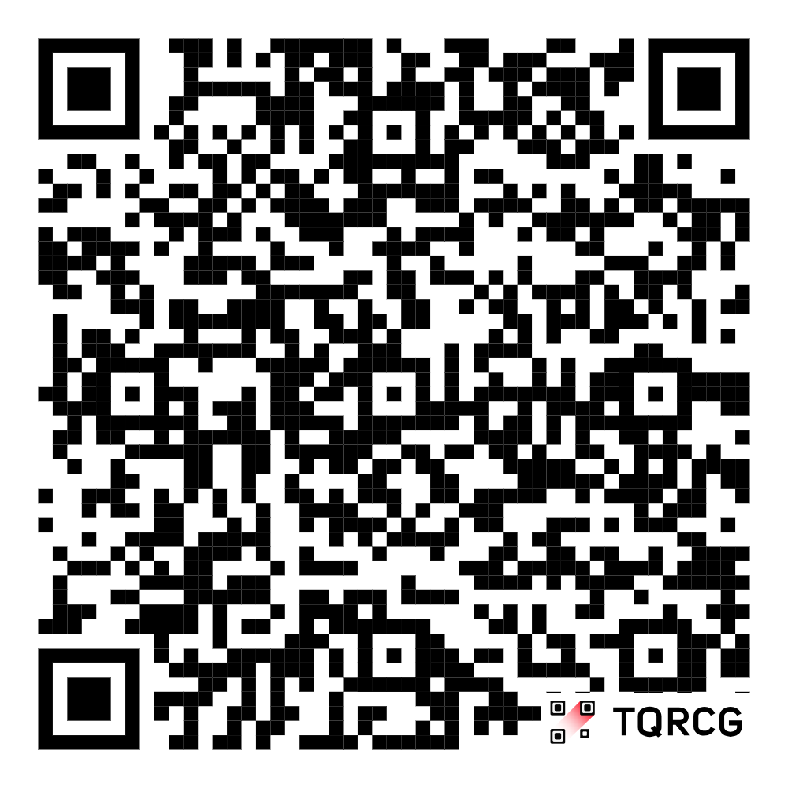
Resources
Website
Student Connectedness Project one-pager to share with Friends
https://drive.google.com/drive/folders/1q_vuZiBcV6ofnIcMCZFBm3k7xBwA4r6j
www.redesign.every1graduates.org/student-connectedness-project/
Notes:
Jeri

Slide 15

Questions?
Notes:
All

Slide 16

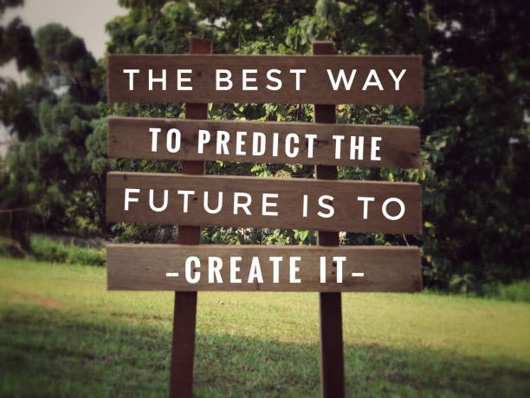
The Everyone Graduates Center Team
Maria Waltemeyer mwaltemeyer@jhu.edu
Jeri Crispe jcrispe1@jhu.edu
Michelle Starnes mstarne7@jhu.edu

