Slide 1
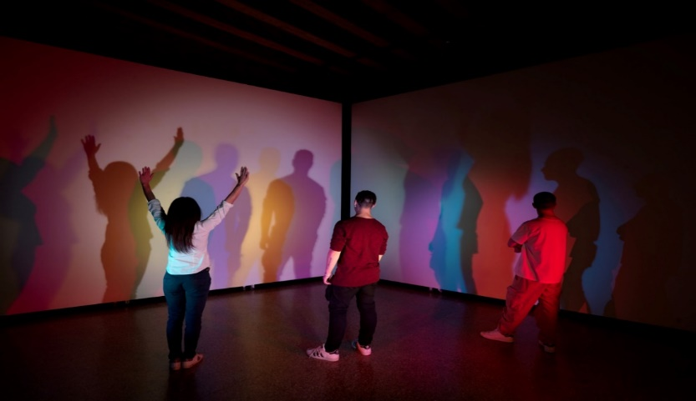
Hazlo Ahora:
Lee el folleto "Yo soy, tú eres... nosotros somos: ¿Quién es Alberto Biasi?”
Resalta o encierra en un círculo las palabras que no conozcas.
Notes:
Students can just jot down unfamiliar words, so no need to make copies
https://www.mutualart.com/Exhibition/Alberto-Biasi--The-Visibility-of-the-Inv/ABAB870434342462

Slide 2
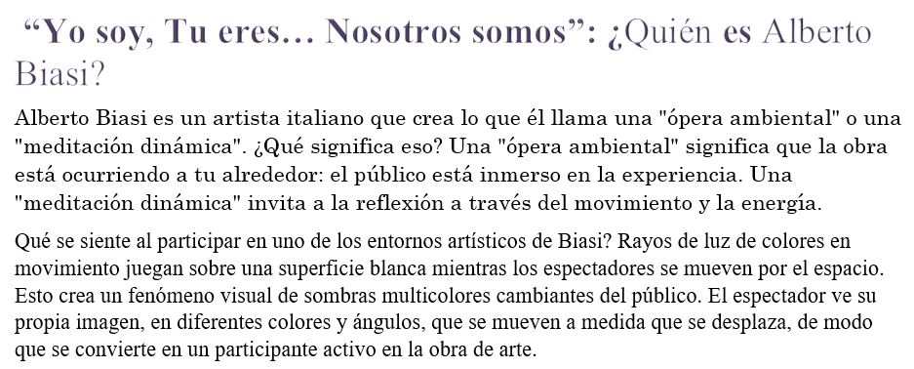
Notes:
https://www.mutualart.com/Exhibition/Alberto-Biasi--The-Visibility-of-the-Inv/ABAB870434342462

Slide 3
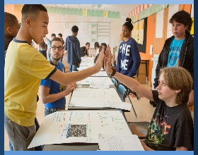
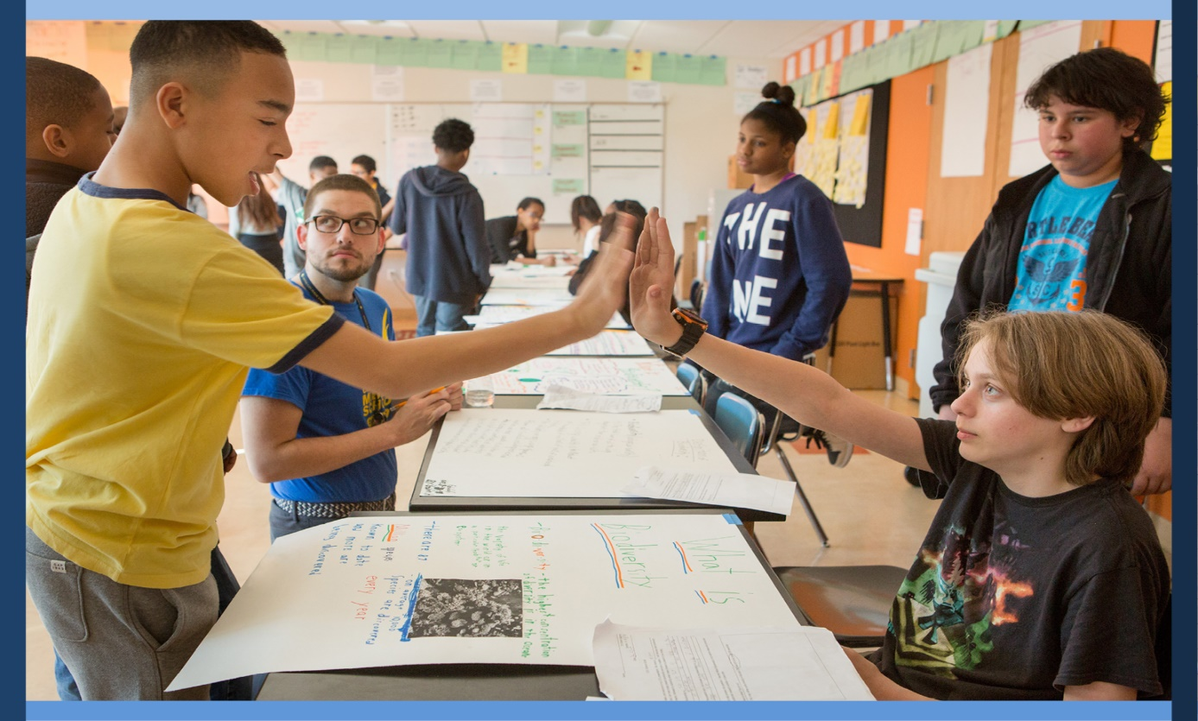
Interactuar con los Demás
Día 8: Creación Conjunta de una Comunidad Solidaria
De la Empatía a la Acción Parte II
Notes:
Image: Allison Shelley, Alliance For Excellent Education https://images.all4ed.org/boys-high-five-in-science-class

Slide 4
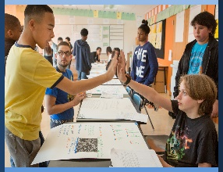
Nuestra Agenda
Introducción al Design Thinking
Entrevistas de Empatía
Construir un Mapa de Empatía
Boleto de Salida

Slide 5


Mientras nos preparamos para crear conjuntamente nuestra comunidad de aula…
Piensa tranquilamente en la conexión entre la obra de arte de Biasi y nuestro propio trabajo creativo futuro. ¿En qué se parece el arte de Biasi al nuestro?
Notes:
Invite students to sit in a connection circle. As we prepare to re-imagine and co-create our classroom community, we think quietly about the connection between Biasi’s artwork and our creative work.
Pose the following question,
How is Biasi’s art similar to ours?
Ask for a volunteer to begin sharing and to move the talking piece sequentially.

Slide 6
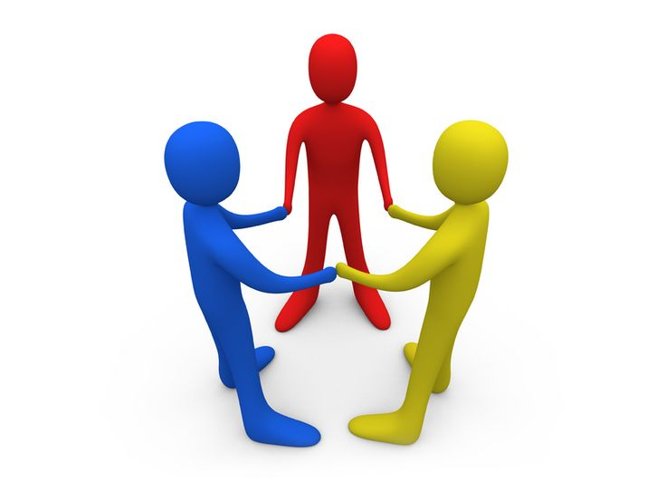
¿Qué es DESIGN THINKING?
Un proceso centrado en las personas para imaginar nuevas formas de hacer las cosas que sean liberadoras y justas para todos.
Notes:
Introduce students to design thinking as a human-centered process used to re-imagine our classroom community.
http://clipart-library.com/clipart/186901.htm

Slide 7
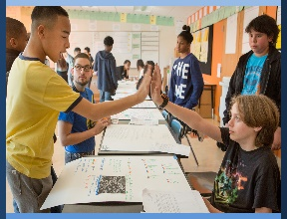

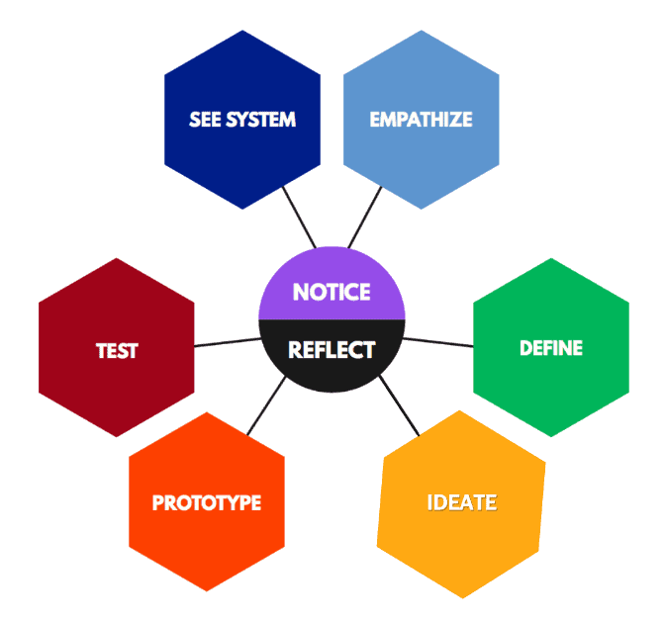
DESIGN THINKING
Componentes centrados en la equidad (Stanford d.school)
Notes:
Show the components of design thinking as presented by the d.school @ Stanford. Highlight empathy as the one component we will be focus on. https://dailyacts.org/ghcdc_design_process/
http://clipart-library.com/clipart/1764131.htm

Slide 8


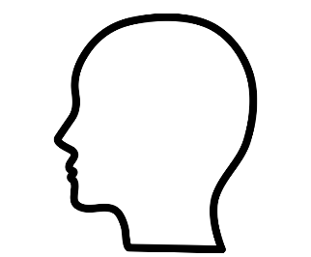
Empatía incluye…
Ver su mundo | Apreciarlos como seres humanos
Entender sus sentimientos | Comunicar su comprensión
Empatía
Notes:
Empathy that comes from observing and interacting enable us to experience deep listening, learning, and gaining. We listen from a variety of perspectives, as we learn to work together with peers and adults, and in the process, we gain appreciation for the unique strengths and contributions each team member brings to the table. The process will help us re-frame our ideas encouraging a holistic view of the classroom before jumping to solutions. Head by Alena Artemova of The Noun Project https://thenounproject.com/search/?q=head&i=2324239

Slide 9
Prestar atención a…
NECESIDADES HUMANAS
Ver Escuchar
Pensar
Sentir
Hacer
EMPATÍA
Notes:
Empathy interviews allow the opportunity to understand individuals’ choices and behaviors as ways to convey needs, and to identify possible designs to meet those needs. Let students know that when interviewing for empathy we ask why even when we think we know the response. We also pay close attention to nonverbal cues, body language and emotions. We respectfully empathize without judgement, with a beginner’s eyes, and with curiosity

Slide 10
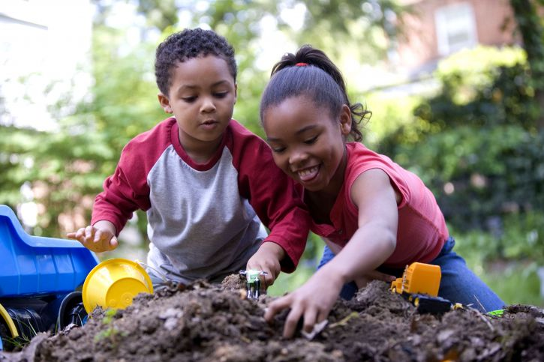
Realizar Entrevistas de Empatía
Empatizar: ¿cómo?
sin juzgar
con ojos de principiante
con curiosidad
con optimismo
con respeto
Notes:
Through empathy interviews we are looking for stories and experiences. We talk about feelings and ask “why”. We use a beginner’s mindset. In a Deloitte article published in the Wall Street Journal (2019, July 25), we learned from Shunryu Suzuki, a Zen monk, teacher, and book author, that “in the beginner’s mindset there are many possibilities. In the expert’s mind there are few” Photo by Cade Martin, Dawn Arlotta, USCDCP https://pixnio.com/people/children-kids/boy-and-girl-are-smiling-playing-with-toys

Slide 11
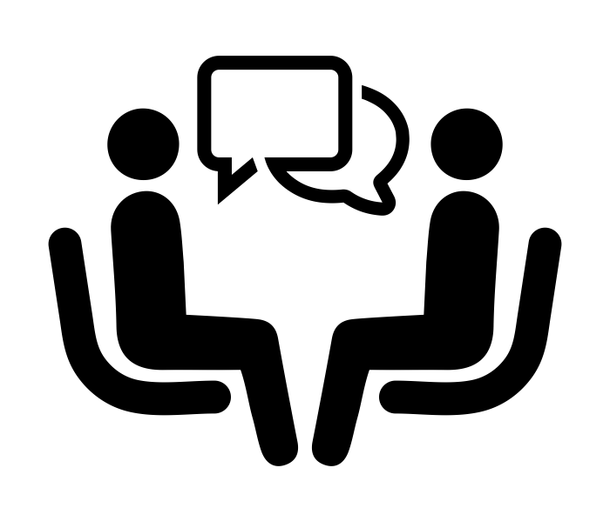
Algunas Sugerencias de Preguntas para Entrevistas sobre Empatía
Cuéntame una experiencia memorable en clase
¿Por qué se te ha quedado grabada esa experiencia?
¿Podrías decirme por qué fue importante para ti?
Al recordar la experiencia, ¿qué sentimientos/emociones tienes?
Háblame de un suceso ocurrido en clase del que todos pudieran aprender.
¿En qué pensabas en ese momento?
RECUERDA:
Escuchar con atención
Tomar notas
Hablar de sentimientos
Observar señales no verbales
Preguntar “por qué”
Cambiar los roles después de 5 min.
Notes:
The flow of an empathy interview should feel less like an interview, and more like a conversation with a friend. Jot down responses including quotes.
The questions are not supposed to be a script. They are to be question starters,
Tell me about a memorable classroom experience
Would you describe what makes that experience remain in your mind?
Could you tell me why is that important to you?
As you recall the experience, what feelings/emotions do you have?
Walk me through something that happened in your classroom that everyone could learn from
What were you thinking at that point?
Partners decide who will be interviewed first.
Take notes.
Be organic with the questions.
Switch roles after 7 minutes.
Image by Delwar Hossain, The Noun Project https://thenounproject.com/term/job-interview/591034/

Slide 12
Mapa de Empatía
Colectivo
DECIR
PENSAR
HACER
SENTIR
En una pizarra o en un póster, recopila los resultados de todas las entrevistas individuales de empatía de tu clase. ¿Qué temas comunes observas? ¿Qué necesidades observas?
Notes:
Invite students to come back as a whole class to build a collective empathy map. Explain to the class that designers use methods and tools to be grounded in the design by unpacking collected responses, identifying needs and insights.An empathy map is a tool that would help synthesize observations and surface unexpected insights. Use a 2x2 matrix on poster paper (sample provided), a whiteboard, or a Miro board labeled Say, Think, Do, and Feel. Ask students to refer to their notes to populate responses for each of the four quadrants.
Say-What did you hear your partner say? What can you imagine him/her saying? Quotes or descriptions used by your interviewee.
Do-What actions and behaviors did you observe?
Think-What might your partner be thinking? What does that tell about your partner’s beliefs?
Feel-What emotions was your partner experiencing?

Slide 13
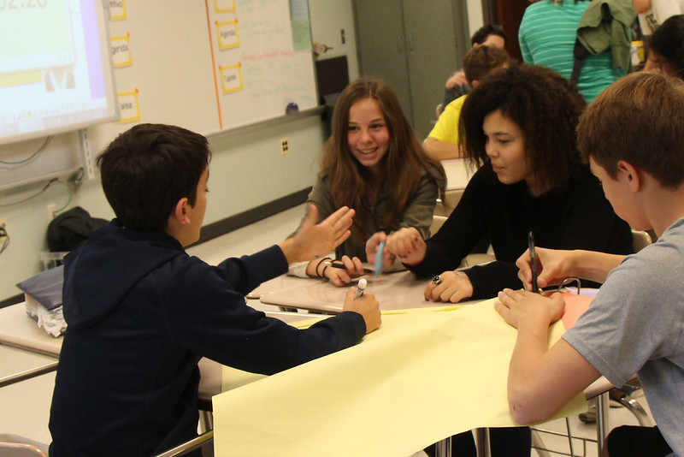
Criterios de creación conjunta de una comunidad solidaria
¿Cómo podemos re-imaginar nuestra clase como una comunidad solidaria? ¿Cómo podemos abordar las necesidades que han surgido?
Notes:
Using the empathy map results, work with students to co-create a list of criteria for what we as a community believe will make the first prototype of our ideal classroom community. Photo Woodley Wonderworks https://www.flickr.com/photos/wwworks/22285865741 CC BY 2.0

Slide 14
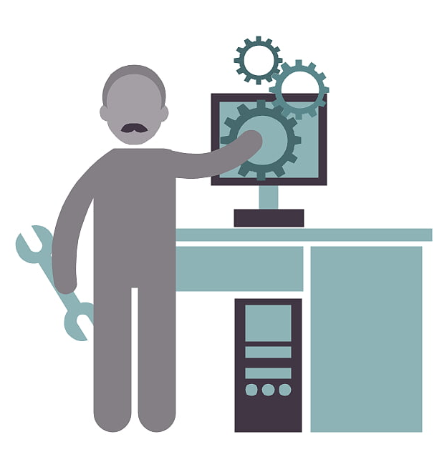
Pruebas de Prototipo
En las próximas semanas pondremos a prueba nuestro prototipo de aula, para averiguar qué partes funcionan y cuáles aún necesitan revisión.
Notes:
Announce that during the next few weeks, we will be testing our prototype. We will determine which parts work, and which will need further revision. Creative professionals, like software engineers, test their prototypes to determine the parts that will break to inform the next version. Image: http://clipart-library.com/clipart/software-engineer-cliparts_10.htm

Slide 15
Closing Circle
Cierre
Una Palabra
Comparte una palabra que capte lo que crees que hemos conseguido en la lección de hoy.
Notes:
Invite students to join in a circle and share one word that captures the collective change made in today’s lesson. Ask for a volunteer to begin sharing.

Slide 16
References & Resources
Photos & Images
Slide 1: https://www.mutualart.com/Exhibition/Alberto-Biasi--The-Visibility-of-the-Inv/ABAB870434342462
Slide 2 and unit thumbnails: Allison Shelley, All4Ed https://images.all4ed.org/boys-high-five-in-science-class
Slide 5: http://clipart-library.com/clipart/186901.htm
Slide 6: https://dailyacts.org/ghcdc_design_process/
http://clipart-library.com/clipart/1764131.htm
Slide 7: Head by Alena Artemova of The Noun Project https://thenounproject.com/search/?q=head&i=2324239
Slide 9: Photo by Cade Martin, Dawn Arlotta, USCDCP https://pixnio.com/people/children-kids/boy-and-girl-are-smiling-playing-with-toys
Slide 10: Image by Delwar Hossain, The Noun Project https://thenounproject.com/term/job-interview/591034/
Slide 12: https://www.flickr.com/photos/wwworks/22285865741 CC BY 2.0
Slide 13: Image: http://clipart-library.com/clipart/software-engineer-cliparts_10.htm

