Slide 1
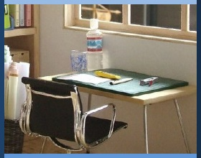

Do Now
Have you ever set a goal for yourself and reached it? Or have you ever set a goal that was unrealistic? What happened?
Write your answer, then share your response with a partner.
Notes:
Students respond in writing to the prompt, then share answers with a partner.
Image http://clipart-library.com/clipart/goals-cliparts_8.htm

Slide 2
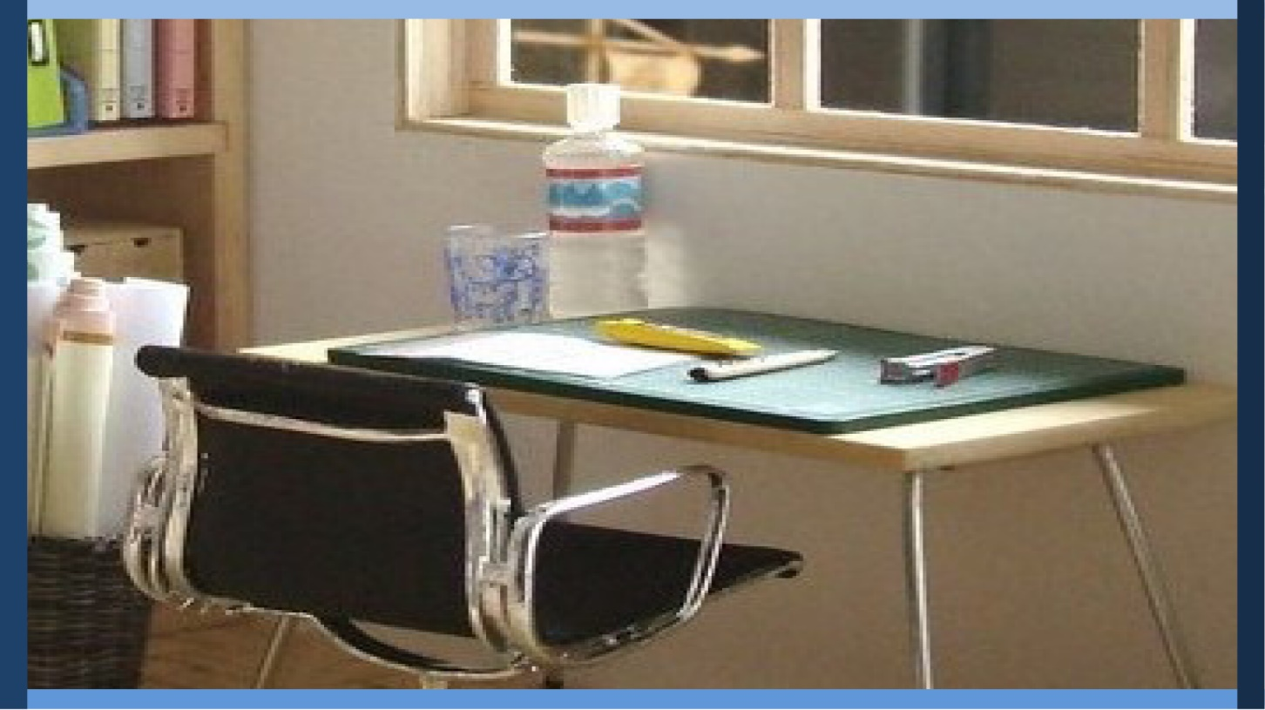
Managing My Learning
Day 8: Setting S.M.A.R.T. Goals
Notes:
Image: https://www.flickr.com/photos/_sk/4276400278

Slide 3

Student Dedication
Notes:
Student Dedication
Then tell students that in this unit they have spent time considering how to get organized and how to study effectively. To close the unit, today’s lesson will focus on setting goals. Invite two or three student volunteers to share their “Do Now” answers with the class.
https://pixabay.com/id/illustrations/akses-banyak-tangan-933142/
Note: You can add the student’s picture to the slide

Slide 4
Agenda By the end of today's lesson you will be able to
Name the steps to a S.M.A.R.T. goal
Identify appropriate goals to set
Set a S.M.A.R.T. goal
Notes:
Explain that today’s lesson will include:
The value of goal setting
How to set a S.M.A.R.T. goal
Time to set your own S.M.A.R.T. goal

Slide 5


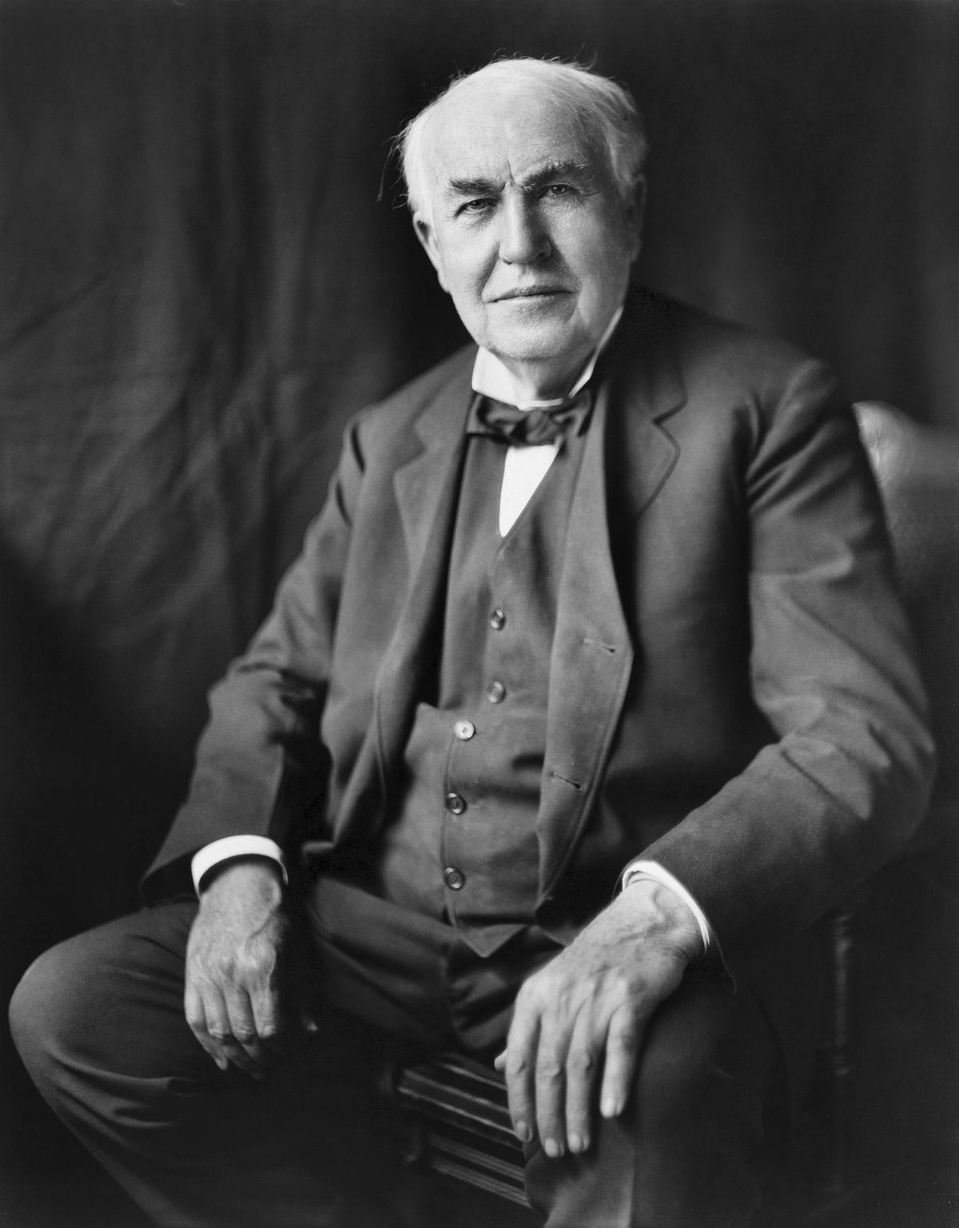

The Value of Goals
Notes:
Tell students that they will first consider the importance of goals by evaluating quotes from four famous individuals.
Divide the class into four groups. Assign each group a quote and associated biography. Either post the quotes/biographies provided throughout the room or have them printed and give a copy to each group. (Note: 8½ x 11" copies of the quotes and biographies are provided; however, you may want to consider printing these in a larger format.) Ask each group to be prepared to:
Share a short summary of the biography
Read the quote to the class
State in their own words how they think the quote applies to goals and goal-setting
Give students time to review and discuss their materials. Then invite groups to share what they learned.
(Quotes are listed in the Teacher's Manual for your convenience; they are also provided as separate pages at the end of the lesson for you to print out. Biographical summaries are adapted from https://kids.kiddle.co/.)
Images https://commons.wikimedia.org/wiki/File:Katie_Ledecky_Olympics_2016.jpg
https://commons.wikimedia.org/wiki/File:Venus_Williams_(14948553428).jpg
https://commons.wikimedia.org/wiki/File:Will_Smith_in_Berlin_(2011).jpg
https://pixabay.com/photos/thomas-alva-edison-inventor-1922-67763/

Slide 6
Partner Reading “Goal Setting: Why and How”
With your partner, answer the following questions.
What is the value of goal setting?
Why do we write down our goals?
Notes:
Give students time to read the handout “Setting Goals: Why and How.” Ask students to discuss with their partners:
What is the value of goal setting?
Why do we write down goals?
Then invite several students to share answers with the class.
Tell students that one way to help us achieve the purposes of goal setting is to be sure to use goals that are “S.M.A.R.T.” This is a popular acronym used to remember the steps of goal setting and to make sure that each goal is as helpful as possible. The five steps can be remembered using the letters to S.M.A.R.T.

Slide 7
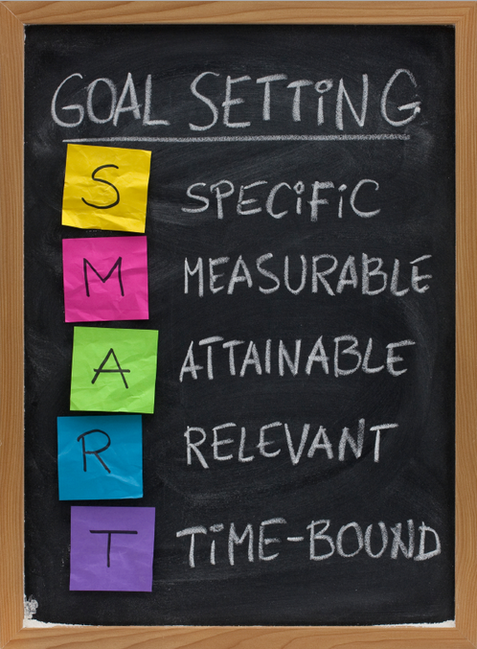
S.M.A.R.T. goals are…
Notes:
Show slide 7, or write out the acronym S.M.A.R.T. vertically on the board and fill in each of the letters. Have students fill in their own acronym chart as you lead them in a whole class discussion of each word’s meaning and importance.
Specific – What do I want to achieve?
Measurable – How will I know I’ve achieved it?
Attainable – Is it challenging, yet still reachable?
Relevant – Why do I want to reach this goal? How will I feel?
Timely – When will I do this? What is my deadline or time limit?
Ask students to provide examples and counter-examples to be sure they understand each word, prompting them with such questions as: “What is an example of a specific goal versus an unspecific goal? How do we measure goals? How do I know if it is attainable? Would becoming president of the United States tomorrow be attainable? How do I know if it is rewarding? When is a realistic deadline?” (Note: the image on slide 7 uses the term “time-bound’ rather than “timely”; assure students that this is simply an alternate terminology.) Students should add notes and examples for each characteristic in the right-hand column.
Photo by Paula Nagle https://www.flickr.com/photos/plnaugle/8334714234 CC BY-NC-SA 2.0

Slide 8


Planning Time
Take this time to fill out your S.M.A.R.T Goals Planning Sheet.
Notes:
Provide students with time to work either individually, or mostly individually with partner check-in, to fill in one or more goals on their S.M.A.R.T. Goals Planning Sheet (slide 8). Circulate through the room to provide additional support and feedback to students. If students finish early, encourage them to go back and edit, set an additional goal, write the goal in their planner, or help a partner.
Images http://clipart-library.com/clipart/calendar-clipart-25.htm
http://clipart-library.com/clipart/8iEb6jAyT.htm

Slide 9
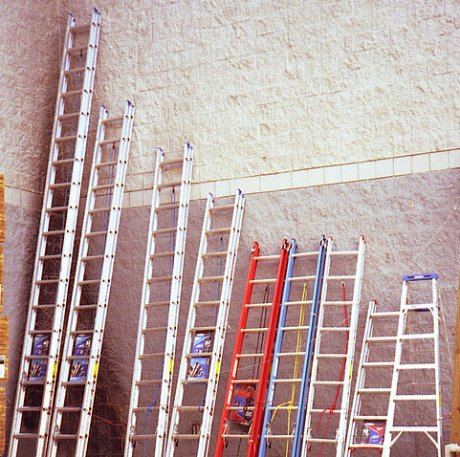
Exit Ticket
My first step to completing my S.M.A.R.T. goal is ______________
Notes:
Provide students with time to share goals with their teams or with the class, depending on time. Have students finish the sentence:
My first step to completing my S.M.A.R.T. goal is….
Photo by Michael Cramer https://www.flickr.com/photos/mikewebkist/746823236/ CC BY-NC 2.0

Slide 10
References & Resources
Photos & Images
Slides 1: http://clipart-library.com/clipart/goals-cliparts_8.htm
Slide 2 and unit thumbnails: Image: https://www.flickr.com/photos/_sk/4276400278
Slide 3: https://pixabay.com/id/illustrations/akses-banyak-tangan-933142/
Slide 4: https://commons.wikimedia.org/wiki/File:Katie_Ledecky_Olympics_2016.jpg
https://commons.wikimedia.org/wiki/File:Venus_Williams_(14948553428).jpg
https://commons.wikimedia.org/wiki/File:Will_Smith_in_Berlin_(2011).jpg
https://pixabay.com/photos/thomas-alva-edison-inventor-1922-67763/
Slide 7: Paula Nagle https://www.flickr.com/photos/plnaugle/8334714234 CC BY-NC-SA 2.0
Slide 8: http://clipart-library.com/clipart/calendar-clipart-25.htm
http://clipart-library.com/clipart/8iEb6jAyT.htm
Slide 9: Michael Cramer https://www.flickr.com/photos/mikewebkist/746823236/ CC BY-NC 2.0

