Slide 1

Do Now: Your Tips for Test-Taking Success
If your younger brother or sister came to you before a big test and asked for tips on how to do well, what would you say? Turn to a partner and share your best test-taking strategies and secrets.
Courtesy Allison Shelley/The Verbatim Agency for American Education: Images of Teachers and Students in Action
Notes:
Students turn to a partner and share their best test-taking strategies and secrets in response to the prompt.
Image: Allison Shelley, All4Ed https://images.all4ed.org/high-school-boy-and-girl-at-computer

Slide 2

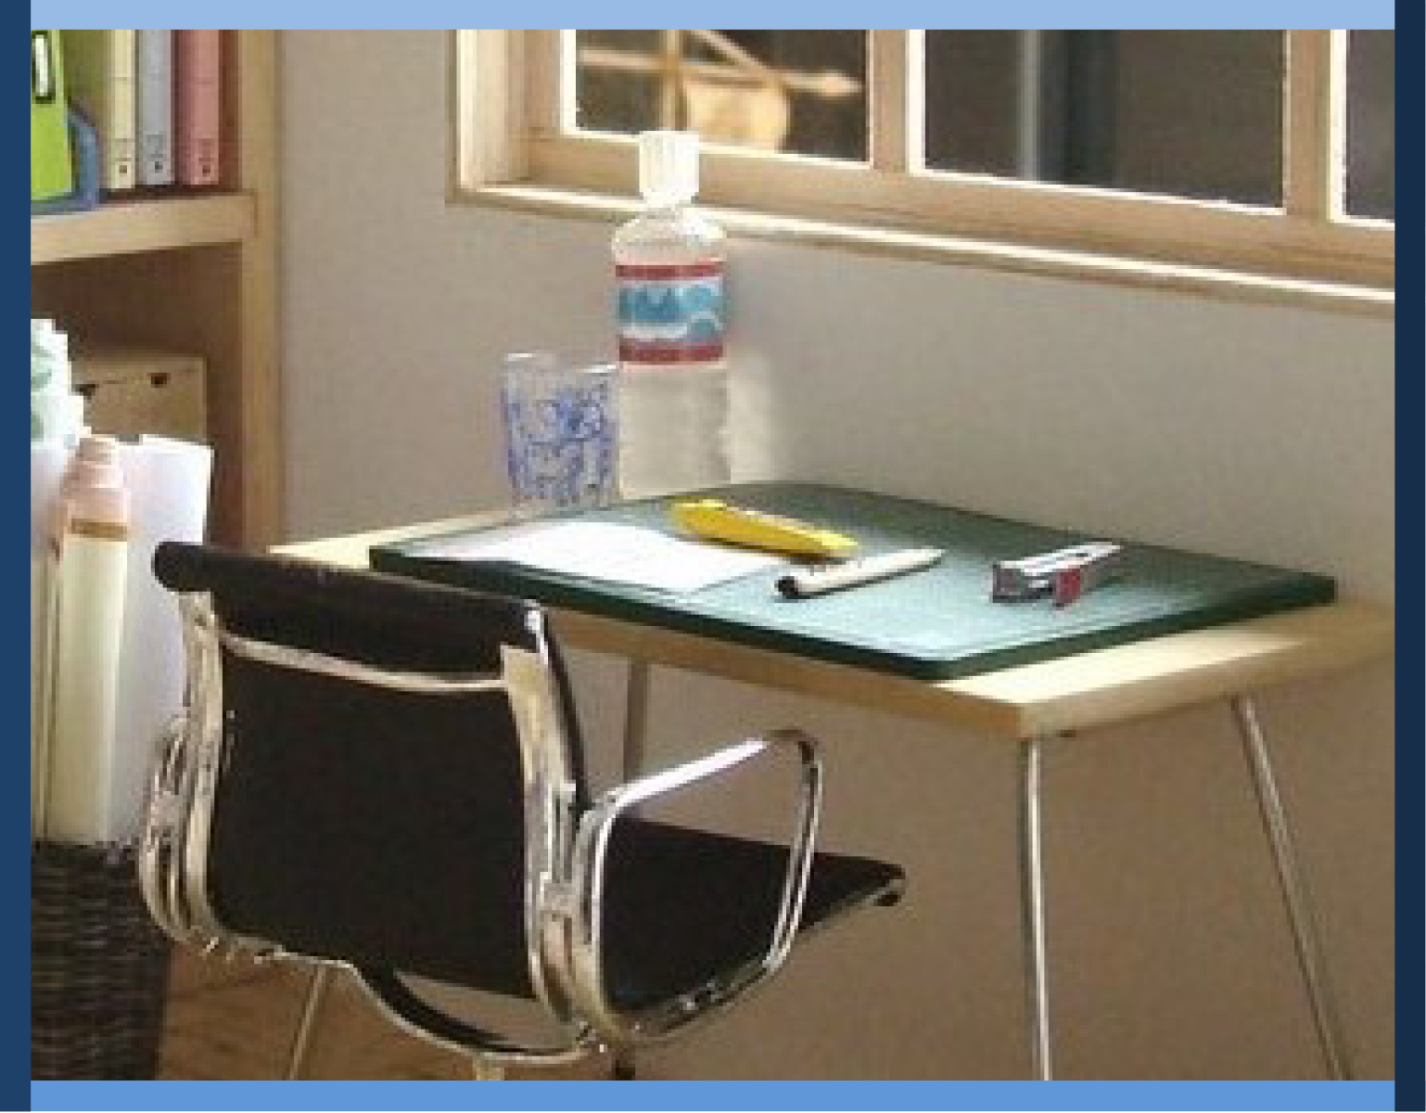
Managing My Learning
Day 7: Measuring My Learning
Notes:
Image: https://www.flickr.com/photos/_sk/4276400278

Slide 3

Student Dedication
Notes:
Student Dedication
https://pixabay.com/id/illustrations/akses-banyak-tangan-933142/
Note: You can add the student’s picture to the slide

Slide 4
Do Now: Your Tips for Test-Taking Success
What are your best test-taking strategies and secrets?
What different kinds of tips have we collected?
Courtesy Allison Shelley/The Verbatim Agency for American Education: Images of Teachers and Students in Action
Notes:
Ask students to share the results of their Do Now activity. Use the following questions as a guide. List student answers on the board or chart paper.
What were some of the tips you shared or heard?
What categories could we use to organize this information?
If we were creating an orientation brochure for new students, how could organizing the information help us?
As students offer suggestions, help them to see that the information would need to be organized into broad categories, such as “test preparation,” “positive mindset,” and “handling different kinds of questions.” Under each general category, you would list specific details.
Image: Allison Shelley, All4Ed https://images.all4ed.org/high-school-boy-and-girl-at-computer

Slide 5
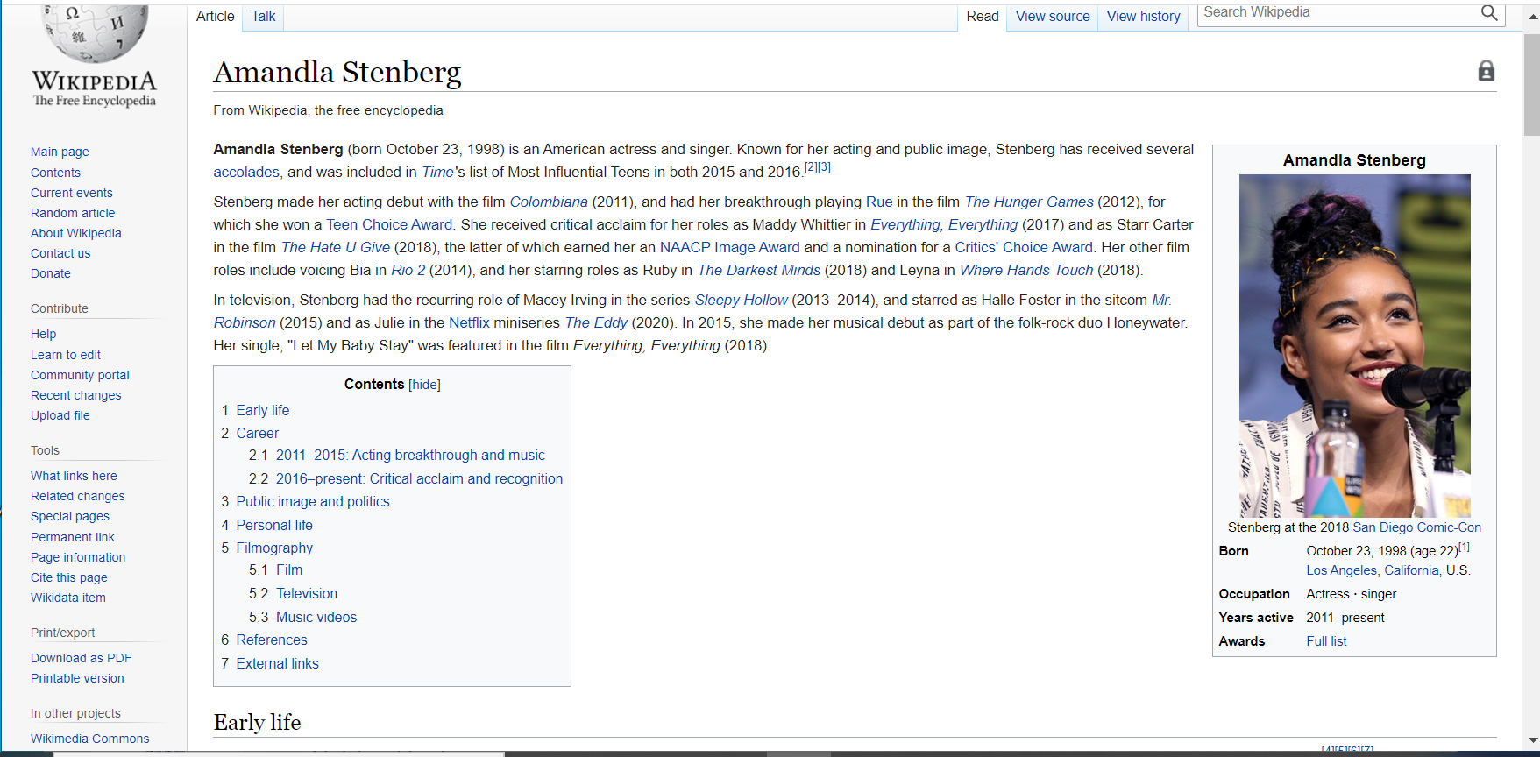

A Wikipedia Outline
Notes:
Ask students how many of them have used Wikipedia for schoolwork. On the Wikipedia screenshot, point out the outline provided near the beginning of the article. Ask students why they think Wikipedia includes an outline at the beginning of every article.

Slide 6
A Useful
Term to
Know
outline:
a way to organize information in a list by topics, sub-topics, and details. Outlines are used
to capture important information when you read
to plan how to present information
to check to see whether your thinking is clear and well organized
Notes:
Ask students, “Who knows what an outline is, or has used an outline in the past?” Have students indicate their familiarity with outlining by a show of hands. Introduce the vocabulary term outline if some students are not familiar with this concept. Ask students how creating outlines can help them in their schoolwork.

Slide 7
Measuring Your Learning: Concept Map
1. How to Use Outlines to Measure Learning
Identify key words/ main ideas
Add supporting details
Title
____________
_________
___________
_________
______
II. ____________
_________
___________
3.
Partner Practice:
“Test-Taking Triumph”
2.
Whole Class Practice:
“Using Outlines for Success”
Notes:
Display the concept map for the lesson. Tell students that during this lesson, they will learn how to create an outline, and how this can help them measure what they have learned. For practice, they will read and outline a text that shares important tips for test-taking success.

Slide 8
Using Outlines for Success
Title
I. First Main Point
A. Supporting Point
B. Supporting Point
II. Second Main Point
A. Supporting Point
B. Supporting Point
III. Third Main Point
A. Supporting Point
B. Supporting Point
IV. Conclusion
A. Supporting Point
B. Supporting Point
Why outline a chapter or article you have read? Outlining helps you become a better reader and student. Creating an outline will help you organize your thoughts, remember what you have read, and show what you have learned.
If you have used graphic organizers, you have already learned some of the steps in making an outline. To fill out an organizer, you had to figure out main points and some supporting details. As you saw how each detail supported the main points, you got a “big picture” view. Outlining can help you in the same way.
But how do you create an outline? Making an outline is like doing a jigsaw puzzle. You have to figure out how each piece fits together with the whole. To make an outline, first decide what the main points of the article or chapter are. Then figure out what are the supporting points. When you create an outline, you do not need to write in complete sentences. This illustration shows how an outline is structured.
Notes:
Show slide “Using Outlines for Success,” and have students follow along in their student texts. Advise students to listen closely as you will work together to outline the text after reading. Either read slides 8-9 aloud, or invite student volunteers to read by paragraphs.

Slide 9
Using Outlines for Success (page 2)
If you are outlining a chapter or article, the author may give you clues about what is important. The first paragraph usually introduces what the chapter is about, or what the author is going to prove. The text may have bold headings. This lets you know what a particular section is about. The author may give examples, facts, or statistics to support these points. The last section usually summarizes the main points and lets the reader know that the chapter or article is over.
When might you want to create an outline? Outlines can help you study, especially when the topic is complicated. Creating an outline is also a great way to prepare to write a report or essay. When your ideas are organized, your writing will be too!
Title
____________
_________
___________
_________
______
II. ____________
_________
___________
Notes:
After the reading is completed, ask students what to do as the first step in creating an outline for this text. (Identify main points.)

Slide 10
Step 1: Identify the main points
Why create outlines
How to create an outline
When to create an outline
Notes:
Show slide and ask students to suggest main points, referring to their written copies of the text. (If they have difficulty, suggest they look for bolded text to give them clues.) After receiving student suggestions, click through to show the three main points on the slide. Ask students what the next step should be. (Identify supporting points.)

Slide 11
Step 2: Find the supporting points
Why create outlines
Become a better reader/student
Organize thoughts
Remember better
Show what I’ve learned
Works like a graphic organizer
Main points & supporting details
Gives “big picture” view
How to create an outline
Like a jigsaw puzzle – figure out where each part fits
Find clues in text – headings, examples, statistics
When to create an outline
Studying (especially complicated topics)
Writing reports or essays
Notes:
Work with students to identify supporting points, clicking through slide 11 as you progress.

Slide 12
How are outlines and mind maps similar? How are they different?
Mind Map
Outline
Both
Title
____________
_________
___________
_________
______
II. ____________
_________
___________
Notes:
After the outline is complete, ask students to comment on the process. Ask them how making an outline is similar to and different from creating a mind map. You may wish to create a Venn diagram on the board to note student observations. After doing so, show slide 13.

Slide 13
How are outlines and mind maps similar? How are they different?
Mind Map
Outline
Both
Organize information
Help you study
Main points and supporting details
More visual
No particular order
More words
Set out in order
Title
____________
_________
___________
_________
______
II. ____________
_________
___________
Notes:
Point out that one advantage of outlines for writing is that when you have created an outline, you have a plan to follow from start to finish.
Explain to students that being able to outline what they learn is one very useful skill that will help them measure and demonstrate their learning. In the next activity, they will practice outlining again, but they will also be learning additional tips for test-taking success.

Slide 14

Your Turn
“Test-taking Triumph”
Take turns reading the text aloud with a partner.
Then create an outline of this text.
The headers and sub-headers help you identify the main points and sub-points.
Notes:
Tell students they will now practice their outlining skills using the student text “Test-Taking Triumph.” A pre-formatted page for outlining is provided, although students can also use ordinary notebook paper. Tell students they are to read the text aloud softly with their partner. Then, they will create an outline to capture the information found in the text. (Note: you may choose to have students work with a partner to create the outline or have them work independently. In either case, each student should fill out a separate outline.)
Circulate among students as they read and create outlines. Answer students’ questions as necessary.
Image https://www.flickr.com/photos/departmentofed/8506636735

Slide 15
Whole Class Discussion
What main points and subtopics did you identify?
Which tips were new to you?
Which ones do you think will be most helpful to you as you take tests in the future?
Notes:
Review the “Test-Taking Triumph” activity with students. Ask students what main points they identified for this text. (These could be something like Before-test strategies, During-test strategies, and What about me?) Ask them whether they noted any sub-sections within those main sections. (Objective questions and subjective questions.) Review the terms “objective questions” and “subjective questions” to make sure students understand the difference between the two.
Ask students which tips were new to them, and which ones they plan to use as they prepare for and take tests in the future. (Note: depending on how much time you have, you can extend or shorten this review of the test-taking tips. You could also incorporate the student questionnaire “How Students Take Tests” at this point if you have extra time.)

Slide 16
Exit Ticket
Your outline is your exit ticket.
Title
____________
_________
___________
_________
______
II. ____________
_________
___________
Notes:
Students’ outlines serve as an exit ticket. However, if you have them turn the pages in, make sure to return them so students can use the tips to improve their test-taking in different content areas.

Slide 17

References & Resources
Photos & Images
Slides 1 and 3: Allison Shelley/The Verbatim Agency for American Education: Images of Teachers and Students in Action https://images.all4ed.org/high-school-boy-and-girl-at-computer
Slide 2 and unit thumbnails: Image: https://www.flickr.com/photos/_sk/4276400278
Slide 3: https://pixabay.com/id/illustrations/akses-banyak-tangan-933142/
Slide 14: https://www.flickr.com/photos/departmentofed/8506636735
Notes:
GMH NOTE:
We should end all the PPTs with this slide. We can include all the necessary attributions, credits, links etc. Not only for the images, videos but also other include topic resources for the teacher.
I researched “the noun project’s” attributions and they only say to include the copyright and provider/artist information.

