Slide 1


Do Now: Why Take Notes?
Quickly jot down
3 ways taking notes can help you in school
2 situations that require taking notes in life
Then share your list with a partner.
Notes:
Students jot down their responses to the prompts shown, then share their lists with partners.
https://thenounproject.com/term/lined-paper/1277808/

Slide 2
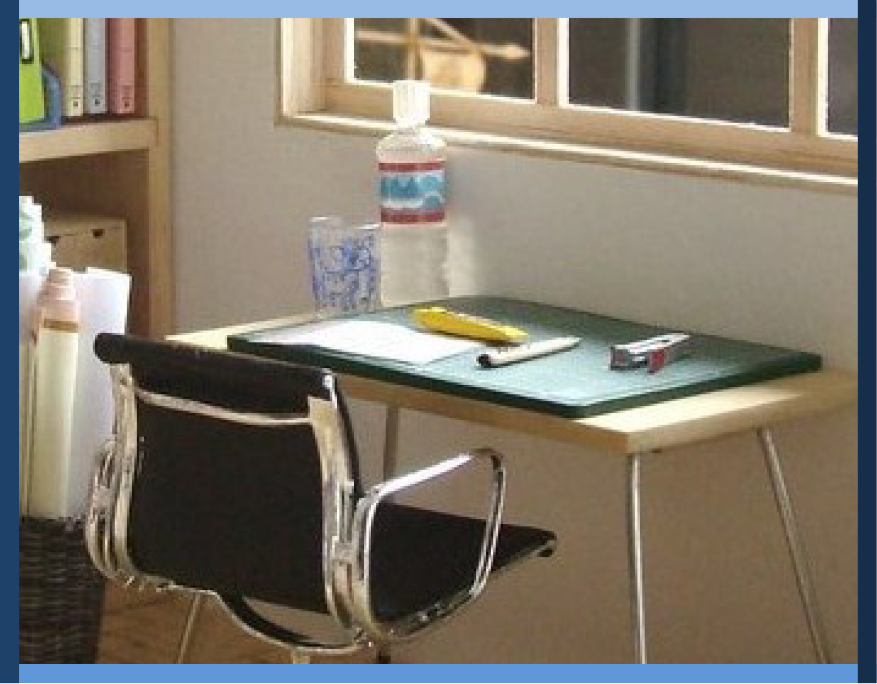
Managing My Learning
Day 6: Taking Useful Notes
Notes:
Image: https://www.flickr.com/photos/_sk/4276400278

Slide 3
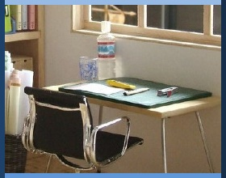

Student Dedication
Notes:
Student Dedication
https://pixabay.com/id/illustrations/akses-banyak-tangan-933142/
Note: You can add the student’s picture to the slide

Slide 4
Do Now: Why Take Notes?
How can taking notes help you in school?
In what situations will you need to take notes in life?
Notes:
Ask students to suggest ways that note-taking can help in school. Listen for the following and add any that students miss. (Don’t show slide 5 until after students have offered suggestions!)
Notes are required in some courses.
Taking notes helps you stay focused and attentive.
Writing information down (and reviewing it later) engages your hands and eyes, which strengthens memory.
Notes make it easy to organize and review information for assignments and tests

Slide 5
Do Now: Why Take Notes?
In school, taking notes
Is sometimes required
Helps you focus
Uses hands and eyes to strengthen memory
Makes it easy to organize and review information
Notes:
Recap by reviewing the reasons listed. Tell students that we need to take notes because we soon forget 80% of what we hear!
Then ask students to suggest life situations (outside of school) in which they may need to take notes, both now and as adults. These could include meetings of clubs, workplace staff, or neighborhood associations; trainings and workshops; and expert presentations on topics of interest to them.
Tell students that taking good notes is an essential skill to help them succeed in school, especially as they go on to high school and college, where they will be responsible for summarizing and learning increasingly complex subjects. The notes they take, whether from their reading or from class sessions, will provide content they can use to study using the tips they explored on Day 5.

Slide 6
Useful
Terms to
Know
key word:
a word that represents an important idea
cue:
a word, phrase, or question that you can use to review and test your memory
shorthand:
abbreviations or symbols that people use to be able to write faster
Notes:
Introduce the vocabulary terms key word, cues, and shorthand. Provide examples of each and invite students to offer their own examples.

Slide 7
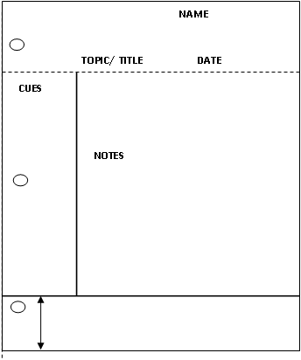
Taking Useful Notes: Concept Map
1. Learn About:
Secrets to Successful Notes
Organize the format
Capture main ideas
Use personal shorthand
Cue & summarize
3.
Practice Round:
“Becoming a Better Student”
2.
Teacher Demo:
“It’s Not Too Soon”
Notes:
Display the concept map for the lesson. Briefly review the activities indicated.

Slide 8
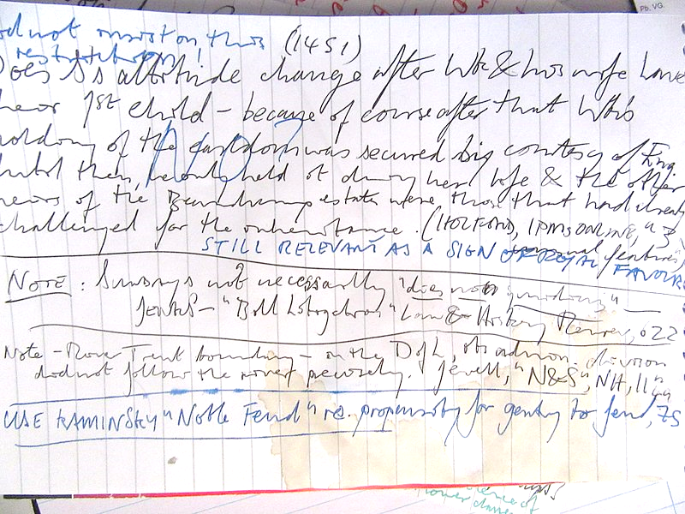
How easy is it to study from a page of notes like this one? Why?
TOO MESSY
TOO MANY WORDS
Notes:
Show slide, “How easy is it to study from a page of notes like this one?” Elicit student responses before clicking to the answer “Too Messy, Too Many Words.”
https://commons.wikimedia.org/wiki/File:Notes_on_medieval_English_nobility.jpg

Slide 9

How easy is it to study from a page of notes like this one? Why?
NOT ENOUGH INFORMATION
Notes:
Follow the same process for this slide (wait for student responses before clicking through to the answer).
https://snappygoat.com/s/?q=bestof%3Ahand+writing+paper+ideas+pen+communication+letter#22f412f0fb448fc9caf47667caabfdf3839860c2,0,774.

Slide 10
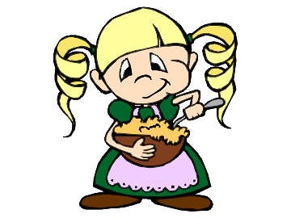
What is the secret to “just-right” note-taking?
TOO MUCH
TOO LITTLE
Notes:
Summarize by telling students that useful notes need to provide the “just right” amount of information neatly presented (just as Goldilocks could not eat porridge that was too hot or too cold, people can’t study from notes that are too crowded or too sparse!). Tell students they will be learning about and practicing a note-taking method called “Cornell note-taking,” after the Cornell University professor who developed it back in 1941. High school and college students around the world have used this method to succeed for many years.
https://www.flickr.com/photos/hirosheridan/472864498

Slide 11
Secrets to “just-right” note-taking
Organize the format
2” top and bottom margins
2” margin on the side
Write your name & the date
Write the title at the top
Notes:
Show slides 11-14, explaining and commenting on the four steps as you do so. Give students time to observe and ask questions at each step, or ask your own questions to check for understanding.
http://clipart-library.com/clipart/Lcd5Eoqni.htm

Slide 12
Secrets to “just-right” note-taking
Organize the format
Capture main ideas
Don’t try to write everything!
WRITE MAIN IDEAS HERE
Notes:
Ask students to suggest ways to identify main ideas (e.g., headings, paragraph spacing, transition words...).

Slide 13
Secrets to “just-right” note-taking
Organize the format
Capture main ideas
Use personal shorthand
+ and ex for example
@ at ? question
= is the same as # number
w/ with w/o without
➔ important
MAIN IDEAS HERE
Notes:
For “Use personal shorthand,” ask students how the examples provided compare with the shortcuts people use when texting or tweeting.

Slide 14
Secrets to “just-right” note-taking
Organize the format
Capture main ideas
Use personal shorthand
Afterward, cue & summarize
MAIN IDEAS HERE
CUES HERE
SUMMARY HERE
Notes:
"Cues" are short words or phrases to jog the memory, or to help you quiz yourself on the material. A summary is a short statement that captures the main idea(s).

Slide 15
Teacher Demo
“It’s Not Too Soon”
Notes:
Tell students that you are going to model the note-taking process using the short text “It’s Not Too Soon.”

Slide 16
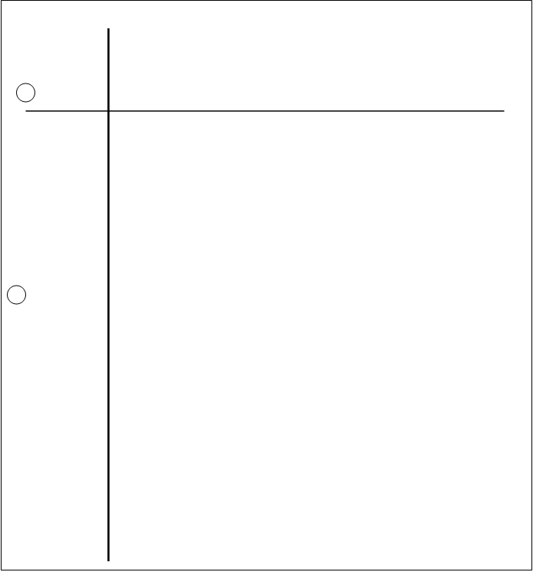
Sample Cornell Notes Page:
Notes:
Display this slide and ask students what you need to do first to set up your notes page. (Answer: add the title, name, and date!)

Slide 17
Sample Cornell Notes Page:
Name
Date
Class period
Title: “It’s Not Too Soon”
Imp. Think about future
Options – college, voc. school, military? Job?
Past – many jobs w/ HS diploma
Diff. today – most jobs require post-HS training – to succeed need certain skills
Note-taking: for now + future—secrets?
Neat + organized
Identify main ideas
Pers. shorthand (abbrev. + symbols)—faster
Add cues + summary after to help study
Notes:
Begin reading the text aloud, inserting the notes on the page as you go. (You may encourage students to follow along as you read, or you may prefer to have them just listen and focus their attention on the note-taking process. Also, the slideshow is formatted so that you can insert the prepared notes by clicking through as you read. However, you may also demonstrate the process using a whiteboard if you prefer.)
After the reading, ask students to comment on ways that you followed the note-taking tips (for example, how you identified main ideas and used personal shorthand). Ask them what your next step should be. (Answer: add cues in the side margin.) Invite students to suggest possible key words, phrases, or questions that you might add.

Slide 18
Sample Cornell Notes Page:
Name
Date
Class period
Title: “It’s Not Too Soon”
Future options
Imp. Think about future
Options – college, voc. school, military? Job?
Past – many jobs w/ HS diploma
Why post-sec. training?
Diff. today – most jobs require post-HS training – to succeed need certain skills
Note-taking: for now + future—secrets?
4 note taking how-tos
Neat + organized
Identify main ideas
Pers. shorthand (abbrev. + symbols)—faster
Add cues + summary after to help study
Notes:
Display slide and add the cues.
Ask students what you still need to do at this point. (Answer: add a summary at the bottom.) Ask students to suggest possible ways to summarize the text.

Slide 19
Sample Cornell Notes Page (bottom of page):
Past – many jobs w/ HS diploma
Why post-sec. training?
Diff. today – most jobs require post-HS training – to succeed need certain skills
Note-taking: for now + future—secrets?
4 note taking how-tos
Neat + organized
Identify main ideas
Pers. shorthand (abbrev. + symbols)—faster
Add cues + summary after to help study
Summary: I need to start thinking now about my future after high school! Note-taking skills will help me succeed now and prepare for the future.
Notes:
Display slide and click to add the summary.

Slide 20

Practice Round!
“Becoming a Better Student”
First, set up your notes page by adding the title and your name.
Then read the text with your partner, taking turns reading aloud.
As you read, take notes on the main ideas.
Notes:
Tell students they will now practice Cornell note-taking using the student text “Becoming a Better Student.” Have students begin by setting up their note-taking page with the title, their name, and the date. (Note: A sample pre-formatted page for Cornell note-taking is provided. However, you may have students use ordinary notebook paper so they can practice setting up the top, bottom, and side margins if you prefer.) Tell students that they are to read the text aloud softly with their partner, but as they read, they should pause when necessary to take notes on main ideas (each student taking notes on his/her own page).
Circulate among students as they read, making sure they are taking notes (not too many or too few!) and answering individual questions where necessary.
Photo by Allison Shelley/The Verbatim Agency for EDUimages https://www.flickr.com/photos/all4ed/35668669474/in/photostream/

Slide 21

Pair and Share
Discuss your notes with your partner.
Brainstorm some possible cues to add, and how to summarize the text.
Then, write your cues and summary on your notes page.
Courtesy Allison Shelley/The Verbatim Agency for American Education: Images of Teachers and Students in Action
Notes:
After students read the text, have them discuss with their partners the notes they took and identify possible cues and summaries to add. Students add their individual cues and summaries.
Photo by Allison Shelley/The Verbatim Agency for EDUimages https://www.flickr.com/photos/all4ed/35668664324/in/photostream/

Slide 22
Whole Class Discussion
How can you use your Cornell notes to create graphic organizers and other study aids for assignments and tests?
Notes:
Ask students how they think Cornell notes can help them create graphic organizers and other study aids for assignments and tests.

Slide 23
Exit Ticket
Your Cornell notes page is your exit ticket!
Notes:
Students’ individual Cornell notes pages serve as an exit ticket. However, if you have them turn the pages in, make sure to return them so students can review the information (and use it if necessary for the homework assignment).

Slide 24
References & Resources
Photos & Images
Slide 3: https://pixabay.com/id/illustrations/akses-banyak-tangan-933142/
Slide 8: https://commons.wikimedia.org/wiki/File:Notes_on_medieval_English_nobility.jpg
Slide 9: https://snappygoat.com/s/?q=bestof%3Ahand+writing+paper+ideas+pen+communication+letter#22f412f0fb448fc9caf47667caabfdf3839860c2,0,774.
Slide 11: http://clipart-library.com/clipart/Lcd5Eoqni.htm
Slide 20: Allison Shelley/The Verbatim Agency for EDUimages https://www.flickr.com/photos/all4ed/35668669474/in/photostream/
Slide 21: Allison Shelley/The Verbatim Agency for EDUimages https://www.flickr.com/photos/all4ed/35668664324/in/photostream/

