Slide 1

Do Now: You’re the Producer!
You are the producer of a new television series about professional sports. It is your job to think of interesting topics to explore on your show. With your teammates, brainstorm as many topics as you can think of on the theme of professional sports. One member of your team should act as recorder.
Notes:
Student teams work together to respond to the prompt on the slide.
Image http://clipart-library.com/clip-art/camera-silhouette-clip-art-3.htm

Slide 2
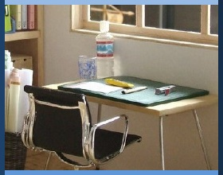
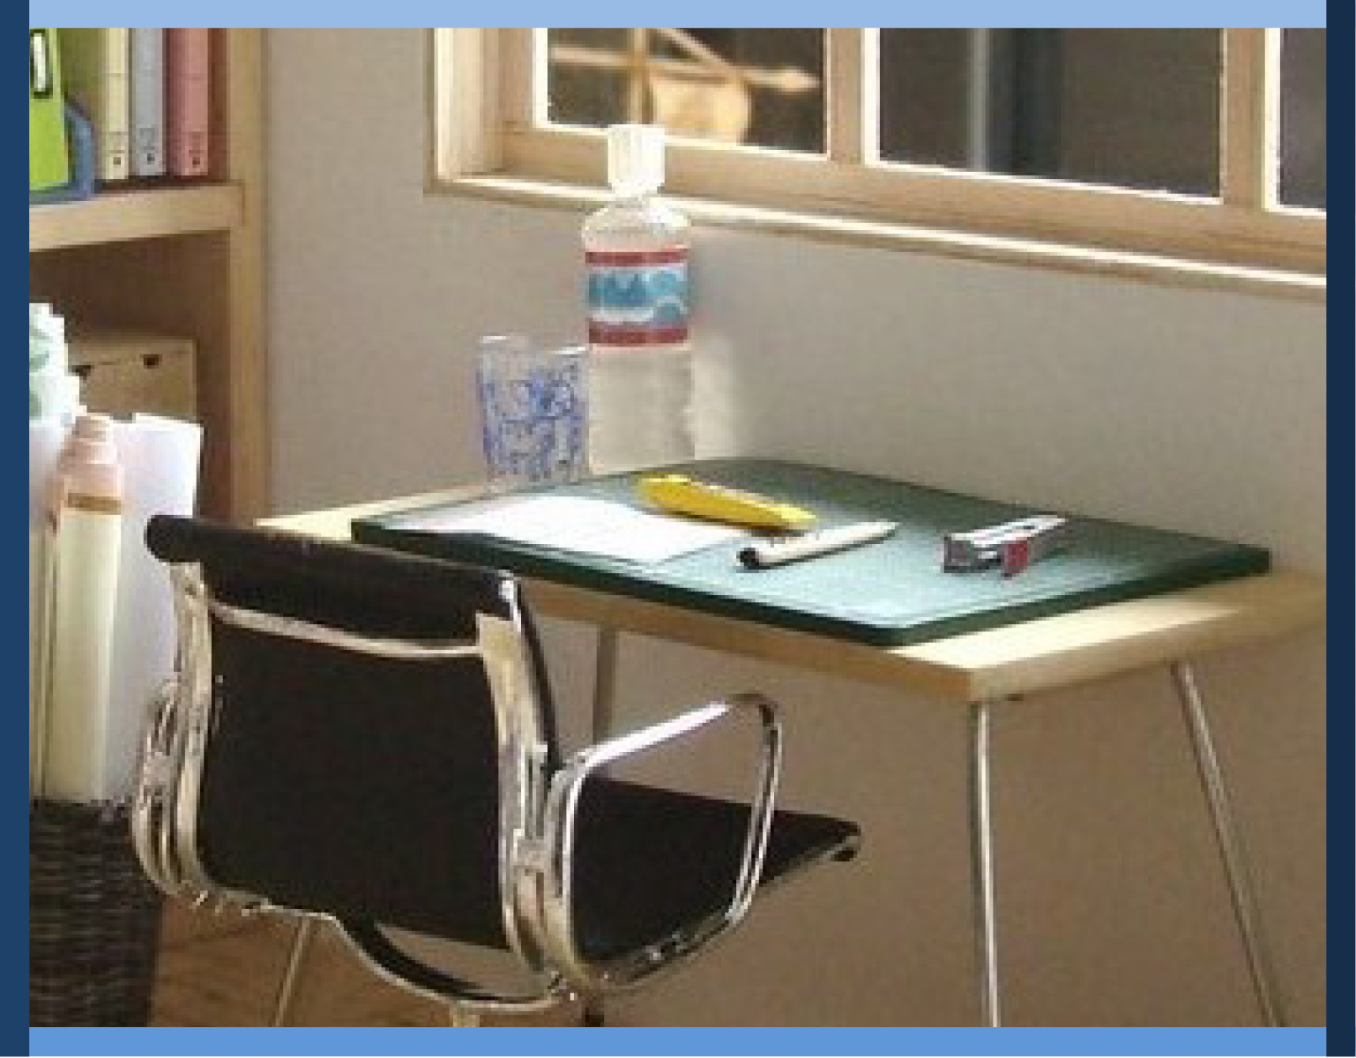
Managing My Learning
Day 5: Learning How to Learn
Notes:
Image: https://www.flickr.com/photos/_sk/4276400278

Slide 3

Student Dedication
Notes:
Student Dedication
https://pixabay.com/id/illustrations/akses-banyak-tangan-933142/
Note: You can add the student’s picture to the slide

Slide 4
Do Now: You’re the Producer!
What topics on the theme of professional sports did you think of? List as many as you can!
Notes:
Ask a reporter from each team to share the team list . Write the ideas on the white board, smart board, or chart paper. Create a simple numbered list as all teams report. Do not use a graphic organizer yet.
After all teams have reported, ask students if they can identify several broad categories or themes within the list (for example, sports personalities, rules and regulations, important sports events, etc.). Make a separate list of themes.

Slide 5
Do Now: Think further…
What categories could we use to organize these topics?
Notes:
Display the Mind Map graphic organizer you have prepared on the board or chart paper (see above). Write “sports topics” in the center circle of the organizer. Write key themes identified from students’ list in the boxes around the center. If desired, you can also show students how to go to an additional level of detail.

Slide 6
Do Now: Think further…
How could organizing the topics by categories help the TV production team?
Notes:
Ask students, How might using an organizer like this one help the producer?

Slide 7
Do Now: Think further…
How could organizing the topics by categories help the TV production team?
How can organizing information help you as you study and learn?
Notes:
Then ask, How might using an organizer like this one help you in your studies?
After students have answered, explain that using graphic organizers can help them understand, organize, categorize, and recall information. Organizers can make their writing, note taking, and studying time more effective. Graphic organizers can help them identify and recall main ideas and supporting details. Organizing information is an important pre-writing step in creating essays, reports, and research papers.

Slide 8



Learning more about how we learn
Practice: different kinds of Graphic Organizers
Concept map
Sequence chart
Cause & effect
Picture it
SQ3R:
A Game Plan for Getting the Most Out of Texts
Choose and Practice a Strategy
Learning with All Your Senses
The power of pictures
Say or sing
Get moving
Make it personal
Notes:
Display the concept map slide for the lesson. Briefly review the activities indicated. Point out to students that this concept map (and others they have seen introducing previous lessons and units) is one kind of graphic organizer.
https://pixabay.com/vectors/music-note-musical-notes-musicale-25659/
https://www.pinterest.com/pin/428123508319862594/
https://pixy.org/1257131/

Slide 9

Listen and Follow
“Make the Most of Your Reading with SQ3R”
Listen carefully, and follow along! You will use this information in a few minutes.
Notes:
Direct students’ attention to the text “Make the Most of Your Reading with SQ3R.” Tell students that this text will recall some of the ideas addressed in yesterday’s lesson on pre- and during-reading strategies, but will also introduce what to do after reading. Tell students to pay attention and follow along as you read, since they will be organizing the information in various ways afterwards.
Read the selection aloud (you can also invite student volunteers to read some paragraphs, if you wish).

Slide 10
Practice with Graphic Organizers
“Make the Most of Your Reading with SQ3R”
Each team will organize information on SQ3R using a different graphic organizer:
Sequence Chain
Mind Map
Cause & Effect
Picture It
Notes:
Call students’ attention to the four laminated posters placed in different corners of the room. Assign each team to one of the posters. Tell students that they are work together to present the information from the reading in the graphic organizer assigned to them. Give students time to move to the stations and work through entering the information on the poster.

Slide 11
Practice with Graphic Organizers
“Make the Most of Your Reading with SQ3R”
How did YOUR team present the information on its graphic organizer?
Sequence Chain
Mind Map
Cause & Effect
Picture It
Notes:
After students have completed the organizers, invite a spokesperson for each group to display their poster and explain why they filled it out as they did. Ask appropriate questions to elicit clarification or elaboration.

Slide 12
More About Graphic Organizers
What OTHER kinds of graphic organizers have you used?
Notes:
Ask students what other kinds of graphic organizers they have used in the past (e.g., Venn diagrams, timelines, story maps). Wait to display slide 13 after students have had a chance to respond.

Slide 13
More About Graphic Organizers
What OTHER kinds of graphic organizers have you used?
Venn Diagram
Character Web
Essay Organizer
Timeline
For which subjects might you use each of these organizers?
Notes:
Ask students for which subjects each type of organizer is most useful (for example, timelines are particularly useful for history classes, character webs for studying literature, etc.)

Slide 14

How does my memory work, anyway? And how can I help it work better?
Notes:
Tell students graphic organizers are just one way to help our memories work better. You are going to explore some other strategies now as well.
https://commons.wikimedia.org/wiki/File:Confused_young_woman.jpg

Slide 15



ALL HANDS ON DECK
Your memory works best when
ALL of your senses are involved!
Let’s find out more.
Notes:
Have students read this slide silently. Ask them what they think it means.
Then, tell students they will partner read a text about how the memory works—and how we can help it work better.
https://www.pinclipart.com/pindetail/ibmbmhw_skit-clipart-png-download/
http://getdrawings.com/get-clipart#card-clipart-1.jpg

Slide 16
working memory:
the ability to remember information for
a short time, just long enough to use it
long-term memory:
the storage of information such that you can recall it over a long period of time
mnemonics:
special techniques to help you remember things
Useful
Terms to
Know
Notes:
Introduce the vocabulary terms working memory, long-term memory, and mnemonics to students, clicking through this slide to show each term.

Slide 17
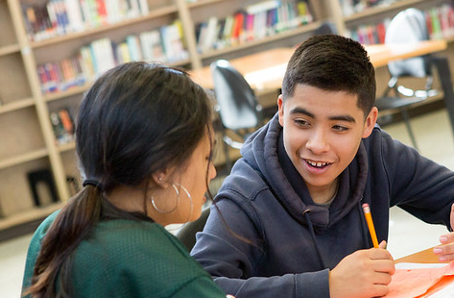
Dig Deeper
“Help Your Memory Work Smarter, Not Harder”
Read the text with your partner, taking turns reading aloud.
As you read, think about ways you could organize this information.
Notes:
Direct students to the text “Help Your Memory Work Smarter, Not Harder.” Instruct them to partner read this text aloud softly, taking turns. Advise them to pay close attention, as they will be using the information to create a graphic organizer of their choice after reading. Circulate among students as they read.
Photo by Allison Shelley/The Verbatim Agency for EDUimages https://www.flickr.com/photos/all4ed/35668669474/in/photostream/

Slide 18

Your Turn
“Help Your Memory Work Smarter, Not Harder”
How would YOU organize the information in this text to learn and master it?
Use the blank activity sheet to create your own mind map or another graphic way to represent this information.
Notes:
After students read the text, have each one create a mind map, graphic organizer, or other visual representation of the content of the text, using the “Your Turn” activity sheet provided. Students should decide what type of organizer they wish to create.
https://www.flickr.com/photos/ucdaviscoe/8406545040

Slide 19

Pair and Share
Share your graphic organizer with your partner or teammates.
Explain why you organized the information the way you did.
Courtesy Allison Shelley/The Verbatim Agency for American Education: Images of Teachers and Students in Action
Notes:
After creating their graphic organizers, students share them with their partners and explain why they chose to organize and represent the information as they did.
Photo: Allison Shelley/The Verbatim Agency for American Education. https://www.flickr.com/photos/all4ed/36335086302/in/photostream/

Slide 20
Whole Class Discussion
“Help Your Memory Work Smarter, Not Harder”
How can what you learned today help you manage your learning?
What changes will you make in your study habits?
Notes:
Ask students how the information they learned today will help them study and learn in the future.

Slide 21
Exit Ticket
Your graphic organizer is your exit ticket!
Notes:
Students’ individual graphic organizers can serve as an exit ticket. (If you have them turn the organizers in, make sure to return them to students promptly so that they can refer to the learning strategies given.)

Slide 22
References & Resources
Photos & Images
Slide 1: http://clipart-library.com/clip-art/camera-silhouette-clip-art-3.htm
Slide 3: https://pixabay.com/id/illustrations/akses-banyak-tangan-933142/
Slide 8: https://pixabay.com/vectors/music-note-musical-notes-musicale-25659/
https://www.pinterest.com/pin/428123508319862594/
https://pixy.org/1257131/
Slide 14: https://commons.wikimedia.org/wiki/File:Confused_young_woman.jpg
Slide 11: http://clipart-library.com/clipart/1304570.htm
Slide 15: https://www.pinclipart.com/pindetail/ibmbmhw_skit-clipart-png-download/
http://getdrawings.com/get-clipart#card-clipart-1.jpg
Slide 17: Allison Shelley/The Verbatim Agency for American Education. https://www.flickr.com/photos/all4ed/35668669474/in/photostream/
Slide 18: https://www.flickr.com/photos/ucdaviscoe/8406545040
Slide 19: Allison Shelley/The Verbatim Agency for American Education. https://www.flickr.com/photos/all4ed/36335086302/in/photostream/

