Slide 1



Do Now: How do I get ready to read?
Turn to a classmate and share your answers to the following question.
When you have a new text to read—whether it’s a website, novel, cookbook recipe,
how-to manual, or chapter in your science book—what do you do to prepare your mind BEFORE you jump into reading?
Notes:
Students discuss with a partner what they do to prepare their minds when they have a new text to read.
Book by Adam Zubin of the Noun Project https://thenounproject.com/search/?q=book&i=35696
Brochure by Smalllike from the Noun Project https://thenounproject.com/search/?q=brochure&i=2240126
Leaflet by Start Up Graphic Design from the Noun Project https://thenounproject.com/term/leaflet/3372042/

Slide 2
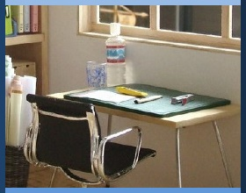
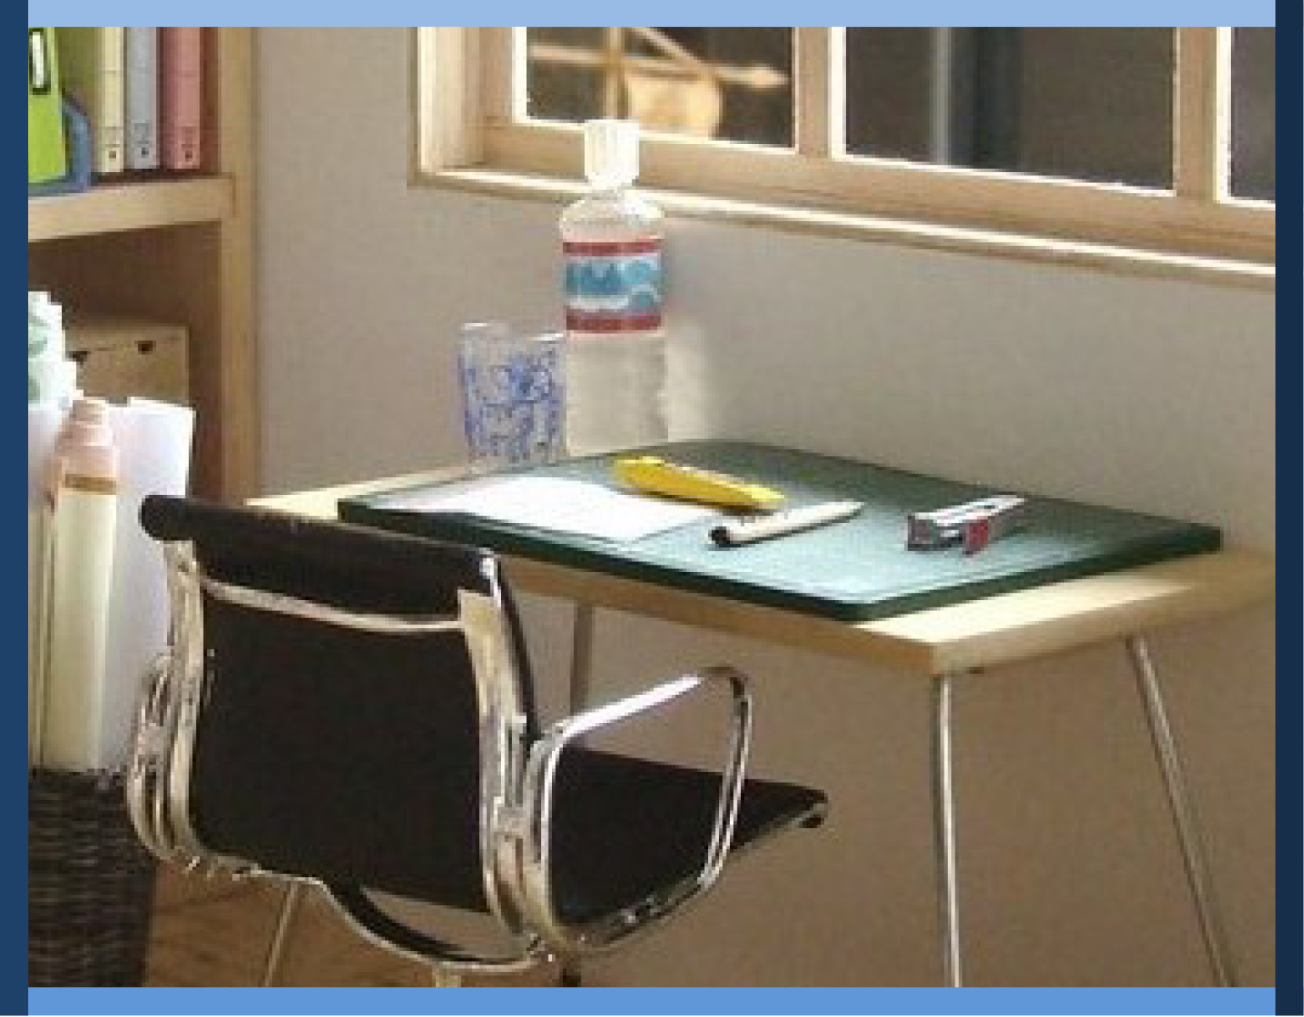
Managing My Learning
Day 4: Attentive Reading
Notes:
Image: https://www.flickr.com/photos/_sk/4276400278

Slide 3

Student Dedication
Notes:
Student Dedication
https://pixabay.com/id/illustrations/akses-banyak-tangan-933142/
Note: You can add the student’s picture to the slide

Slide 4


Exploring attentive reading
Practicing the strategies
Set the purpose
Activate what I know
Notice text features
Ask questions
Learning reading strategies:
What’s my purpose?
What do I already know?
What text features do I see?
What do I expect to learn?
Notes:
Tell students that in the last three lessons, they have considered how to organize themselves to manage their learning more effectively. Today, they will be learning ways to prepare their minds to learn more effectively when they have something to read. Show the concept map for the lesson; briefly review the activities listed.
http://clipart-library.com/clipart/1424227.htm

Slide 5
attentive:
(adj.) paying close attention to something; mindful
“I love talking to my aunt because she’s always such an attentive listener, completely focused on what I’m saying.”
“Attentive drivers who keep their eyes on the road have fewer accidents than those who are distracted.”
How does being attentive help us succeed in school and in life?
Notes:
Introduce the vocabulary words. Ask students whether they know what each word means, or what they think it might mean. Ask them to identify related words that they already know (attention, active). Use each word in a sentence. Ask students to provide examples of when and how being attentive can help them be successful in school and life; tell them they will learn more about the other vocabulary words later in the lesson.

Slide 6
Do Now: How do I get ready to read?
What do YOU do to prepare your mind before you jump into reading?
Notes:
Review the Do Now with students. Ask student volunteers to share some of the things they like to do when they approach a new text. Generate follow-up discussion with questions such as, “Why do you like to begin that way?” or “How do you find that doing this helps you when you read?"

Slide 7

Being attentive: the key to learning when you read
What strategies have you learned in other classes?
Notes:
Explain that just as habits (such as listening carefully and asking questions) help students learn better in class, there are also habits that help readers get more out of what they read—whether it’s a classroom textbook, a movie review, or an online recipe! Ask students to help you create a list of strategies they’ve learned in other classes that help them understand things they read. Write their suggestions on the board.

Slide 8

Before- and During-Reading Strategies
Set a purpose for reading
Make connections
Activate prior knowledge
Ask questions
Make predictions
Note text features (title, sub-titles, charts, pictures…)
Visualize (make a mind movie)
Notes:
Uncover the classroom poster “Before- and During-Reading Strategies” (also on this slide). Briefly describe each strategy, then ask students to indicate by a show of hands if they are familiar with the strategy and practice it regularly.
Photo by Allison Shelley for American Education: Images of Teachers and Students in Action https://images.all4ed.org/middle-school-girl-concentrating

Slide 9
activate:
(verb) to set in motion; to “wake up”
prior knowledge:
(noun) information you already know
text features:
(noun) title, sub-titles, illustrations, charts, etc. in a text
visualize:
(verb) to imagine visually; to “see” with your mind
Useful
Terms to
Know
Notes:
Introduce the vocabulary terms text features, activate, prior knowledge, and visualize (click through this slide to show each word and its definition).
Tell students that you are going to model using the strategies as you read the class text “Secrets of Effective Readers.” Direct students to listen for you to use the strategies listed on the poster, and to indicate by snapping their fingers each time they hear you use one of the strategies.

Slide 10


Secrets of Effective Readers
Imagine walking into a new house or apartment. You enter your bedroom, ready to put away your clothes. But you have no closet, no hangers! Furthermore, you have no dresser! No shelves! Nowhere to put your clothes! How can you organize your room? How can you ever find things if your clothes stay unpacked in boxes, or scattered around the floor in random piles? It’s a big mess!
Your brain is like that room. When you learn new information—or read something new—your brain wants to file it with similar information. It wants to “wake up” the knowledge it already has about that topic, and connect the new learning to what you already know. That way, it can organize it, remember it, and retrieve it!
Before opening that book or looking at that informational web site, a successful reader prepares his or her mind to receive the new information. You may not always “see” how an effective reader does this—or be aware that you are doing this yourself. But practicing pre-reading skills can make a big difference in how well you learn.
Notes:
Ask students to follow along as you read the text “Secrets of Effective Readers.” As you read, be sure to pause frequently to model the use of strategies by “thinking aloud.” Prompts are included on the teacher version of the text to provide examples of “thinking aloud,” but you should feel free to adapt these to your own communication style. (Text continues on slide 11.)
Brain by Meaghan Hendricks of the Noun Project https://thenounproject.com/search/?q=brain&i=454654
This page and the next reproduce the reading selection which the teacher will use to demonstrate pre- and during-reading strategies.

Slide 11
Secrets of Effective Readers continued…
1. Set a purpose for reading.
To prepare your brain for the new information, know WHY you are reading. What do I hope to learn? Do I need to find out something? Am I curious about this topic? Do I need to know this for a test?
2. “Wake up” or activate prior knowledge.
How does this connect to what I already know about this subject? Thinking about what I already know will help me understand and remember more of what I read.
3. Notice text features.
As I look over the text, what illustrations, captions, and headings do I notice? What words are bolded, and do I know what they mean?
4. Ask questions.
I wonder what the title means? What is this text about? What will I learn?
Notes:
As you read, continue to pause frequently to model the use of strategies by “thinking aloud.”

Slide 12
What reading strategies did I use?
When did you hear me use them?
Notes:
After reading the text, ask students to comment on the strategies they observed and identify points at which you used various strategies.

Slide 13

Your Turn
“Secrets of Effective Readers: Putting it Into Practice”
With your team or partner, read the scenarios.
Discuss the four pre-reading steps for each situation.
Write your answers.
Notes:
Tell students that they will now practice several of the before-reading strategies in their teams. Direct students to the worksheet “Secrets of Effective Readers: Putting It in Practice.” Instruct students to read through one (or two, if time allows) of the scenarios with their team, discuss the before-reading strategy questions, and jot down their answers to the questions. (Note: If time is short, you can assign just one scenario for students to address; otherwise, allow students to select a scenario, or assign different scenarios to different teams.)
http://clipart-library.com/clipart/1304570.htm

Slide 14
Whole Class Discussion
“Secrets of Effective Readers: Putting it Into Practice”
For each scenario:
What was the purpose for reading?
What did the reader already know about the topic?
What text features might he/she observe?
What questions might he/she have?
Notes:
Review student responses in a whole-class discussion.

Slide 15
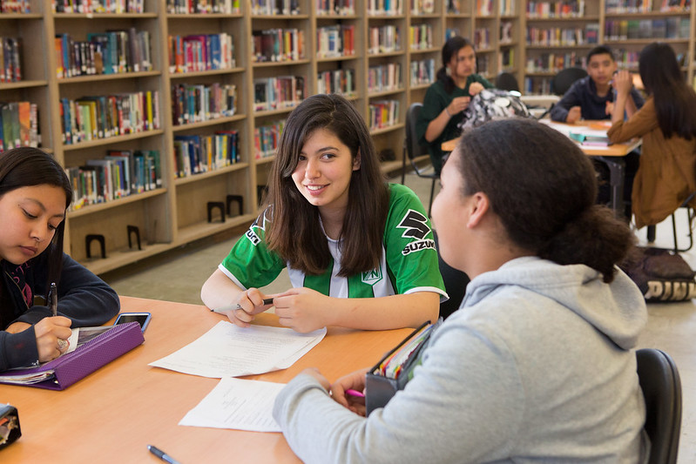
Dig Deeper
“Why Reading Matters—
and How to Be a Better Reader”
Read this text with your partner, taking turns reading aloud.
Be sure to practice the pre-reading steps first!
Notes:
Tell students they will now practice using these reading strategies with their reading partners (slide 15). Direct students to the reading “Why Reading Is Important—And How to Be a Better Reader.” Remind students to go through the four steps before they begin reading.
Students read silently, then softly partner read the selection aloud (students alternate reading paragraphs or sections). Circulate as students read to make sure they practice the pre-reading steps.
Photo by Allison Shelley/The Verbatim Agency for EDUimages https://www.flickr.com/photos/all4ed/35668664324/in/photostream/

Slide 16
Whole Class Discussion
“Why Reading Matters—and How to Be a Better Reader”
Did you learn anything from this text that surprised you?
What do you like to read? How can you get more reading into your day?
Notes:
Briefly discuss the reading selection as a class. Ask students whether they learned anything that surprised them. Ask students what kinds of texts they enjoy reading, and how they think they can increase the amount of time they read each day with texts that they find personally rewarding.

Slide 17
Exit Ticket
Complete the following sentence:
“One new thing I learned today about reading is…”
Notes:
As an exit ticket, have each student complete the prompt above on a half sheet of paper.

Slide 18
References & Resources
Photos & Images
Slide 1: Book by Adam Zubin of the Noun Project https://thenounproject.com/search/?q=book&i=35696
Brochure by Smalllike from the Noun Project https://thenounproject.com/search/?q=brochure&i=2240126
Leaflet by Start Up Graphic Design from the Noun Project https://thenounproject.com/term/leaflet/3372042/
Slide 3: https://pixabay.com/id/illustrations/akses-banyak-tangan-933142/
Slide 4: http://clipart-library.com/clipart/1424227.htm
Slide 8: Allison Shelley for American Education: Images of Teachers and Students in Action https://images.all4ed.org/middle-school-girl-concentrating
Slide 10: Brain by Meaghan Hendricks of the Noun Project https://thenounproject.com/search/?q=brain&i=454654
Slide 11: http://clipart-library.com/clipart/1304570.htm
Slide 15: Photo by Allison Shelley/The Verbatim Agency for EDUimages https://www.flickr.com/photos/all4ed/35668664324/in/photostream/
.com/photos/all4ed/35668664324/in/photostream/

