Slide 1
Do Now
Write your answers to the following questions:
How much time do you spend studying/doing homework on an average day?
What distractions do you face while studying/doing homework?
Then turn and share your answers with a partner.
Notes:
Students write answers to the questions on the slide, then share their answers with a partner.
Allow 2-3 students to share their answers with the class.

Slide 2
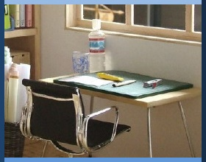
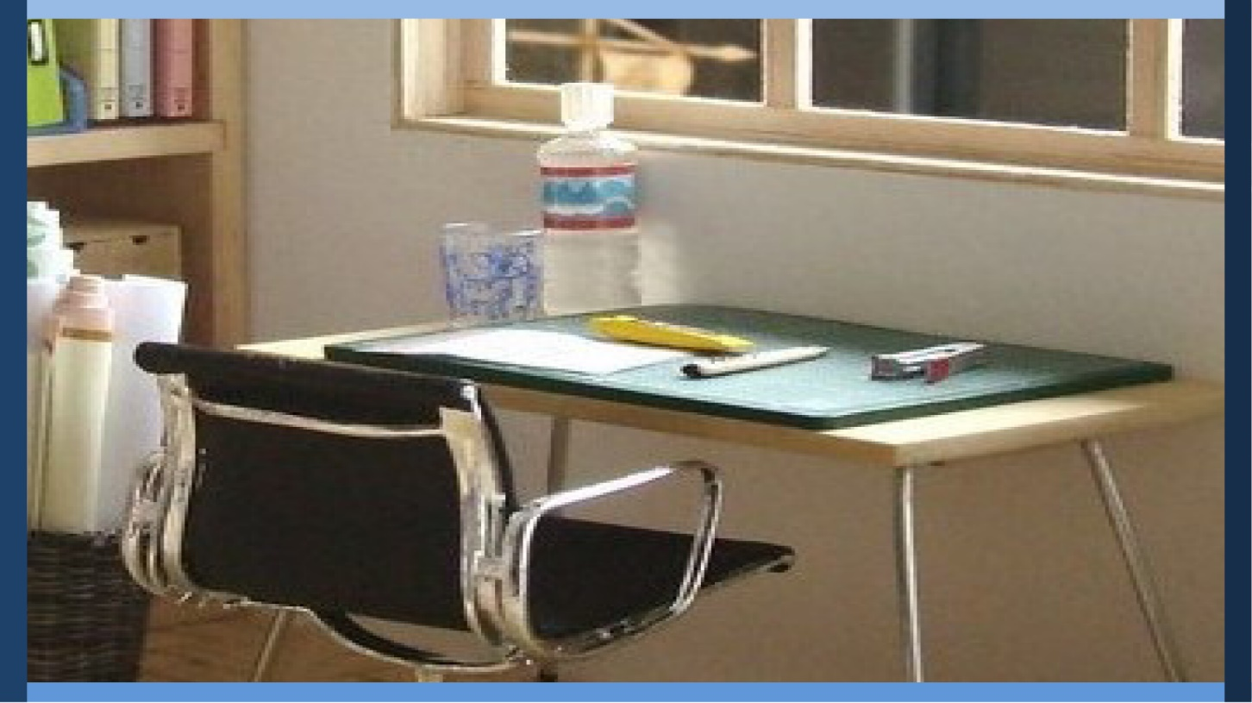
Managing My Learning
Day 3: Planning for Effective Studying
Maintaining a Study Space and Minimizing Distractions
Notes:
Image: https://www.flickr.com/photos/_sk/4276400278

Slide 3

Student Dedication
Notes:
Student Dedication
https://pixabay.com/id/illustrations/akses-banyak-tangan-933142/
Note: You can add the student’s picture to the slide

Slide 4
Objectives
By the end of today's lesson, you will be able to
  Identify an appropriate study space
  Name appropriate strategies to avoid distractions while studying outside of school
Notes:
Introduce the lesson objectives by telling students that yesterday, they learned how to manage their schedules more effectively; today they will build on this by talking about how to develop a strong focused environment in which to study and do homework. To begin, they will do a quick activity to see how well they can focus on a task (next slide).

Slide 5
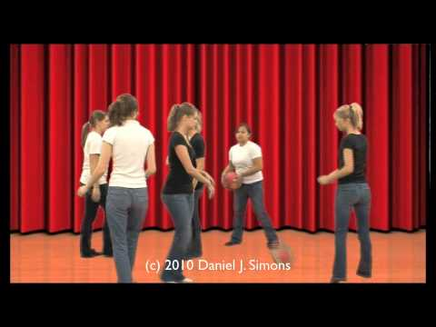

Video Activity
https://www.youtube.com/watch?v=IGQmdoK_ZfY
Notes:
Show the video embedded in slideshow: https://www.youtube.com/watch?v=IGQmdoK_ZfY
Ask students, “What does this activity tell us about focus?” (Take time to discuss as a group.)
Key points include:
Sometimes we think we are better at multi-tasking than we really are.
Our attention can easily be diverted if we are not careful.
Tell students that today you will build on these ideas by thinking about the environment they study in and ways to reduce distractions and make the most of their study time.

Slide 6
Read “The Multi-Tasking Brain?”
After reading, on the following page:
List all the “other” things you like to do during your time for homework and studying (for example, TV, music, answering calls or texts, TikTok, Instagram, snacking, web surfing, playing games, etc.). Discuss your list with your partner.
Notes:
Have students partner read the handout “The Multitasking Brain?,” complete the “Personal ‘Multitasking’ Inventory” that follows the reading, and discuss their answers with their partners.
As a class, have students share their answers and list them on the board or chart paper. Continue until you have at least ten items.
Invite students to comment on the challenges of “multitasking.” Have any of them ever tried turning off their phone or the TV to focus on a particularly challenging problem? How could they use the extra time they would have if they finished homework more quickly?

Slide 7
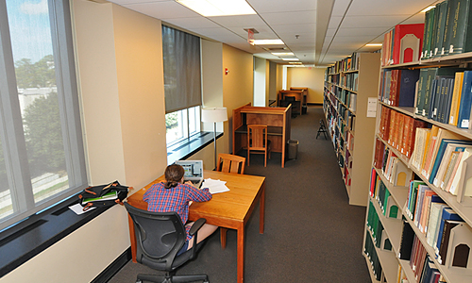
What should a study space have?
What does a good study space need?
This Photo by Unknown author is licensed under CC BY-SA-NC.
Notes:
Tell students that the next step is to consider what a good study place looks like. This Photo by an unknown author is licensed under CC BY-SA-NC

Slide 8
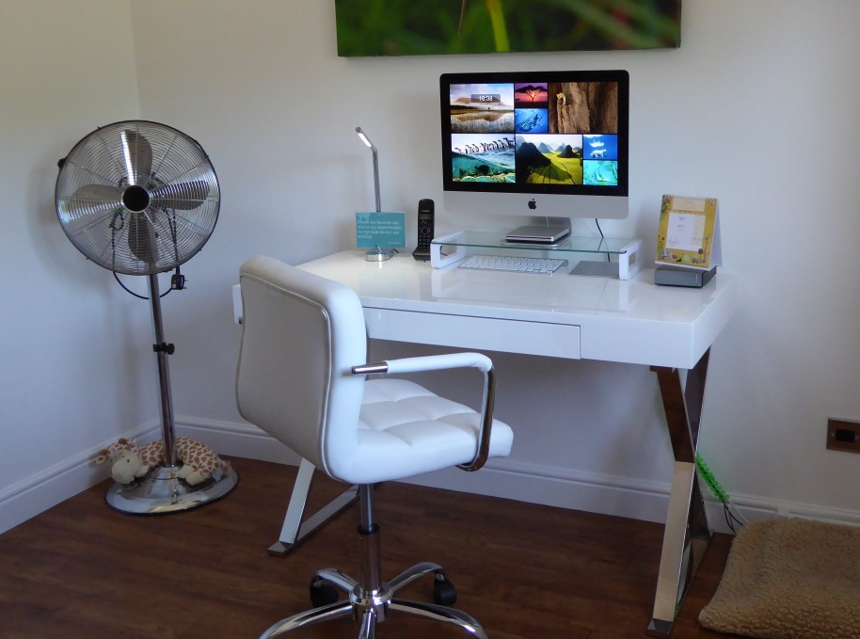
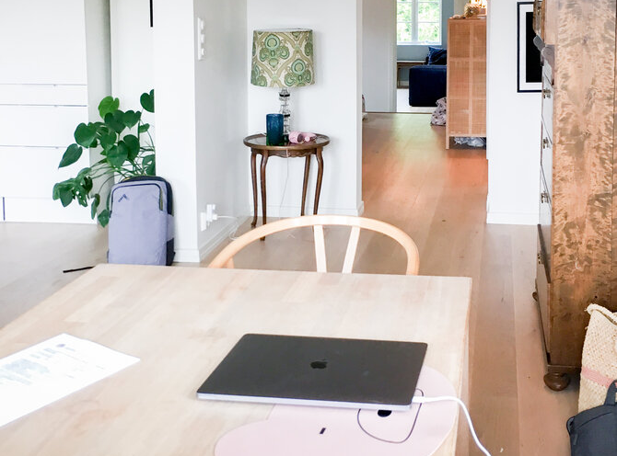
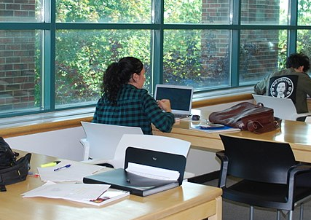
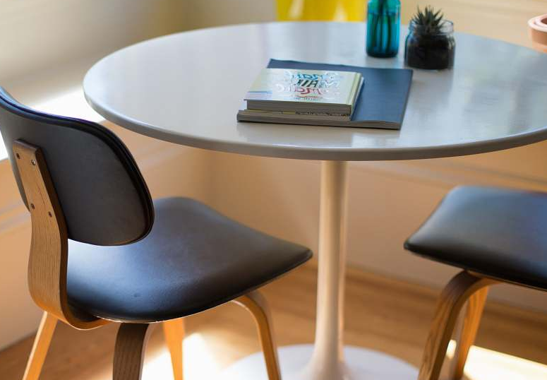
What do you need in a study space in order to work effectively?
Think about:
Supplies
Furniture
Lighting
Sound
Notes:
Give students time to discuss with a partner what they need in a space to study effectively
Images https://pxhere.com/en/photo/493370 CC0 Public Domain
https://www.2hd.uk/workshop/2018/extending-a-family-house-in-jar CC-BY-S.A.-4.0
https://commons.wikimedia.org/wiki/File:Study_space_at_the_Vanier_Library.jpg CC-BY-4.0
https://photostockeditor.com/image/table-round-white-dining-table-beside-two-chairs-on-brown-hardwood-flooring-dining-table-35150

Slide 9
What do you need in a study space in order to work effectively?
Let’s make a list.
What can you do if it’s hard to find a good study space and necessary materials?
Notes:
Then, as a class, create a list either on poster or on chart paper of ideal study space need-to-haves.
Note that for students that it can be difficult to create this environment. Click to reveal the question, “What can you do if it’s hard to find a good study space and necessary materials?”
Have the class brainstorm possible solutions. Some possible answers include
Borrow supplies in advance/ reach out to teachers to borrow needed supplies
Use headphones to listen to instrumental music or a nature sounds app to block out noise
Find a space outside your home to study (library, friend’s home, etc.)

Slide 10
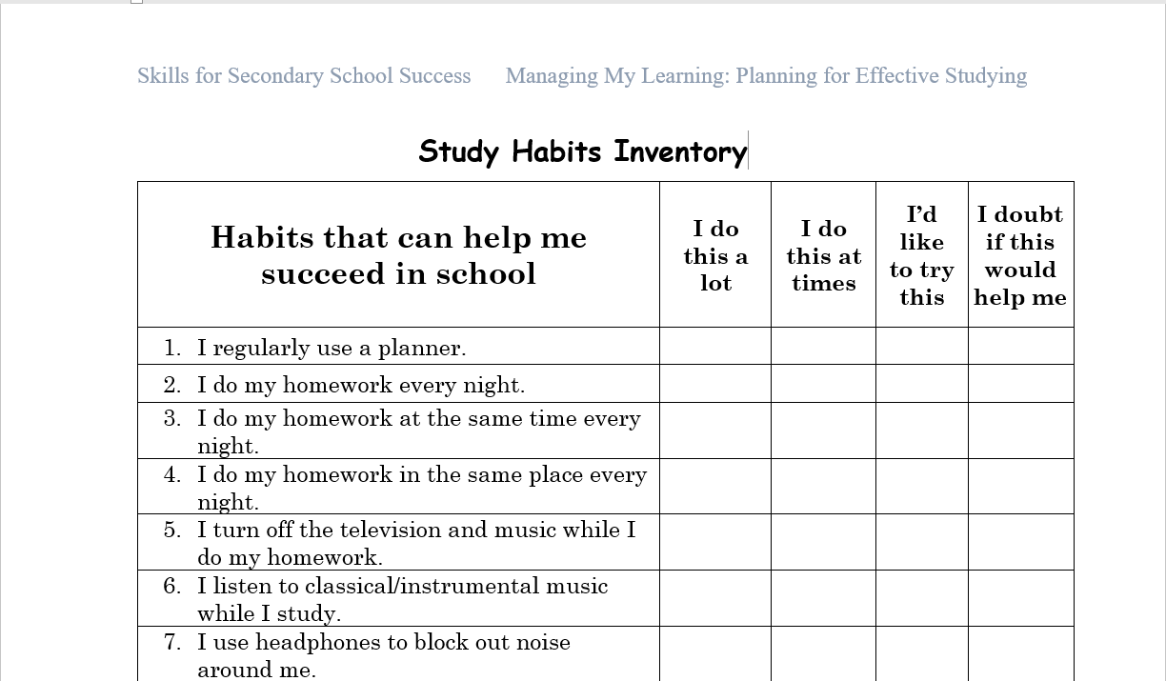
Study Habits Inventory
Notes:
Tell students that now that they’ve learned what habits are effective and ineffective, it’s time to think about what their current study habits look like.
Have them fill out the “Study Habits Inventory.”
Class discussion: Invite students to share what they observed.

Slide 11
Create your study plan
Where will you study?
When will you study?
What distractions do you anticipate?
How can you overcome these obstacles?
Notes:
Now give students time to create their own study plan. The plan should include
the time and place they intend to study
what distractions they anticipate could occur; and
how they plan to overcome or avoid these distractions.
As students complete this assignment, circulate in the classroom to monitor and provide feedback. Choose strong student answers to share with the class.

Slide 12
Exit Ticket
Complete the following:
Tonight, I will change up my study routine by ___________________
Notes:
As an exit ticket, have students complete the sentence on the slide.

Slide 13
References & Resources
Photos & Images
Slide 2 and unit thumbnails: https://www.flickr.com/photos/_sk/4276400278
Slide 3: https://pixabay.com/id/illustrations/akses-banyak-tangan-933142/
Slide 5: https://www.youtube.com/watch?v=IGQmdoK_ZfY
Slide 7: This Photo by Unknown author is licensed under CC BY-SA-NC https://naming.library.duke.edu/room/9072
Slide 8: https://pxhere.com/en/photo/493370 CC0 Public Domain
https://www.2hd.uk/workshop/2018/extending-a-family-house-in-jar CC-BY-S.A.-4.0
https://commons.wikimedia.org/wiki/File:Study_space_at_the_Vanier_Library.jpg CC-BY-4.0
https://photostockeditor.com/image/table-round-white-dining-table-beside-two-chairs-on-brown-hardwood-flooring-dining-table-35150
Slide 11: PPT icons

