Slide 1
Do Now
Complete the following sentences:
  Three things that I want to spend more time on are _________________________________.
  Two things that I want to spend less time on are _________________________________.
  Share your responses with a partner.
Notes:
Students complete the sentences above on a piece of paper. After they finish, click to give them 30 seconds to share answers with a partner. Then, ask one to three volunteers to share their answers with the class.

Slide 2
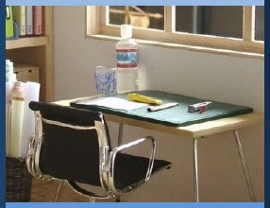

Managing My Learning
Day 2: Managing Time and Setting Priorities
Notes:
Image: https://www.flickr.com/photos/_sk/4276400278

Slide 3


Student Dedication
Notes:
Student Dedication
https://pixabay.com/id/illustrations/akses-banyak-tangan-933142/
Note: You can add the student’s picture to the slide

Slide 4
Today's Objectives
By the end of today you will be able to...
  Organize and maintain a daily schedule
  Prioritize and sort tasks to accomplish
Notes:
Point out to students that as they prepare for high school, they will have more and more responsibilities. These will include increased schoolwork and academic obligations but perhaps also clubs, sports, extracurricular activities, greater family responsibilities, and a social life. To manage all of these they will need to identify tasks, complete them in an orderly manner, and keep them organized in a planner. This lesson will help them develop these skills and organize a planner that they can begin to use today.

Slide 5
Organizing Two Student Schedules
How is this similar or different from your life?
What challenges do you notice?
What is helpful about the schedule?
Notes:
Have students turn to the activity “Organizing Two Student Schedules.” Each pair of students should pick one of the student schedules. They will read through the paragraph and plan the student’s week out, using the schedule provided. If some students finish quickly, encourage them to read the paragraph they did not choose and try the activity for that student for extra practice. After students have finished, lead a class discussion addressing the questions on this slide.

Slide 6
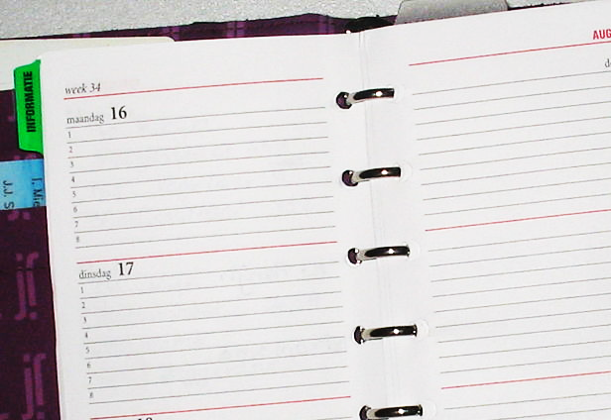
What do you do all day?
Complete the Daily Log handout by listing the things you did yesterday in each time slot.
Discuss your daily schedule with your partner using the questions provided below.
  Did anything surprise you?
  How much of your schedule can you control/change?
  How much of your schedule is already set?
  What changes would you like to make to your personal schedule/routine?
Notes:
Explain that the next step is understanding what time management looks like for oneself. Have students take the next 3 minutes to fill out the “Daily Log” handout entering yesterday’s activities. Have them do their best to fill out what they were doing during each hour of your day. If they do not remember perfectly that is okay, but the purpose is for them to see how they are spending their time.
When all students have filled out their schedules, ask them to turn and discuss their schedule with their neighbor. Click twice to display the guide questions:
Did anything surprise you?
How much of your schedule can you control? How much of it is already set for you?
Are there things that you would like to make changes to?
Then discuss these questions as a class. Highlight for students that there are only so many hours in a day; no one can do everything, and some things are more important than others.
Ask students, “What are some strategies that you already use to organize your time?”
Image: https://commons.wikimedia.org/wiki/File:Agenda.jpg

Slide 7
How to build your planner
Have ONE designated place to write/record ALL scheduling items. For example…
  Notebook
  Planner
  Google doc/ calendar
  Phone app
Notes:
Tell students that now that you’ve discussed some of the many activities and challenges that they as students must manage, you will take some time to discuss strong organizational habits. Display these using the slideshow, or a white board, poster, or similar large format

Slide 8
How to build your planner
Sort activities into daily, weekly, monthly tasks
Include important personal dates such as:
  Birthdays of friends and family members
  Holidays
  School activities
  Sports events, concerts, club meetings, etc.

Slide 9
How to build your planner
Write down homework assignments as soon as they are assigned.
Check your schedule:
  Each day before going home (to make sure you have all materials needed for homework)
  Each night before going to bed (to make sure you have completed all assignments for school the next day)

Slide 10

Now you try!
Take the next ten minutes to organize your schedule using the tips provided. Make this time useful for you!
Notes:
Now, ask students to complete a daily, weekly, and monthly schedule.
If students already have a planner, encourage them to use it for this exercise. If they do not have a planner, encourage them to dedicate a notebook to it, or provide them with scheduling worksheets. Walk around and answer questions students may have. Encourage students to work together to discuss coming assignments to help build a sense of community.
Image: http://clipart-library.com/clipart/1871800.htm

Slide 11
Exit Ticket
Complete the following sentences:
  Using a planner can help me to _________________.
  One thing I hope to change as a result of today's lesson is ___________________.
Notes:
For today's exit ticket, have students complete the sentences on the slide.

Slide 12
References & Resources
Photos & Images
Slide 2 and unit thumbnail: https://www.flickr.com/photos/_sk/4276400278
Slide 3: https://pixabay.com/id/illustrations/akses-banyak-tangan-933142/
Slide 6: https://commons.wikimedia.org/wiki/File:Agenda.jpg
Slide 10: http://clipart-library.com/clipart/1871800.htm

