Slide 1
Unit 3 Introductory Game
Move into teams as assigned by your teacher. Each team will get a different High School Challenge sheet.
Discuss the high school challenge highlighted on your sheet with your team. Decide which of the strategies on the list is best suited to address it.
Choose one team member to write the strategy on the board.
Keep your challenge sheet for future reference.
Notes:
When students enter the classroom, divide them into seven groups of about three or four students each, sending them to different spaces in the classroom. When all groups have at least three members, give each group a different challenge scenario (see student sheets and answer key at end of this lesson). Explain that this course prepares them for challenges in high school, and this lesson will focus on particular academic challenges they will face. Each team is to read its particular challenge together, figure out the skill or strategy needed to meet that challenge (from the list at the bottom of the sheet), and then write it on the board by their particular challenge number. The team that writes a correct answer on the board first will get a prize.
Image: http://clipart-library.com/clipart/6cpo5zXdi.htm

Slide 2
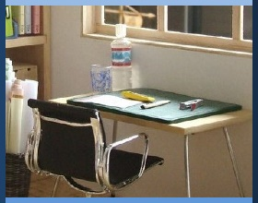
Strategies for Meeting High School Challenges
1. Getting & Staying Organized
2. Managing Time & Setting Priorities
3. Finding Space for Effective Studying
4. Attentive Reading
5. Taking Useful Notes
7. Setting Goals
6. Strategies for Remembering Information

Slide 3

Managing My Learning
Day 1: Getting and Staying Organized
Notes:
Image: https://www.flickr.com/photos/_sk/4276400278

Slide 4

Student Dedication
Notes:
Either teacher or a volunteer student will give the lesson dedication. https://pixabay.com/id/illustrations/akses-banyak-tangan-933142/
Note: You can add the student’s picture to the slide

Slide 5
Managing My Learning Road Map
Getting & Staying Organized
Managing Time & Setting Priorities
Planning for Effective Studying
Attentive Reading
Learning to Learn
Taking Useful Notes
Setting S.M.A.R.T. Goals
Measuring My Learning
Notes:
Briefly review with students the road map for this unit, which is the set of skills the students themselves have identified in their teams.

Slide 6
Today’s Agenda
Brainstorm: What I Need Each Day
Learning Organizational Strategies
Practicing Organizational Strategies
Planning for Progress

Slide 7
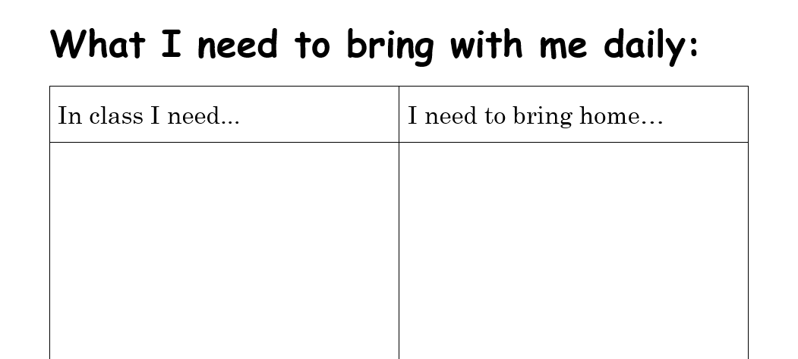
Think, Pair, and Share
Brainstorm with a partner to complete the “What I Need” activity sheet.
Notes:
Tell students that the focus of this lesson is to help them make sure they are prepared with everything they need for school and to complete homework each day. Ask students to turn to the What I Need chart and fill out each of the columns with a partner. After students have worked with partners, lead the class to create a global list, filling out the blank chart you’ve prepared on the board or chart paper. Take students’ suggestions, then add any other necessary items that students did not mention, for example, notebooks, loose leaf paper, pencils, pens, binders, textbooks, homework, worksheets, library books, agenda book, calculator, etc. Be sure to include items of specific importance to your school or grade level.

Slide 8

Organizational Options
Binders
  One big binder for all classes organized with dividers
    Dividers for each class/activity
    Blank notebook paper
    A place to store hole punched worksheets or homework
  Multiple binders
    One for each class
    Blank notebook paper
    A place to store hole punched worksheets or homework
Notes:
Tell students that because there are so many materials, it’s important to create a strong organization system of binders and folders to make sure they can access what they need when they need it. Point out that some students may already be doing this well and just need to clean things out, while others may need a full organizational overhaul. Both stages are okay and will be well served by today’s lesson. Share with students the organizational options listed on this slide and the following one.
Image http://clipart-library.com/binders-cliparts.html

Slide 9



Organizational Options
Folders
Notebooks
Labels
One for each class, AND
One dedicated to homework
One multi-subject notebook for multiple classes, OR
One dedicated notebook for each class
All items should be labeled so that if you leave them somewhere, you are more likely to get them back.
Notes:
Image created by Ardi Nurfiyanto from Noun Project https://thenounproject.com/search/?q=pencil&i=4008186
http://clipart-library.com/clipart/6iy59X4KT.htm
https://thenounproject.com/term/backpack/2551/

Slide 10
Personal Reflection
Evaluate your personal organizational system. Write down answers to the following:
How do you keep your materials organized?
What do you like about your current system?
What would you like to change?
Now turn and share your conclusions with a partner.
Notes:
Give students 3 minutes to evaluate their own organization systems. Have them write down at the bottom of the handout what their current system looks like, what they intend to keep the same, and what they would like to change. Then give students 1 minute to share with their partner.

Slide 11
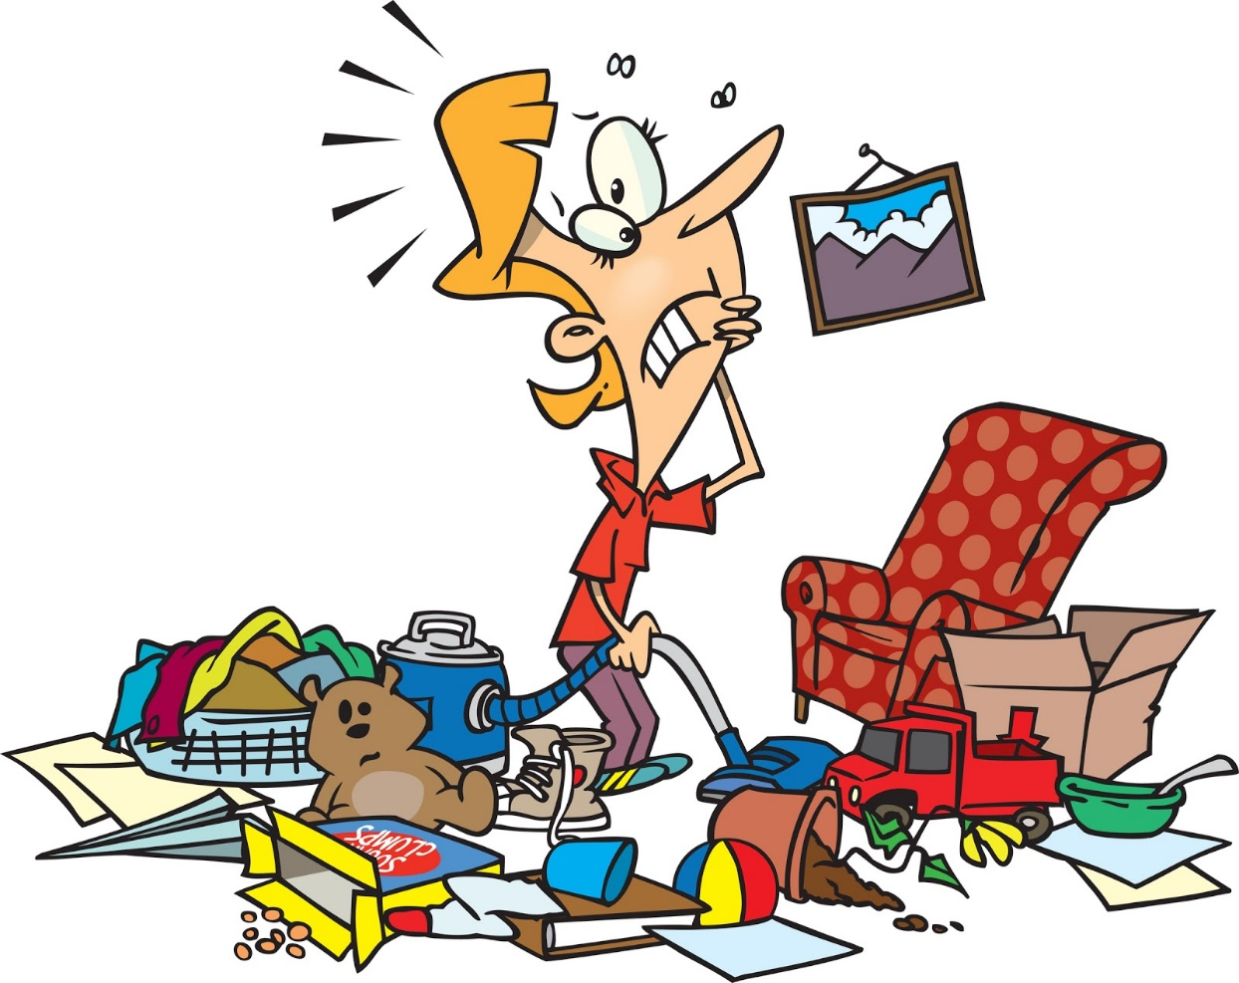
Organizational Time
Take time to implement activities from today, including:
  Organizing and cleaning items in binders
  Labelling
  Sorting
Notes:
Tell students that, having identified what they need to do, they will now have time to do it (slide 11). One key part of organizing your space is getting rid of things you don’t need. Give students time and space to work on throwing away old papers (where possible, check in with other teachers first to understand what units are no longer relevant), sorting remaining items, and labeling items. Circulate through the room to provide suggestions, tips, and support to students who need it.
http://clipart-library.com/clipart/1884711.htm

Slide 12
For today's exit ticket, please complete the following sentences:
Today I improved my organization by _____________________.
In order to continue improving my organizational skills, I still need to ______________________.
Notes:
For today’s exit ticket have students complete the two sentences on the slide.

Slide 13
References & Resources
Photos & Images
Slide 1: http://clipart-library.com/clipart/6cpo5zXdi.htm
Slide 2 and unit thumbnail: https://www.flickr.com/photos/_sk/4276400278
Slide 3: https://pixabay.com/id/illustrations/akses-banyak-tangan-933142/
Slide 8: http://clipart-library.com/binders-cliparts.html
Slide 9: Ardi Nurfiyanto from Noun Project https://thenounproject.com/search/?q=pencil&i=4008186
http://clipart-library.com/clipart/6iy59X4KT.htm
https://thenounproject.com/term/backpack/2551/
Slide 11: http://clipart-library.com/clipart/1884711.htm

