Slide 1
Do Now:
Draw a picture
or write down ten words or phrases that come to mind when you hear the word
FAILURE.

Slide 2

Confronting Challenges
Day 8: Famous Failures—
“Failing Forward” to Success
Notes:
Slide 2 and unit thumbnails https://www.freepik.com/premium-photo/boy-putting-cross-impossible-blackboard-with-math-calculations_14413311.htm

Slide 3

Student Dedication
Notes:
https://pixabay.com/id/illustrations/akses-banyak-tangan-933142/
Note: You can add the student’s picture to the slide

Slide 4
Do Now:
What do YOU picture or think when you hear the word FAILURE?

Slide 5
Our Agenda
Video Reflection and Discussion
Partner Activity: Famous Failures who Refused to Give Up
Individual Reflection: Learning from Failure
Large Group Reflections on Learning from Unit 2

Slide 6
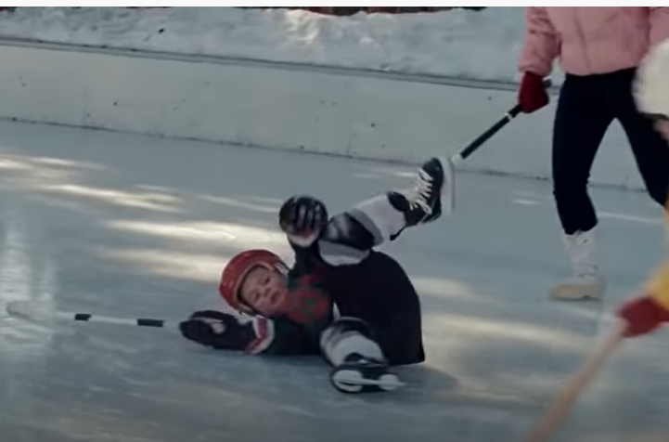


Video Reflection and Discussion
https://www.youtube.com/watch?v=6Ult4t-1NoQ&list=PLvzOwE5lWqhQaMdlA9uIB9OxPPkchIr-6&index=2
What questions, thoughts, and ideas went through your mind as you watched the video?
What do you think was the main point the creators of the video were trying to convey?
Notes:
https://www.youtube.com/watch?v=6Ult4t-1NoQ&list=PLvzOwE5lWqhQaMdlA9uIB9OxPPkchIr-6&index=2

Slide 7

Partner Activity: Famous Failures Who Refused to Give Up
7
In this activity you will work in pairs (or groups of 3) to read about a “Famous Failure.”
Google “HuffPost 21 Famous Failures.”
Choose ONE person from the list and read about him or her.
Then discuss the following questions.
What do you think this person felt when experiencing failure?
What would people have missed if this person had given up after failing?
What do you think kept this person going to keep on trying?
Share what you learned with the rest of the class.
Notes:
https://www.huffpost.com/entry/21-famous-failures-who-refused-to-give-up_b_57da2245e4b04fa361d991ba

Slide 8


Time for Individual Reflection
This Photo by Unknown Author is licensed under CC BY-SA
This Photo by Unknown Author is licensed under CC BY-NC
Notes:
Images: https://cutewallpaper.org/download.php?file=/21/reflection/Reflection-Wallpapers-Cool-Reflection-3600x1585.jpg

Slide 9


Class Sharing about Unit 2 Learning
Notes:
Insert online pictures “Group Sharing” Creative commons only
https://www.freepngimg.com/thumb/web_design/51077-6-share-images-png-download-free.png
http://thaigoodview.com/files/u98198/cartoon-image-on-sharing-ideas_0.jpg

Slide 10
References & Resources
Photos & Images
Slide 2 and unit thumbnails https://www.freepik.com/premium-photo/boy-putting-cross-impossible-blackboard-with-math-calculations_14413311.htm
Slide 3: https://pixabay.com/id/illustrations/akses-banyak-tangan-933142/
Slide 6: https://www.youtube.com/watch?v=6Ult4t-1NoQ&list=PLvzOwE5lWqhQaMdlA9uIB9OxPPkchIr-6&index=2
Slide 7: https://www.huffpost.com/entry/21-famous-failures-who-refused-to-give-up_b_57da2245e4b04fa361d991ba
Slide 8: https://cutewallpaper.org/download.php?file=/21/reflection/Reflection-Wallpapers-Cool-Reflection-3600x1585.jpg
Slide 9: Insert online pictures “Group Sharing” Creative commons only
https://www.freepngimg.com/thumb/web_design/51077-6-share-images-png-download-free.png
http://thaigoodview.com/files/u98198/cartoon-image-on-sharing-ideas_0.jpg

