Slide 1

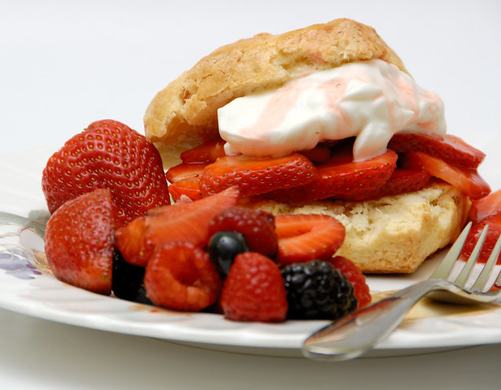
Do Now: Quiz Night at Jorge’s Favorite Restaurant
The Juan in a Million Café hosts a game night every Tuesday. Each customer draws a card from a deck of “general knowledge” questions. Anyone who correctly answers the five questions on the card wins a free dessert. Here are the questions Jorge answered last Tuesday. Write down your answer to each one. (If you aren’t sure… guess! LOOKING UP ANSWERS ELECTRONICALLY IS NOT ALLOWED. )
What is the highest mountain in North America?
What is the capital of Chile?
What is the smallest country in the world?
Alberta is a province in which country?
Which is the only vowel not used as the first letter of a US state?
Notes:
Image by Taku https://www.flickr.com/photos/smaku/512074534/ CC BY-NC-ND 2.0

Slide 2
Confronting Challenges
Day 7: The Real Difference Having a Growth Mindset Makes
Notes:
Image https://www.freepik.com/premium-photo/boy-putting-cross-impossible-blackboard-with-math-calculations_14413311.htm

Slide 3

Student Dedication
Notes:
https://pixabay.com/id/illustrations/akses-banyak-tangan-933142/
Note: You can add the student’s picture to the slide

Slide 4
Game Night Answers
What is the highest mountain in North America?
Denali (in Alaska)
What is the capital of Chile? Santiago
What is the smallest country in the world? Vatican City
Alberta is a province in which country? Canada
Which is the only vowel not used as the first letter of a US state? E

Slide 5
Our Agenda
Review from last time: what did we learn from London taxi drivers?
Partner activity: How many teens have a growth mindset?
Virtual field trip: Columbia University’s brain-wave lab
  Two students’ stories from the brain-wave lab
  Reviewing results for all students in the brain-wave study
Being the “Voice of Truth” to myself: Positive and productive self-talk, mindsets, and actions

Slide 6
Partner Activity:
How many teenagers have a growth mindset?
6
If you have a growth mindset, you agree with statements such as:
I can change my intelligence by working hard.
I can increase my intelligence by challenging myself.
I can learn anything if I really try.
I can do well in a subject even if I am not naturally good in it.
But, if you have a growth mindset, you disagree with statements like:
Your intelligence is something that you can’t change very much.
In 2018, a study surveyed 600,00 15-year-olds from 78 countries.
What percentage do you think disagreed with the statement in red?

Slide 7
What percent of 15-year-olds disagree with the statement: “Your intelligence is something that you can’t change very much”?
63%

Slide 8
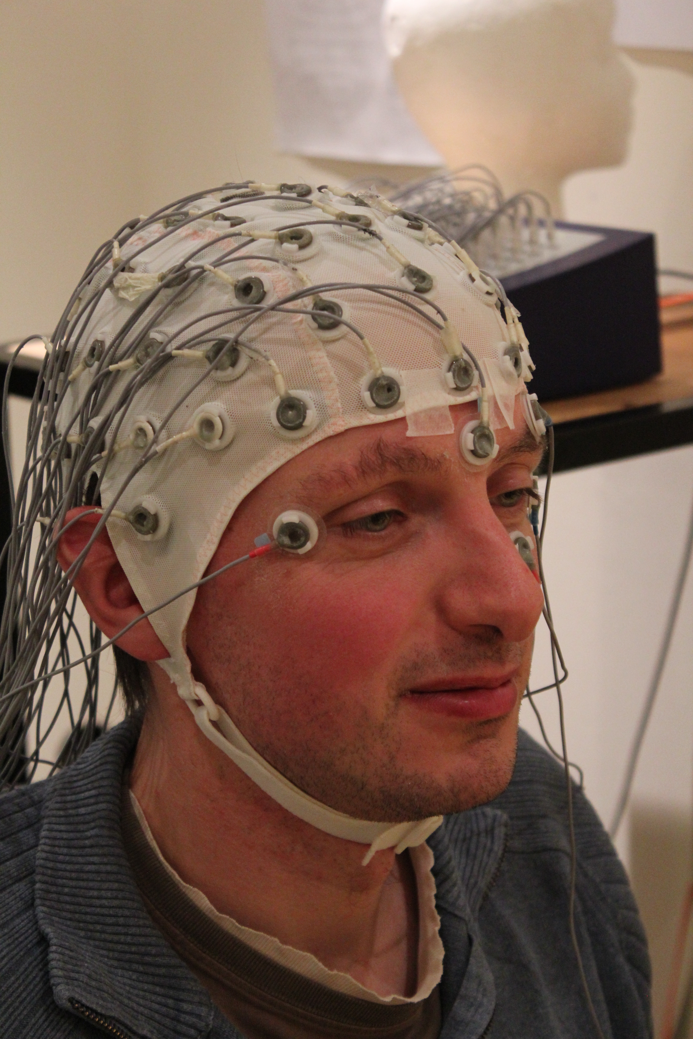
Virtual Field Trip:
Columbia University’s
Brain Wave Lab
College Student Wired to an EEG
Notes:
Photo by Tim Sheerman-Chase https://flickr.com/photos/68932647@N00/8135749317 CC-BY-2.0

Slide 9
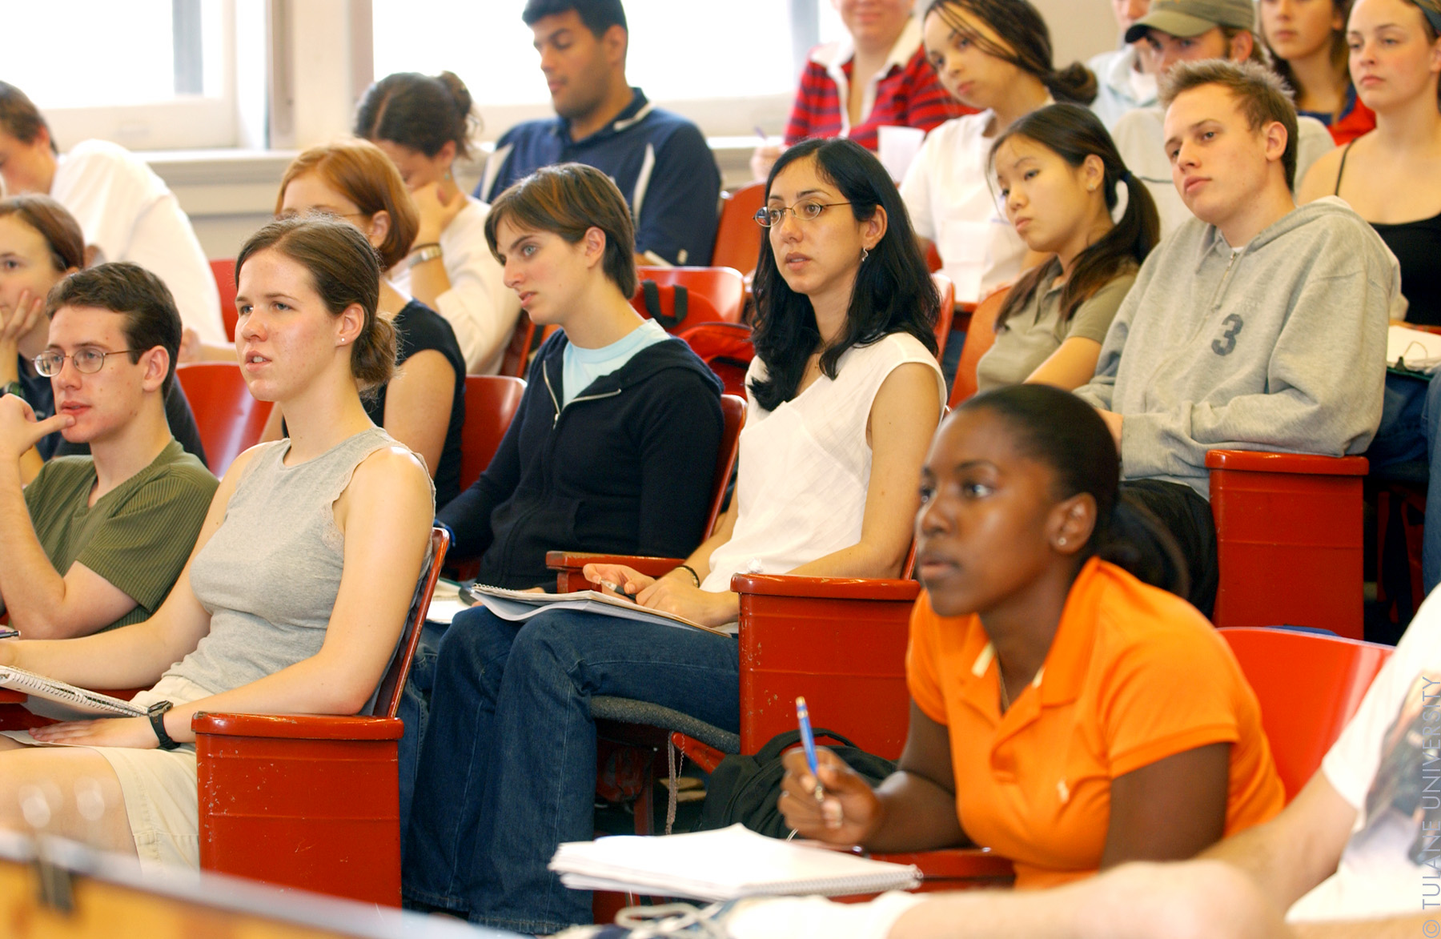
A Tale of Two Mindsets
Jocelyn
Ronnie
Notes:
Image https://commons.wikimedia.org/wiki/File:Student_in_Class_(3618969705).jpg
Both of these images are in creative commons according to Bing images (but feel free to replace them if you have better ones.

Slide 10
What is the capital of Australia?
Sydney

Slide 11

*

Slide 12

Canberra

Slide 13
When is PI Day celebrated around the world?
March 14

Slide 14
*

Slide 15
March 14

Slide 16
The Bhagavad Gita is the sacred text of which people?
Buddhists

Slide 17
*

Slide 18
Hindus

Slide 19
A Tale of Two Mindsets: Part 2
Jocelyn
Ronnie
Notes:
Image https://commons.wikimedia.org/wiki/File:Student_in_Class_(3618969705).jpg
Both of these images are in creative commons according to Bing images (but feel free to replace them if you have better ones.

Slide 20
The Artful Dodger is a skilled pickpocket in which novel?
Oliver Twist

Slide 21
*

Slide 22
Oliver Twist

Slide 23
7-year-old Jeanne Wakatsuki was among the 120,000 Japanese Americans forcibly relocated during World War 2. What was the name of the internment camp in the desert of California where she lived for 43 months with thousands of other detainees?
(You may have read her book, “Farewell to [this place]”.)
Manzanita

Slide 24
*

Slide 25
Manzanar

Slide 26
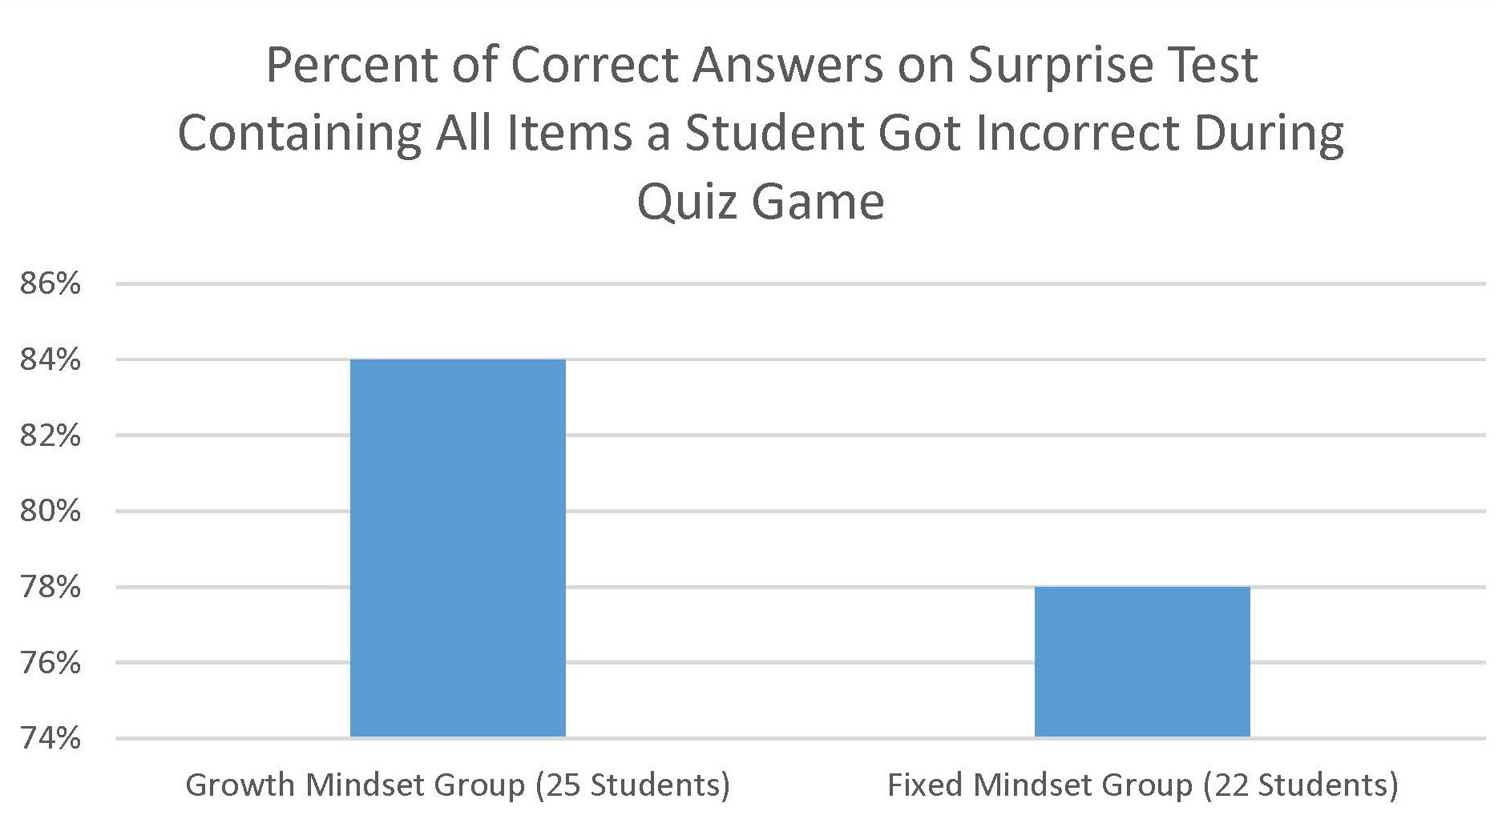

Slide 27
Make a Hypothesis:
Why did students with a growth mindset gain more knowledge while playing the game than students with a fixed mindset?
Pair and Share

Slide 28
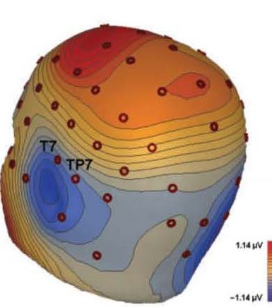
Left Temporal Lobe Neurons “Saving to Memory” When Correct Answer is Revealed (image from Mangels et al., 2006)

Slide 29
Being an Encouraging “Voice of Truth” to Myself
Positive and Productive Self-Talk, Mindsets, and Actions

Slide 30
Being an Encouraging “Voice of Truth” to Myself
With a partner, read the selection “Positive Self-Talk = More Stamina and Enthusiasm.”

Slide 31
Closure
How could you use positive self-talk to have a better experience as a new high school student?

Slide 32
References & Resources
Photos & Images
Slide 1: Taku https://www.flickr.com/photos/smaku/512074534/ CC BY-NC-ND 2.0
Slide 2 and unit thumbnails https://www.freepik.com/premium-photo/boy-putting-cross-impossible-blackboard-with-math-calculations_14413311.htm
Slide 3: https://pixabay.com/id/illustrations/akses-banyak-tangan-933142/
Slide 8: Tim Sheerman-Chase https://flickr.com/photos/68932647@N00/8135749317 CC-BY-2.0
Slides 9 and 19 : https://commons.wikimedia.org/wiki/File:Student_in_Class_(3618969705).jpg
Slide 28: Mangels et al., 2006

