Slide 1
Do Now:
Consider the problem below, then discuss with a classmate how you might help.
Allie forgets to bring her completed homework to school at least once a week, and has been losing points. Her grade will be lower than it should be if she doesn’t turn in more of her homework.
What might Allie do to make sure she is able to turn in her homework each day?

Slide 2


Student Dedication
Notes:
https://pixabay.com/id/illustrations/akses-banyak-tangan-933142/
Note: You can add the student’s picture to the slide

Slide 3
Confronting Challenges
Day 6: Having a Growth Mindset
Using Facts from Brain Science to Change Your Life
Notes:
Image https://www.freepik.com/premium-photo/boy-putting-cross-impossible-blackboard-with-math-calculations_14413311.htm

Slide 4
Our Agenda
About the brain: good news from science
Good news from you: Think/Pair/Share
Four videos
How London taxi drivers exercise their brains to become better navigators
How neuroplasticity enables us to create new possibilities within our brains
“You Can Learn Anything” – and rating these two videos
How John Legend used a growth mindset to become a recording star
Exit ticket: video reviews

Slide 5
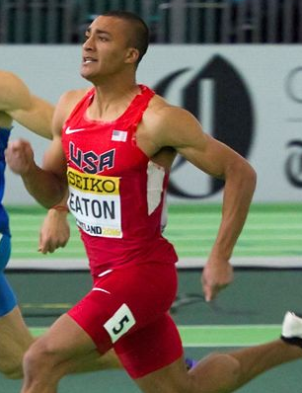
What is one of the most important scientific findings about the brain?
The different parts of our brain are like muscles: They get stronger (and gain expertise) when you exercise them.
Notes:
Photo Filip Bossuyt https://flickr.com/photos/115827683@N07/26028750441 CC BY 2.0

Slide 6
Pair and Share
Take 90 seconds to think of something you do well that many people don’t know how to do. How did you train your brain to have that skill?
Then take 4 minutes to share with a partner what your special skill is and how you exercised your brain to learn to do it.
What examples did you find of ways to exercise the brain?

Slide 7
How do you exercise your brain to make it grow expert skill and knowledge?
By gaining experience doing things
By working on challenging material
By solving difficult tasks
By learning from my mistakes
This Photo by Unknown Author is licensed under CC BY-SA
Notes:
Animated slide, only the question at the top appears when the slide is reached. After pairs share ideas with the class, the teacher wraps up this activity by clicking through 4 key answers (with the teacher commenting on how the slide’s answers connect with -- or-- echo the ideas the pairs shared).

Slide 8
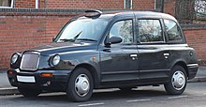

How do people who want to be taxi drivers in London exercise their brains to learn the city?
To become a taxi driver in London, you have to first pass a very difficult licensing exam.
  Let’s watch a 3-minute video about how they prepare: “Cracking London’s Legendary Taxi Test” https://www.youtube.com/watch?v=sU4W36_5oiM
Notes:
Image: https://en.wikipedia.org/wiki/Hackney_carriage

Slide 9
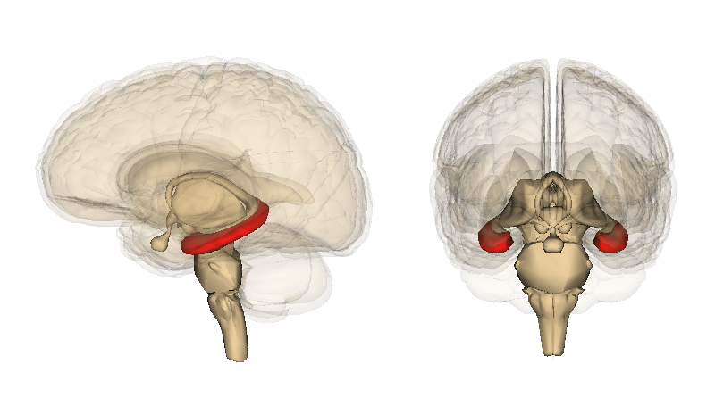
Meet the Hippocampus – Where Your Brain’s GPS Is Found
Notes:
Image https://commons.wikimedia.org/wiki/File:Hippocampus_image.png

Slide 10
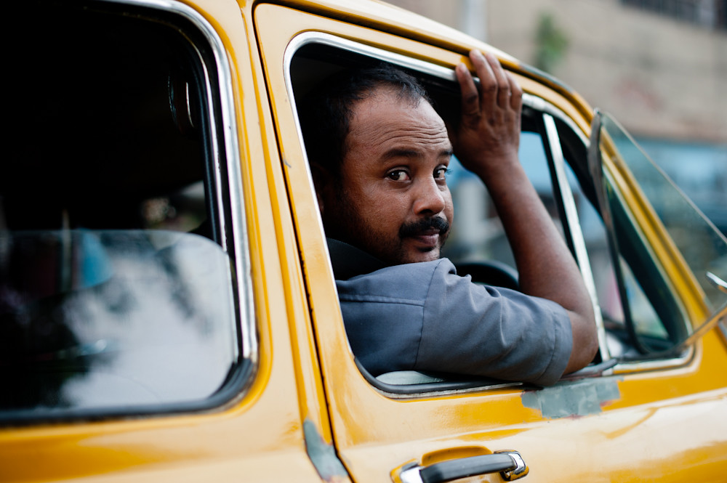

How do the brains of taxi drivers compare to those of other people?
Taxi Drivers
A Non-Taxi-Driver
Notes:
Photos: James Offer https://www.flickr.com/photos/joffley/5339044114/ CC BY-NC-SA 2.0; https://pxhere.com/en/photo/892994

Slide 11
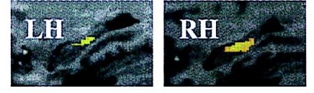
Close-ups of the left and right hippocampus of a London taxi driver
The highlighted sections show where taxi drivers grew 4 times more gray matter than did non-taxi drivers.
Notes:
From https://doi.org/10.1073/pnas.070039597

Slide 12
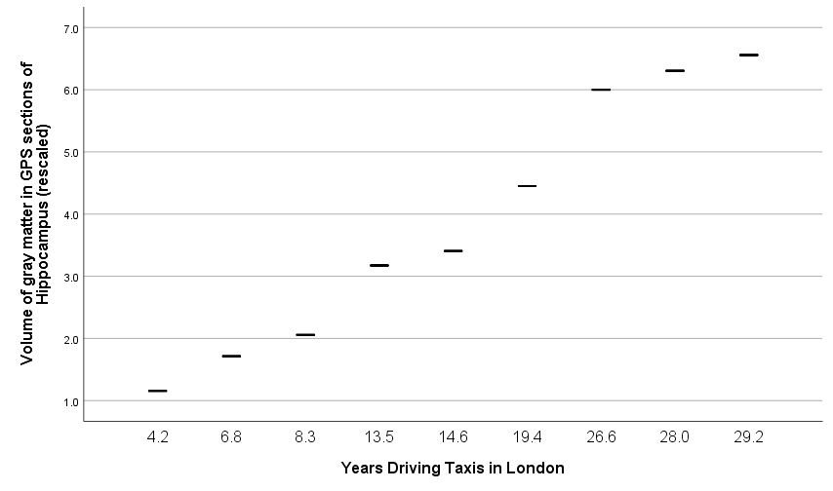
The “GPS” in Taxi Drivers’ Brains Continues to Grow Throughout their Careers
Notes:
Original chart based on data from https://doi.org/10.1073/pnas.070039597

Slide 13



Watch and Rate two Videos
The Felicity of Neuroplasticity: https://www.katrinadreamertutoring.com/The%20Importance%20of%20Growth%20Mindset%20and%20Neuroplasticity.html
You Can Learn Anything:
https://www.youtube.com/watch?v=JC82Il2cjqA
Notes:
Images: https://pixabay.com/vectors/food-green-health-plant-red-1294019/; http://clipart-library.com/clipart/1851629.htm

Slide 14
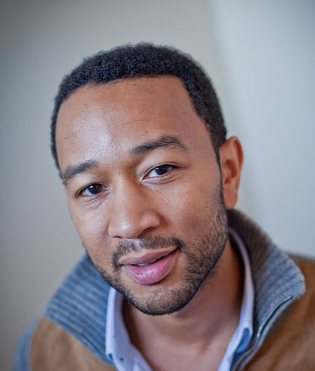
The Power of a Growth Mindset: How I Became a Recording Star
John Legend shares his path to success: https://www.youtube.com/watch?v=LUtcigWSBsw
Notes:
Photo Thatcher Hullerman Cook https://www.flickr.com/photos/poptech/5107260975 CC BY-SA 2.0

Slide 15
Please Turn in Your Video Reviews at the End of Class
This will help the curriculum creators decide which videos should be used for the next edition of this course.

Slide 16
References & Resources
Photos & Images
Slide 1: Bruno Schoonbrodt https://www.flickr.com/photos/schoonbrodt/49060752293/ (cropped) CC BY-NC-ND 2.0
Slide 2: https://pixabay.com/id/illustrations/akses-banyak-tangan-933142/
Slide 3 and unit thumbnails https://www.freepik.com/premium-photo/boy-putting-cross-impossible-blackboard-with-math-calculations_14413311.htm
Slide 5: Filip Bossuyt https://flickr.com/photos/115827683@N07/26028750441 CC BY 2.0Slide 6: http://clipart-library.com/clipart/311074.htm
Slide 8: https://www.youtube.com/watch?v=sU4W36_5oiM; https://en.wikipedia.org/wiki/Hackney_carriage
Slide 9 : https://commons.wikimedia.org/wiki/File:Hippocampus_image.png
Slide 10: https://commons.wikimedia.org/wiki/File:Hippocampus_image.pngSlide 11: http://clipart-library.com/clipart/smile-clip-art-5.htm
Slide 11: https://doi.org/10.1073/pnas.070039597
Slide 12: Original chart based on data from https://doi.org/10.1073/pnas.070039597
Slide 13: https://pixabay.com/vectors/food-green-health-plant-red-1294019/; http://clipart-library.com/clipart/1851629.htm; https://www.katrinadreamertutoring.com/The%20Importance%20of%20Growth%20Mindset%20and%20Neuroplasticity.html; https://www.youtube.com/watch?v=JC82Il2cjqA
Slide 14: Photo Thatcher Hullerman Cook https://www.flickr.com/photos/poptech/5107260975 CC BY-SA 2.0;
https://www.youtube.com/watch?v=LUtcigWSBsw

