Slide 1
Do Now
Turn and share with a partner:
Have you heard the term “mindfulness”?
What does it mean to you, or what do you think it might mean?

Slide 2

Confronting Challenges
Day 5: Mindfulness
Notes:
Image https://www.freepik.com/premium-photo/boy-putting-cross-impossible-blackboard-with-math-calculations_14413311.htm

Slide 3

Student Dedication
Notes:
https://pixabay.com/id/illustrations/akses-banyak-tangan-933142/
Note: You can add the student’s picture to the slide

Slide 4
Agenda
Student dedication
Introduction to mindfulness
Practicing mindfulness
What do you really mean?

Slide 5
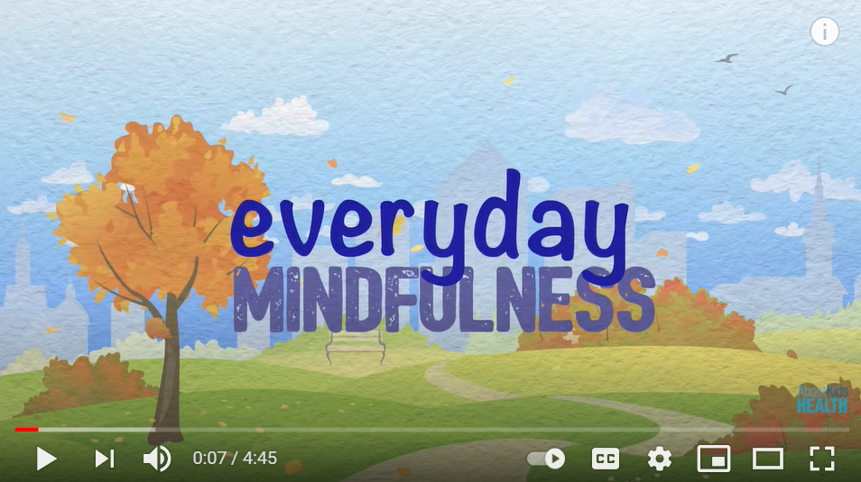

Mindfulness
What does it mean to be mindful?
As you watch the video, jot down your ideas on
    What does it mean to be mindful?
    How can mindfulness be helpful?
    What are some ways we can practice mindfulness?
What did you learn that was new, or that surprised you?
Notes:
https://www.youtube.com/watch?v=QTsUEOUaWpY
https://www.youtube.com/watch?v=QTsUEOUaWpY

Slide 6
What is Mindfulness?
Mindfulness is the practice of paying attention, on purpose, in the present moment without judgment
Focus attention on one aspect of your experience
What does your pencil feel like in your hand?
What parts of your feet are touching the ground?
Notes:
http://clipart-library.com/clipart/311074.htm

Slide 7
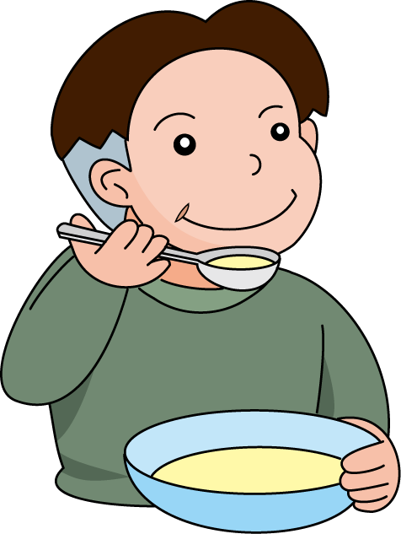
What is Mindfulness?
Mindfulness is NOT just about sitting and meditating
It does NOT require a clear mind
You can be mindful while you walk, listen to music, or eat
Notes:
http://clipart-library.com/clipart/1588746.htm

Slide 8
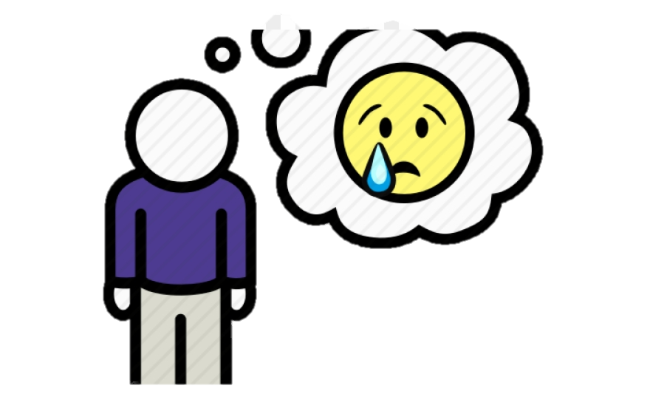
Mindfulness
The first step is being open to ALL feelings, including unpleasant ones
It is important not to judge or criticize yourself for however you are feeling
It is okay to have negative feelings!
Notes:
http://clipart-library.com/clipart/desire-cliparts_18.htm

Slide 9
Mindfulness
Another part of being mindful is pausing and taking inventory of your body.
How are you feeling?
Is there tension anywhere?
Do you have any pain?
What emotions are you feeling?
Is something bothering you?
Are your thoughts positive or negative?
Notes:
http://clipart-library.com/clipart/BigrqK9gT.htm

Slide 10
Why is Mindfulness Important?
We are so busy, but we need to slow down sometimes.
Mindfulness teaches us how to be present.
We often focus on the past or the future.
Unless we pause, it can be difficult to understand our different thoughts and emotions.
Notes:
http://clipart-library.com/clipart/slow-sign-cliparts_15.htm

Slide 11
How Does Mindfulness Help?
Mindful practices:
Can help you better understand your emotions
Can help you increase positive emotions, focus, memory, attention, and compassion
Can decrease stress or negative feelings
Can even boost your immune system
Notes:
http://clipart-library.com/clipart/smile-clip-art-5.htm

Slide 12
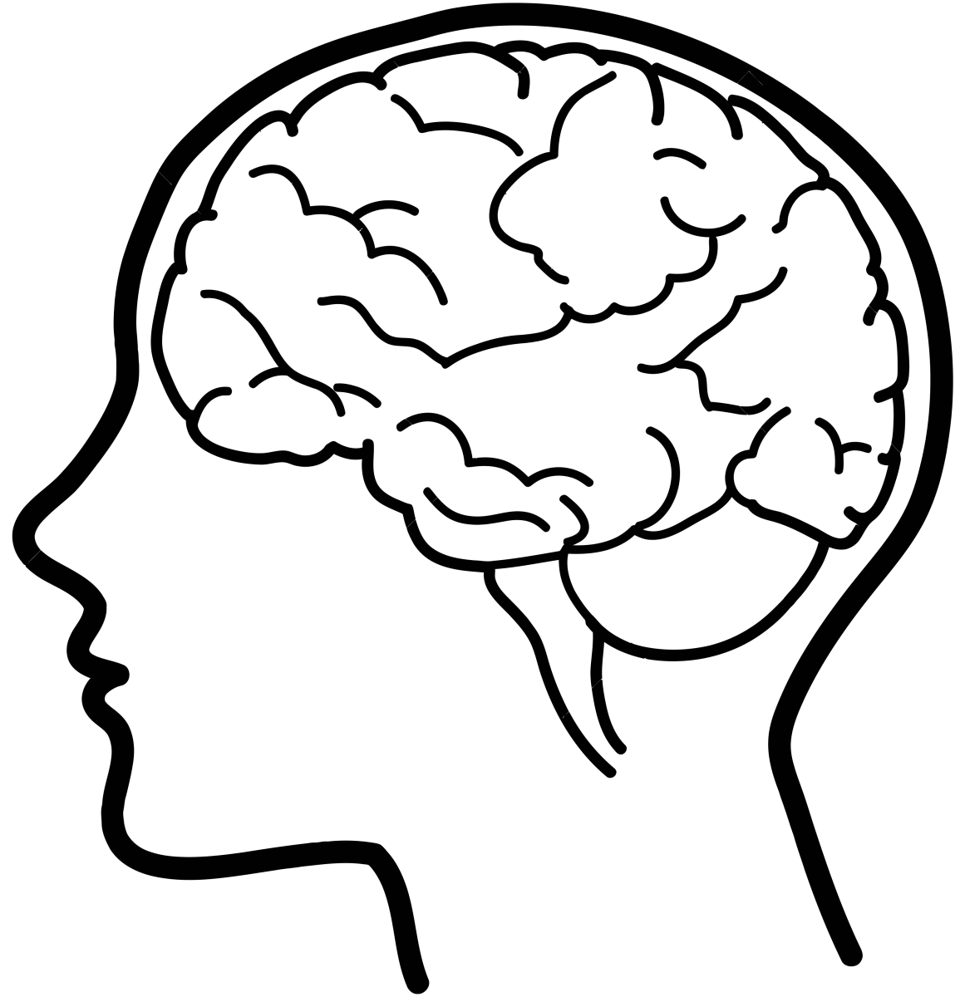
Mindfulness and the Brain
Mindfulness can also change our brain!
The amygdala is part of the brain where our emotions live
People who practice mindfulness have a slightly smaller amygdala
They may experience less stress and fear
Notes:
http://clipart-library.com/clip-art/brain-transparent-7.htm

Slide 13
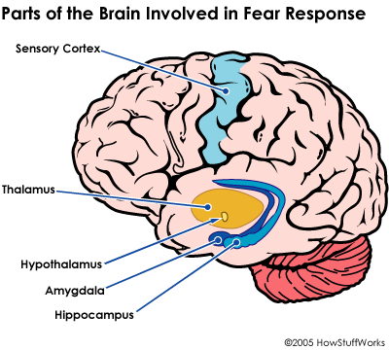
Mindfulness and the Brain
This hippocampus is part of the brain that is important for memory
People who practice mindfulness may have a hippocampus that is more active
More activity = more learning occurring
Notes:
http://clipart-library.com/clipart/1585770.htm

Slide 14
Mindfulness and the Brain
Our prefrontal cortex is the part of the brain that helps us make decisions and control behaviors
Mindfulness can help the prefrontal cortex become more activated
We develop better planning and problem solving skills when we practice mindfulness

Slide 15
Mindfulness: Myths or Fact?
Read the statements about mindfulness with your partner and determine which are true and which are myths.
1. Mindfulness can only be practiced by adults.
2. To be mindful, you have to sit in a quiet room.
3. Mindfulness is just about paying attention and being intentional.
4. Identifying negative thoughts is part of being mindful.
5. Practicing mindfulness can make you smarter.
6. Mindfulness can change your brain.
7. Mindfulness can reduce your stress level.
8. To be mindful, you need to clear your mind.

Slide 16

Practicing Mindfulness
There are many ways to practice mindfulness.
We can start with a breathing exercise.
Inhale and count to three, then count to three as you exhale.
Sometimes people use their fingers to measure their breaths.
Breathe in as you trace up your finger (knuckle to fingertip).
Breathe out as you trace down from the fingertip to knuckle of next finger.
Repeat for all five fingers.
Notes:
http://clipart-library.com/clipart/gTeEKqoxc.htm

Slide 17

Practicing Mindfulness
Close your eyes, if you want, and take 1 minute to listen to this clip:
https://www.youtube.com/watch?v=STWVMl_cGuc
Pay attention to your senses
What do you hear?
What do you smell?
How does your body feel?
Are you feeling tense?

Slide 18
Other Mindful Practices
Mindful coloring
Listening to music
Going for a walk—and paying attention to your surroundings

Slide 19
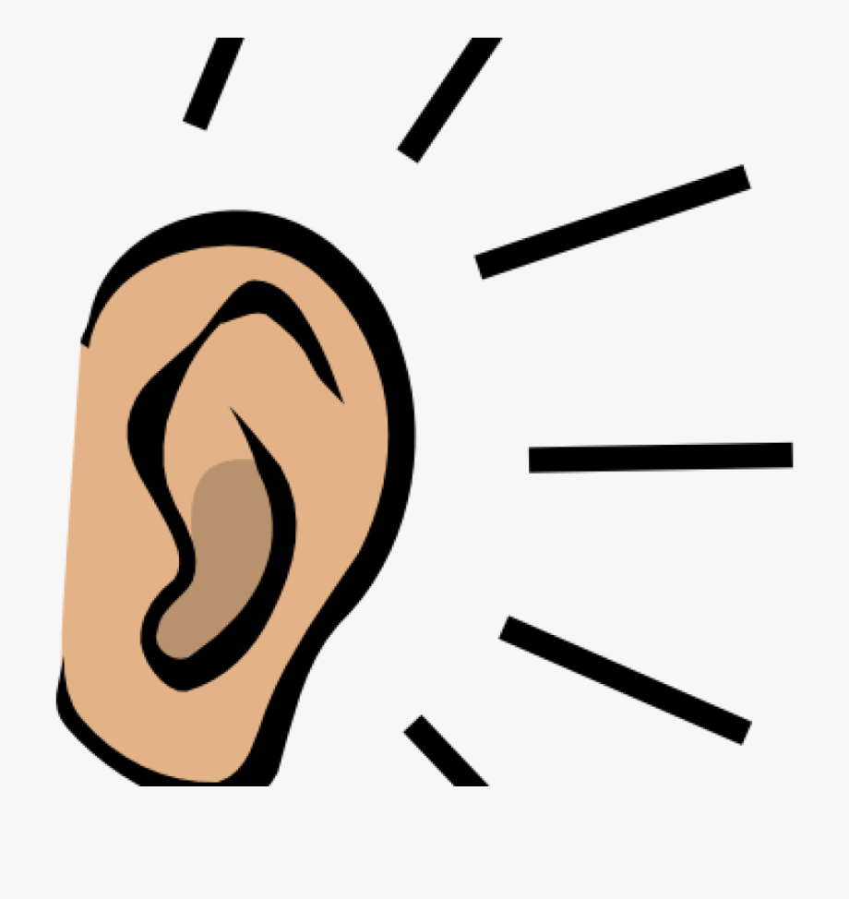
Mindful Listening
Part of being mindful is listening to someone and focusing on what they are saying.
The goal is to UNDERSTAND rather than RESPOND.
Notes:
http://clipart-library.com/clipart/listening-ears-cliparts_6.htm

Slide 20
What Do You Mean?
Part of being mindful is being aware of your own feelings and those of others.
With your partner, read the statements on the “What You Say vs. What You May Feel” activity sheet.
Try to identify what the person making each statement may be feeling.
Think about ideas for things to do that could make that person feel better.

Slide 21
Closure—Exit ticket
Briefly answer the following questions:
What does it mean to be mindful?
What are two ways you can be more mindful in your life?

Slide 22
References & Resources
Photos & Images
Slide 2 and unit thumbnails https://www.freepik.com/premium-photo/boy-putting-cross-impossible-blackboard-with-math-calculations_14413311.htm
Slide 3: https://pixabay.com/id/illustrations/akses-banyak-tangan-933142/
Slide 5: https://www.youtube.com/watch?v=QTsUEOUaWpY
Slide 6: http://clipart-library.com/clipart/311074.htm
Slide 7: http://clipart-library.com/clipart/1588746.htm
Slide 8: http://clipart-library.com/clipart/desire-cliparts_18.htm
Slides 9 and 17: http://clipart-library.com/clipart/BigrqK9gT.
Slide 10: http://clipart-library.com/clipart/slow-sign-cliparts_15.htm
Slide 11: http://clipart-library.com/clipart/smile-clip-art-5.htm
Slide 12: http://clipart-library.com/clip-art/brain-transparent-7.htm
Slides 13 and 14: http://clipart-library.com/clipart/1585770.htm
Slide 16: http://clipart-library.com/clipart/gTeEKqoxc.htm
Slide 17: https://www.youtube.com/watch?v=STWVMl_cGuc
Slide 19: http://clipart-library.com/clipart/listening-ears-cliparts_6.htm

