Slide 1

Do Now: Stress and the Body
Briefly jot down your answers to the following questions.
How does your body tell you if you are feeling stressed?
What are some physical symptoms you experience?
Notes:
YouTube Link: https://youtu.be/5Y00Oe-cODw
Time Link: https://www.roomrecess.com/Tools/ClassroomTimer/timer.html
WWW Link: https://learningcenter.unc.edu/tips-and-tools/reading-comprehension-tips/

Slide 2
Confronting Challenges
Day 2: Identifying Signs of Stress
Notes:
Have a copy of the Lesson’s 2-sided Activity Sheet for each student (found on pages 63-64 of the Teacher’s Manual). Also have a copy of the lesson’s exit ticket for each student (p. 65 of the manual).
Students will use the Lesson’s Activity sheet to list as many symptoms of stress as they can in their cooperative learning team during Activity 2 (as described on page 61 of the Manual). Then, in Activity 3, they will talk about (and write down) situations or experiences that cause them stress and then then brainstorm (and write down) ideas for making schools better, less stressful, and more helpful in assisting students to manage stress.
The exit ticket for the lesson (manual p. 65) has each student write down three differences between the stress response and the relaxation response.

Slide 3

Lesson Dedication
Notes:
If the student assigned to dedicate today’s lesson to an inspirational person in his or her life has supplied the person’s name in advance, you could add it in a text box on this slide or you could insert a digital photo of the person, if the student has supplied one. After the student shares a few words of how the person has inspired them for 30-60 seconds, the teacher begins leading students through the lesson.
https://pixabay.com/id/illustrations/akses-banyak-tangan-933142/
Note: You can add the student’s picture to the slide

Slide 4
Agenda
Understanding the body’s response to stress
Identifying our symptoms of stress
Causes of stress
Making schools better
Notes:
“Today you will learn about the flight or fight response and what happens to our body when we’re stressed. We will identify signs of stress, causes of stress, and also brainstorm ways of making schools better for students.”

Slide 5
Stress and the Body
What does stress feel like in your body?
What are some symptoms you experience?
Notes:
“Look at what you wrote down during the Do Now. What does stress feel like in your body?” “What are some of the symptoms of stress?”

Slide 6
Is Stress Bad?
What do you think? Why or why not?
Not all stress is bad!!
We often feel stressed or activated for good reasons. For example:
  A musician about to perform
  An athlete about to compete
The adrenaline rush gets you excited and ready
Notes:
“Do you consider stress bad? Why or why not” [Then click to reveal the remaining bullets suggesting that not all stress is bad if it helps us to be ready to do what needs to be done.]

Slide 7
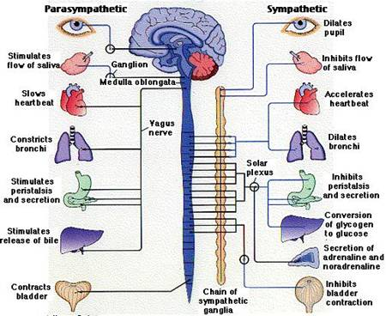
Two Parts of the Autonomic Nervous System
Parasympathetic
Sympathetic
Notes:
“The parts of the nervous system through which the brain controls our organs is often called the “autonomic” nervous system because it automatically adjusts how our organs and other parts of the body respond depending upon whether were are facing stressful conditions, normal conditions, or restful conditions. The sympathetic and parasympathetic parts of the system work together to adjust the body to changing conditions.”
Note “para” means “alongside,” (the parasympathetic system works together and in cooperation with the sympathetic system in helping the body adjust appropriately.)
http://clipart-library.com/clipart/1968801.htm

Slide 8
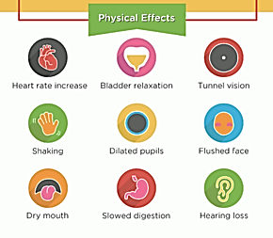
The Sympathetic Nervous System
Most active when we feel stressed, in danger, or on stage
Also called the “fight or flight” system
When activated by stress:
  Pupils expand to let in more light
  Heart rate increases
  Skin flushes
  Digestion slows
  Sweating increases
Notes:
“The sympathetic part of our nervous system kicks into high gear when we are under stress, in danger, or performing under challenging conditions. Imagine you are running away from a lion to survive, you would need to muster all the energy and focus you can. The sympathetic system activates to make pupils in your eyes expand to let in more light so that you can see better. It increases your heart rate so your blood can carry extra oxygen and sugar to your muscles, legs, arms, and brain. This helps you think faster and move quickly. It also sets your body’s cooling system on high by activating the sweat glands of the face, armpits and hand.”
https://commons.wikimedia.org/wiki/Category:Sympathetic_nervous_system#/media/File:The_Fight_or_Flight_Response.jpg

Slide 9
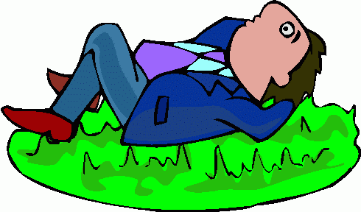
The Parasympathetic Nervous System
The Rest & Digest Response
After the stressful event has passed, all activated body systems slow down again.
Heart rate and breathing rate decrease.
Pupils constrict.
Digestion resumes.
Calmness and broader focus return.
Helps us rest and digest
After the stressor has passed, our body returns to baseline
  Heart rate slows down
  We digest food again
  Pupils get smaller
Notes:
“When the stressful event is past, the parasympathetic system kicks in to calm us down, slow us down, and help us chill out. Your heart and breathing rates slow to normal or to resting levels, your digestive system resumes normal operation, and the pupils of your eyes return to their normal size.”
http://clipart-library.com/clipart/109289.htm

Slide 10
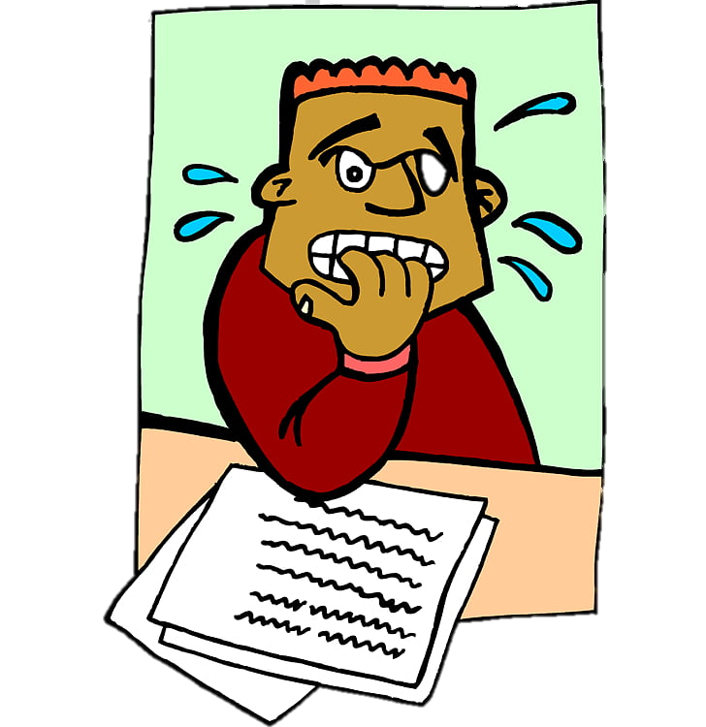
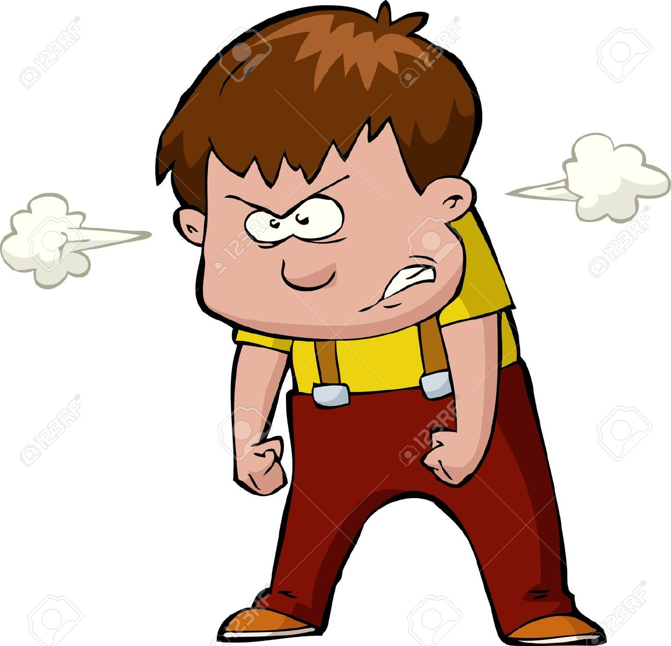
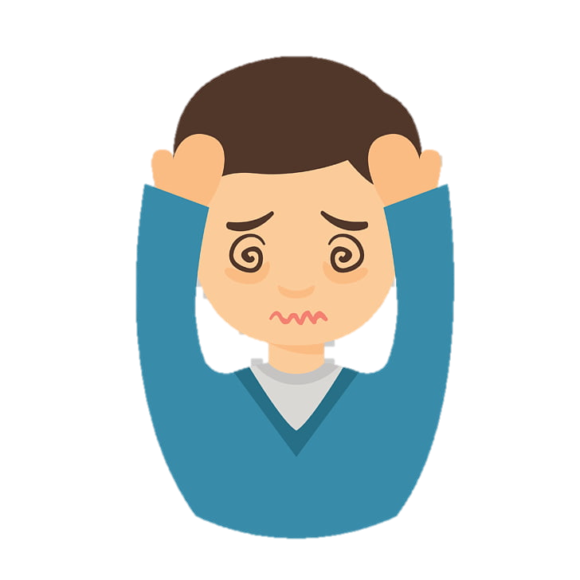
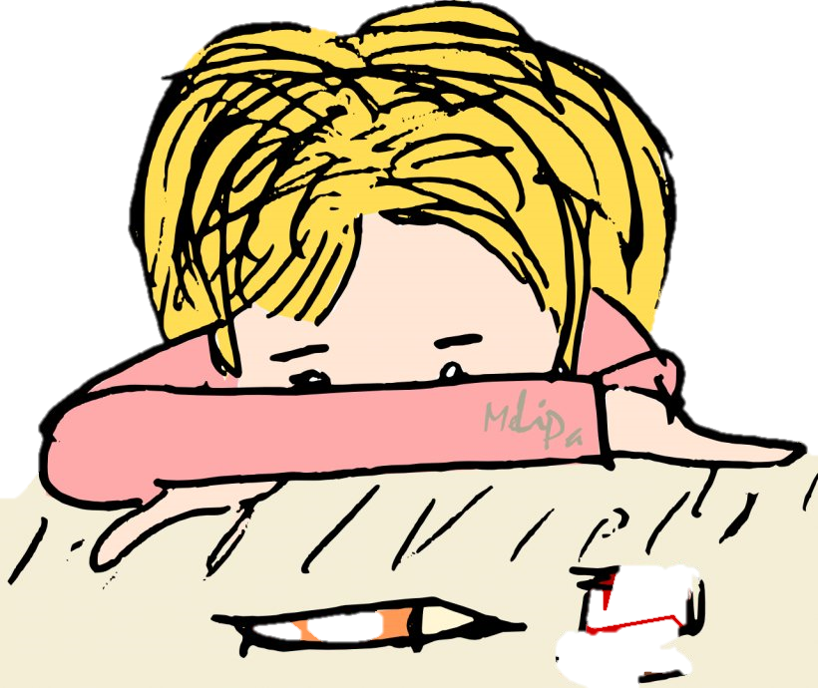
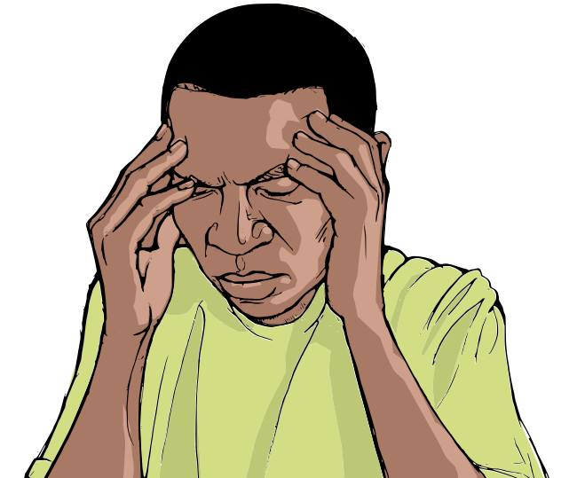
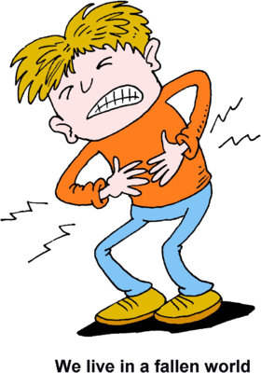
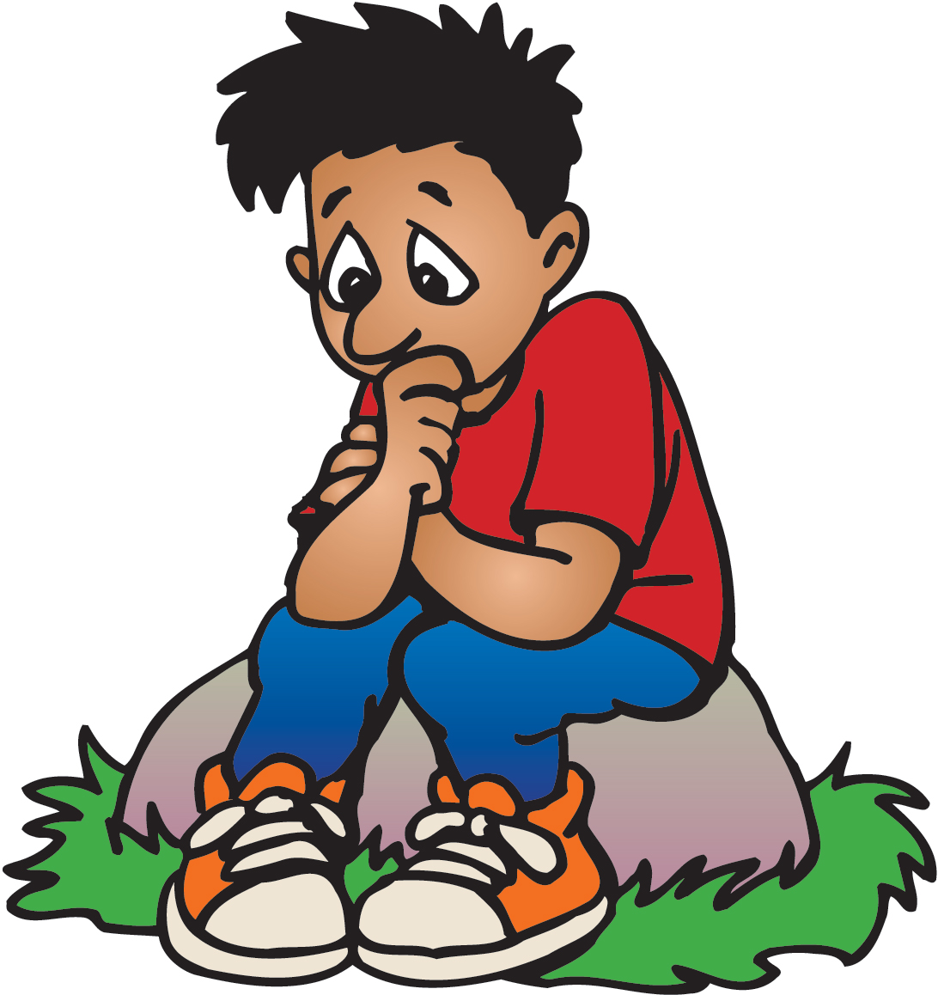
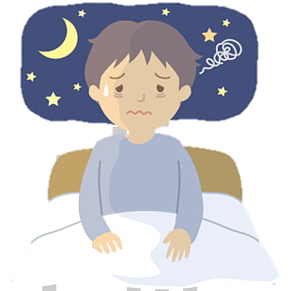
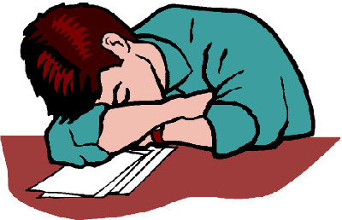
Other Symptoms of Stress
COMMON SIGNS OF STRESS
ANXIETY
BEING IRRITABLE
TENSION
If you experience stressors over a longer period, you may have other symptoms such as
Headache
Stomachache
Fatigue
Irritability
Sadness
DEPRESSION
HEADACHE
STOMACH ACHE
ISOLATION
TIREDNESS
SLEEPLESSNESS
Notes:
“If stressors continue for a long time, the sympathetic nervous system stays too active for too long which produces anxiety, irritability, constant tension or depression, headaches, and sleeplessness”
http://clipart-library.cm/clipart/final-cliparts_17.htm
http://clipart-library.com/clipart/1981793.htm
http://clipart-library.com/clip-art/792940_headache-png.htm
http://clipart-library.com/clipart/stress-cliparts_19.htm
http://clipart-library.com/clipart/132555.htm
http://clipart-library.com/clipart/415602.htm
http://clipart-library.com/clipart/migraine-cliparts_8.htm
http://clipart-library.com/clipart/di9X5LgpT.htm
http://clipart-library.com/clipart/sleepless-cliparts_15.htm

Slide 11
Identifying Our Own Symptoms
With your group, think about some symptoms of stress.
What are physical, emotional, behavioral, or mental signs that someone is feeling stressed?
Fill out the chart on the Signs of Stress Worksheet with your group.
Notes:
Direct students to brainstorm some symptoms of stress with the other members of their cooperative learning team.

Slide 12
Examples of Different Kinds of Symptoms
Physical Symptoms | Emotional Symptoms
Headache | Sense of isolation
Behavioral Symptoms | Mental Symptoms
Sleeping too much or too little | Difficulty concentrating
Notes:
The 2-sided “Signs of Stress” activity sheet can be found on p. 63-64 of the teacher’s manual. P. 63 includes a blank chart for students to list as many symptoms of stress as possible. They will share some of these symptoms they identified as you move through slides 13-16.

Slide 13

Physical Symptoms
What are some physical signs of stress?
Notes:
http://clipart-library.com/clip-art/274-2740176_png-file-stethoscope-clipart.htm

Slide 14

Emotional Symptoms
What are some emotional signs of stress?
Notes:
http://clipart-library.com/clipart/1737347.htm

Slide 15


Behavioral Symptoms
What are some behavioral signs of stress?
Notes:
http://clipart-library.com/clip-art/face-silhouette-outline-7.htm
http://clipart-library.com/clip-art/171321_gear-icon-png.htm

Slide 16

Mental Symptoms
What are some mental signs of stress?
Notes:
http://clipart-library.com/clip-art/head-transparent-20.htm

Slide 17

Spotting Signs
Why might it be helpful for you to identify signs of stress in yourself?
Why might it be helpful for you to identify signs of stress in someone else?
Notes:
http://clipart-library.com/clipart/kcKopp8Xi.htm

Slide 18
What Causes Stress?
Causes of Stress
With your group, brainstorm different situations or experiences that cause stress for teenagers. Add these to the back page of the
“Signs of Stress” activity sheet.

Slide 19
How Can We Help?
Life is stressful! What are ways that schools can help support students better?
With your team, think of at least 3 creative solutions or ideas and add them to the activity sheet.

Slide 20
Closure – Exit Ticket
Complete the “Stress Response: Sympathetic vs. Parasympathetic Nervous System” handout.

Slide 21
References & Resources
Photos & Images
Slide 3: https://pixabay.com/id/illustrations/akses-banyak-tangan-933142/
Slide 7: http://clipart-library.com/clipart/1968801.htm
Slide 8: https://commons.wikimedia.org/wiki/Category:Sympathetic_nervous_system#/media/File:The_Fight_or_Flight_Response.jpg
Slide 9: http://clipart-library.com/clipart/109289.htm
Slide 10: http://clipart-library.cm/clipart/final-cliparts_17.htm
http://clipart-library.com/clipart/1981793.htm
http://clipart-library.com/clip-art/792940_headache-png.htm
http://clipart-library.com/clipart/stress-cliparts_19.htm
http://clipart-library.com/clipart/132555.htm
http://clipart-library.com/clipart/415602.htm
http://clipart-library.com/clipart/migraine-cliparts_8.htm
http://clipart-library.com/clipart/di9X5LgpT.htm
http://clipart-library.com/clipart/sleepless-cliparts_15.htm
Slide 13: http://clipart-library.com/clip-art/274-2740176_png-file-stethoscope-clipart.htm
Slide 14: http://clipart-library.com/clipart/1737347.htm
Slide 15: http://clipart-library.com/clip-art/face-silhouette-outline-7.htm
http://clipart-library.com/clip-art/171321_gear-icon-png.htm
Slide 16: http://clipart-library.com/clip-art/head-transparent-20.htm
Slide 17: http://clipart-library.com/clipart/kcKopp8Xi.htm

