Slide 1


Do Now
When you hear the word stress, what do you think of?
What are your favorite activities to do when you are feeling stressed?
STRESS
Notes:
“During today’s Do Now: Share with a partner your thoughts on these two questions.”
Note to teacher: Don’t forget to put up posters 1 through 6 (that match slides 8 thru 13) spaced throughout the room (e.g., one in each corner plus one on the back wall and one at the front of the room) so that each student group can visit each poster.
http://clipart-library.com/clipart/pop-cliparts_3.htm
http://clipart-library.com/clip-art/transparent-red-balloon-15.htm

Slide 2

Confronting Challenges
Day 1: Managing Stress
Notes:
On the notes page for each slide, you can include notes to your self, that won’t appear to students.

Slide 3

Lesson Dedication
Notes:
If the student assigned to dedicate today’s lesson (to a inspirational person in his or her life) has supplied a digital photo of the person to whom he or she is dedicating the lesson, you can add it to this slide, or simply replace the slide with the photo. Of course, in some instances the student who is doing the dedication will have supplied a photo that has the honoree and the student together, which is fine. The student shares a few words of how the person has inspired them (30- to 60-seconds), and then the lesson begins.
https://pixabay.com/id/illustrations/akses-banyak-tangan-933142/

Slide 4
Agenda
Introduction to Unit 2
Gallery Walk to Respond to Posters 1 to 6
Class Reviews and Discusses These Responses
What Stress Feels Like and Strategies For Calming Down and Refocusing

Slide 5

Unit 2: Confronting Challenges
This unit focuses on confronting challenges and developing a growth mindset
When things get challenging, we want to:
  Recognize signs of tension in our body
  Learn how to regulate our emotions
  Cope with the challenges
  Maintain a growth mindset
BREATHE
SOCIALIZE
EXERCISE
SLEEP
Notes:
Image: https://commons.wikimedia.org/wiki/File:A_Cartoon_Black_Woman_In_Deep_Meditation.svg

Slide 6



What Is a Growth Mindset?
Our brain continues to develop over time
As we practice new skills or tasks, our brain is constantly developing
Having a growth mindset includes remembering that we might not be there YET, but we can get there with practice
Notes:
Composite image: pixabay https://encrypted-tbn0.gstatic.com/images?q=tbn:ANd9GcQSUryy0Bi9ptfzQ2gAKCiKTntYD2T8FxxyOaNX4s4f_thbdqCW&s and https://encrypted-tbn0.gstatic.com/images?q=tbn:ANd9GcSAy7KmWQYSbkE_RzKFhCUZpN9O0cCLPq7Dgx8VHWAiI8Y228Q&s
http://clipart-library.com/clip-art/plant-transparent-background-20.htm

Slide 7
Gallery Walk
Walk around the room and visit the 6 posters. Write your answer to each question on a post-it and stick it on the poster. You will have 2 minutes at each station
  What is stress?
  How do you know if you are feeling stress?
  What causes stress?
  What do you do to relieve stress?
  What can schools do to help students feel less stressed?
  Look at the growth mindset picture. What are some differences you notice between a fixed and growth mindset?
Notes:
For the Gallery Walk, you can divide students into 6 groups (Group 1 starts at poster 1, Group 2 starts at poster 2., …. Group 6 starts at poster 6), and each group then visits the next poster in the sequence (Group 1 moves on to poster 2, Group 2 moves on to poster 3,… but Group 6 moves to poster 1) when you signal the end of each 2-minute-long visit. Once every group has visited and posted their answers on all six posters, have students return to their seats.

Slide 8
Poster 1
What is stress?
What do you think about when you hear the word “stress”?
Notes:
Review some of the responses posted on poster 1 either by having a student volunteer read the post-it notes on the poster or by reading the responses yourself and then inviting students’ comments and reflections.

Slide 9
Poster 2
How do you know if you are feeling stress?
What do you feel in your body?
What thoughts do you have?
Notes:
Review some of the responses posted by the class.

Slide 10
Poster 3
What causes stress?
Notes:
Review some of the causes posted by the class

Slide 11
Poster 4
What do you do to relieve stress?
Do you have any favorite activities?
Notes:
Review some of the responses posted by the class.

Slide 12
Poster 5
What can schools do to help students feel less stressed?
Notes:
Review some of the responses posted by the class.

Slide 13
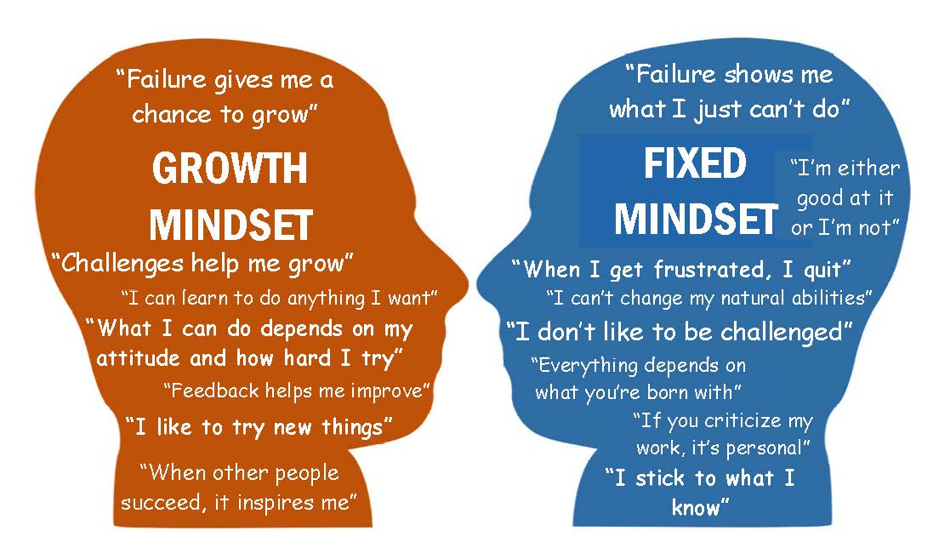
Poster 6
What are some differences between a fixed and growth mindset?
Notes:
Review some of the differences noted by the class.
http://clipart-library.com/free/human-silhouette-head.html

Slide 14
How I Experience Stress and Strategies I Use to Calm Down
Take a few minutes to think about how YOU feel when you are stressed out (using the questions from the Experience of Stress handout). You do not have to share your answers with anyone.
Then, complete the Self-Regulation Strategies inventory to identify strategies you like and use to help you calm down or refocus.
Notes:
Give each student a copy of the Experience of Stress symptom checker (from p. 57 of Teacher’s Manual) and of Self-Regulation Strategies (from inventory on p. 58 of the Teacher’s Manual)

Slide 15
Coming up in this unit…
Identifying causes of stress
Managing our emotions
Problem solving strategies
Mindfulness: what’s all the hype?
Developing a growth mindset
The power of positive talk
Famous fails

Slide 16
Closure – Exit Ticket
Respond to the following:
What are two things you hope to learn about in this unit?
Think about a parent, sibling, grandparent, guardian or close friend. What are some clues that they might be feeling stressed?

Slide 17
References & Resources
Photos & Images
Slide 1: http://clipart-library.com/clipart/pop-cliparts_3.htm
http://clipart-library.com/clip-art/transparent-red-balloon-15.htm
Slide 3: https://pixabay.com/id/illustrations/akses-banyak-tangan-933142/
Slide 5: https://commons.wikimedia.org/wiki/File:A_Cartoon_Black_Woman_In_Deep_Meditation.svg
Slide 6: pixabay https://encrypted-tbn0.gstatic.com/images?q=tbn:ANd9GcQSUryy0Bi9ptfzQ2gAKCiKTntYD2T8FxxyOaNX4s4f_thbdqCW&s and https://encrypted-tbn0.gstatic.com/images?q=tbn:ANd9GcSAy7KmWQYSbkE_RzKFhCUZpN9O0cCLPq7Dgx8VHWAiI8Y228Q&s
http://clipart-library.com/clip-art/plant-transparent-background-20.htm
Slide 13: http://clipart-library.com/free/human-silhouette-head.html

