Slide 1

Do Now:
Life’s Blueprint Inspiration
Share with your partner what you learned or were inspired by while watching the video(s) and previewing vision boards.
What did you notice?
Are there ideas you want to incorporate into your own board or project?
Notes:
Image https://www.flickr.com/photos/ronsombilongallery/3240111905/in/photostream/ CC BY-ND 2.0

Slide 2

Learning with a Purpose
Day 7: My Future Self (part 2)
Notes:
Image licensed from iStock https://www.istockphoto.com/photo/young-boy-dressed-as-superhero-at-beach-during-sunset-gm510397386-86226803

Slide 3

Student Dedication
Notes:
https://pixabay.com/id/illustrations/akses-banyak-tangan-933142/
Note: You can add the student’s picture to the slide

Slide 4
Our Agenda
Dedication
My Life’s Blueprint Think Sheet
Create Vision Boards
Exit Ticket

Slide 5
Lesson Objective
Students will create Vision Boards or other visualization products that express their Life’s Blueprint (Vision) for their future.

Slide 6
Creating Your Vision Board or Object
Fill in Life’s Blueprint Think Sheet.
Identify what kind of Vision Board you will create and decide its basic structure.
Place your goals and ideas (words, symbols, etc.) on your board/project.
Select images, words, and quotes (use magazines, the Internet, & your photos).
Add doodles or sketches if you like!
Arrange the items in your space.
Edit the board. For physical boards, glue items in place.
Notes:
Students complete their Life’s Blueprint Think Sheet to helpguide the creation of their Life’s Blueprint boards and projects.(Students complete the sheet individually, but can discussideas with partners or teams.)b.Students decide what kind of vision board or project they willmake and choose a basic structure, drawing on examples fromyesterday’s lesson.c.Students place goals and ideas (words, symbols, etc.) on theirboard/project.d.Students find images, words, and/or quotes (from personalphotos, magazines, and/or the internet) for their visionboard/products. Students can also add doodles or sketches.Encourage them to be as creative as they like.e.Students sort and arrange the images and words on theirboards or digital spaces.f.Students edit their boards and (for physical boards) glue theimages, words, etc., in place.
Step 3 actions a.-d. From lesson plan

Slide 7
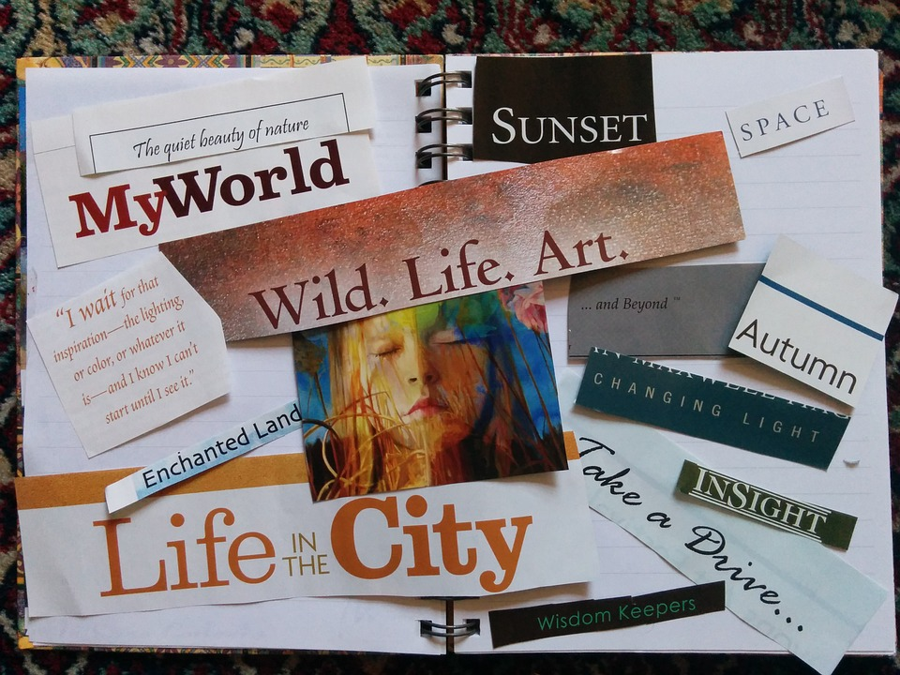
Share your Vision Board/Object
Share your board with a partner or small group.
Decide where you will put your board so it can motivate you every day!
Notes:
Students share their boards with their team or a partner.5.Students identify a place to display their boards where they will see them, use them, and be motivated by them on a regular basis.
Image: https://pixabay.com/id/photos/papan-visi-manifestasi-lembar-memo-520757/

Slide 8
Exit Ticket
Your exit ticket is your completed Vision Board or Vision Object.

Slide 9
References & Resources
Photos & Images
Slide 2 and unit thumbnails image licensed from iStock https://www.istockphoto.com/photo/young-boy-dressed-as-superhero-at-beach-during-sunset-gm510397386-86226803
Slide 3: https://pixabay.com/id/illustrations/akses-banyak-tangan-933142/
Slide 5: https://www.flickr.com/photos/ronsombilongallery/3240111905/in/photostream/ CC BY-ND 2.0
Slide 7: https://pixabay.com/id/photos/papan-visi-manifestasi-lembar-memo-520757/

