Slide 1
Do Now: Picture This
Think about what you want your life to be ten years from now. What does it look like? What does it sound like? Turn and share with a partner.

Slide 2

Learning with a Purpose
Day 6: My Future Self
Notes:
Image licensed from iStock https://www.istockphoto.com/photo/young-boy-dressed-as-superhero-at-beach-during-sunset-gm510397386-86226803

Slide 3
Our Agenda
Dedication
Life’s Blueprint Speech
Vocabulary Exercise
Visualization Boards
Exit Ticket

Slide 4

Student Dedication
Notes:
https://pixabay.com/id/illustrations/akses-banyak-tangan-933142/
Note: You can add the student’s picture to the slide

Slide 5
Lesson Objective
Students will gain an understanding of the importance of having a clear direction and a Life’s Blueprint (Vision) for their future.
Notes:
Explain to students that during the next two days, they will build out a Life’s Blueprint (vision) for their future selves.

Slide 6
Words to Know
Dignity
Crucial
Endeavor
Justice
Visualization
Blueprint
Notes:
Distribute the student activity sheet “Your Life’s Blueprint Vocabulary Exploration.” Introduce new vocabulary words (slide 5) by asking the students whether they know what each word means or what they think it might mean. (If you choose to use the longer version of the video, Dr. King explains what a blueprint is and how it is used.) Have students copy the words in the first column.

Slide 7
Dignity – value; worth; self-respect
Crucial – very important; essential; key
Endeavor – an undertaking; something you put effort into
Justice – fairness; what is right for everyone
Visualization –a picture you create in your mind to help you imagine what something looks like
Blueprint – a technical drawing of how a building will be built
Notes:
After students have offered their suggestions, review accurate definitions of the words (slide 6). Use each word in a sample sentence that showcases its meaning. Students take notes in center column. b. Have students discuss words with a partner by restating or explaining each one in their own words, or by using words in original sentences. c. Explain to the students they are going to encounter these words in Dr. King’s speech, so they should look or listen for how these words are used in the context of the speech and note this on the Vocabulary Exploration sheet (right hand column).

Slide 8
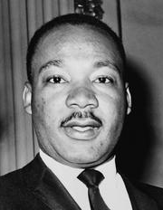


“Life’s Blueprint”
(speech by Dr. Martin Luther King, Jr.)
Watch one of the following videos:
https://www.youtube.com/watch?v=aDaGhmaWmo4 (7:43 min.) or https://www.youtube.com/watch?v=852_SQ1EK98 (3:33 min.)
or
Read the speech using the handout provided.
Notes:
Explain to students that Dr. Martin Luther King Jr. gave his “Life’s Blueprint” speech to a group of Philadelphia junior high students about their age.
After reading or watching the speech, further discuss the use of the word blueprint as a metaphor. (This metaphor represents having a life goal and developing a clear plan for reaching that goal.) Have students work with their partners to identify the three things that Dr. King shares that should be part of their life’s blueprint, and record these on their activity sheets.
Have paper copies of the speech available if preferred.
Image: https://snappygoat.com/s/?q=martin+luther+king+jr#b5cde5da494cc916858783164fc880e0a193834d,0,1.

Slide 9
What 3 things should be part of your Life’s Blueprint?
1.
2.
3.
Belief in your own “somebodiness”
Determination to achieve excellence
Commitment to principles of beauty, truth, and justice
Notes:
Ask students to list the three things a life’s blueprint should include. As they share, click through the slide to confirm answers.

Slide 10
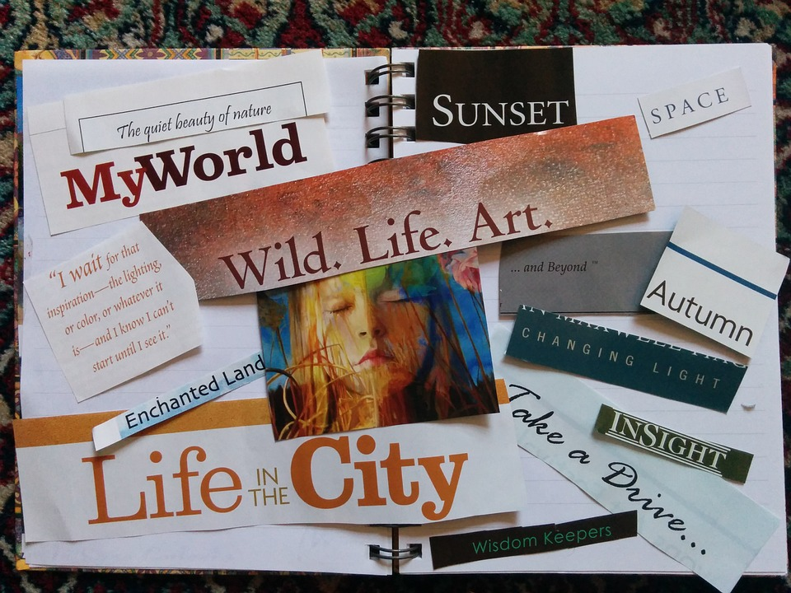
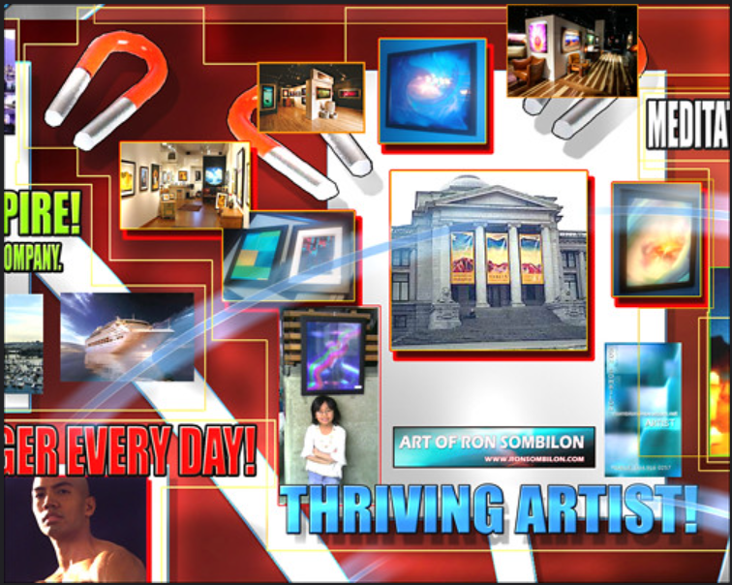
Designing Your Own Life’s Blueprint:
Sample Vision Boards
Notes:
To introduce the concept of students creating or designing theirown “Life’s Blueprints” by constructing visualization boards orproducts that represent how they see their future selves, havestudents explore examples of vision boards. (Two examples areprovided on slide 10. To find more examples, enter the term“middle school vision boards” in a search engine.) If you createdyour own Vision Board as an example, you can share it now.
Add more slides as necessary to accommodate examples that you want to share with students.
Images: https://pixabay.com/id/photos/papan-visi-manifestasi-lembar-memo-520757/
https://www.flickr.com/photos/ronsombilongallery/3240111905/in/photostream/ CC BY-ND 2.0

Slide 11

How to Create a
Vision Board
Watch one of these videos on how to create Vision Boards.
o How to Create a Vision Board
  https://www.youtube.com/watch?v=wjy_nT0yT18
o How to Create a Digital Vision Board
  https://www.youtube.com/watch?v=kTYE3ZvXfXU
Or read this blog for practical ideas on creating your Vision Board: https://www.lifehack.org/articles/productivity/8-ideas-create-your-own-vision-board.html
Notes:
Show one of the following videos, or another of your choosing (slide11). If students have Internet access on their devices, you can givethem the choice (depending on whether they prefer to create their vision boards manually or electronically).

Slide 12
Exit Ticket
Your exit ticket is your completed Vocabulary Exploration and Vision Board Idea Activity Sheet.
If you want to use an electronic device (e.g., cell phone or tablet) to create your Vision Board, bring it to class tomorrow.
If you want to include personal photos, be sure to bring them too.
Notes:
The exit ticket is students’ completed Vocabulary Exploration and Idea ActivitySheet. Remind those who plan to create digital Vision Boards on personal devices(e.g. cell phones) to bring these devices to class tomorrow. Students may wish tobring personal photos to include on their vision boards.

Slide 13

References & Resources
Photos & Images
Slide 2 and unit thumbnails image licensed from iStock https://www.istockphoto.com/photo/young-boy-dressed-as-superhero-at-beach-during-sunset-gm510397386-86226803
Slide 3: https://pixabay.com/id/illustrations/akses-banyak-tangan-933142/
Slide 7: https://snappygoat.com/s/?q=martin+luther+king+jr#b5cde5da494cc916858783164fc880e0a193834d,0,1 ; https://www.youtube.com/watch?v=aDaGhmaWmo4 ; https://www.youtube.com/watch?v=852_SQ1EK98; https://voiceofoc.org/wp-content/uploads/2017/01/MLK-Lifes-Blueprint.pdf
Slide 9: https://pixabay.com/id/photos/papan-visi-manifestasi-lembar-memo-520757/
https://www.flickr.com/photos/ronsombilongallery/3240111905/in/photostream/ CC BY-ND 2.0
Slide 10: https://pxhere.com/en/photo/1434695 https://www.youtube.com/watch?v=wjy_nT0yT18
https://www.youtube.com/watch?v=kTYE3ZvXfXU
https://www.lifehack.org/articles/productivity/8-ideas-create-your-own-vision-board.htm

