Slide 1
Do Now: Lifestyle Impacts of Career Choices
With a partner, brainstorm ways people’s career choices affect their lifestyle outside of work.
Jot down at least three examples of positive or negative impacts that different careers could have.
family
location
leisure
job security
travel
retirement
health

Slide 2


Learning with a Purpose
Day 5: Career Exploration II
Notes:
Image licensed from iStock https://www.istockphoto.com/photo/young-boy-dressed-as-superhero-at-beach-during-sunset-gm510397386-86226803

Slide 3

Student Dedication
Notes:
https://pixabay.com/id/illustrations/akses-banyak-tangan-933142/
Note: You can add the student’s picture to the slide

Slide 4
Do Now: Lifestyle Impacts of Career Choices
Give examples of some impacts you identified.
family
location
leisure
job security
travel
retirement
health

Slide 5












Career Choice Lifestyle Trade-offs
Less money
income
Lots of money
Lots of free time
time
Very little free time
Rural
location
Urban
No travel
travel
Lots of travel
Very safe
safety
Very risky
Very steady
job security
Very uncertain
Brief training
required training
Lots of education
Notes:
After students have offered suggestions, show slide 5, “Career Choice Lifestyle Trade-offs,” and ask students to comment on the graphic.
You do not need to discuss each area in depth, but be sure to make the following points.
The graphic does not represent “either/or” choices, but sliding scales—for example, income can fall anywhere in between “little money” and “lots of money.”
Most of these variables are not “good” or “bad,” but represent choices where individual preferences will vary. Some people would rather live and work in a big city while others prefer the country; for some people, lots of travel is exciting, while others are happy to just stay home.
There are some real trade-offs, where an advantage in one category may mean a sacrifice in another. For example, people with very well-paid jobs often work many more hours each week, so they may have less time for their families or leisure pursuits; however, those whose jobs entail fewer responsibilities are often not well-paid, so they have less money for basic necessities as well as “extras” like travel, vacations, or luxury items.
https://pixy.org/4371546/
https://gallery.yopriceville.com/Free-Clipart-Pictures/Summer-Vacation-PNG/Summer_Hammock_Clip_Art_PNG_Image#.YF4wtK9Kg2w
https://pixabay.com/id/vectors/search/stopwatch/
https://pixabay.com/id/illustrations/search/summer%20house/
https://pixabay.com/id/vectors/kota-bangunan-pencakar-langit-48851/
https://snappygoat.com/free-public-domain-images-nurse_woman_person_nursing/WwFDPzRvYn0nQMSqAxZ4VP_g921D42DZ5cLoz3L5-Lc.html#,0,0.0c536854a768f6fc0b373d71f1899d0eeb8fc45f
http://clipart-library.com/clipart/223346.htm
https://commons.wikimedia.org/wiki/File:Black_Man_Working_at_his_Desk_Cartoon_Vector.svg
https://pixabay.com/id/vectors/pesawat-terbang-pesawat-jumbo-303639/
https://pixabay.com/id/vectors/kursi-mebel-2022418/
https://pixy.org/5779445/

Slide 6
Career Exploration II: Concept Map
1. Exploring Career Choices (https://www.bls.gov/ooh/)
What do people do in this career?
What are some benefits and tradeoffs of this career?
How can I prepare for this career?
2. Exploring Education & Training Opportunities
What colleges and institutions in my area offer training in this field?
What can I do now to prepare to pursue this career interest?
Notes:
Display the concept map for the lesson (slide 6). Tell students that during this lesson, they will use the internet to learn more about the career choices they identified in the previous lesson. Also, they will have an opportunity to learn more about some local colleges or institutions that offer postsecondary degrees or professional training that could prepare them for the careers they are investigating.

Slide 7

Career Choice Lifestyle Trade-offs
Very steady
job security
Very uncertain
Notes:
Show slide 8, “Useful Terms to Know.” Ask students what they think “job security” means. Show the definition and explain to students in your own words. Ask students to give examples of jobs they think might offer high job security. (For example, nurses and health care workers are in demand all over the country. If a nurse moves to a new location, he or she can usually find a new job fairly quickly.) Ask students to name jobs that might offer less job security. (People in the entertainment field are usually on short contracts. It can take a long time to get a job, and when it is over, they must find another one. As another example, professional athletes are at constant risk of career-ending injuries.)

Slide 8
Useful
Terms to
Know
job security:
how easy it is to get and keep a job in a specific field
job outlook:
a forecast of how much demand will increase or decrease for workers in a particular job
Notes:
Then click to show the definition of “job outlook.” Explain to students that changes in society and technology mean that some jobs become more important, while others decline. For example, there were no careers in web design before the internet became widespread! On the other hand, as more and more robots are used in manufacturing plants, the need for human workers in those plants is declining. Ask students to suggest other examples of jobs that are increasing or declining.

Slide 9
Career Choice Lifestyle Trade-offs
Very steady
job security
Very uncertain
Brief training
required training
Lots of education
On-the-job training
Apprenticeships, certifications
Associate’s degree (2-year college)
Bachelor’s degree (4-year college)
Master’s degree (~ 2 years beyond college)
PhD, MD, JD etc.: 3-5 years beyond college
Notes:
Finally (slide 9), remind students of the need to plan ahead, keeping in mind the preparation required for various careers. Doctors and lawyers, for example, invest in at least three to five years of professional training beyond a four-year college degree.

Slide 10

Learning More About the Careers You Selected
Search for “Occupations Outlook Handbook”
(or look up www.bls.gov/ooh/).
Notes:
Distribute the “Career Profile Notes” sheet (at least three per student; tell students that if they complete three profiles and need more, you can supply them). Have students take out their Career Investigation Planners from the previous lesson. 7. Display slide 10, “Learning More About the Careers You Selected” (Note: If you prefer, project your computer screen and walk students through the process of exploring a career, as follows, using the actual Occupational Outlook Handbook website. The screenshot slides are provided in case you are unable, or prefer not, to project the website from your computer.)

Slide 11
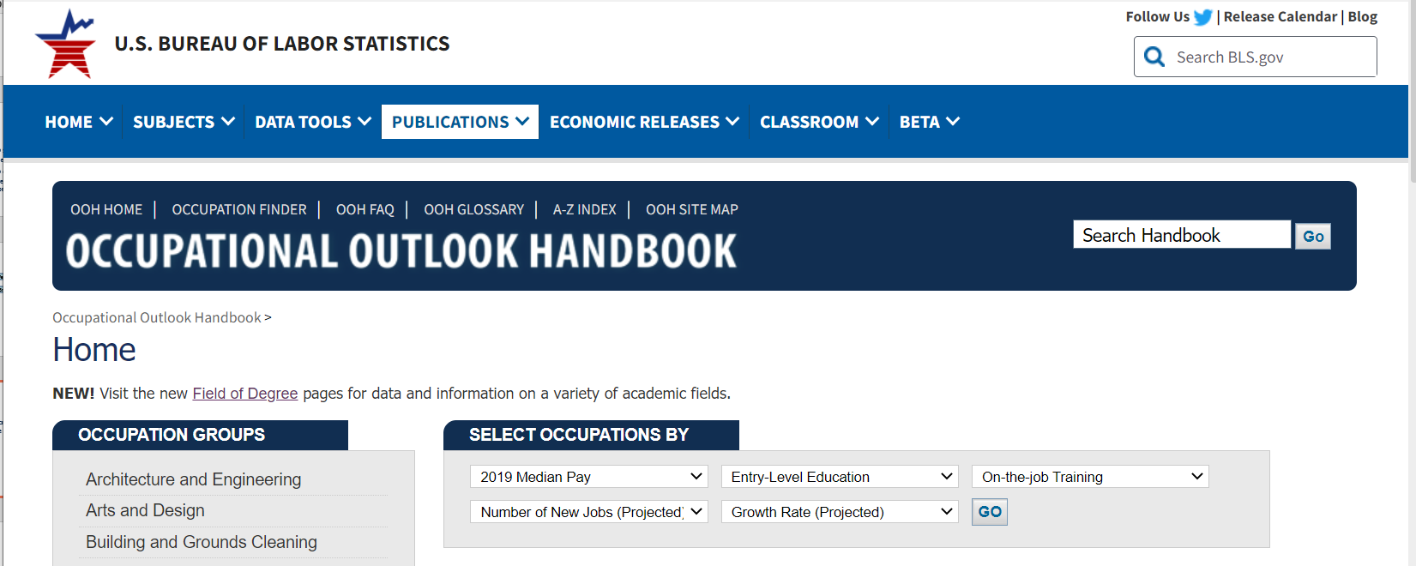

Career Profiles: www.bls.gov/ooh/
1. In the search bar, type the name of one career that you identified in the last lesson and click “Go.”
Notes:
Have students open the OOH website on their devices (slide 11). 8. Direct students to enter the name of one selected career (from their Career Investigation Planner) in the search bar (upper right of the website), and click “Go.” Before moving on, make sure all students have done so successfully. (Note: the exact job title entered may not come up, but a list will show similar titles; students should choose one of these. Make sure students are spelling the job titles correctly.)

Slide 12
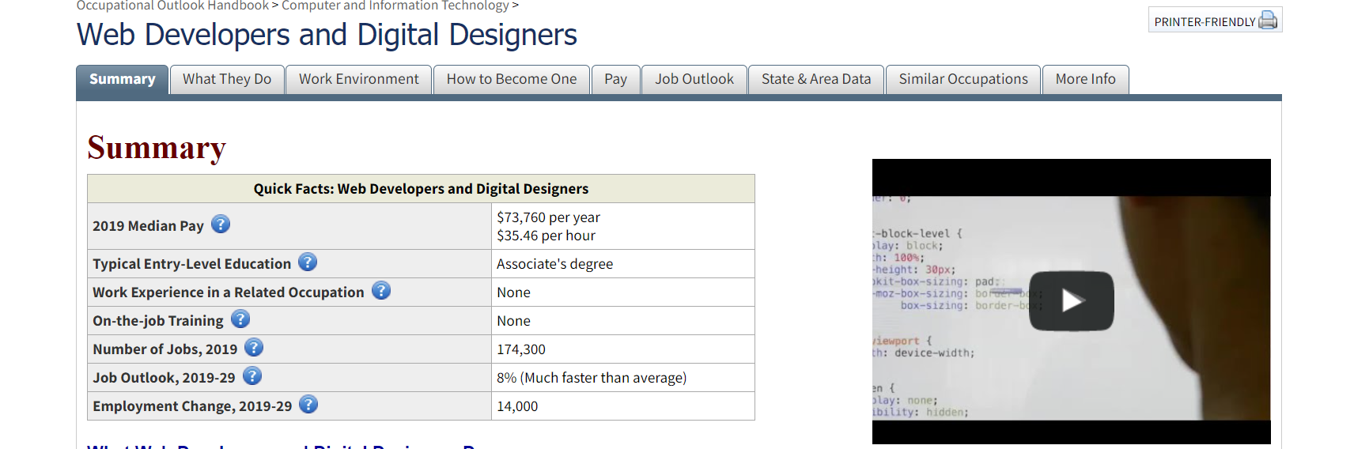
Career Profiles: www.bls.gov/ooh/
1. Search for one of the careers that you identified in the last lesson and click “Go.”
2. Check out the Summary. Start to take notes!
Notes:
Guide students to review the “Summary” section that comes up when they entered a job title (slide 12). Ask them: • What information does the summary provide? • Does the summary use any terms that are unfamiliar? Point out the small blue circles with question marks beside each term. Clicking on these circles will open a pop-up window with an explanation of the term. For example, “median pay” is like an average—it means that half of people in that occupation earn more than this number, and half earn less. Give students time to take notes on the information provided in the summary about the career they are investigating

Slide 13
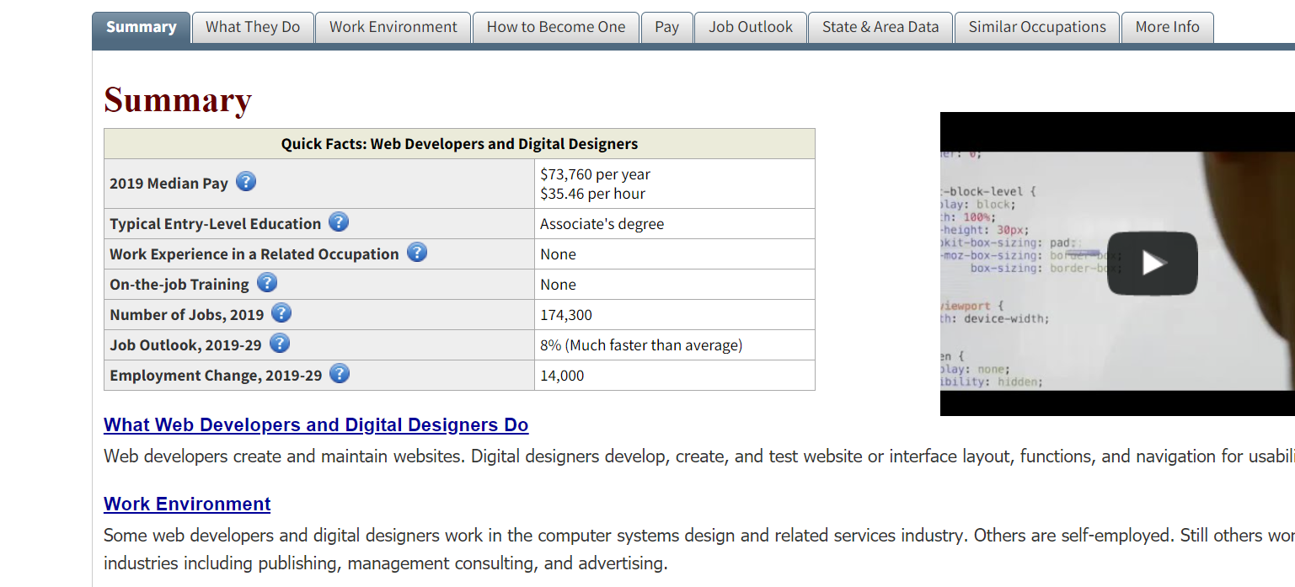
Career Profiles: www.bls.gov/ooh/
1. Search for one of the careers that you identified in the last lesson and click “Go.”
2. Check out the Summary. Start to take notes!
3. Click on the links to dig into the details (or open the Tabs).
Notes:
Ask students to comment on the topics listed below the summary (and in the tabs, slide 13). Why would these topics be important for someone to consider when choosing a career? • Tell students they can explore all of the tab topics or only a few; however, they should make sure to open enough topics to fill in all of the spaces in the Career Profile Notes page. • Advise students that when they are satisfied with the information they have collected on their first selected career, they should take a second Career Profile Notes sheet and repeat the process with a different career (slide 14). In all, they should complete at least three Notes sheets; they may do more if they have time.

Slide 14
Career Profiles: www.bls.gov/ooh/
1. Search for one of the careers that you identified in the last lesson and click “Go.”
2. Check out the Summary. Start to take notes!
3. Scroll down to dig into the details (or open the Tabs). Take more notes!
4. Repeat the same process to explore a different career, using a new Career Profile Notes sheet. Explore at least three careers.
(Hint: If one of your chosen careers doesn’t have a very good Job Outlook—or if there’s just one aspect of it that you don’t like—check out some related careers under “Similar Occupations.”)
Notes:
Point out that the section “Similar Occupations” lists related careers that may be of interest, especially if some of the things they learn about the careers they previously identified sound less than appealing. For example, the job “Assemblers and Fabricators” (= factory workers) has a declining Job Outlook. However, the similar occupation “Industrial Machinery Mechanics…” has a bright future, with projected 13% growth! A student who likes to work with his or her hands and does not want to sit in a classroom after high school might want to explore an Industrial Machinery Mechanic apprenticeship, as explained in “How to Become One.” 11. Give students time to explore the site on their devices. Circulate in the classroom to assist students as needed, to make sure students stay on task, and to provide additional Notes sheets to students who finish the first three.

Slide 15
Learning More About the Careers You Selected
What did you discover?
Notes:
Ask students to comment on what they learned about the careeroptions they identified based on their Holland codes (slide 15). Ask:•Who learned something interesting about the job outlook for one ofyour career options?•Who explored at least one other “similar occupation” to one of thecareer choices you listed yesterday?

Slide 16



Exploring Education and Training Opportunities
What you can learn from college websites:
Programs offered
How to apply
Financial aid
And lots more!!!
Notes:
Tell students (slide 16) they will now have an opportunity to explore afew of the college and training opportunities available locally. (Ofcourse, as students continue in high school they will want to exploremany other options! This is just a chance for them to begin to discoversome of the possibilities.)
https://pixabay.com/id/vectors/mouse-komputer-blogging-6072594/
https://pixabay.com/id/vectors/pendidikan-perguruan-tinggi-lembaga-295185/
https://pixabay.com/vectors/graduation-silhouette-boy-cap-1345123/

Slide 17
Exploring Education and Training Opportunities
Check out some nearby colleges
and training institutions!
Notes:
Then choose one of the following options (slide 17): Option A: If students have access to the Internet on individualdevices, provide a list of several (3-5) local colleges, universities,and/or training institutions of interest. Your list should include atleast one public 2-year college and one public 4-year college. We alsorecommend including a private 4-year college and a reputable localtrade school. Give students time to visit the websites of one or moreinstitutions. In particular, they should visit the list of programs ormajors (usually found in the “Academics” section of the website) and see whether the institution offers a program corresponding to the career interests that they have identified. They should also visit the “Admissions” section to learn more about the steps to apply and the support the institution provides applying students. Please note: • College websites vary in their presentation and structure. As a teacher, please explore the website of each institution listed in advance, so you can help students find the relevant information.
Students should have some freedom to explore. While the “Academics” and “Admissions” sections should be their main focus, they should be allowed to visit anything on the institutional website that interests them. For example, many students may want to find out what their options for financial aid would be. Encourage students to take notes on whatever they find useful and interesting (“My Postsecondary Education Notes” page). Circulate as students investigate to help students as necessary and make sure they are on task and taking notes. • Another area in many institutions that students may wish to explore is dual enrollment (the opportunity to enroll in classes and earn college credit while they are still in high school).

Slide 18

Pair and Share
Share with a partner:
What careers do you want to learn more about?
What are some questions you still have about colleges or training opportunities in your area?
Courtesy Allison Shelley/The Verbatim Agency for American Education: Images of Teachers and Students in Action
Notes:
Have students share with a partner one or two career, education, and/ or training opportunities they would like to explore further (slide 18). 17. Close by reminding students that their schoolwork now is what prepares them for the exciting future opportunities they’ve been exploring.

Slide 19
Exit Ticket
Your Career Profile Notes are your exit ticket.
Notes:
Exit ticket: students’ Career Profile Notes serve as an exit ticket (slide 19).

Slide 20
References & Resources
Photos & Images
Slide 2 and unit thumbnails image licensed from iStock https://www.istockphoto.com/photo/young-boy-dressed-as-superhero-at-beach-during-sunset-gm510397386-86226803
Slide 3: https://pixabay.com/id/illustrations/akses-banyak-tangan-933142/
Slide 5: https://pixy.org/4371546/
https://gallery.yopriceville.com/Free-Clipart-Pictures/Summer-Vacation-PNG/Summer_Hammock_Clip_Art_PNG_Image#.YF4wtK9Kg2w
https://pixabay.com/id/vectors/search/stopwatch/
https://pixabay.com/id/illustrations/search/summer%20house/
https://pixabay.com/id/vectors/kota-bangunan-pencakar-langit-48851/
https://snappygoat.com/free-public-domain-images-nurse_woman_person_nursing/WwFDPzRvYn0nQMSqAxZ4VP_g921D42DZ5cLoz3L5-Lc.html#,0,0.0c536854a768f6fc0b373d71f1899d0eeb8fc45f
http://clipart-library.com/clipart/223346.htm
https://commons.wikimedia.org/wiki/File:Black_Man_Working_at_his_Desk_Cartoon_Vector.svg
https://pixabay.com/id/vectors/pesawat-terbang-pesawat-jumbo-303639/
https://pixabay.com/id/vectors/kursi-mebel-2022418/
https://pixy.org/5779445/
Slides 11-13: www.bls.gov/ooh/
Slides 16-17: https://pixabay.com/id/vectors/mouse-komputer-blogging-6072594/
https://pixabay.com/id/vectors/pendidikan-perguruan-tinggi-lembaga-295185/
https://pixabay.com/vectors/graduation-silhouette-boy-cap-1345123/
Slide 18: Courtesy Allison Shelley/The Verbatim Agency for American Education: Images of Teachers and Students in Action

