Slide 1

Do Now: Career Party
Look at the Career Party handout.
Choose the groups that you would like to hang out with!
Write the word for each group in the appropriate box.
(Choose words from the Key at the bottom of the page.)
Notes:
Have Career Party handout ready for students to pick up for this Do Now activity,
https://pixabay.com/id/illustrations/balon-tali-confetti-ulang-tahun-5293367/

Slide 2

Learning with a Purpose
Day 4: Career Exploration I
Notes:
Image licensed from iStock https://www.istockphoto.com/photo/young-boy-dressed-as-superhero-at-beach-during-sunset-gm510397386-86226803

Slide 3

Student Dedication
Notes:
https://pixabay.com/id/illustrations/akses-banyak-tangan-933142/
Note: You can add the student’s picture to the slide

Slide 4
Do Now: Career Party
What were your top two groups?
Why did you choose those groups?
What about them sounded interesting to you?
Notes:
Ask students to indicate by a show of hands how many of them selected Group 1
as their first choice. Then, ask those who selected Group 1 as a second choice to
raise their hands. Ask students to comment on why they chose Group 1 and what
they found attractive about its description. Do the same for the other five groups,
giving all students an opportunity to comment on their choices.

Slide 5
What does the term CAREER mean to you?
What is the difference between a CAREER and a JOB?

Slide 6
A Useful
Term to
Know
career:
An occupation (type of work) for which a person plans and trains
What are some examples of careers?

Slide 7
Why is the choice of a career important for having a fulfilling and satisfying life?
How do the decisions you make in middle and
high school affect the options you
will have for your career?

Slide 8
Career Exploration I: Concept Map
1. Exploring the Holland Codes
What do I like/ dislike doing?
What am I interested in?
What career types match my personality?
3.
My Choices:
Identifying careers that I am interested in
2. Which Careers Match My Codes?
onetonline.org
Notes:
Tell students that during this
lesson, they will identify some careers that they might want to explore, based
on their interests and personal preferences.
Activity 1: Exploring the Holland Codes

Slide 9
All About Me Questionnaire
What kind of jobs would best fit your personality and abilities?
Would you rather work with numbers or work with people?
Work with your hands or work with ideas?
Learn more about yourself by completing this questionnaire.
Notes:
Explain to students that the “Do Now” was a fun introduction to the
different career categories in the Holland framework. They will now
use a more detailed questionnaire that will help them gain further
insight into their personal Holland profile.

Slide 10
Useful
Terms to
Know
Holland career codes:
a way of categorizing career choices based on the personality types of people who enjoy those careers
investigative:
related to finding things out and trying to understand them
enterprising:
interested in starting new things or leading people in new directions

Slide 11
The Holland Career Hexagon
Investigative
The Thinkers
Realistic
Artistic
The Doers
The Creators
The Helpers
The Organizers
Social
Conventional
The Persuaders
Enterprising
Notes:
After students complete the questionnaire, have them identify their top two categories (the categories for which they checked off the
greatest number of statements). Have them place their questionnaires and their Do Now handouts on their desks. Tell them
that they are now going to learn more about the six Holland codes
Click to display the first Holland code category, “Realistic.” Ask students to summarize the discussion of this category from the Do Now. Ask students
• What are some jobs or careers that would appeal to those who rated high on the “Realistic” scale? • Why do you think this group of careers is called “Realistic”?
Continue with each of the other five categories in the same way. The
naming of the categories can be explained as follows:
• Investigative—these jobs involve investigating, exploring, and
analyzing to try to understand ideas and situations.
• Artistic—these careers focus on creative expression in various
media (writing, dance, and theater as well as the plastic arts).
• Social—“social” relates to society or groups of people. This career
group is for those who want to help others or work with people.
• Enterprising—these people want to start new things or lead
people in new directions. This word is related to “entrepreneur,” a
person who starts a new business.
• Conventional—“conventions” are accepted practices that keep
things going. This career group is for detail-oriented people who
are orderly and precise.

Slide 12

Share with a partner your two top Holland codes and how you think they fit your personality and interests.

Slide 13
Finding Careers
That Match Your Profile
Look up “ONET Online Interests Search.”
ONET

Slide 14
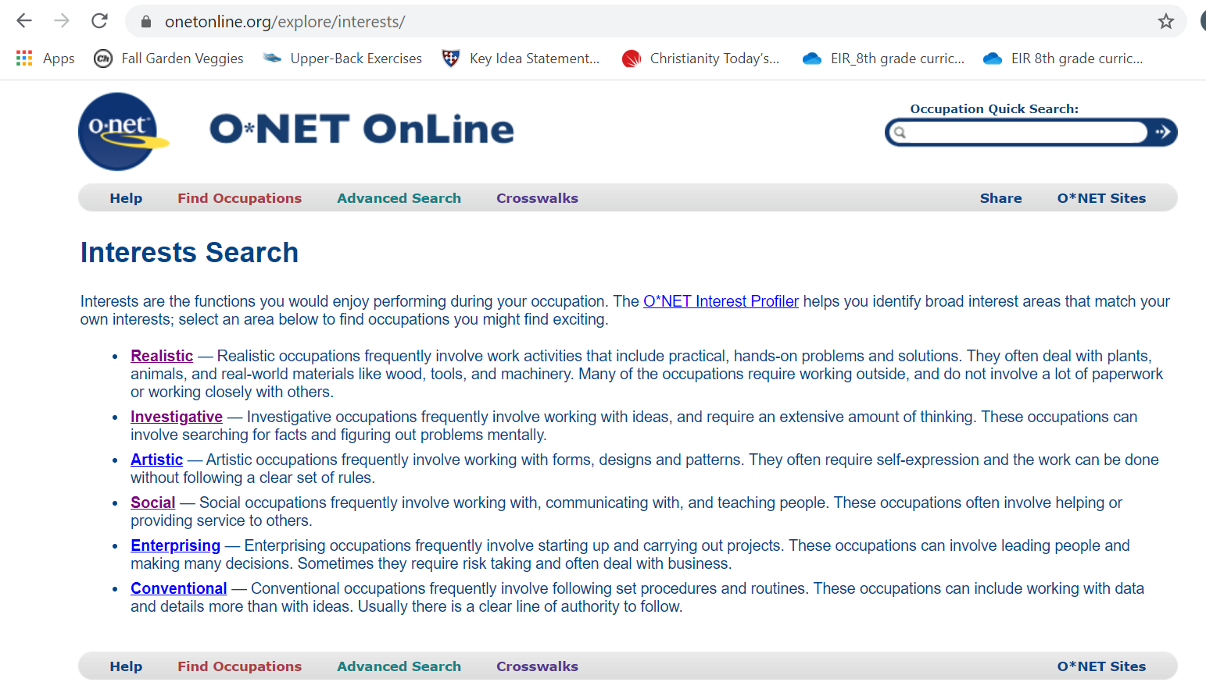
Click on your top code!
Notes:
Teachers choose EITHER slides 9-12 OR slides 13-14 to help students identify careers matching their Holland code categories.
Have students click on the name of their top Holland code in the
list shown. This should bring up a screen like the one on slide 11.
• Students then select their second-choice code from the dropdown
menu, as shown, and click “Go.” This brings up a list of career
options (as in slide 12).
• If the list generated is too long, students can try adding their third
code (click to show pointer); if the list is too short, they can try
switching the order of the codes, or entering their third-choice code
in place of the second. Encourage students to play with the site
until they see some career options that they find interesting.

Slide 15
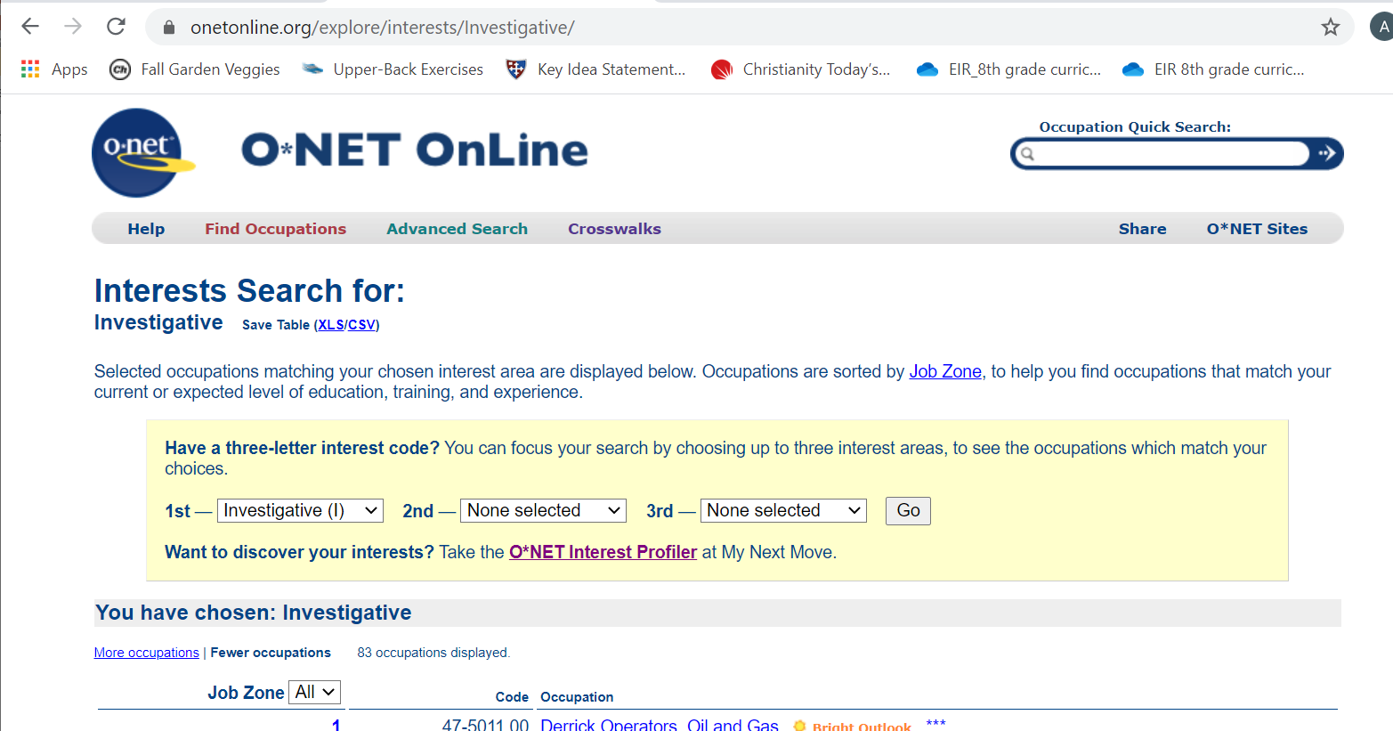
Choose your second code from dropdown menu.
Then click “Go”.

Slide 16
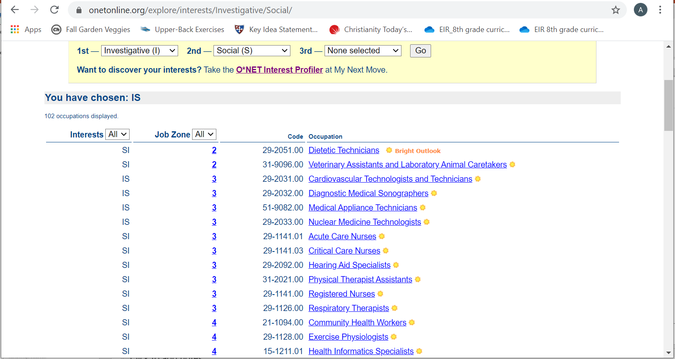
Too many choices? Add a 3rd Holland code and click Go again.
Not enough choices? Try switching your 1st and 2nd choice, or enter your 3rd choice in place of your 2nd.

Slide 17
You can click on a job title to bring up a description of what people do in that career.

Slide 18
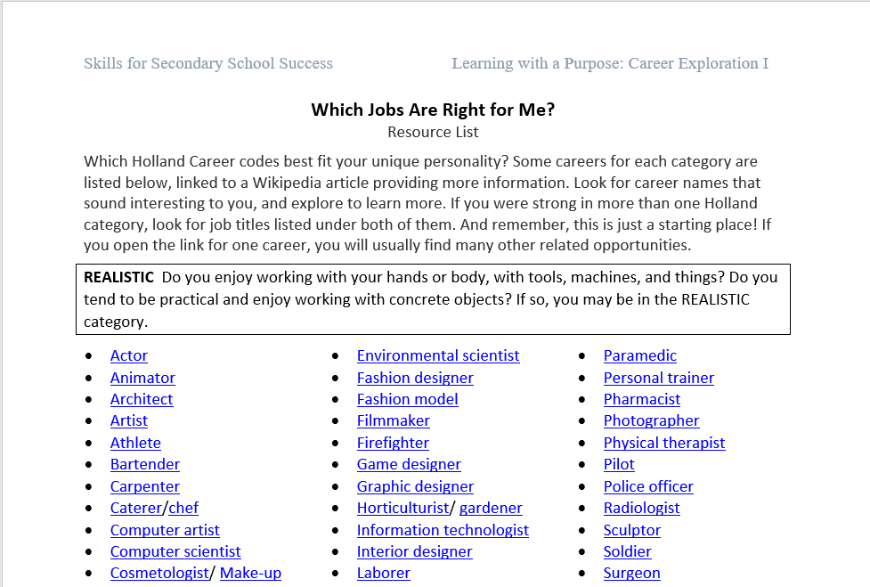
Notes:
Again: slides 13-14 are an ALTERNATIVE to slides 9-12. If students have looked up careers using the ONET website, slides 13-14 should not be used.

Slide 19
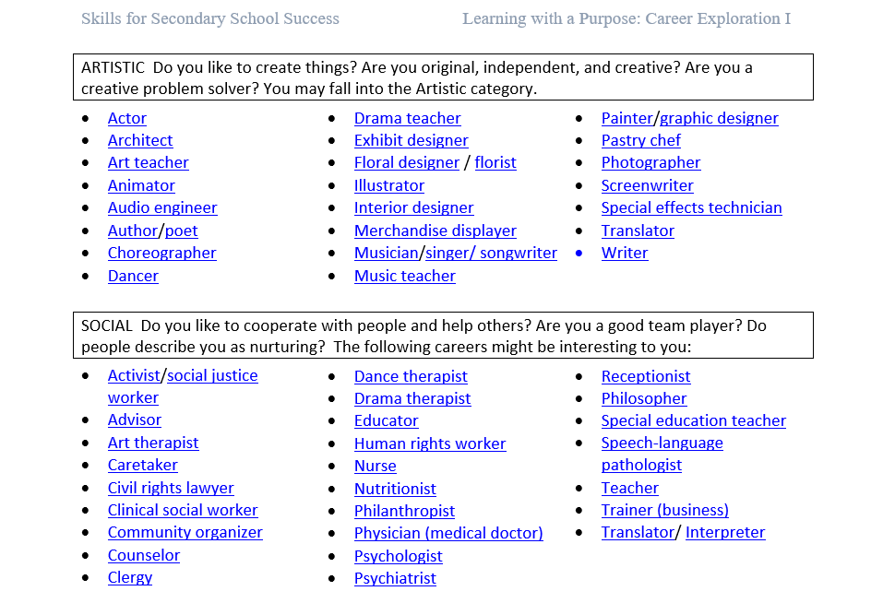
Draw a frame around the lists for your top two Holland code categories

Slide 20





List at least three (and up to five) careers that you want to learn more about.
________________________
________________________
________________________
________________________
________________________
Notes:
https://pixy.org/101375/
https://pixabay.com/vectors/search/heavy%20machinery/
https://openclipart.org/detail/281773/microscope
https://pixabay.com/illustrations/lawyer-judge-african-cartoon-man-3819044/
https://openclipart.org/detail/322170/woman-in-scrubs-2

Slide 21
Whole Class Discussion
What have you learned about yourself?
What careers have you learned about that you didn’t think about before?

Slide 22
Exit Ticket
Your Career Investigation Planner is your exit ticket.

Slide 23

References & Resources
Photos & Images
Slide 1: https://pixabay.com/id/illustrations/balon-tali-confetti-ulang-tahun-5293367/
Slide 2 and unit thumbnails image licensed from iStock https://www.istockphoto.com/photo/young-boy-dressed-as-superhero-at-beach-during-sunset-gm510397386-86226803
Slide 3: https://pixabay.com/id/illustrations/akses-banyak-tangan-933142/
Slides 9-13: https://www.onetonline.org/explore/interests
Slide 16: https://pixy.org/101375/
https://pixabay.com/vectors/search/heavy%20machinery/
https://openclipart.org/detail/281773/microscope
https://pixabay.com/illustrations/lawyer-judge-african-cartoon-man-3819044/
https://openclipart.org/detail/322170/woman-in-scrubs-2

