Slide 1
Do Now:
Look over the examples of Who I am poems, raps, and spoken word, and begin thinking of ways you can express yourself creatively.
https://steemit.com/poetry/@pressemman/eagle-s-poem-i-am-an-eagle-a1454683dce57
https://examples.yourdictionary.com/examples-of-i-am-poems.html
Notes:
SCRIPT: In the spirit of expressing our identities Creatively, we will use creative expressions in a poem, rap, or spoken word to share our personality, values, talents, skills, interests, and/or goals. Begin with the examples (provided in hard copy or on the board). Use the provided links as sources.
You may consider printing the poems listed on slides# 8-10 to have them available for students as exemplars when students are writing their own.

Slide 2

Learning with a Purpose
Day 3: Expressing Myself
Notes:
Image licensed from iStock https://www.istockphoto.com/photo/young-boy-dressed-as-superhero-at-beach-during-sunset-gm510397386-86226803
SCRIPT: The activities in this lesson are preparing us for career explorations while highlighting the role of the school and the community in solidifying one’s life mission and work.

Slide 3

Student Dedication
Notes:
https://pixabay.com/id/illustrations/akses-banyak-tangan-933142/
Note: You can add the student’s picture to the slide
SCRIPT: Let's give a warm welcome to (student's name) who will be presenting the lesson dedication

Slide 4
Our Agenda
Dedication
Overview of Essential Question
Exploring Self-Portrait Poetry
Writing My Self-Portrait Poem
Sharing Our Poems (voluntary)
Whole Group Conclusion
Notes:
SCRIPT: Our agenda includes, the lesson dedication which we had the pleasure to hear, followed by the overview of Essential Question, we explore Self-Portrait Poetry, then writing My Self-Portrait Poem, asking for volunteers to share their creative work , and participating in Whole Group Conclusion.

Slide 5
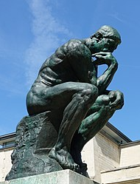
Who am I? What is my purpose?
One of the most important things human beings do
is to think about –
or contemplate –
    their existence
    their being
    who they are.
We are all philosophers.
Notes:
SCRIPT: Who Am I? And What is my purpose are the questions we will be reflecting upon and thinking with all the possibilities at our reach.
Photo Wikipedia https://en.wikipedia.org/wiki/The_Thinker#/media/File:Mus%C3%A9e_Rodin_1.jpg

Slide 6
"Be yourself; everyone else is already taken"
Oscar Wilde
Notes:
SCRIPT: You are awesome and wonderful....that's how you were divinely made....you are enough....just the way you are...

Slide 7
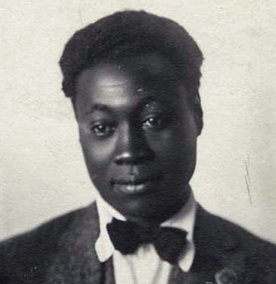
I Know My Soul
I plucked my soul out of its secret place,
And held it to the mirror of my eye,
To see it like a star against the sky,
A twitching body quivering in space,
A spark of passion shining on my face….
Claude McKay, Jamaican-born poet in Harlem, New York, 1922
Notes:
SCRIPT: What is the message the author is conveying? What/Whom is Claude McKay describing? (Remind students of this poem about knowing themselves)
Image courtesy of the Black Past Remembered (adapted; photographer unknown) https://www.flickr.com/photos/washington_area_spark/38344414184

Slide 8

Expressing
Myself
Creatively in
Poetry or
Spoken Word
Notes:
Creative commons Star https://pixabay.com/vectors/star-fractal-gold-shiny-metallic-2858923/

Slide 9
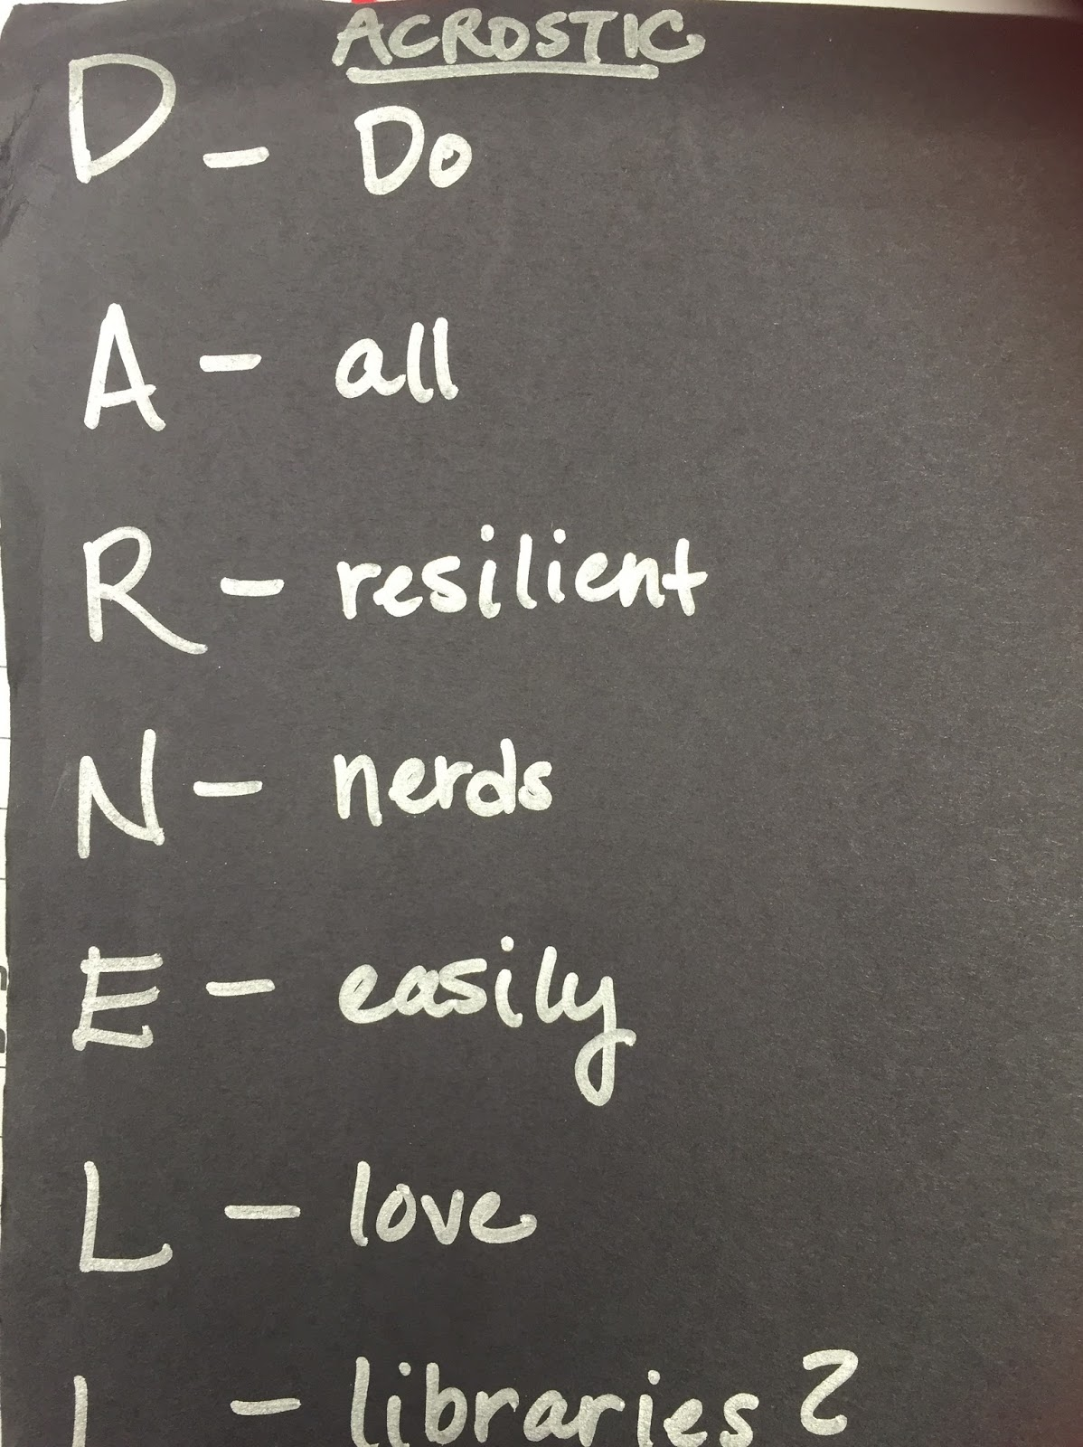
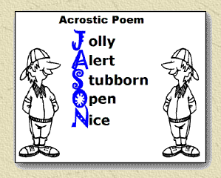
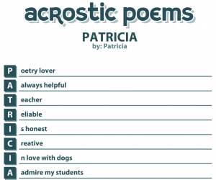
Self-Portrait Poetry:
An Acrostic Poem Using Your Name
Ways to share Who I am through poetry
This Photo by Unknown Author is licensed under CC BY
Notes:
SCRIPT: These are examples of Self-Portrait poem, rap, or spoken word. In the “Do Now” we saw some other examples as well as those presented on slides 9-11. How are the poems similar to, and different from, one
Another? Kindly enter your thoughts on …..............
https://www.awakenlibrarian.com/2016_08_28_archive.html
https://obwe.weebly.com/acrostic-poems.html
https://pchujman.cumbresblogs.com/2013/04/21/project-work/
Please note, PPT “insert online pictures” says these are CC licensed but I have not been able to verify that.

Slide 10
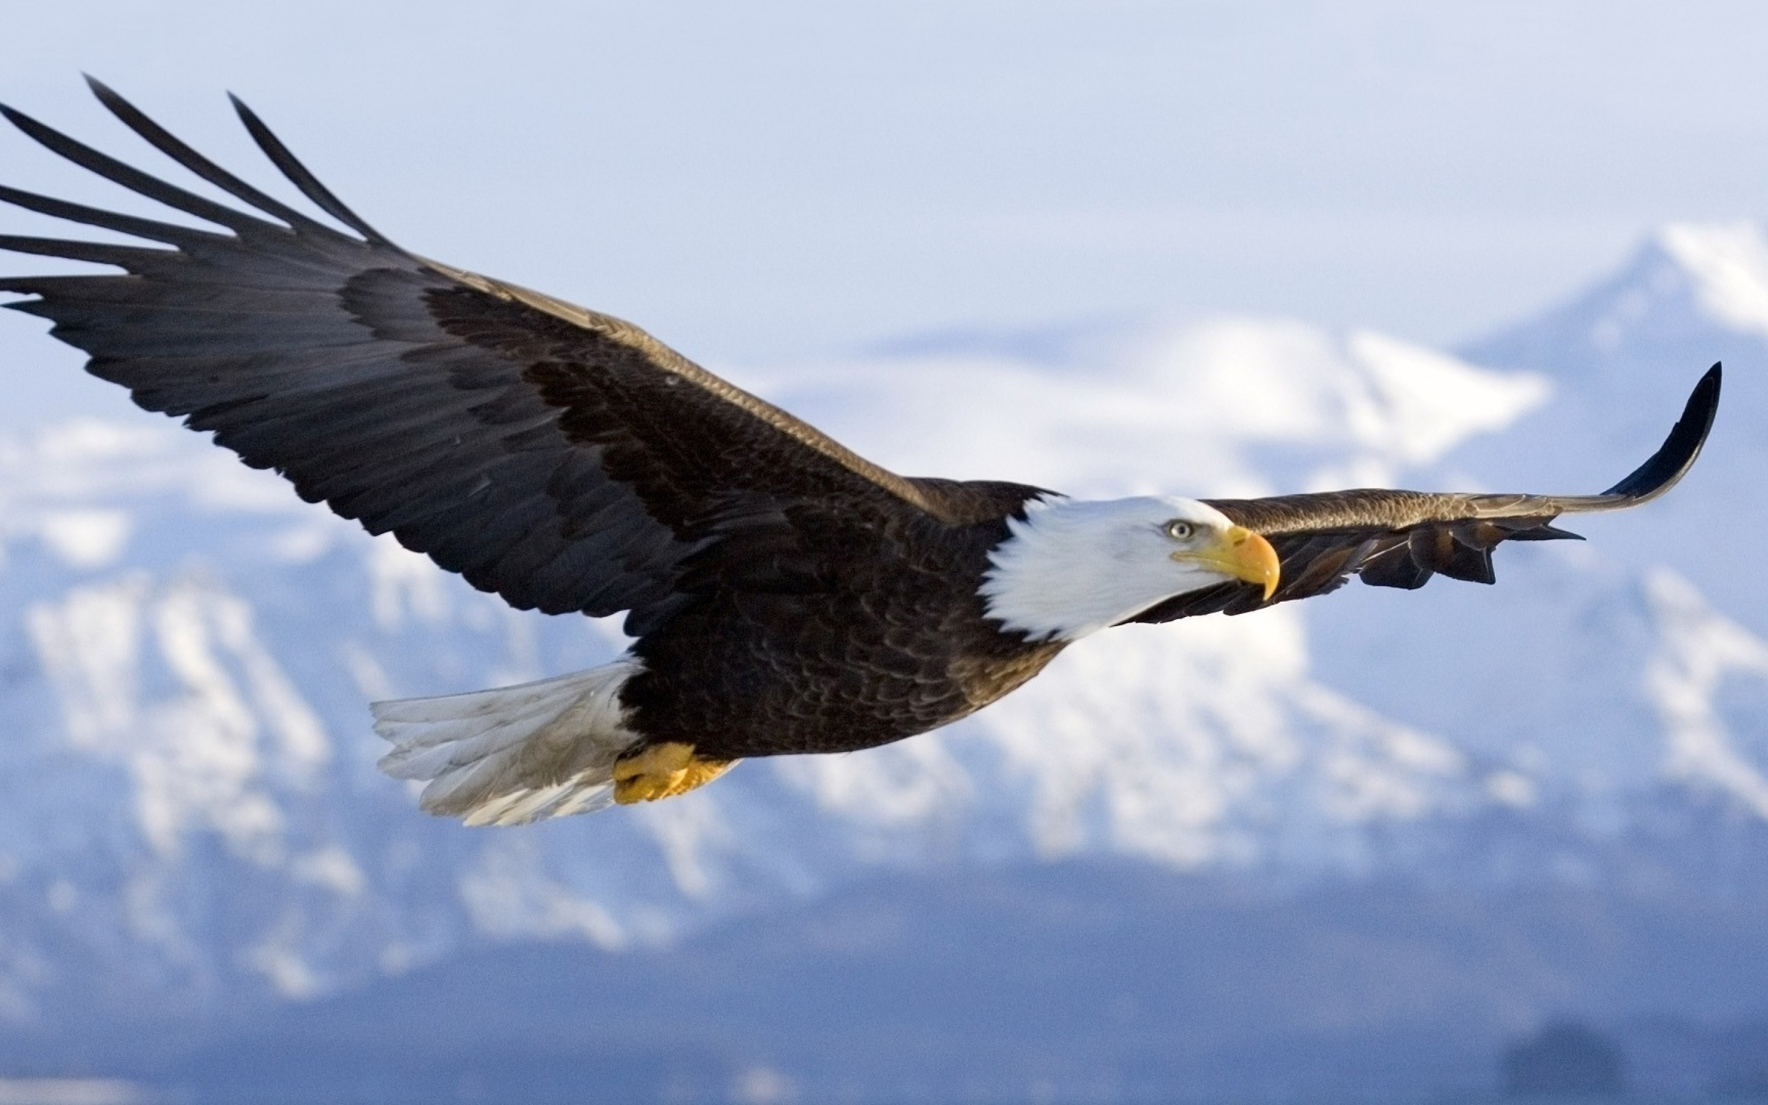

Imagine Yourself as an Animal
“I Am an Eagle”
https://steemit.com/poetry/@pressemman/eagle-s-poem-i-am-an-eagle-a1454683dce57
Notes:
https://wallpapercave.com/free-bald-eagle-wallpaper
SCRIPT: We may see ourselves, our essence in the strength and attributes of other creatures......

Slide 11
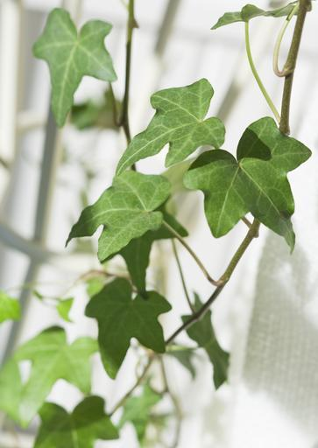
Describe Yourself as a Color
I am green
I am full of energy, full of life,
growing like the ivy up the side of my house.
I love hiking in the woods in spring and swimming in the lake.
I still have lots to learn, but I have always had a green thumb.
Plants just grow for me.
I love planting and caring for my garden,
tomatoes and squash and strawberries
and tulips and daffodils and iris in my flower bed.
Maybe I will run a greenhouse some day to earn my living
And spread the joy of growing things to others.
I want to put my roots down deep in this town with my friends and family
And keep on growing and learning myself
So that I can be a source of strength to others. Anonymous
Notes:
https://snappygoat.com/b/b02e3024dcfad0f0c9bd39130697cb1403fe26e8
SCRIPT: or perhaps we see ourselves in the vibrancy and warmth of a color?

Slide 12
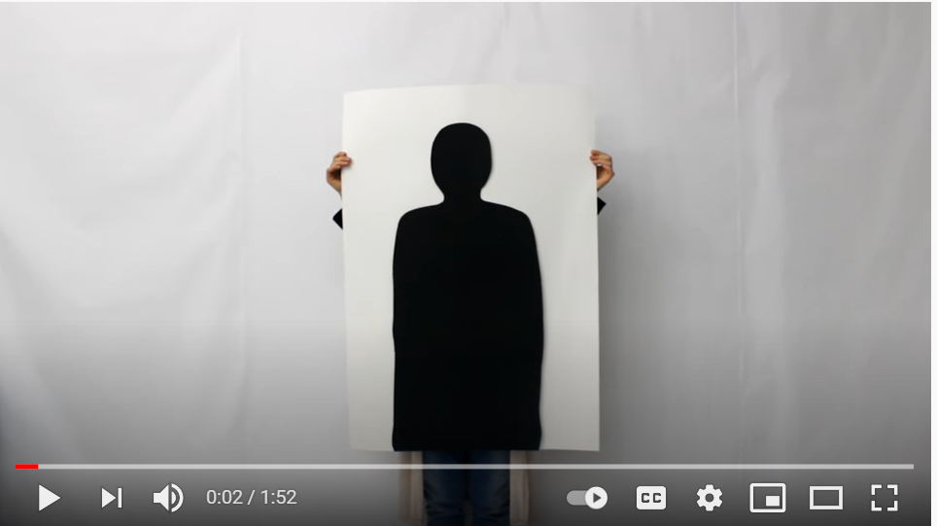

Write A Self-Portrait Rap or
Spoken Word Poem
I AM LIMITLESS
https://www.youtube.com/watch?v=f5CLnmN2QcQ
Notes:
SCRIPT: We will watch a short video clip and share our reactions.

Slide 13


NOW WRITE YOUR OWN
POEM/ RAP/ SPOKEN WORD
Notes:
SCRIPT: We will now have approximately 20-25 minutes for students to create their own poem/rap/spoken word. Ensure enough time for volunteers to share what they have created.
https://www.wannapik.com/vectors/3421
http://clipart-library.com/search2/?q=creative%20writing#gsc.tab=1&gsc.q=creative%20writing&gsc.page=1

Slide 14
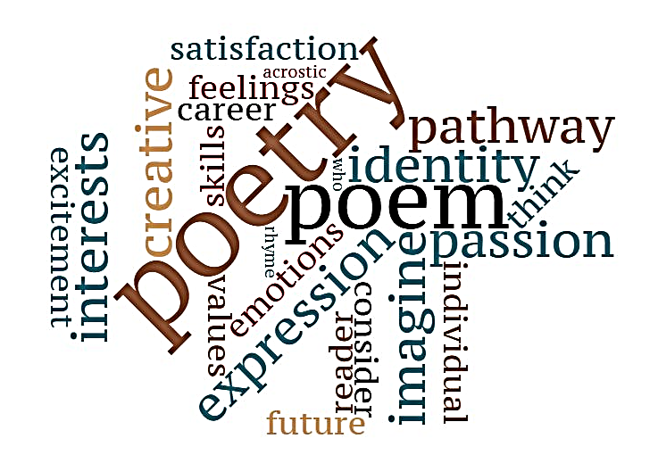
Sharing My Poem
Notes:
SCRIPT: Let's have students share in small groups or before the entire class, depending on time and preferences.
Affirm student creativity and tell students you will post all student work on walls.
Original word cloud

Slide 15

Preview of Coming Attractions…
What careers could fit
my talents, interests and strengths?
Notes:
SCRIPT: Next lesson we begin exploring possible
Careers matching our interests and personality.

Slide 16

References & Resources
Photos & Images
Slide 2 and unit thumbnails image licensed from iStock https://www.istockphoto.com/photo/young-boy-dressed-as-superhero-at-beach-during-sunset-gm510397386-86226803
Slide 3: https://pixabay.com/id/illustrations/akses-banyak-tangan-933142/
Slide 5: https://en.wikipedia.org/wiki/The_Thinker#/media/File:Mus%C3%A9e_Rodin_1.jpg
Slide 7: Image courtesy of the Black Past Remembered (adapted; photographer unknown) https://www.flickr.com/photos/washington_area_spark/38344414184 ; poem https://poets.org/poem/i-know-my-soul
Slide 8: https://pixabay.com/vectors/star-fractal-gold-shiny-metallic-2858923/
Slide 9: https://www.awakenlibrarian.com/2016_08_28_archive.html
https://obwe.weebly.com/acrostic-poems.html
https://pchujman.cumbresblogs.com/2013/04/21/project-work/
(CC-licensed according to PPT “insert online pictures”)
Slide 10: https://wallpapercave.com/free-bald-eagle-wallpaper ; https://steemit.com/poetry/@pressemman/eagle-s-poem-i-am-an-eagle-a1454683dce57
Slide 11: https://snappygoat.com/b/b02e3024dcfad0f0c9bd39130697cb1403fe26e8
Slide 12: https://www.youtube.com/watch?v=f5CLnmN2QcQS
Slide 13: https://www.wannapik.com/vectors/3421
http://clipart-library.com/search2/?q=creative%20writing#gsc.tab=1&gsc.q=creative%20writing&gsc.page=1

