Slide 1

Do Now:
Fill out the reflection sheet
“A Few Fast Facts About Me.”
Notes:
Photo https://www.flickr.com/photos/asiandevelopmentbank/8426494962

Slide 2

Lesson Dedication
Notes:
Explain that one of the daily class routines will be a lesson dedication. Teacher models a 30-60 dedication to someone important in their own life. Ask for volunteers for upcoming lessons (provide a signup sheet students can sign at end of class).
More on lesson dedication: https://www.edutopia.org/article/daily-ritual-builds-trust-and-community-among-students
Image: https://pixabay.com/id/illustrations/akses-banyak-tangan-933142/
Note: You can add your picture to the slide if you wish! (For future lessons you would add the student’s picture, if available.)

Slide 3

Learning with a Purpose
Day 2: You Are the Author of Your Life Story
Notes:
Image licensed from iStock https://www.istockphoto.com/photo/young-boy-dressed-as-superhero-at-beach-during-sunset-gm510397386-86226803

Slide 4
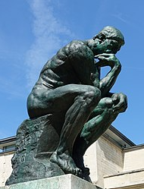
Who am I? What is my purpose?
One of the most important things human beings do
Is to think about –
or contemplate –
their existence
their being
who they are.
We are all philosophers.
Notes:
Explain that class will explore these questions – Who am I? What is my purpose? -- throughout the seven lessons in Unit 1.
Use text on slide to start discussion that will continue on following slides.
Photo Wikipedia https://en.wikipedia.org/wiki/The_Thinker#/media/File:Mus%C3%A9e_Rodin_1.jpg

Slide 5
“I am awesomely and wonderfully made.”
An ancient Hebrew poet (about 1000 BC)
Notes:
Ask for a volunteer to read this quotation. Ask for any reactions to the quotation from the class – How does this statement make them feel?

Slide 6
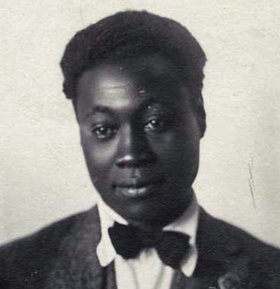
I Know My Soul I plucked my soul out of its secret place, And held it to the mirror of my eye, To see it like a star against the sky, A twitching body quivering in space, A spark of passion shining on my face….
Claude McKay, Jamaican-born poet in Harlem, New York, 1922
Notes:
Introduce the Harlem poet Claude McKay and read these five lines from his poem, I Know My Soul.
Use questions on following slides to lead a short class discussion about the poem.
Image courtesy of the Black Past Remembered (adapted; photographer unknown) https://www.flickr.com/photos/washington_area_spark/38344414184

Slide 7

What comes to mind for you when you hear the words: “I plucked my soul out of its secret place”?
Notes:
PPT’s “Insert online pictures” says this image is CC-licensed, but I can’t find the source.

Slide 8
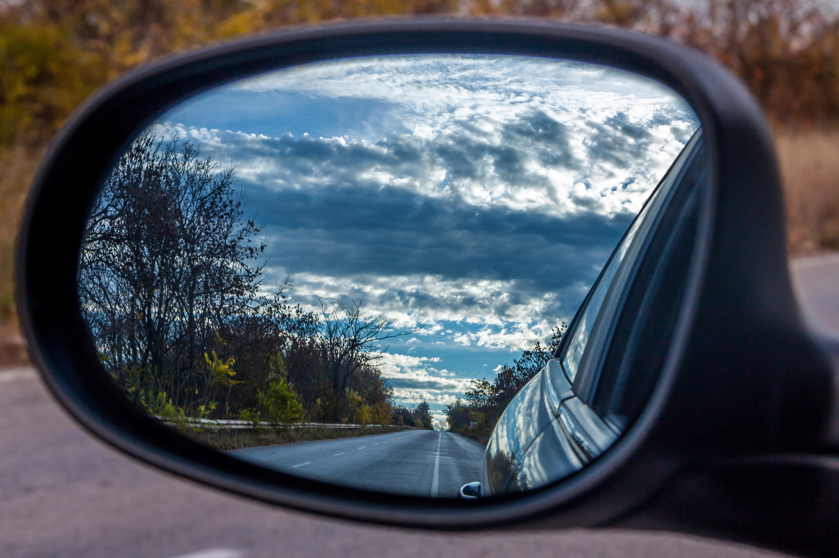
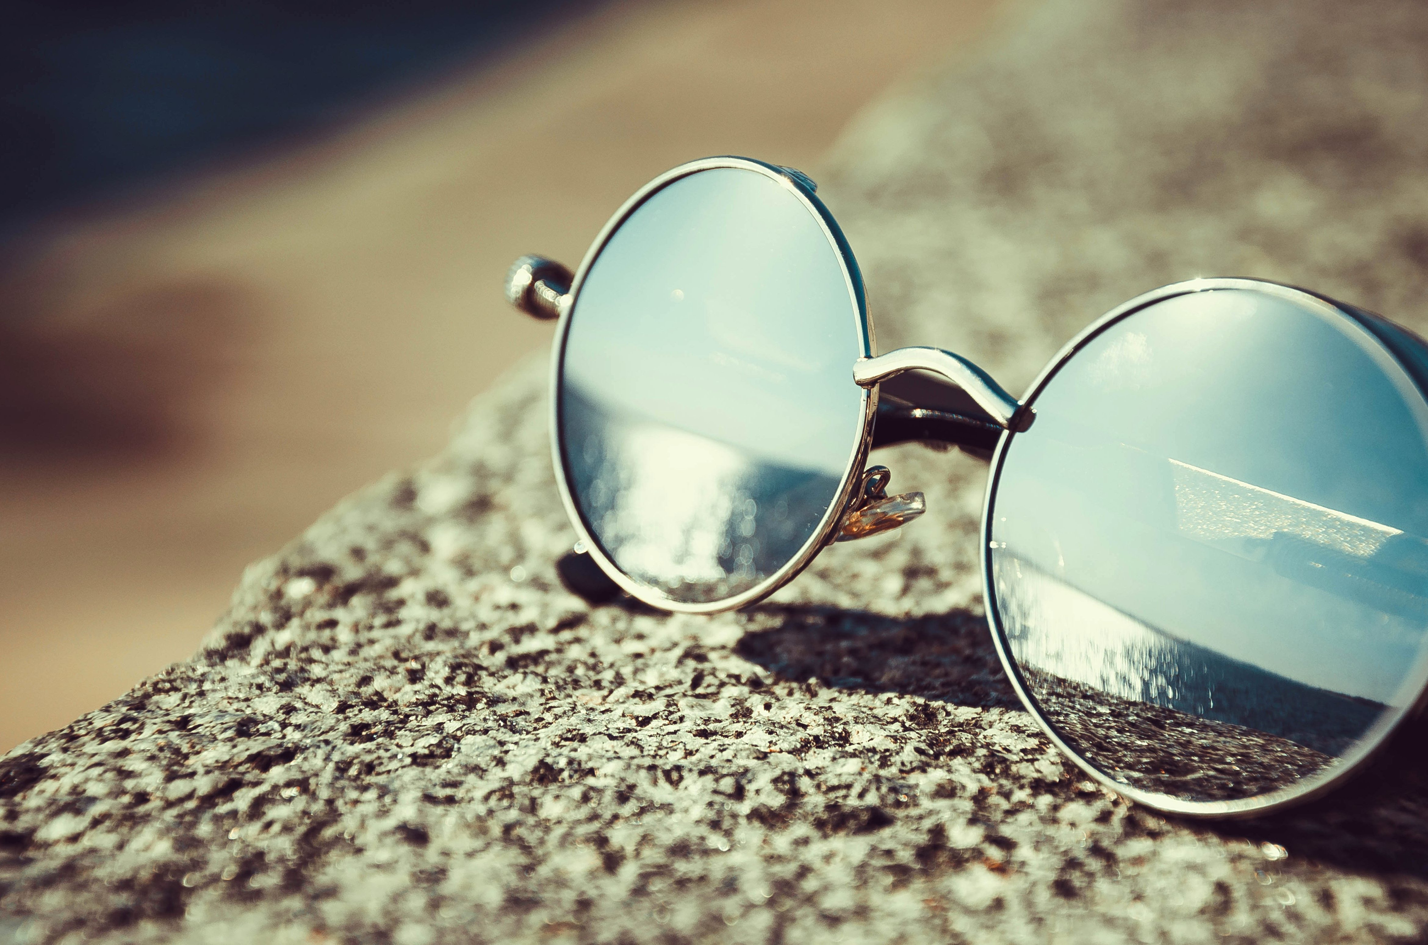
What do you think McKay means by:
“And held it to the
mirror of my eye”?
Notes:
CC0 https://www.peakpx.com/613028/black-car-side-mirror
CC0 https://pixnio.com/objects/sunglasses-mirror-reflection-object-summer

Slide 9
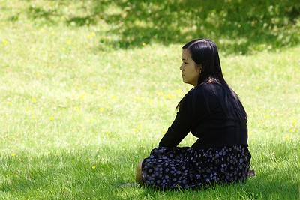
What things does he compare his soul to? How does it make you feel to think of your soul in these ways?
Why do think it is a good thing to spend time looking inward and seeking to know yourself better?
To see it like a star against the sky, A twitching body quivering in space, A spark of passion shining on my face….
Notes:
Photo by Glenn Euloth CC BY-NC-ND 2.0 https://www.flickr.com/photos/eulothg/5824971632/

Slide 10

The Starring Role in Your Life Story: Inviting My Soul to Take the Time to Consider Who I Am
Notes:
Introduce the idea that “you are the author of your life story,” and the
importance of reflecting on your personality, interests, talents, skills, values, and
goals as you think about your future
Creative commons Star https://pixabay.com/vectors/star-fractal-gold-shiny-metallic-2858923/

Slide 11
Exploring My …
Personality
Interests
Values
Skills
Talents
Goals

Slide 12
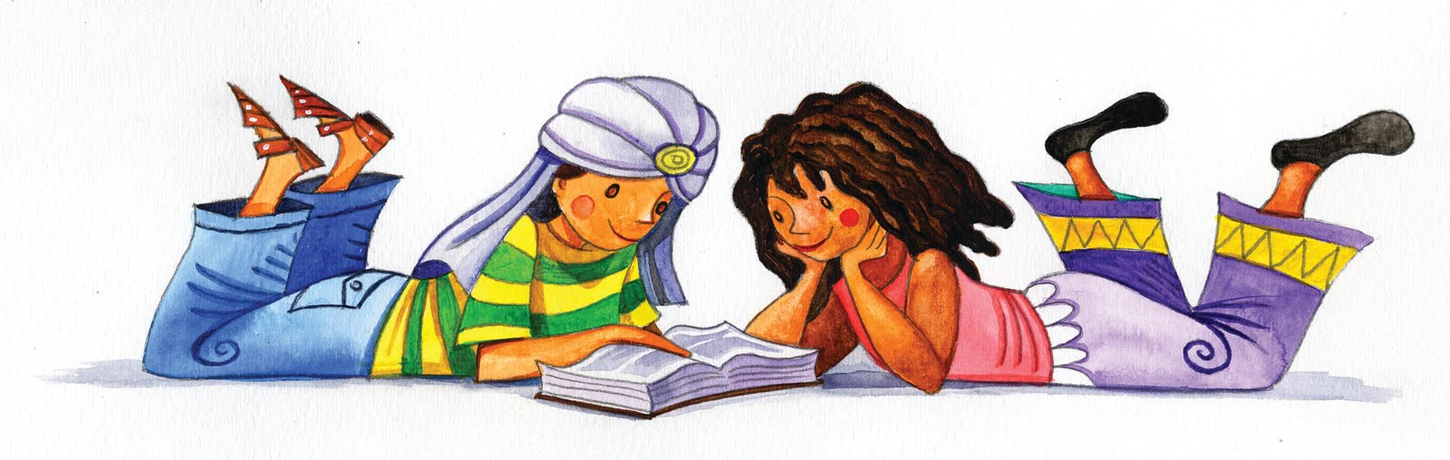
Partner Reading:
“The Starring Role in Your Life Story”
This Photo by Unknown Author is licensed under CC BY-NC-ND
Notes:
Divide class into pairs and pass out the short text “Starring Role in Your Life Story.” Explain that they should alternate reading the paragraphs together. Bring class back together when most pairs have finished.
PPT’s “Insert online pictures” says this image is a CC license, but I can’t find the source.

Slide 13
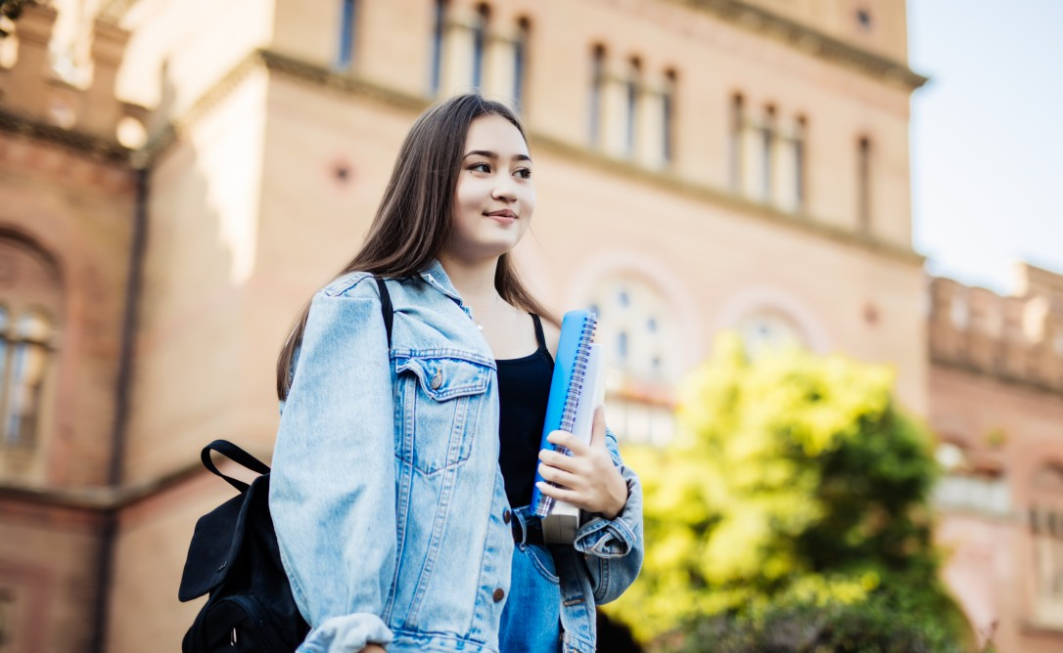
Individual Exploration Time
Think through (and fill out!)
“The Starring Role in Your Life Story.”
Notes:
Pass out the student reflection sheet and circulate as students work independently to complete it.
Image CC public domain https://pxhere.com/en/photo/1630674

Slide 14

Partner Sharing Time
Notes:
Students share what they have written in this
brainstorming sheet and the Do Now sheet (“A Few Fast Facts”)
with a partner or small group.
Sitting by Marian Elisa Torrealba Medina from the Noun Project https://thenounproject.com/search/?q=seated+figure&i=161448

Slide 15

Preview of Coming Attractions…
Tomorrow:
Use your creativity
to celebrate
and showcase
your unique
qualities in a
poem, rap,
or other format!
Personality
Interests
Skills
Talents
Values
Goals
Notes:
Tell students they will use their brainstorming activities from today to
express their identity creatively in the next lesson.
http://clipart-library.com/clipart/1733208.htm

Slide 16

References & Resources
Photos & Images
Slide 1: Photo https://www.flickr.com/photos/asiandevelopmentbank/8426494962
Slide 2 and unit thumbnails image licensed from iStock https://www.istockphoto.com/photo/young-boy-dressed-as-superhero-at-beach-during-sunset-gm510397386-86226803
Slide 3: Lesson Dedication – see https://www.edutopia.org/article/daily-ritual-builds-trust-and-community-among-students
Image: https://pixabay.com/id/illustrations/akses-banyak-tangan-933142/
Slide 5: Wikipedia https://en.wikipedia.org/wiki/The_Thinker#/media/File:Mus%C3%A9e_Rodin_1.jpg
Slide 7: https://www.flickr.com/photos/washington_area_spark/38344414184 ; https://poets.org/poem/i-know-my-soul
Slide 8: Image from PPT “Insert online pictures” (CC licensed)
Slide 9: CC0 https://www.peakpx.com/613028/black-car-side-mirror
CC0 https://pixnio.com/objects/sunglasses-mirror-reflection-object-summer
Slide 10: Photo by Glenn Euloth CC BY-NC-ND 2.0 https://www.flickr.com/photos/eulothg/5824971632/
Slide 11: Star https://pixabay.com/vectors/star-fractal-gold-shiny-metallic-2858923/
Slide 13: Image from PPT “Insert online pictures” (CC licensed)
Slide 14: CC public domain https://pxhere.com/en/photo/1630674
Slide 15: Sitting by Marian Elisa Torrealba Medina from the Noun Project https://thenounproject.com/search/?q=seated+figure&i=161448

