Slide 1
Hazlo Ahora
Escribe tus respuestas a las siguientes preguntas:
¿Cuánto tiempo dedicas a estudiar/hacer deberes en un día normal?
¿Qué distracciones tienes cuando estudias o haces los deberes?
A continuación, gira y comparte tus respuestas con un compañero.
Notes:
Students write answers to the questions on the slide, then share their answers with a partner.
Allow 2-3 students to share their answers with the class.

Slide 2
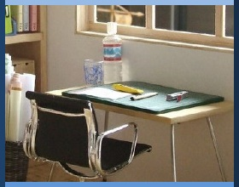
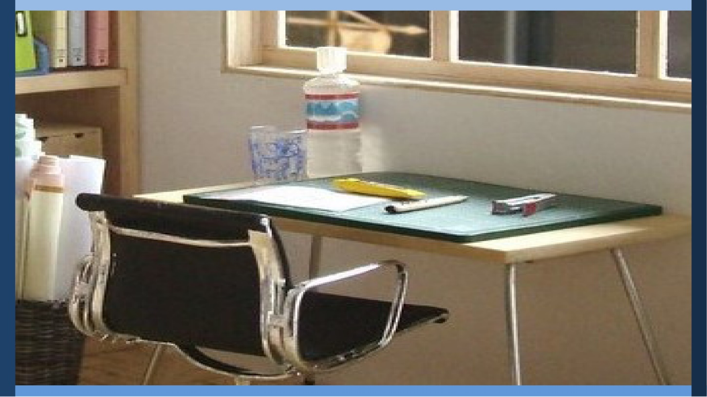
Gestionar Mi Aprendizaje
Día 3: Planificar un Estudio Eficaz
Mantener un Espacio de Estudio y Minimizar las Distracciones
Notes:
Image: https://www.flickr.com/photos/_sk/4276400278

Slide 3

Dedicación Estudiantil
Notes:
Student Dedication
https://pixabay.com/id/illustrations/akses-banyak-tangan-933142/
Note: You can add the student’s picture to the slide

Slide 4
Objetivos
Al final de la lección de hoy, serás capaz de
  Identificar un espacio de estudio adecuado
  Nombrar estrategias adecuadas para evitar distracciones mientras se estudia fuera de la escuela
Notes:
Introduce the lesson objectives by telling students that yesterday, they learned how to manage their schedules more effectively; today they will build on this by talking about how to develop a strong focused environment in which to study and do homework. To begin, they will do a quick activity to see how well they can focus on a task (next slide).

Slide 5
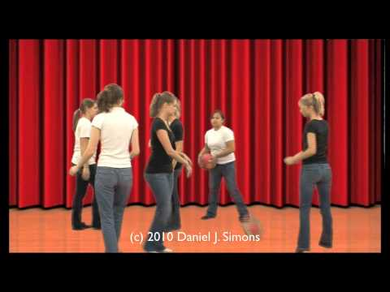

Actividad de Video
https://www.youtube.com/watch?v=IGQmdoK_ZfY
Notes:
Show the video embedded in slideshow: https://www.youtube.com/watch?v=IGQmdoK_ZfY
Ask students, “What does this activity tell us about focus?” (Take time to discuss as a group.)
Key points include:
Sometimes we think we are better at multi-tasking than we really are.
Our attention can easily be diverted if we are not careful.
Tell students that today you will build on these ideas by thinking about the environment they study in and ways to reduce distractions and make the most of their study time.

Slide 6
Leer "¿El cerebro multitarea?"
Después de leer, en la página siguiente:
Enumera todas las "otras" cosas que te gusta hacer durante el tiempo que dedicas a los deberes y al estudio (por ejemplo, TV, música, contestar llamadas o mensajes de texto, TikTok, Instagram, picar algo, navegar por Internet, jugar, etc.). Comenta tu lista con tu compañero.
Notes:
Have students partner read the handout “The Multitasking Brain?,” complete the “Personal ‘Multitasking’ Inventory” that follows the reading, and discuss their answers with their partners.
As a class, have students share their answers and list them on the board or chart paper. Continue until you have at least ten items.
Invite students to comment on the challenges of “multitasking.” Have any of them ever tried turning off their phone or the TV to focus on a particularly challenging problem? How could they use the extra time they would have if they finished homework more quickly?

Slide 7
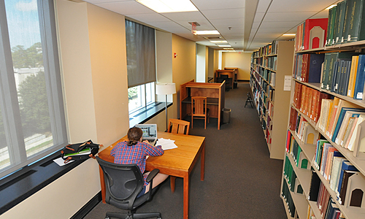
What should a study space have?
¿Qué necesita un buen espacio de estudio?
This Photo by Unknown author is licensed under CC BY-SA-NC.
Notes:
Tell students that the next step is to consider what a good study place looks like. This Photo by an unknown author is licensed under CC BY-SA-NC

Slide 8
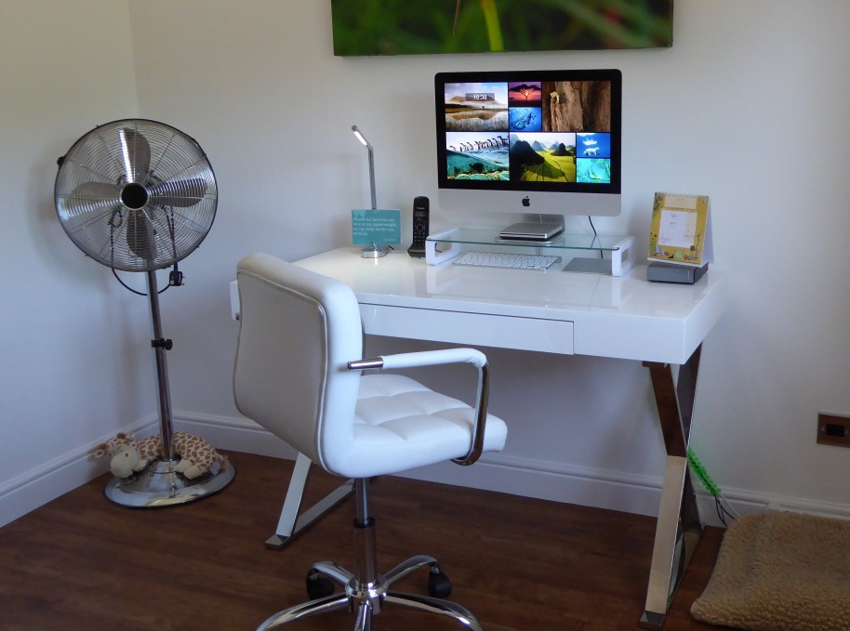
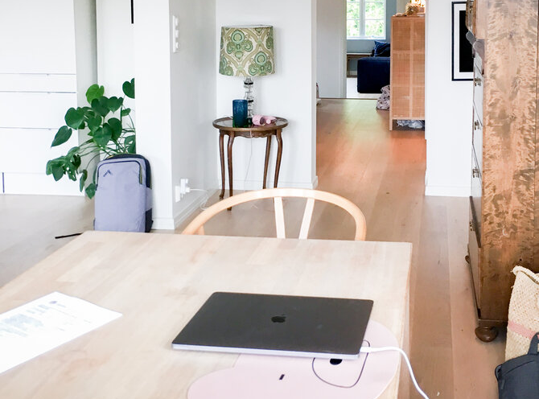
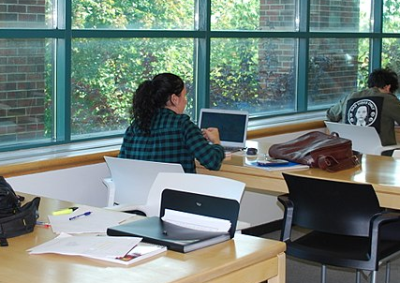
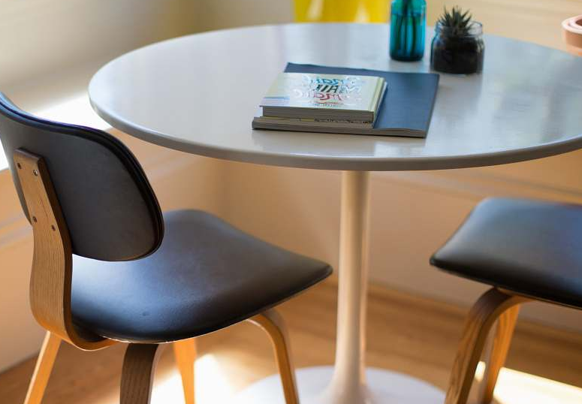
¿Qué necesitas en un espacio de estudio para trabajar eficazmente?
Piensa en:
Suministros
Muebles
Iluminación
Sonido
Notes:
Give students time to discuss with a partner what they need in a space to study effectively
Images https://pxhere.com/en/photo/493370 CC0 Public Domain
https://www.2hd.uk/workshop/2018/extending-a-family-house-in-jar CC-BY-S.A.-4.0
https://commons.wikimedia.org/wiki/File:Study_space_at_the_Vanier_Library.jpg CC-BY-4.0
https://photostockeditor.com/image/table-round-white-dining-table-beside-two-chairs-on-brown-hardwood-flooring-dining-table-35150

Slide 9
¿Qué necesitas en un espacio de estudio para trabajar eficazmente?
Hagamos una lista.
¿Qué puedes hacer si te cuesta encontrar un buen espacio de estudio y el material necesario?
Notes:
Then, as a class, create a list either on poster or on chart paper of ideal study space need-to-haves.
Note that for students that it can be difficult to create this environment. Click to reveal the question, “What can you do if it’s hard to find a good study space and necessary materials?”
Have the class brainstorm possible solutions. Some possible answers include
Borrow supplies in advance/ reach out to teachers to borrow needed supplies
Use headphones to listen to instrumental music or a nature sounds app to block out noise
Find a space outside your home to study (library, friend’s home, etc.)

Slide 10
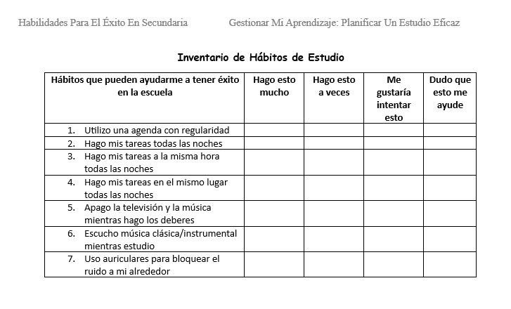
Inventario de Hábitos de Estudio
Notes:
Tell students that now that they’ve learned what habits are effective and ineffective, it’s time to think about what their current study habits look like.
Have them fill out the “Study Habits Inventory.”
Class discussion: Invite students to share what they observed.

Slide 11
Crea tu plan de estudio
¿DÓNDE ESTUDIARÁS?
¿CUÁNDO VAS A ESTUDIAR?
¿QUÉ DISTRACCIONES ANTICIPAS?
¿CÓMO PUEDES SUPERAR ESTOS OBSTÁCULOS?
Notes:
Now give students time to create their own study plan. The plan should include
the time and place they intend to study
what distractions they anticipate could occur; and
how they plan to overcome or avoid these distractions.
As students complete this assignment, circulate in the classroom to monitor and provide feedback. Choose strong student answers to share with the class.

Slide 12
Boleto de Salida
Completa lo siguiente:
Esta noche, cambiaré mi rutina de estudio por ___________________
Notes:
As an exit ticket, have students complete the sentence on the slide.

Slide 13
References & Resources
Photos & Images
Slide 2 and unit thumbnails: https://www.flickr.com/photos/_sk/4276400278
Slide 3: https://pixabay.com/id/illustrations/akses-banyak-tangan-933142/
Slide 5: https://www.youtube.com/watch?v=IGQmdoK_ZfY
Slide 7: This Photo by Unknown author is licensed under CC BY-SA-NC https://naming.library.duke.edu/room/9072
Slide 8: https://pxhere.com/en/photo/493370 CC0 Public Domain
https://www.2hd.uk/workshop/2018/extending-a-family-house-in-jar CC-BY-S.A.-4.0
https://commons.wikimedia.org/wiki/File:Study_space_at_the_Vanier_Library.jpg CC-BY-4.0
https://photostockeditor.com/image/table-round-white-dining-table-beside-two-chairs-on-brown-hardwood-flooring-dining-table-35150
Slide 11: PPT icons

