Slide 1
Hazlo Ahora
Completa las siguientes frases:
  Tres cosas a las que quiero dedicar más tiempo son_________________________________.
  Dos cosas a las que quiero dedicar menos tiempo son _________________________________.
  Comparte tus respuestas con un compañero.
Notes:
Students complete the sentences above on a piece of paper. After they finish, click to give them 30 seconds to share answers with a partner. Then, ask one to three volunteers to share their answers with the class.

Slide 2
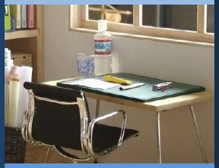

Gestionar mi aprendizaje
Día 2: Gestionar el Tiempo y Establecer Prioridades
Notes:
Image: https://www.flickr.com/photos/_sk/4276400278

Slide 3


Dedicación Estudiantil
Notes:
Student Dedication
https://pixabay.com/id/illustrations/akses-banyak-tangan-933142/
Note: You can add the student’s picture to the slide

Slide 4
Objetivos de Hoy
Al final del día de hoy serás capaz de...
  Organizar y mantener una agenda diaria
  Priorizar y ordenar las tareas a realizar
Notes:
Point out to students that as they prepare for high school, they will have more and more responsibilities. These will include increased schoolwork and academic obligations but perhaps also clubs, sports, extracurricular activities, greater family responsibilities, and a social life. To manage all of these they will need to identify tasks, complete them in an orderly manner, and keep them organized in a planner. This lesson will help them develop these skills and organize a planner that they can begin to use today.

Slide 5
Organizar los horarios de dos alumnos
¿En qué se parece o en qué se diferencia de tu vida?
¿Qué desafíos observas?
¿Qué tiene de útil el horario?
Notes:
Have students turn to the activity “Organizing Two Student Schedules.” Each pair of students should pick one of the student schedules. They will read through the paragraph and plan the student’s week out, using the schedule provided. If some students finish quickly, encourage them to read the paragraph they did not choose and try the activity for that student for extra practice. After students have finished, lead a class discussion addressing the questions on this slide.

Slide 6
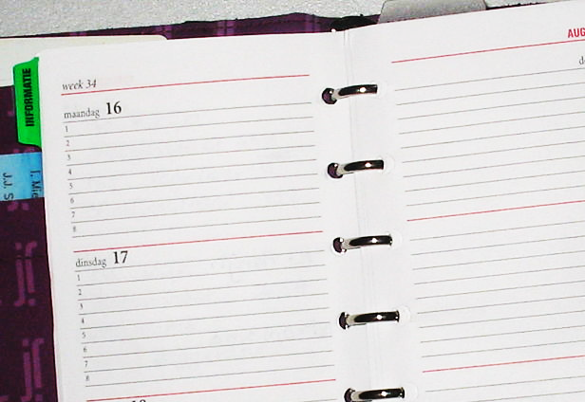
¿Qué haces todo el día?
Completa la hoja de registro diario enumerando las cosas que hiciste ayer en cada franja horaria.
Comenta tu horario diario con tu compañero utilizando las preguntas que se ofrecen a continuación.
  ¿Te sorprendió algo?
  ¿Qué parte de tu horario puede controlar/cambiar?
  ¿Qué parte de tu horario ya está fijada?
  ¿Qué cambios te gustaría hacer en tu horario/rutina personal?
Notes:
Explain that the next step is understanding what time management looks like for oneself. Have students take the next 3 minutes to fill out the “Daily Log” handout entering yesterday’s activities. Have them do their best to fill out what they were doing during each hour of your day. If they do not remember perfectly that is okay, but the purpose is for them to see how they are spending their time.
When all students have filled out their schedules, ask them to turn and discuss their schedule with their neighbor. Click twice to display the guide questions:
Did anything surprise you?
How much of your schedule can you control? How much of it is already set for you?
Are there things that you would like to make changes to?
Then discuss these questions as a class. Highlight for students that there are only so many hours in a day; no one can do everything, and some things are more important than others.
Ask students, “What are some strategies that you already use to organize your time?”
Image: https://commons.wikimedia.org/wiki/File:Agenda.jpg

Slide 7
Cómo construir tu agenda
Ten UN lugar designado para escribir/registrar TODOS los elementos de programación. Por ejemplo…
  Cuaderno
  Planificador
  Google doc/ calendario
  Aplicación de teléfono
Notes:
Tell students that now that you’ve discussed some of the many activities and challenges that they as students must manage, you will take some time to discuss strong organizational habits. Display these using the slideshow, or a white board, poster, or similar large format

Slide 8
Cómo construir tu agenda
Clasifica las actividades en tareas diarias, semanales y mensuales
Incluye fechas personales importantes como:
  Cumpleaños de amigos y familiares
  Vacaciones
  Actividades escolares
  Eventos deportivos, conciertos, reuniones de clubes, etc.

Slide 9
Cómo construir tu agenda
Anota los deberes en cuanto te los asignen.
Comprueba tu horario:
  Cada día antes de ir a casa (para asegurarte de que tienes todos los materiales necesarios para los deberes)
  Cada noche antes de irte a la cama (para asegurarte de que has completado todos los deberes para el día siguiente)

Slide 10

¡Ahora inténtalo tú!
Dedica los próximos diez minutos a organizar tu agenda siguiendo los consejos que te ofrecemos. ¡Haz que este tiempo te sea útil!
Notes:
Now, ask students to complete a daily, weekly, and monthly schedule.
If students already have a planner, encourage them to use it for this exercise. If they do not have a planner, encourage them to dedicate a notebook to it, or provide them with scheduling worksheets. Walk around and answer questions students may have. Encourage students to work together to discuss coming assignments to help build a sense of community.
Image: http://clipart-library.com/clipart/1871800.htm

Slide 11
Boleto de Salida
Completa las siguientes frases:
  Utilizar una agenda puede ayudarme a _________________.
  Una cosa que espero cambiar como resultado de la lección de hoy es___________________.
Notes:
For today's exit ticket, have students complete the sentences on the slide.

Slide 12
References & Resources
Photos & Images
Slide 2 and unit thumbnail: https://www.flickr.com/photos/_sk/4276400278
Slide 3: https://pixabay.com/id/illustrations/akses-banyak-tangan-933142/
Slide 6: https://commons.wikimedia.org/wiki/File:Agenda.jpg
Slide 10: http://clipart-library.com/clipart/1871800.htm

