Slide 1
Hazlo Ahora: Imagina Esto
Piensa en cómo quieres que sea tu vida dentro de diez años. ¿Qué aspecto tiene? ¿Cómo suena? Gírate y compártelo con un compañero.

Slide 2

Aprendiendo con un Propósito
Día 6: Mi Yo del Futuro
Notes:
Image licensed from iStock https://www.istockphoto.com/photo/young-boy-dressed-as-superhero-at-beach-during-sunset-gm510397386-86226803

Slide 3
Nuestra Agenda
Dedicación
Discurso del Plano de Vida
Ejercicio de Vocabulario
Tableros de Visualización
Boleto de Salida

Slide 4

Dedicación Estudiantil
Notes:
https://pixabay.com/id/illustrations/akses-banyak-tangan-933142/
Note: You can add the student’s picture to the slide

Slide 5
Objetivo de la Lección
Los estudiantes comprenderán la importancia de tener una dirección clara y un plano de vida (Visión) para su futuro.
Notes:
Explain to students that during the next two days, they will build out a Life’s Blueprint (vision) for their future selves.

Slide 6
Palabras a Conocer
Dignidad
Crucial
Empeño
Justicia
Visualización
Plano
Notes:
Distribute the student activity sheet “Your Life’s Blueprint Vocabulary Exploration.” Introduce new vocabulary words (slide 5) by asking the students whether they know what each word means or what they think it might mean. (If you choose to use the longer version of the video, Dr. King explains what a blueprint is and how it is used.) Have students copy the words in the first column.

Slide 7
Dignidad – valor; valía; amor propio
Crucial – muy importante; esencial; clave
Empeño – una empresa; algo en lo que pones esfuerzo
Justicia – equidad; lo que es justo para todos
Visualización –una imagen que creas en tu mente para ayudarte a imaginar cómo es algo
Plano – un dibujo técnico de cómo se construirá un edificio
Notes:
After students have offered their suggestions, review accurate definitions of the words (slide 6). Use each word in a sample sentence that showcases its meaning. Students take notes in center column. b. Have students discuss words with a partner by restating or explaining each one in their own words, or by using words in original sentences. c. Explain to the students they are going to encounter these words in Dr. King’s speech, so they should look or listen for how these words are used in the context of the speech and note this on the Vocabulary Exploration sheet (right hand column).

Slide 8
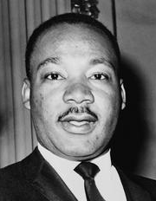


“El Plano de Vida” (discurso del Dr. Martin Luther King, Jr.)
Mira uno de los siguientes videos:
https://www.youtube.com/watch?v=aDaGhmaWmo4 (7:43 min.) or https://www.youtube.com/watch?v=852_SQ1EK98 (3:33 min.)
o
Lee el discurso usando el material proporcionado.
Notes:
Explain to students that Dr. Martin Luther King Jr. gave his “Life’s Blueprint” speech to a group of Philadelphia junior high students about their age.
After reading or watching the speech, further discuss the use of the word blueprint as a metaphor. (This metaphor represents having a life goal and developing a clear plan for reaching that goal.) Have students work with their partners to identify the three things that Dr. King shares that should be part of their life’s blueprint, and record these on their activity sheets.
Have paper copies of the speech available if preferred.
Image: https://snappygoat.com/s/?q=martin+luther+king+jr#b5cde5da494cc916858783164fc880e0a193834d,0,1.

Slide 9
¿Qué tres cosas deberían formar parte del Plano de tu Vida?
1.
2.
3.
Creer en tu propio “alguien”
Determinación para alcanzar la excelencia
Compromiso con los principios de belleza, verdad y justicia
Notes:
Ask students to list the three things a life’s blueprint should include. As they share, click through the slide to confirm answers.

Slide 10
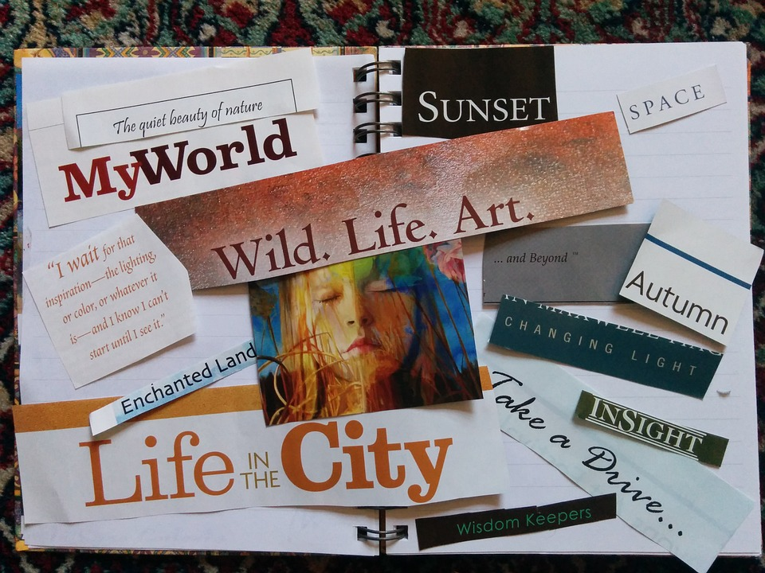
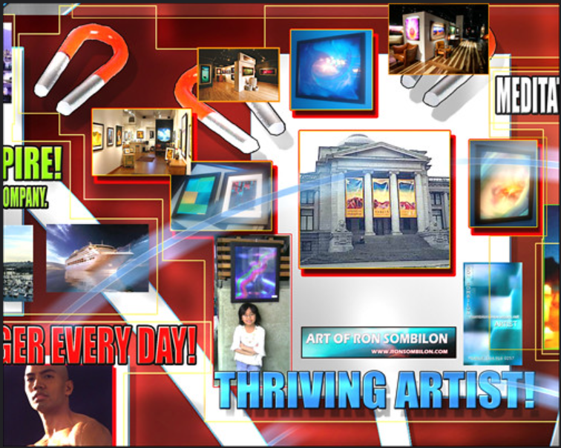
Diseñar Tu Propio Plano de Vida: Ejemplos de Tableros de Visión
Notes:
To introduce the concept of students creating or designing theirown “Life’s Blueprints” by constructing visualization boards orproducts that represent how they see their future selves, havestudents explore examples of vision boards. (Two examples areprovided on slide 10. To find more examples, enter the term“middle school vision boards” in a search engine.) If you createdyour own Vision Board as an example, you can share it now.
Add more slides as necessary to accommodate examples that you want to share with students.
Images: https://pixabay.com/id/photos/papan-visi-manifestasi-lembar-memo-520757/
https://www.flickr.com/photos/ronsombilongallery/3240111905/in/photostream/ CC BY-ND 2.0

Slide 11

Cómo Crear un Tablero de Visión
Mira uno de estos videos sobre cómo crear Tableros de Visión.
o Cómo Crear un Tablero de Visión
https://www.youtube.com/watch?v=wjy_nT0yT18
o Cómo Crear un Tablero de Visión Digital
https://www.youtube.com/watch?v=kTYE3ZvXfXU
o lee este blog para obtener ideas prácticas sobre cómo crear tu tablero de visión: https://www.lifehack.org/articles/productivity/8-ideas-create-your-own-vision-board.html
Notes:
Show one of the following videos, or another of your choosing (slide11). If students have Internet access on their devices, you can givethem the choice (depending on whether they prefer to create their vision boards manually or electronically).

Slide 12
Boleto de Salida
Tu Boleto de salida es tu Hoja de Exploración de Vocabulario y Tablero de Ideas de Visión completada.
Si deseas utilizar un dispositivo electrónico (por ejemplo, teléfono celular o tableta) para crear tu Tablero de Ideas tráelo a clase mañana.
Si quieres incluir fotos personales, asegúrate de traerlas también.
Notes:
The exit ticket is students’ completed Vocabulary Exploration and Idea ActivitySheet. Remind those who plan to create digital Vision Boards on personal devices(e.g. cell phones) to bring these devices to class tomorrow. Students may wish tobring personal photos to include on their vision boards.

Slide 13
References & Resources
Photos & Images
Slide 2 and unit thumbnails image licensed from iStock https://www.istockphoto.com/photo/young-boy-dressed-as-superhero-at-beach-during-sunset-gm510397386-86226803
Slide 3: https://pixabay.com/id/illustrations/akses-banyak-tangan-933142/
Slide 7: https://snappygoat.com/s/?q=martin+luther+king+jr#b5cde5da494cc916858783164fc880e0a193834d,0,1 ; https://www.youtube.com/watch?v=aDaGhmaWmo4 ; https://www.youtube.com/watch?v=852_SQ1EK98; https://voiceofoc.org/wp-content/uploads/2017/01/MLK-Lifes-Blueprint.pdf
Slide 9: https://pixabay.com/id/photos/papan-visi-manifestasi-lembar-memo-520757/
https://www.flickr.com/photos/ronsombilongallery/3240111905/in/photostream/ CC BY-ND 2.0
Slide 10: https://pxhere.com/en/photo/1434695 https://www.youtube.com/watch?v=wjy_nT0yT18
https://www.youtube.com/watch?v=kTYE3ZvXfXU
https://www.lifehack.org/articles/productivity/8-ideas-create-your-own-vision-board.htm

