Slide 1
Hazlo Ahora:
Revisa los ejemplos de poema de identidad, raps y palabra hablada y empieza a pensar en formas de expresar tu identidad de forma creativa.
https://steemit.com/poetry/@pressemman/eagle-s-poem-i-am-an-eagle-a1454683dce57
https://examples.yourdictionary.com/examples-of-i-am-poems.html
Notes:
SCRIPT: In the spirit of expressing our identities Creatively, we will use creative expressions in a poem, rap, or spoken word to share our personality, values, talents, skills, interests, and/or goals. Begin with the examples (provided in hard copy or on the board). Use the provided links as sources.
You may consider printing the poems listed on slides# 8-10 to have them available for students as exemplars when students are writing their own.

Slide 2

Aprendiendo con un Propósito
Día 3: Expresar mi Identidad Creativamente
Notes:
Image licensed from iStock https://www.istockphoto.com/photo/young-boy-dressed-as-superhero-at-beach-during-sunset-gm510397386-86226803
SCRIPT: The activities in this lesson are preparing us for career explorations while highlighting the role of the school and the community in solidifying one’s life mission and work.

Slide 3

Dedicación Estudiantil
Notes:
https://pixabay.com/id/illustrations/akses-banyak-tangan-933142/
Note: You can add the student’s picture to the slide
SCRIPT: Let's give a warm welcome to (student's name) who will be presenting the lesson dedication

Slide 4
Nuestra Agenda
Dedicación
Resumen de la Pregunta Esencial
Explorando la Poesía del Autorretrato
Escribiendo el Poema de Mi Autorretrato
Compartiendo Nuestros Poemas (voluntario)
Conclusión de Todo el Grupo
Notes:
SCRIPT: Our agenda includes, the lesson dedication which we had the pleasure to hear, followed by the overview of Essential Question, we explore Self-Portrait Poetry, then writing My Self-Portrait Poem, asking for volunteers to share their creative work , and participating in Whole Group Conclusion.

Slide 5
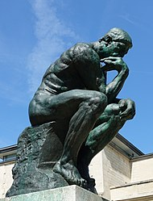
¿Quién soy? ¿Cuál es mi propósito?
Una de las cosas más importantes que hacen los seres humanos es pensar–
o contemplar –
    su existencia
    su ser
    quiénes son.
Todos nosotros somos filósofos.
Notes:
SCRIPT: Who Am I? And What is my purpose are the questions we will be reflecting upon and thinking with all the possibilities at our reach.
Photo Wikipedia https://en.wikipedia.org/wiki/The_Thinker#/media/File:Mus%C3%A9e_Rodin_1.jpg

Slide 6
“Estoy asombrosa y maravillosamente hecho.”
Antiguo poeta Hebreo (cerca del año 1000 a.C)
Notes:
SCRIPT: You are awesome and wonderful....that's how you were divinely made....you are enough....just the way you are...

Slide 7
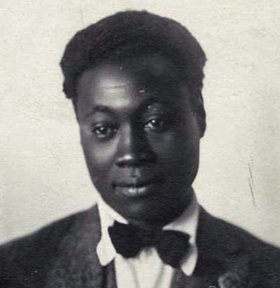
Conozco Mi Alma
Arranqué mi alma de su lugar secreto,
Y la sostuve ante el espejo de mis ojos,
Para verla como una estrella contra el cielo,
Un cuerpo tembloroso estremeciéndose en el espacio,
Una chispa de pasión brillando en mi rostro….
Claude McKay, poeta de orígen Jamaicano en Harlem, New York, 1922
Notes:
SCRIPT: What is the message the author is conveying? What/Whom is Claude McKay describing? (Remind students of this poem about knowing themselves)
Image courtesy of the Black Past Remembered (adapted; photographer unknown) https://www.flickr.com/photos/washington_area_spark/38344414184

Slide 8

Expresando
Creativamente
Mi
Identidad con
Poesía o
Palabra Hablada
Notes:
Creative commons Star https://pixabay.com/vectors/star-fractal-gold-shiny-metallic-2858923/

Slide 9
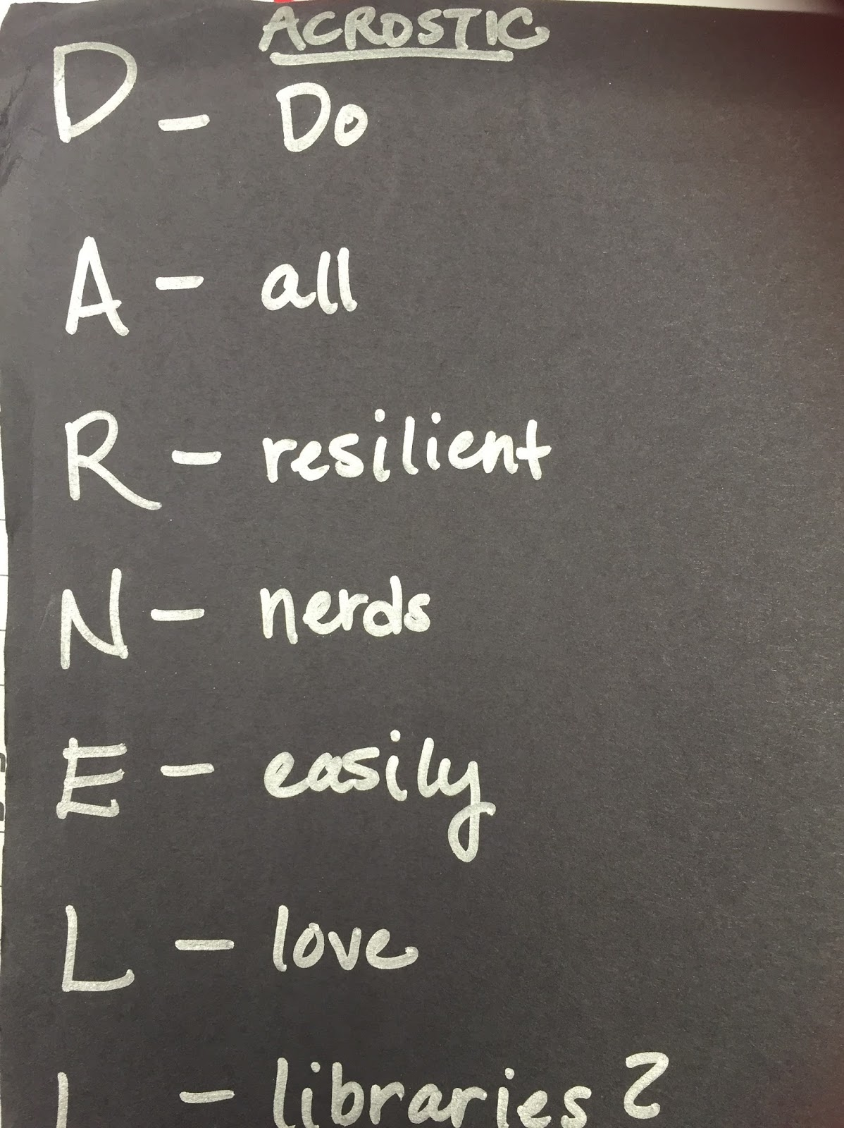
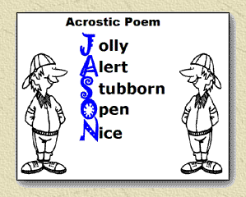
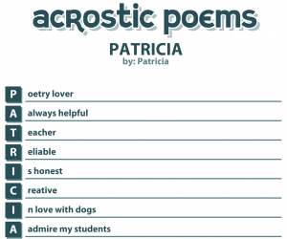
Autorretrato Poético:
Un Poema Acróstico con tu Nombre
Formas de Compartir quién soy a través de la poesía
This Photo by Unknown Author is licensed under CC BY
Notes:
SCRIPT: These are examples of Self-Portrait poem, rap, or spoken word. In the “Do Now” we saw some other examples as well as those presented on slides 9-11. How are the poems similar to, and different from, one
Another? Kindly enter your thoughts on …..............
https://www.awakenlibrarian.com/2016_08_28_archive.html
https://obwe.weebly.com/acrostic-poems.html
https://pchujman.cumbresblogs.com/2013/04/21/project-work/
Please note, PPT “insert online pictures” says these are CC licensed but I have not been able to verify that.

Slide 10
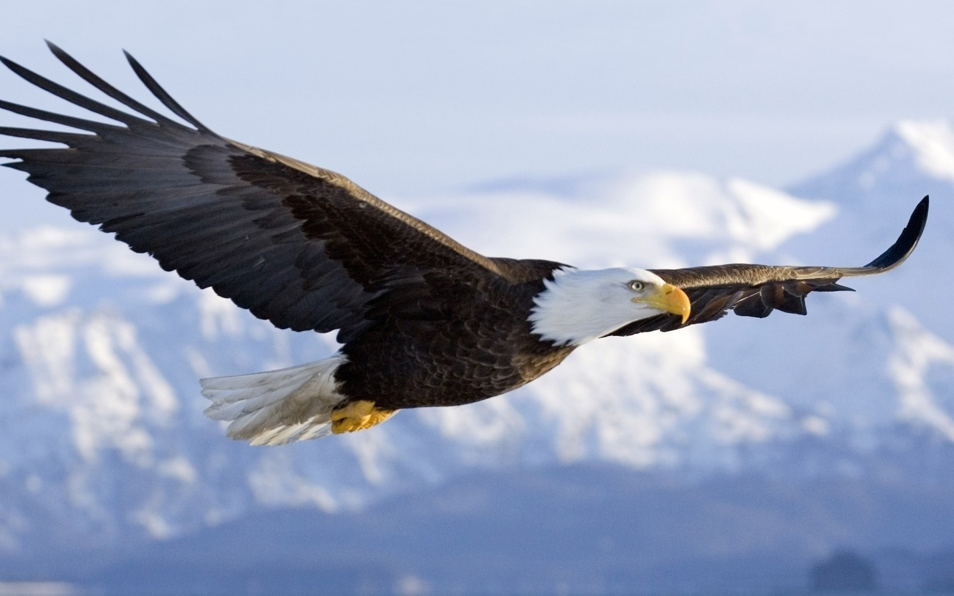

Imagínate como un Animal
“Yo Soy un Águila”
https://steemit.com/poetry/@pressemman/eagle-s-poem-i-am-an-eagle-a1454683dce57
Notes:
https://wallpapercave.com/free-bald-eagle-wallpaper
SCRIPT: We may see ourselves, our essence in the strength and attributes of other creatures......

Slide 11
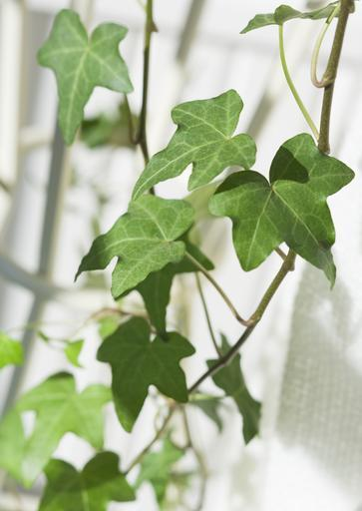
Descríbete como un Color
Yo soy verde
Estoy lleno de energía, lleno de vida,
Creciendo como la hiedra por el lateral de mi casa.
Me encanta ir de excursión por el bosque en primavera y nadar en el lago.
Todavía tengo mucho que aprender, pero siempre he tenido un pulgar verde.
Las plantas crecen por mí.
Me encanta plantar y cuidar mi jardín,
Tomates, calabazas y fresas
Y tulipanes y narcisos e iris en mi florero.
Quizá algún día dirija un invernadero para ganarme la vida.
Y compartir a los demás la alegría de cultivar cosas.
Quiero echar raíces profundas en esta ciudad con mis amigos y mi familia
Y seguir creciendo y aprendiendo
Para poder ser una fuente de fortaleza para los demás. Anonymous
Notes:
https://snappygoat.com/b/b02e3024dcfad0f0c9bd39130697cb1403fe26e8
SCRIPT: or perhaps we see ourselves in the vibrancy and warmth of a color?

Slide 12
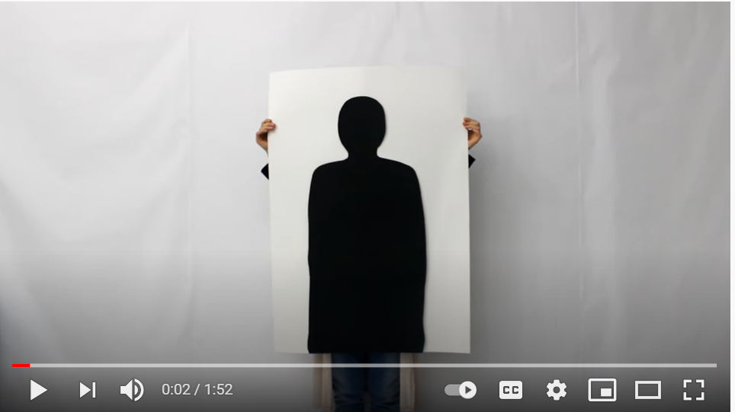

Escribe un Autorretrato Rap o Poema Hablado
SOY ILIMITADA
https://www.youtube.com/watch?v=f5CLnmN2QcQ
Notes:
SCRIPT: We will watch a short video clip and share our reactions.

Slide 13


AHORA ESCRIBE TU POPIO
POEMA/ RAP/ PALABRA HABLADA
Notes:
SCRIPT: We will now have approximately 20-25 minutes for students to create their own poem/rap/spoken word. Ensure enough time for volunteers to share what they have created.
https://www.wannapik.com/vectors/3421
http://clipart-library.com/search2/?q=creative%20writing#gsc.tab=1&gsc.q=creative%20writing&gsc.page=1

Slide 14
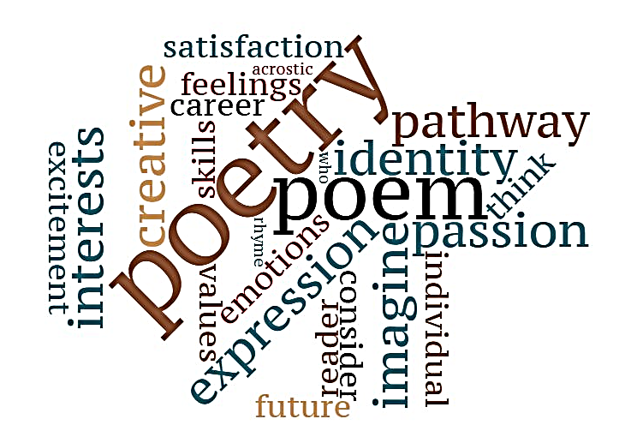
Compartiendo Mi Poema
Notes:
SCRIPT: Let's have students share in small groups or before the entire class, depending on time and preferences.
Affirm student creativity and tell students you will post all student work on walls.
Original word cloud

Slide 15

Avance de
Las Próximas
Atracciones…
¿Qué profesiones podrían encajar con mis talentos, intereses y fortalezas?
Notes:
SCRIPT: Next lesson we begin exploring possible
Careers matching our interests and personality.

Slide 16
References & Resources
Photos & Images
Slide 2 and unit thumbnails image licensed from iStock https://www.istockphoto.com/photo/young-boy-dressed-as-superhero-at-beach-during-sunset-gm510397386-86226803
Slide 3: https://pixabay.com/id/illustrations/akses-banyak-tangan-933142/
Slide 5: https://en.wikipedia.org/wiki/The_Thinker#/media/File:Mus%C3%A9e_Rodin_1.jpg
Slide 7: Image courtesy of the Black Past Remembered (adapted; photographer unknown) https://www.flickr.com/photos/washington_area_spark/38344414184 ; poem https://poets.org/poem/i-know-my-soul
Slide 8: https://pixabay.com/vectors/star-fractal-gold-shiny-metallic-2858923/
Slide 9: https://www.awakenlibrarian.com/2016_08_28_archive.html
https://obwe.weebly.com/acrostic-poems.html
https://pchujman.cumbresblogs.com/2013/04/21/project-work/
(CC-licensed according to PPT “insert online pictures”)
Slide 10: https://wallpapercave.com/free-bald-eagle-wallpaper ; https://steemit.com/poetry/@pressemman/eagle-s-poem-i-am-an-eagle-a1454683dce57
Slide 11: https://snappygoat.com/b/b02e3024dcfad0f0c9bd39130697cb1403fe26e8
Slide 12: https://www.youtube.com/watch?v=f5CLnmN2QcQS
Slide 13: https://www.wannapik.com/vectors/3421
http://clipart-library.com/search2/?q=creative%20writing#gsc.tab=1&gsc.q=creative%20writing&gsc.page=1

