Slide 1
Hazlo Ahora: Habilidades para el Éxito en la Escuela Secundaria
Resumen del Curso
Consulta la Hoja Resumen del Curso.
¿De qué crees que tratará cada unidad?
Pon una marca al lado de la que te parece más interesante o útil
Notes:
“Do Now” is a 2-3 minute routine at the beginning of the class period for students to take the instruction sheet and work independently or in groups to focus their attention on the theme of the lesson while the teacher is doing necessary administration (like taking attendance). If this is not a standard routine in your classroom, take time to explain that this will be a regular time at the beginning of class for students to pick up the needed materials for this Do Now time and work quietly until the start of full-group instruction. Students will need the “Course Overview Sheet” distributed for this Do Now activity.

Slide 2

Habilidades para el Éxito en la Escuela Secundaria
Introducción: Aprendiendo con un Propósito
Notes:
Image from iStock by license https://www.istockphoto.com/photo/young-boy-dressed-as-superhero-at-beach-during-sunset-gm510397386-86226803

Slide 3

Comunidad de la Clase
This Photo by Unknown Author is licensed under CC BY
Notes:
1. Welcome students to Skills for Secondary School Success. Explain that today’s
goal is to give students an overview of what they will be learning and doing in
this course, which is designed to help them prepare for high school.
2. Explain that before they dive into looking at the different units in the course,
they will take part in an activity to build a sense of community within the class.
Image from Creative Commons https://openclipart.org/detail/170352/extended-community-circle-by-josephluis-170352

Slide 4
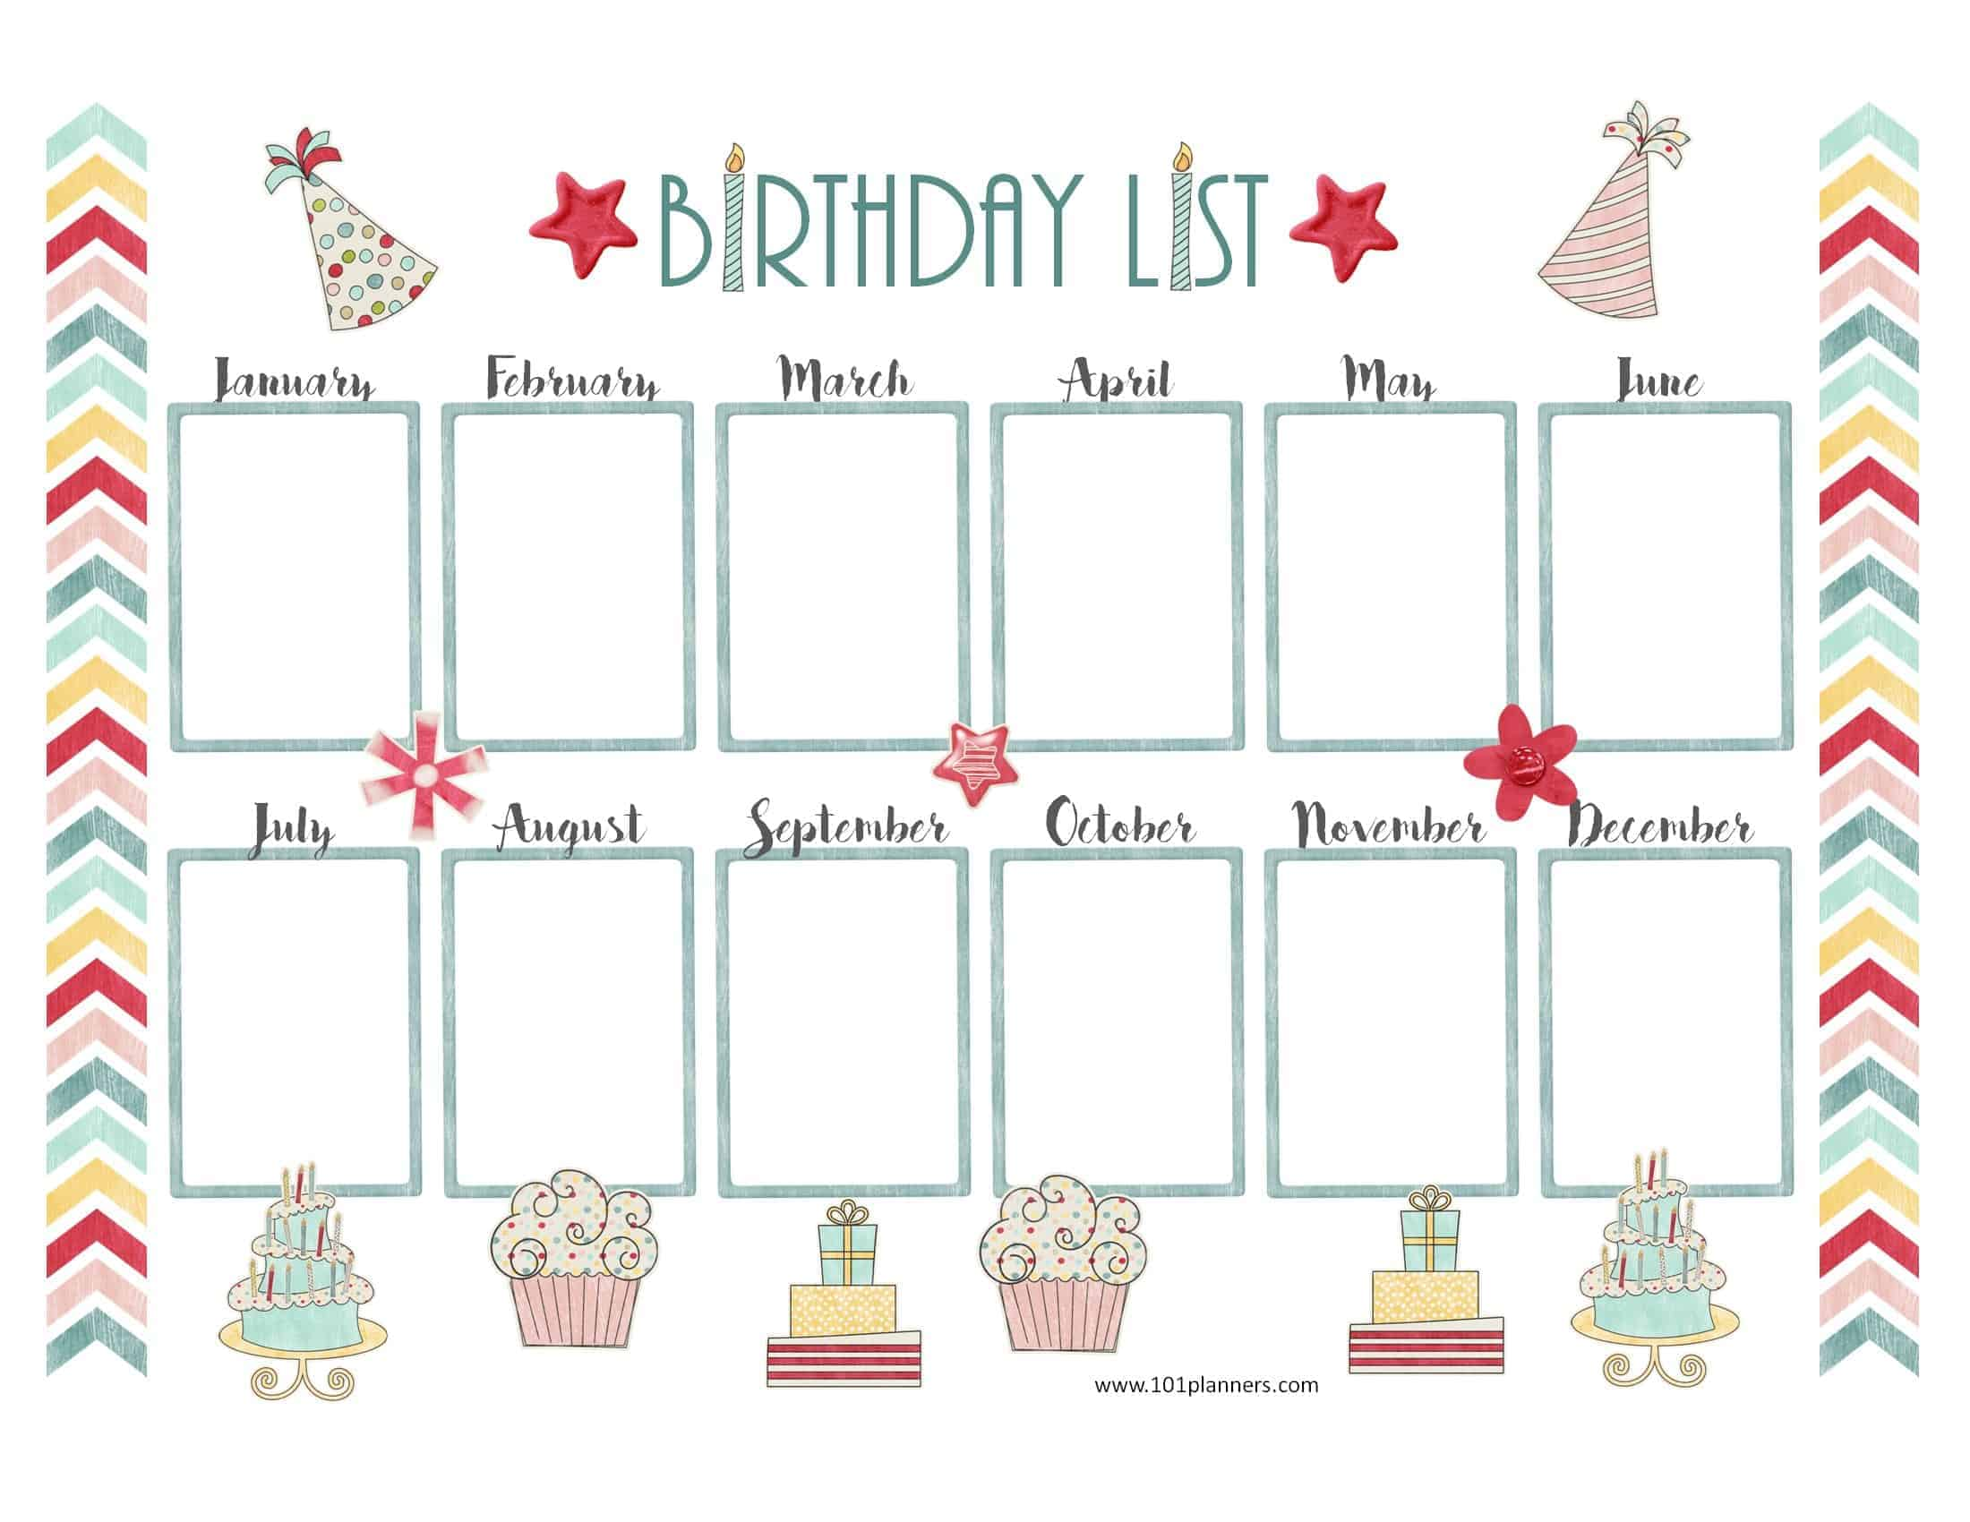
Calendario de Cumpleaños
META:
Alinearse por orden de cumpleaños
tan rápido como sea posible
sin hablar
se acepta la comunicación escrita
This Photo by Unknown Author is licensed under CC BY-SA
Notes:
Explain to students the goal and guidelines for the Birthday Lineup.
• Goal is for students to line up in order of their birthdays, from
Jan. 1 to Dec. 31, as quickly as possible (teacher times the class).
• No one may speak out loud, but students can write messages
using the paper provided.
When students have lined up, each one shares his/her name,
birthday, and favorite birthday food; teacher records birthdates of all
students (using sheet provided at end of lesson plan guide, if
desired). Acknowledge upcoming birthdays.
Including the debrief discussion (next slide), this activity should take no more than 10 minutes.
https://www.101planners.com/wp-content/uploads/2016/02/birthday-calendar-template-2.jpg

Slide 5

Reflexión & Informe
¿Notaste los pasos que dieron los miembros de la clase para hacer que esto funcione?
¿Qué pasos podrían habernos ayudado a hacerlo más rápido (además de poder hablar en voz alta)?
¿Encontraste a alguien con un cumpleaños cercano al tuyo y no lo sabías?
Notes:
Teacher leads class to debrief the activity.
Creative commons Reflection https://www.flickr.com/photos/glaciernps/7198413770/

Slide 6
HABILIDADES PARA EL ÉXITO EN ESCUELAS SECUNDARIAS
Unidades
Aprendiendo con un Propósito
Afrontando Retos y Teniendo Mentalidad de Crecimiento
Gestionando mi Aprendizaje
Interactuando con Otros Mientras Aprendemos Juntos
Marcando la Diferencia en Mi Comunidad y el Mundo
Notes:
Classroom should have 5 stations, one for each unit, with the Unit Galley Walk Poster for each unit (in Posters and Classroom materials folder) at each of the stations. Pass out student sheets with questions for each of the unit stations.
Explain to students that they will be circulating among the stations (with 3-5 minutes per station, depending on the length of class period) to discuss questions about each of the units.

Slide 7
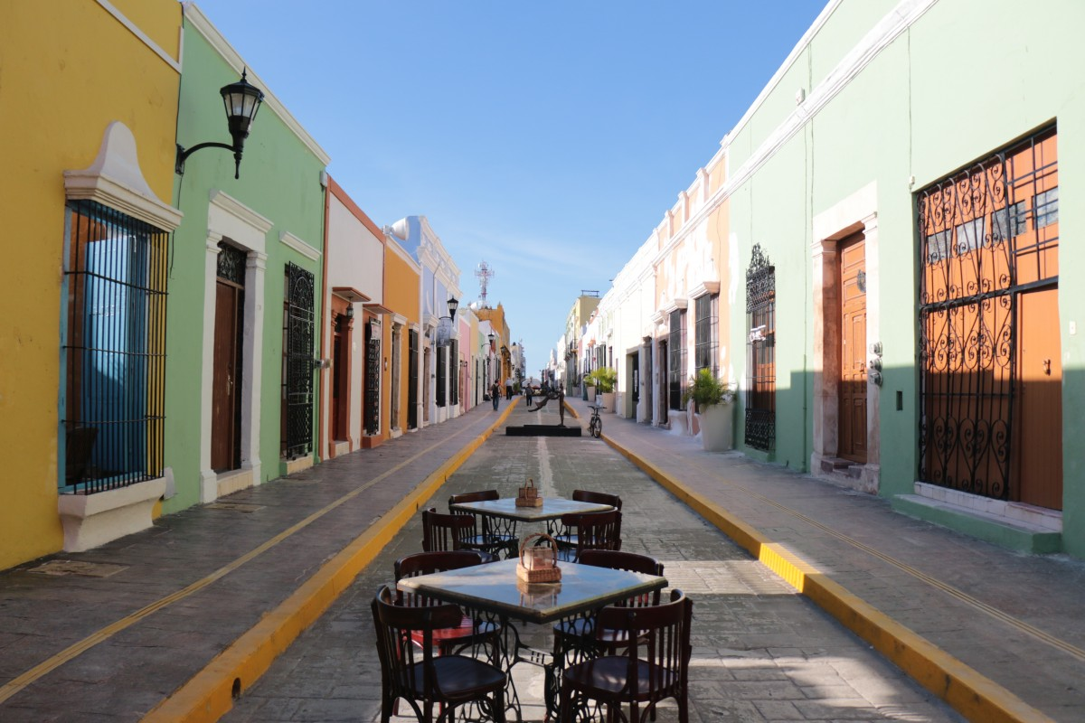
Paseo por la Galería
Dividirse en pequeños grupos por cumpleaños
Viaje a cada Expositor de Unidad y debata en grupo al menos una de las preguntas
Notes:
1. Divide students into five groups by birthday. Groups do a gallery
walk to discover what each unit will focus on (using the
• Encourage students to discuss or post responses to the questions
at each unit station.
• Groups spend about 3-5 minutes at each station. (Advise students
when it is time to move to the next station.)
2. Invite students to briefly report on what they noticed. Which units
do they think will be most interesting? Most fun? Most useful?
Creative commons https://pxhere.com/en/photo/1196529

Slide 8
Aprendiendo con un Propósito
¿Quién soy? ¿Cuál es mi propósito?
¿Qué trabajo encajará con mis talentos, intereses y personalidad?
¿Cómo me prepara la escuela para cumplir el propósito de mi vida y mi trabajo?
Notes:
Teacher gives a brief overview of upcoming Unit 1 themes and activities (using slide
show):
• Who am I? What is my purpose?
• What work will fit with my talents, interests, and personality?
• How does school prepare me to fulfil my life’s purpose and work?
Next slide previews next lesson.

Slide 9

Avance de las Próximas Atracciones…
Mañana:
¡Actividades para descubrir y mostrar
tus cualidades!
Personalidad
Intereses
Habilidades
Talentos
Valores
Metas
Notes:
This is what we’ll be focusing on tomorrow!
http://clipart-library.com/clipart/1733208.htm

Slide 10
References & Resources
Photos & Images
Slide 2 and unit thumbnails image licensed from iStock https://www.istockphoto.com/photo/young-boy-dressed-as-superhero-at-beach-during-sunset-gm510397386-86226803
Slide 3: https://openclipart.org/detail/170352/extended-community-circle-by-josephluis-170352
Slide 4: https://www.101planners.com/wp-content/uploads/2016/02/birthday-calendar-template-2.jpg
Slide 5: https://www.flickr.com/photos/glaciernps/7198413770/
Slide 7: https://pxhere.com/en/photo/1196529
Slide 9: http://clipart-library.com/clipart/1733208.htm

