Slide 1
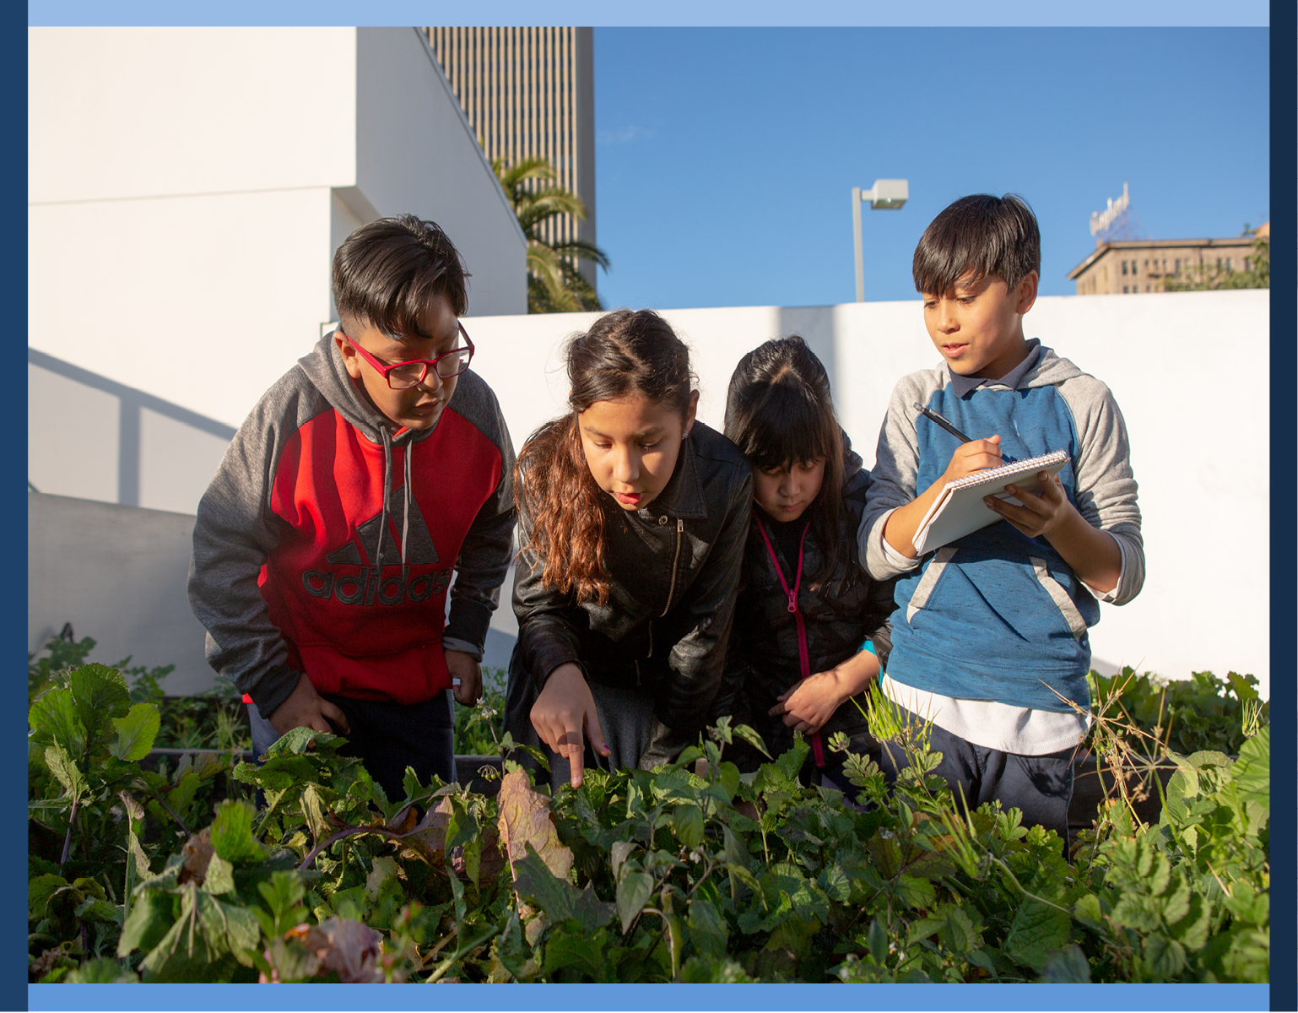
Skills for Secondary School Success (4S)
Unit 5: Making a Difference
Notes:
Facilitators introduce themselves and share that today we begin with the lessons in Unit 1, Learning with a Sense of Purpose.

Slide 2

Agenda
Connection Circle/Reflection on Unit 4
Overview of Unit 5 Lessons
Reflections/Questions
Use your copy of the
Teacher’s Manual for
reference throughout the
Session.
Notes:
In this session I will summarize the key activities in each lesson. Next, we will look over the whole set of lessons to see how they connect. We will share reflection questions throughout the presentation. Feel free to pause to look at material more in depth when needed.

Slide 3
Connection Circle
Reflecting on Experience with 4S
So Far
What growth did you observe in students as active listeners?
How did students respond to the empathy interviews?
What changes in empathy are you hoping to see in students? In yourself as a teacher?
Notes:
Facilitator asks the questions on the slide.
5min.

Slide 4

Making a Difference Road Map
Expanding our Circles of Concern
Exploring Needs in My Neighborhood
Addressing Community Needs
Choosing a Project to Make a Difference
Using Project Management Skills
Working on Project Proposals
Presenting Project Proposals
Completing Project Proposals
Course Wrap-Up
Notes:
This is a roadmap for the 9 lessons in Unit 5.

Slide 5
Unit 5
Essential
Question
How can I apply the things I’ve learned to make a difference in my community?
Notes:
The essential question is: How can I apply the things I’ve learned to make a difference in my community?

Slide 6
Lesson 1 Key Activities
Expanding Our Circles of Concern
Objective: This lesson leads students to explore social circles of concern and identify school community needs while connecting learnings from previous units.
Notes:
Lesson 1 leads students to explore social circles of concern and identify school community needs while connecting learnings from previous units.

Slide 7
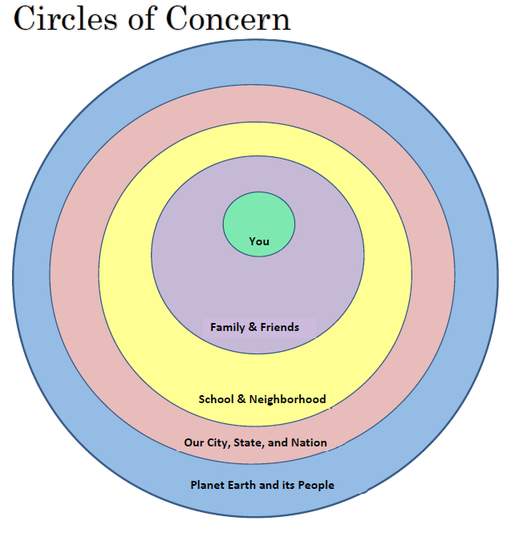
Lesson 1: Expanding Our Circles of Concern
Activity 1: The teacher walks through a “circles of concern” figure. They explain to the students that each of us has concerns for many people in the word. It starts off with each of us personally and expands eventually to everyone on the earth.
Students are asked to think about who they are concerned about beyond their family and friends.
Notes:
In activity 1 the teacher walks through a “circles of concern” figure. They explain to the students that each of us has concerns for many people in the word. It starts off with each of us personally and expands eventually to everyone on the earth. Students are asked to think about who they are concerned about beyond their family and friends.

Slide 8
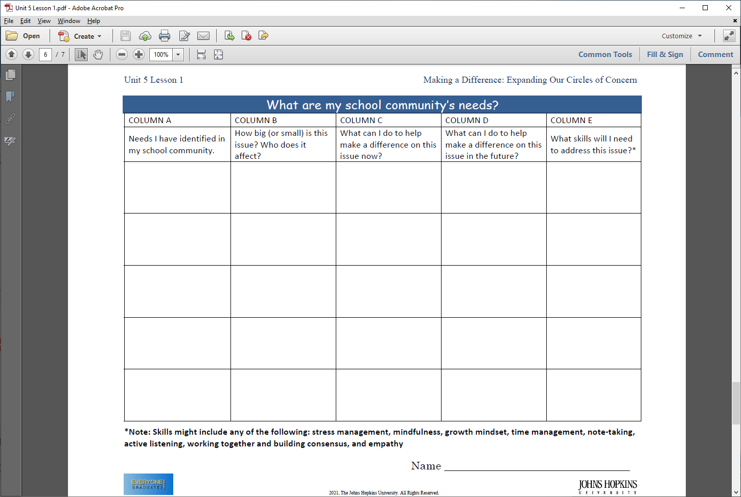
Lesson 1: Expanding Our Circles of Concern
Activity 2: Teachers help students brainstorm their school community needs and hands out the graphic organizer below. Students are asked to write their “school community needs” on post-it notes and hang up their post-its on a Wall of Needs.
Notes:
In Activity 2 teachers help students brainstorm their school community needs and hands out the worksheet below.
Students are then asked to write their “school community needs” on post-it notes and hang up their post-its on a Wall of Needs.

Slide 9
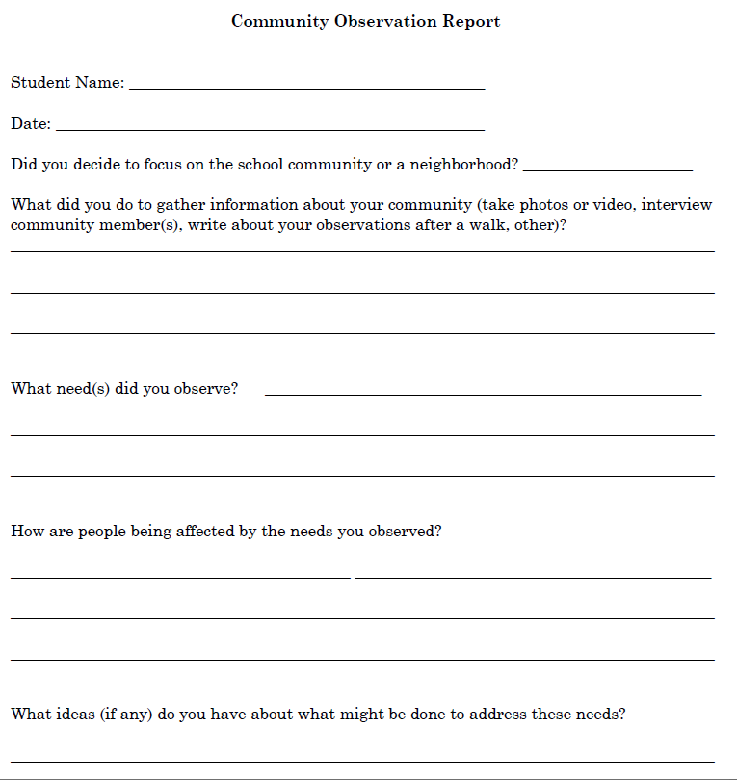
Lesson 1: Expanding Our Circles of Concern
Activity 3: Teachers help students brainstorm ideas to learn about needs of their neighborhood. The teacher will hand out the “Community Observation Report” form. Teachers will request that students fill out this form by a certain date.
Notes:
In Activity 3 teachers help students brainstorm ideas to learn about needs of their neighborhood. The teacher will hand out the “Community Observation Report” form. Teachers will request that students fill out this form by a certain date.

Slide 10
Lesson 2 Key Activities
Exploring Needs in My
Neighborhood Community
Objective: This lesson leads students to explore and identify neighborhood community needs while connecting what they learned in previous units.
Notes:
Lesson 2 leads students to explore and identify neighborhood community needs while connecting what they learned in previous units.

Slide 11
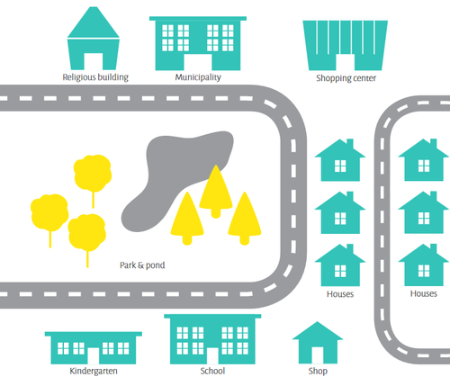
Lesson 2: Exploring Needs in My Neighborhood Community
Activity 1: The teacher will help students sketch out a map of their neighborhood surrounding the school. They discuss what are the important buildings and defining characteristics, what is different from other neighborhoods, and what is special about it.
Notes:
In Activity 1 The teacher will help students sketch out a map of their neighborhood surrounding the school. They discuss what are the important buildings and defining characteristics, what is different from other neighborhoods, and what is special about it.

Slide 12
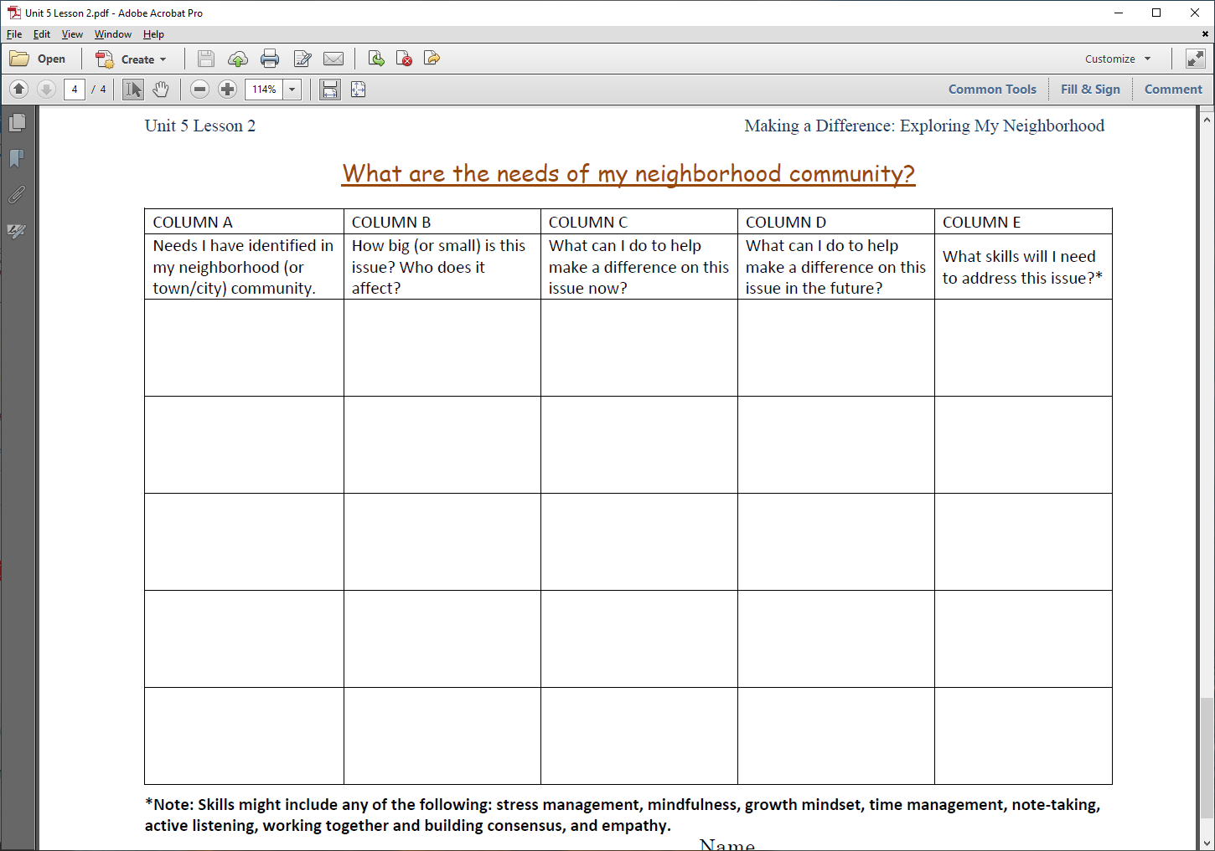
Activity 2: Students work in teams to brainstorm neighborhood community needs. Students are asked to complete columns A and B on the graphic organizer. Students are asked to write their “school community needs” on post-it notes and hang up their post-its on a Wall of Needs.
Lesson 2: Exploring Needs in My Neighborhood Community
Notes:
In Activity 2 Students work in teams to brainstorm neighborhood community needs. Students are asked to complete columns A and B on the graphic organizer. Students are asked to write their “school community needs” on post-it notes and hang up their post-its on a Wall of Needs.

Slide 13
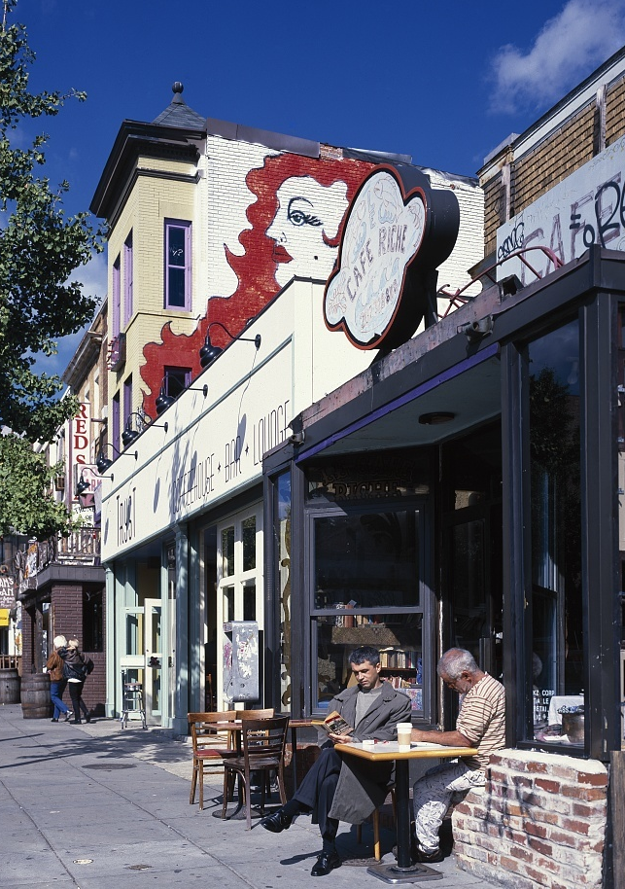
Lesson 2: Exploring Needs in My Neighborhood Community
Activity 3: Students share steps they have taken to learn more about their school or neighborhood community needs and what they have learned. The teacher helps students make plans to learn more information.
Notes:
In Activity 3 Students share steps they have taken to learn more about their school or neighborhood community needs and what they have learned. The teacher helps students make plans to learn more information.

Slide 14
Lesson 3 Key Activities
Addressing School or Neighborhood Community Needs
Objective: This lesson is designed to help students explore ways to address identified school or neighborhood community needs.
Notes:
Lesson 3 is designed to help students explore ways to address identified school or neighborhood community needs.

Slide 15
Lesson 3: Addressing School or Neighborhood Community Needs
Activity 1: Students share what they learned from their information gathering efforts. They may share photos or videos. The teacher will write these on a poster and they will look for overarching themes.
Notes:
In Activity 1: Students share what they learned from their information gathering efforts. They may share photos or videos. The teacher will write these on a poster and they will look for overarching themes.

Slide 16
Activity 2: Students to brainstorm ways to meet school or community needs. Students select the school community or neighborhood community chart and complete columns C-E.
Lesson 3: Addressing School or Neighborhood Community Needs
Notes:
In Activity 2: Students to brainstorm ways to meet school or community needs. Students select the school community or neighborhood community chart and complete columns C-E.

Slide 17
DISCUSSION TIME
How important are these lessons on addressing school and community needs? How much other instruction/guidance have they had already on these issues?
How do you think they will react to these lesson activities? What ideas do you have for keeping them engaged?
Unit 5
Notes:
Facilitator asks the questions on the slide.

Slide 18
Lesson 4 Key Activities
Choosing a Project to
Make a Difference
Objective: This lesson is designed to lead students to select and start planning an individual or team community project using what they have learned from previous units.
Notes:
Lesson 4 is designed to lead students to select and start planning an individual or team community project using what they have learned from previous units.

Slide 19
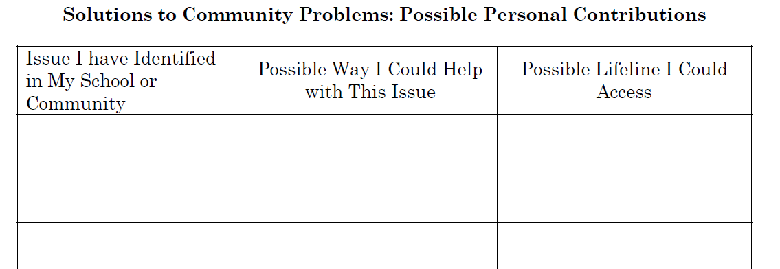
Lesson 4: Choosing a Project to Make a Difference
Activity 1: Students share ideas they have written on their school and neighborhood community sheets. They list their favorites on the “Possible Personal Contributions” activity sheet. The teacher can identify groups of students to work together on a community project plan.
Notes:
In Activity 1: Students share ideas they have written on their school and neighborhood community sheets. They list their favorites on the “Possible Personal Contributions” activity sheet. The teacher can identify groups of students to work together on a community project plan.

Slide 20

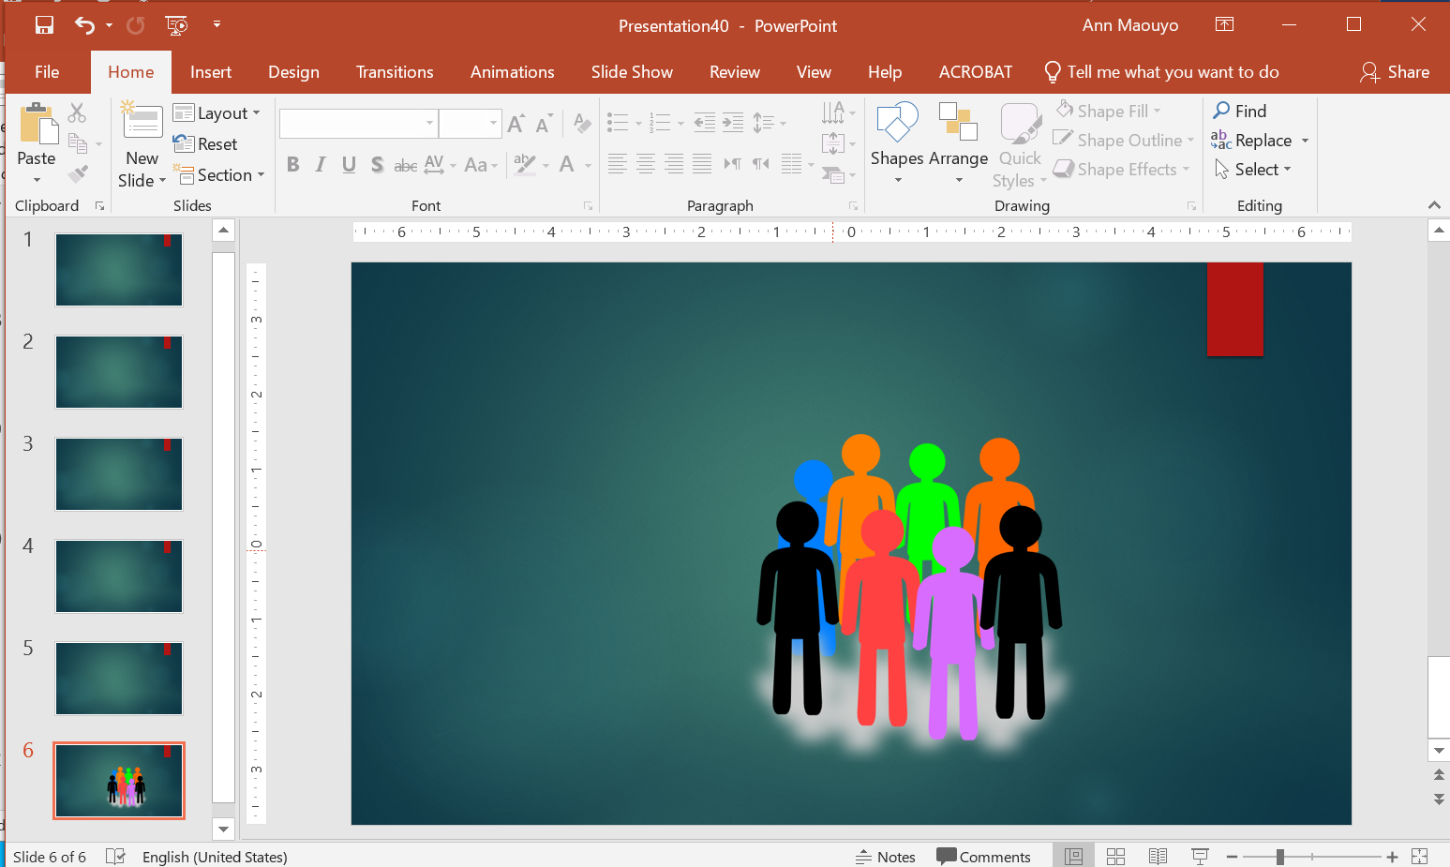
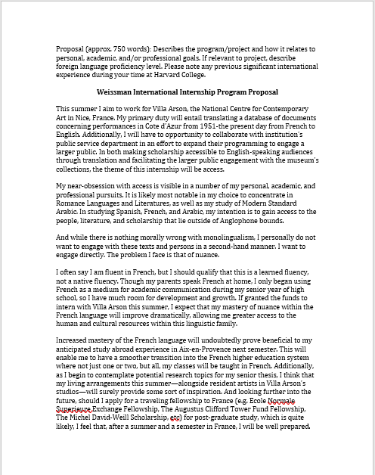
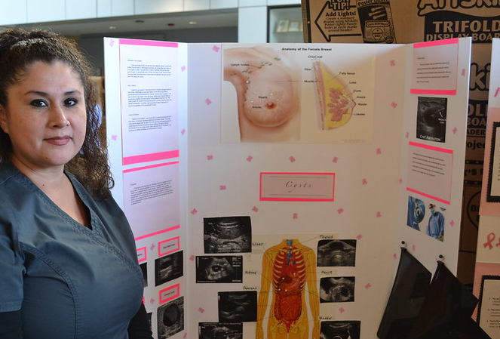

Activity 2: The teacher will explain that students will create a volunteer project plan by the end of this unit and that they can present this plan as a written report, slide presentation, poster presentation, blog post, TikTok video, or oral presentation (add or subtract from this list as necessary).
Lesson 4: Choosing a Project to Make a Difference
Notes:
In Activity 2: The teacher will explain that students will create a volunteer project plan by the end of this unit and that they can present this plan as a written report, slide presentation, poster presentation, blog post, TikTok video, or oral presentation (add or subtract from this list as necessary).

Slide 21
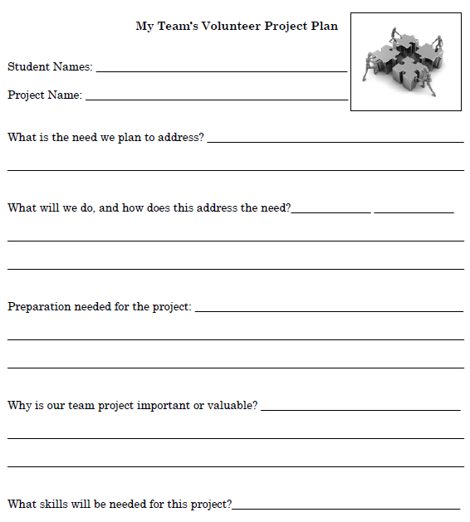
Lesson 4: Choosing a Project to Make a Difference
Activity 3: Individually or in groups the students will complete the “My Team’s Volunteer Project Plan” worksheet.
Notes:
In Activity 3: Individually or in groups the students will complete the “My Team’s Volunteer Project Plan” worksheet.

Slide 22
Lesson 5 Key Activities
Using Project Management Skills
For Your Volunteer Project
Objective: This lesson is designed to help students learn a transferrable project management process as they design a plan for their volunteer project.
Notes:
Lesson 5 is designed to help students learn a transferrable project management process as they design a plan for their volunteer project.

Slide 23
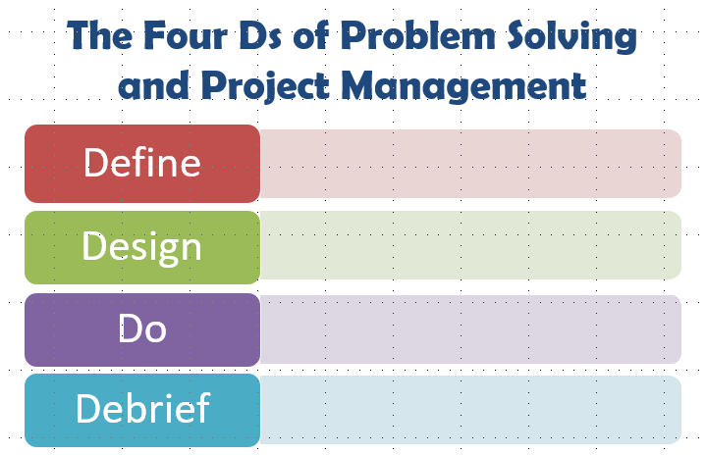
Lesson 5: Using Project Management Skills for Your Volunteer Project
Activity 1: The teacher will go through the 4 Ds of project management.
Notes:
In Activity 1: The teacher will go through the 4 Ds of project management.

Slide 24
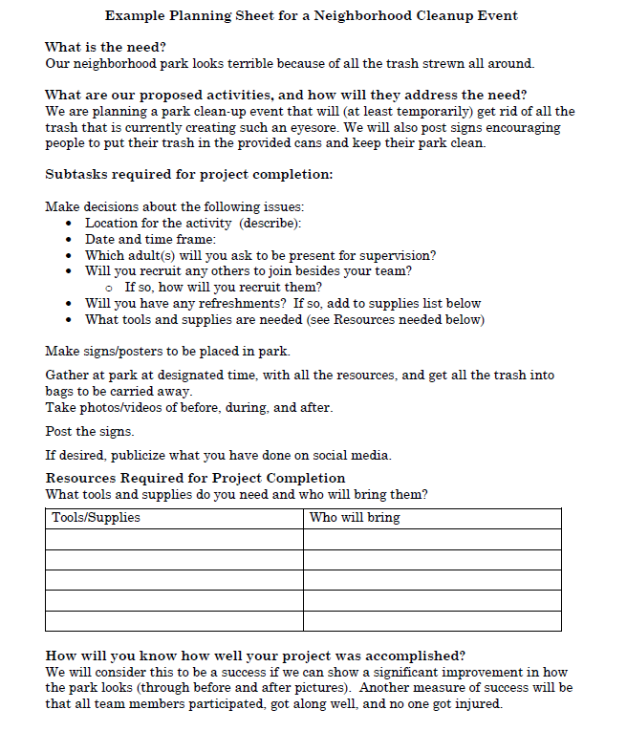
Lesson 5: Using Project Management Skills for Your Volunteer Project
Activity 2: Students complete the project definition, project design, and project timeline planning sheets.
Notes:
In Activity 2: Students complete the project definition, project design, and project timeline planning sheets.

Slide 25
Lesson 6 Key Activities
Working on Project Proposals
Objective: This lesson provides students time and guidance as they work on their project proposals.
Notes:
Lesson 6 provides students time and guidance as they work on their project proposals.

Slide 26

Lessons 6: Working on Project Proposals
Activity 1: Students spend the period working on project planning and associated research and organization. Circulate during the period to check in on all students and groups to monitor progress and offer encouragement (and suggestions if needed).
Notes:
During Lesson 6: Students spend the period working on project planning and associated research and organization. Circulate during the period to check in on all students and groups to monitor progress and offer encouragement (and suggestions if needed).

Slide 27
Lesson 7 Key Activities
Completing Project Proposals
Objective: This lesson is to provide students time and guidance to complete work on their project proposals.
Notes:
Lesson 7 provides students time and guidance to complete work on their project proposals.

Slide 28
Lesson 7: Completing Project Proposals
Activity 1: Students will continue to work individually or in teams to complete their proposals and presentation materials, as well as practice giving their presentations (e.g., fitting within time limits, assigning speaking parts) if applicable. Circulate during the period to check in on all students and groups to monitor progress and offer encouragement (and suggestions if needed).
Notes:
During Lesson 7: Students will continue to work individually or in teams to complete their proposals and presentation materials, as well as practice giving their presentations (e.g., fitting within time limits, assigning speaking parts) if applicable. Circulate during the period to check in on all students and groups to monitor progress and offer encouragement (and suggestions if needed).

Slide 29
Lesson 8 Key Activities
Presentation of Project Proposals
Objective: This lesson gives students the opportunity to share their work with the class (and outside visitors as possible).
Notes:
Lesson 8 gives students the opportunity to share their work with the class (and outside visitors as possible).

Slide 30
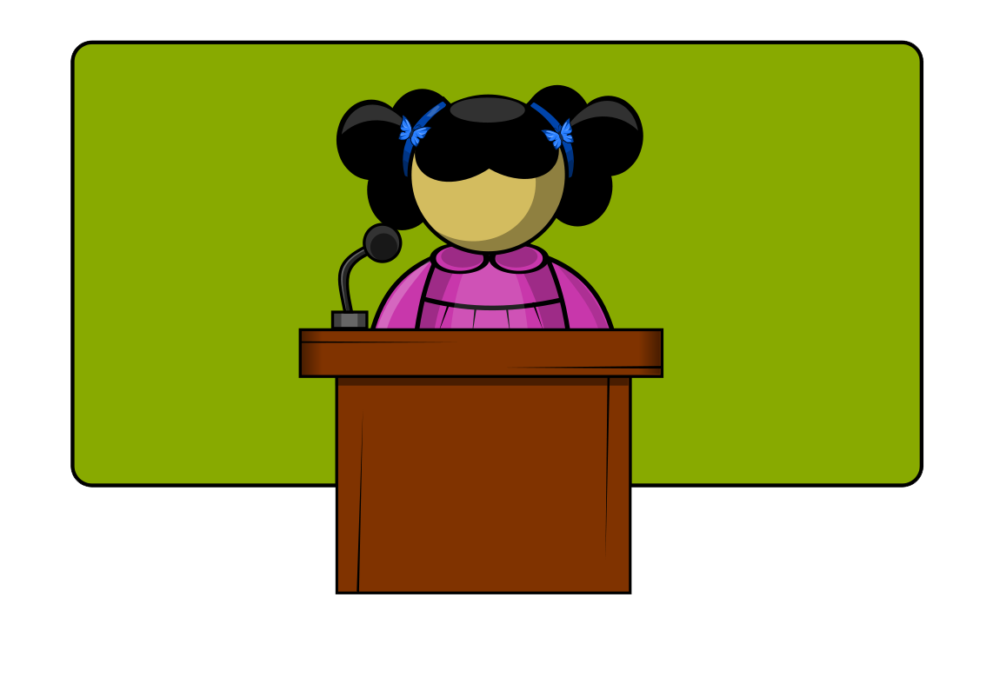
Lesson 8: Presentation of Project Proposals
Activity 1: students who choose an oral, digital slide, or TikTok presentation format to go first, presenting to the entire class.
For students who chose a poster or other visual display, divide the class into two groups. The first group will stand by their visual displays and answer questions as members of the second group (the “audience”) walk around the classroom and visit each display to ask clarifying questions and share thoughtful feedback. Switch groups.
Notes:
During Lesson 8: students who choose an oral, digital slide, or TikTok presentation format to go first, presenting to the entire class.
For students who chose a poster or other visual display, divide the class into two groups. The first group will stand by their visual displays and answer questions as members of the second group (the “audience”) walk around the classroom and visit each display to ask clarifying questions and share thoughtful feedback. Switch groups.

Slide 31
Do you feel that your students will enjoy planning a community project?
What help will they need to successfully complete a project plan?
How do you think they will react to these lesson activities? What ideas do you have for keeping them engaged?
Unit 5
Notes:
Facilitator asks the questions on the slide.

Slide 32
Lesson 9 Key Activities
Course Wrap-Up
Objective: This lesson helps students to reflect on their learning in the course and how they will use it going forward.
Notes:
Lesson 9 helps students to reflect on their learning in the course and how they will use it going forward.

Slide 33
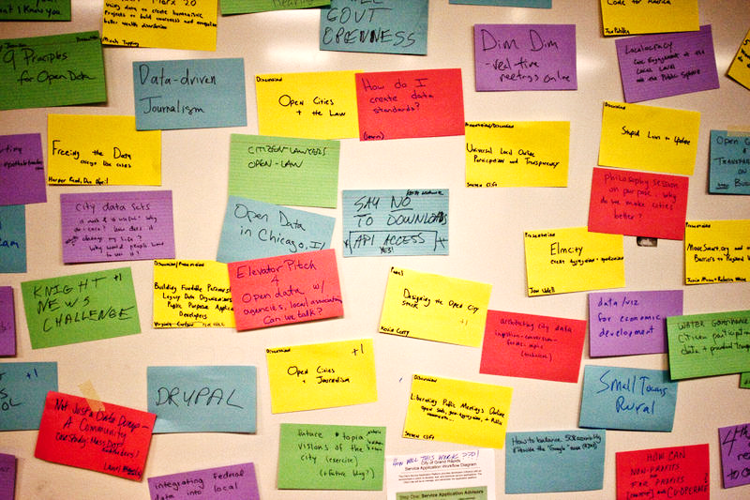
Lesson 9: Course Wrap-Up
Activity 1: Divide students into 5 groups (using color-coded strips or some other method). Direct groups to circulate to each Unit “Station” poster (3 minutes per station) and discuss together what they learned in that unit. Students should individually write on sticky notes the most important “take-away” they had for each unit and post it on or near the poster before moving on to the next station.
Notes:
In Activity 1: the teacher will divide students into 5 groups (using color-coded strips or some other method). Direct groups to circulate to each Unit “Station” poster (3 minutes per station) and discuss together what they learned in that unit. Students should individually write on sticky notes the most important “take-away” they had for each unit and post it on or near the poster before moving on to the next station.

Slide 34
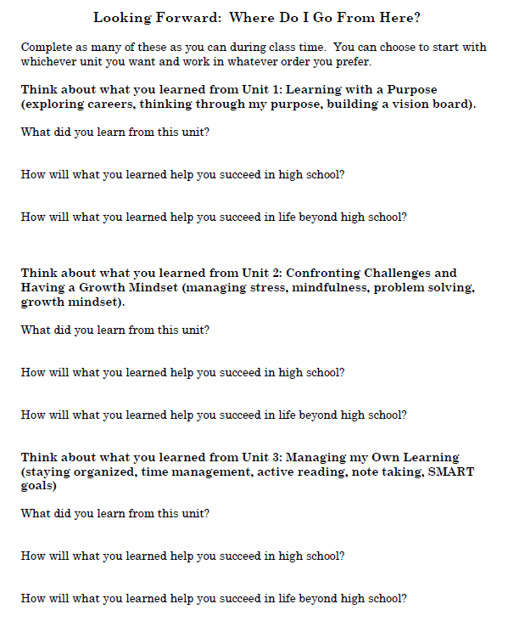

Lesson 9: Course Wrap-Up
Activity 2: Hand out the “Looking Forward: Where Do I Go From Here?” reflection sheet. Students may answer questions in any order they prefer.
Notes:
In Activity 2: The teacher will hand out the “Looking Forward: Where Do I Go From Here?” reflection sheet. Students may answer questions in any order they prefer.

Slide 35
Expanding Our Circles of Concern | Having students think outside the needs of their close family and friends. Students explore needs of their school community.
Exploring Needs in My Neighborhood Community | Students explore needs of their neighborhoods.
Addressing School or Neighborhood Community Needs | Students explore ways to address community needs.
Choosing a Project to Make a Difference | Students select a project to make a difference.
Using Project Management Skills for Your Volunteer Project | Students begin to plan a volunteer project plan.
Working on Project Proposals | Students work on their volunteer project plan.
Completing a Project Proposal | Students complete their volunteer project plan.
Presentation of Project Proposals | Students present their volunteer project plan.
Course Wrap-Up | Students think about what they learned over the whole course.

Slide 36

Overview of Unit 5
Take a few minutes to review the unit overview slides now and reflect on the following questions:
1) How do you see learning building from lesson to lesson? Within the unit?
2) What issues might arise when students plan out their volunteer project proposals?
3) How will learning these lessons help your students better prepare for high school and build the academic/social/emotional skills from ealier units?
4) How can I make a difference in my students’ lives?
5) How can I help students connect with each other to work together to make a difference?
Notes:
Facilitator asks the questions on the slide.

Slide 37


PD Feedback Survey
Your feedback matters to us!
Please check your email now for a link to our feedback survey and complete it now.
Thanks so much!
This Photo by Unknown Author is licensed under CC BY-SA
Notes:
It is very important to our partners at Johns Hopkins to receive our feedback. Please check your email now for a link to the survey about this PD session and take time to complete it now.
Thanks so much!

