Slide 1
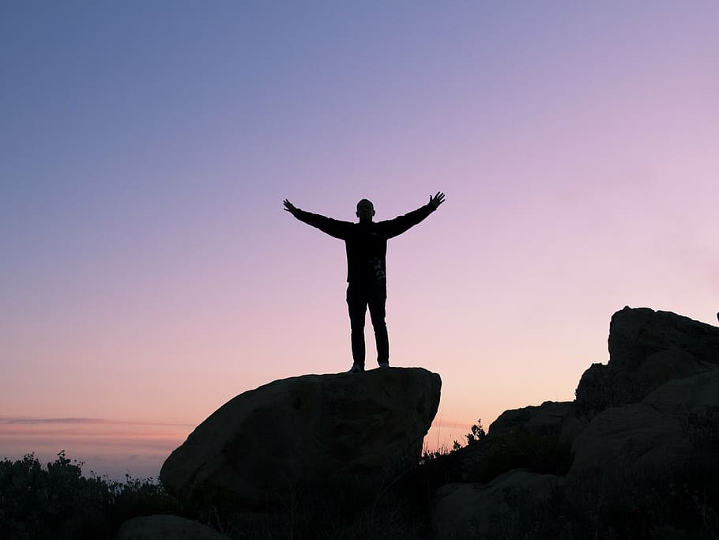
Skills for Secondary School Success (4S)
Unit 4 Interacting with Others as We Learn Together
Notes:
Read the slide to introduce Unit 4
1 min.

Slide 2

Agenda
Connection Circle
4S Unit 3 Reflection
Unit 4- Lesson by Lesson guidance
Notes:
Read the agenda or have someone read it for you

Slide 3
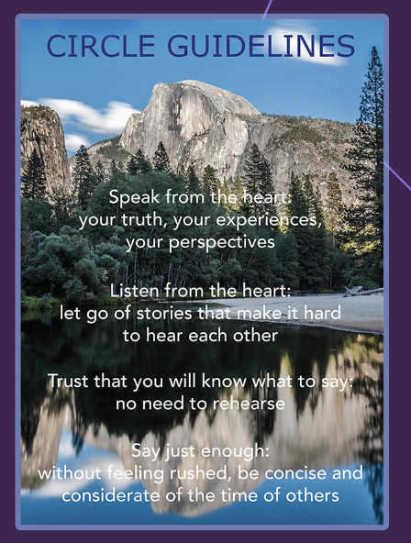
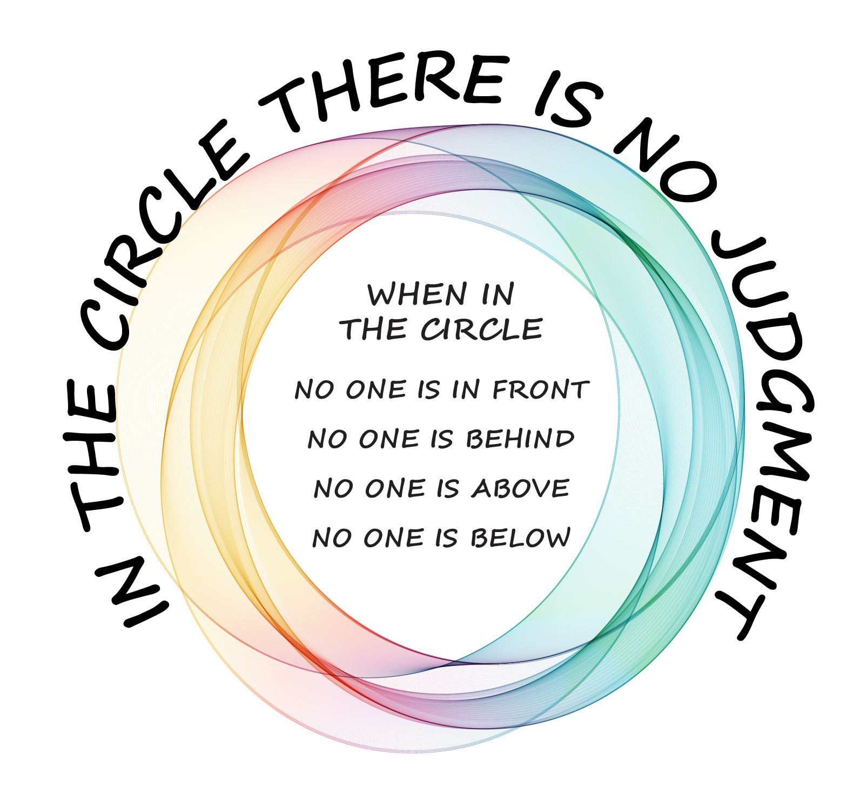
Connection Circle
Share one new thing you tried this week in your teaching and how it went.
Notes:
Gather your participants together in a circle to answer the connection circle prompt.

Slide 4

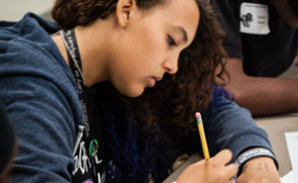
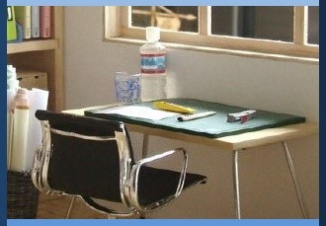
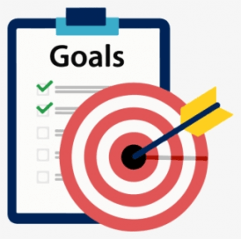

A
4S
Unit 3
Reflection
Are there any questions or reflections that surfaced for you concerning Unit 3 that you would like to share with others for feedback or discussion?
Notes:
Ask the question on the slide to the participants to see if there is anything that needs to be clarified or explored.
2 min.

Slide 5
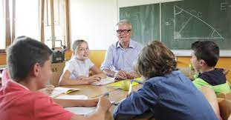
Unit 4
Essential Question
How do we co-create a classroom and school community where learning is engaging and liberating for all?
Notes:
Kindly read the essential question designed for Unit 4 and elicit responses from participants.
30 sec.

Slide 6

Unit 4 Interacting with Others as We Learn Together
Lesson 1: Connection Circles to Build Community and Relationships
Lesson 7,8 : Co-Creating a Caring Community I & II
Lesson 2:
Building Community through Gratitude
How do we co-create a classroom and school community where learning is engaging and liberating for all?
Lesson 6 : Strengthening Emotional Health
Lesson 3: Friendship
Lesson 5 : Working Together
Lessons 4: Effective Communication
Notes:
Read through the lessons of Unit 4 for a comprehensive overview of what students will be learning to build connection and coherence for your participants.
30 sec.

Slide 7
Lesson 1 Key Activities
Connection Circles to Build Community and Deepen Relationships
Objectives: Students will understand what community circles are and
how they help to deepen relationships. Students will participate in a community circle. Students will understand how their unique and diverse identities enrich the classroom community.
Notes:
Read the slide or have a participant read the slide. Share that circles have been an important part of building our 4S professional learning community and ask your participants how they envision community circles working in their classrooms and help their relationships with their students and the student-to-student relationships in their classrooms

Slide 8
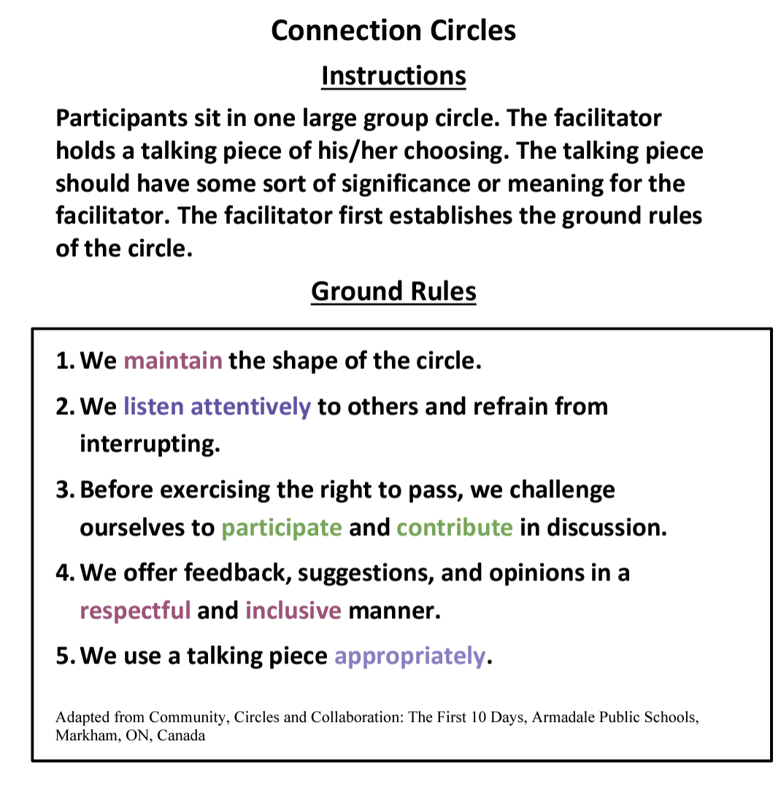
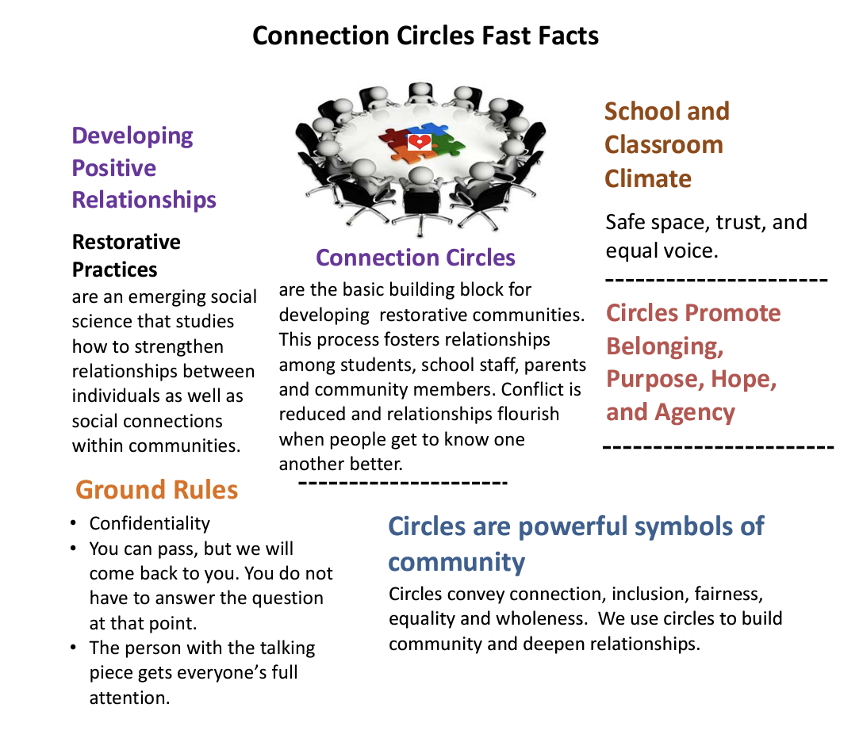
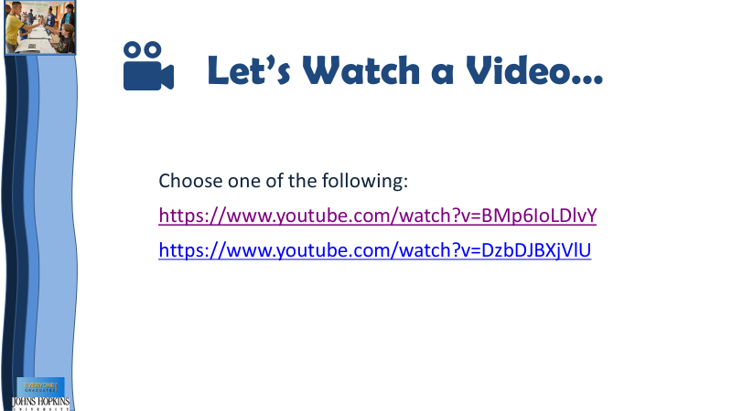
Lesson 1:
Connection Circles to Build Community and Deepen Relationships
Activity 1:
Students will learn about community circles through videos and discussion
Notes:
For this activity you will need to preselect one of two videos to share with your students to introduce community circles. After the video you will gather your students together in a circle to talk about circles, introduce a “talking piece” – a physical object that you will need to decide on before the lesson-an object with personal meaning to you-the talking piece will move around the circle and be held by the person sharing.

Slide 9
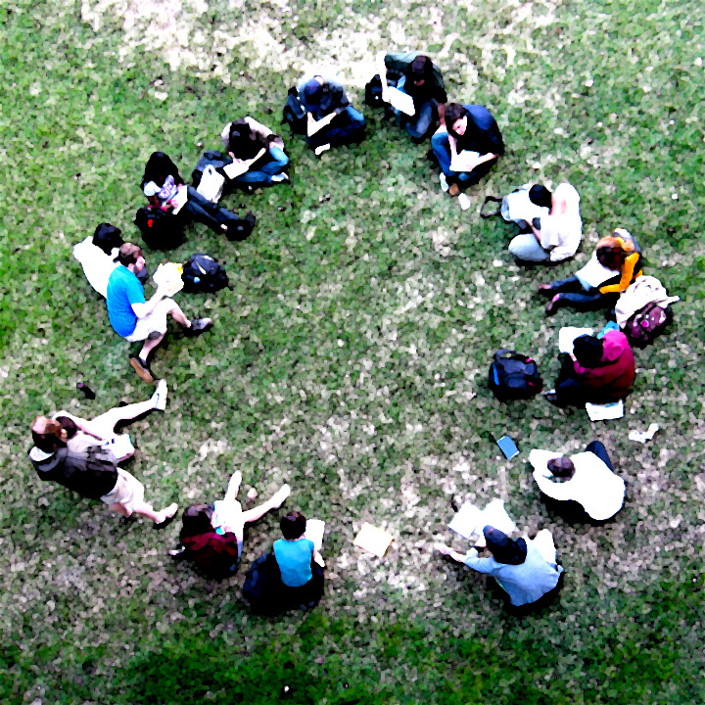
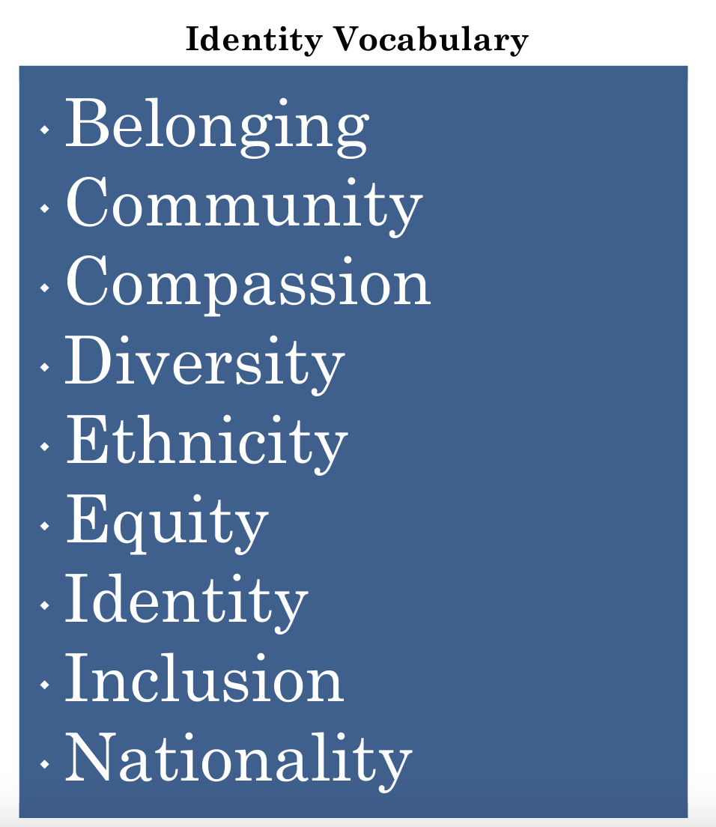
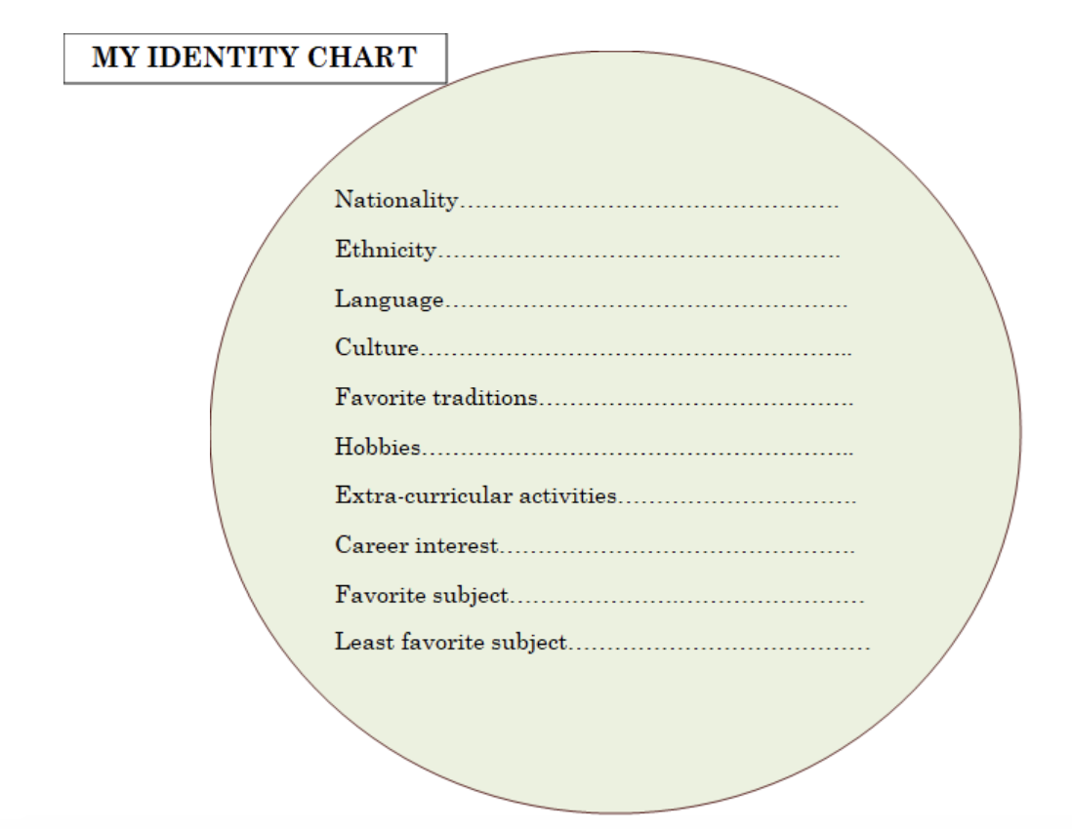
Activity 2: Students will use their identity charts to share something about themselves in the circle.
Lesson 1:
Connection Circles to Build Community and Deepen Relationships
Notes:
Students will participate in a connection circle using the Identity charts they completed during the introductory ”Do Now” portion of the lesson. The students can rely on their charts to answer on of two prompts.
1-Share something people do not know about you or 2 Share a fact on your Identity Chart that would surprise others
In addition, students will be adding their identity charts to a community wall-a space on the wall you designate for this purpose as well as explore identity-related vocabulary words that you or the students would like to highlight to help support collective compassion and understanding in classrooms.

Slide 10
Lesson 2 Key Activities
Building Community through Gratitude
Objectives: Students will understand the power and importance of gratitude. Students will work collaboratively to express gratitude in the school community.
Notes:
Read the slide or have a participant read the slide to ground the group in understanding the objective for this lesson.

Slide 11



Lesson 2
Building Community through Gratitude
Activity 1:
In groups, students will create a gratitude poster for someone in their school.
Notes:
Students will work in groups of three to design a poster for a person that is agreed upon by the group.
Gratitude posters will include the following: a) Name of the person b) A quote of something the person says often c) Three words to describe the person d) An image or symbol that represents the person e) Three things you appreciate about this person f) Explain how this person makes others feel special or positively contributes to the school community
Students will be given time to share their posters and as a class you will decide when to give the gratitude posters to the persons represented on each poster.

Slide 12
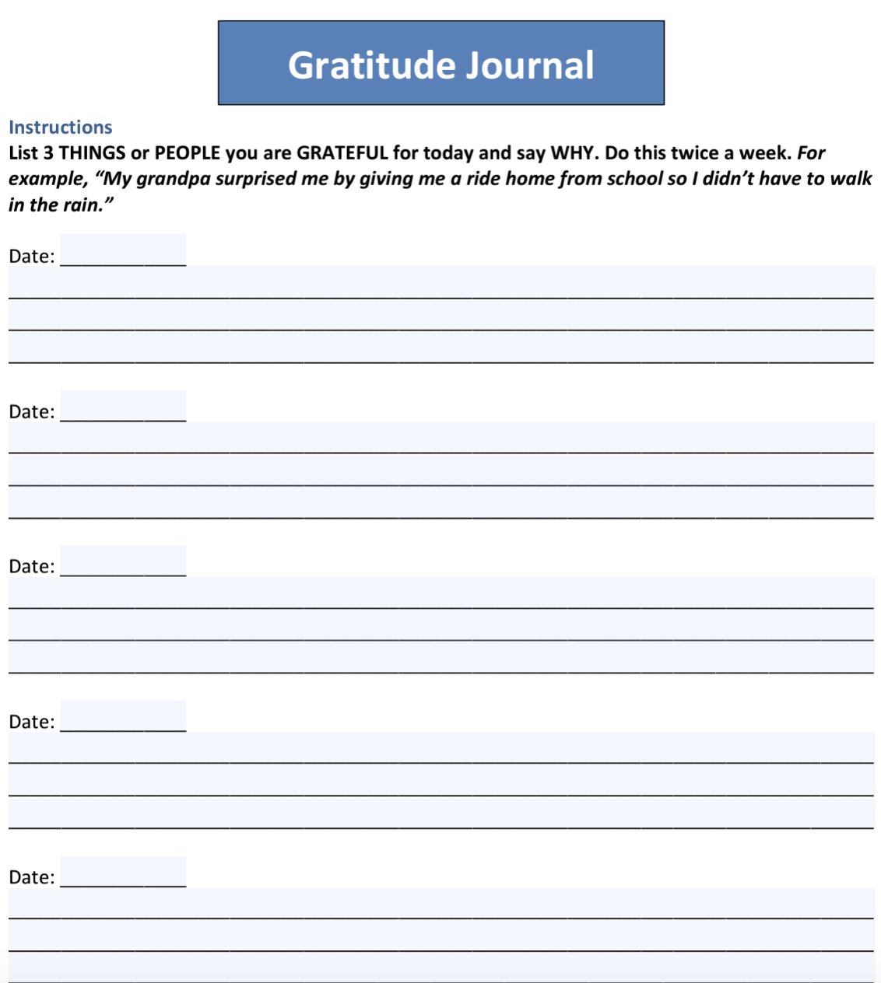
Lesson 2
Building Community through Gratitude
Activity 2:
Students will begin writing in Gratitude Journals.
Notes:
To help with the introduction of gratitude journals, there is an option video to show https://www.youtube.com/watch?v=XlQKaCl0_xY.
Students can create journals using an online platform, composition notebook, notes app on their phones-whatever makes the most sense for your classroom. Be sure to share the Gratitude prompts from slide 11 in the ppt deck for this lesson. Students will share with their groups of 3-3 things they are grateful for and why to close out this activity.

Slide 13
Lesson 3 Key Activities
Friendship
Objective: Students will discuss the essential qualities needed in friendships. Students will acknowledge their differing perspectives and preferences regarding friendships.
Notes:
Please read the slide or have a participant read the slide.

Slide 14
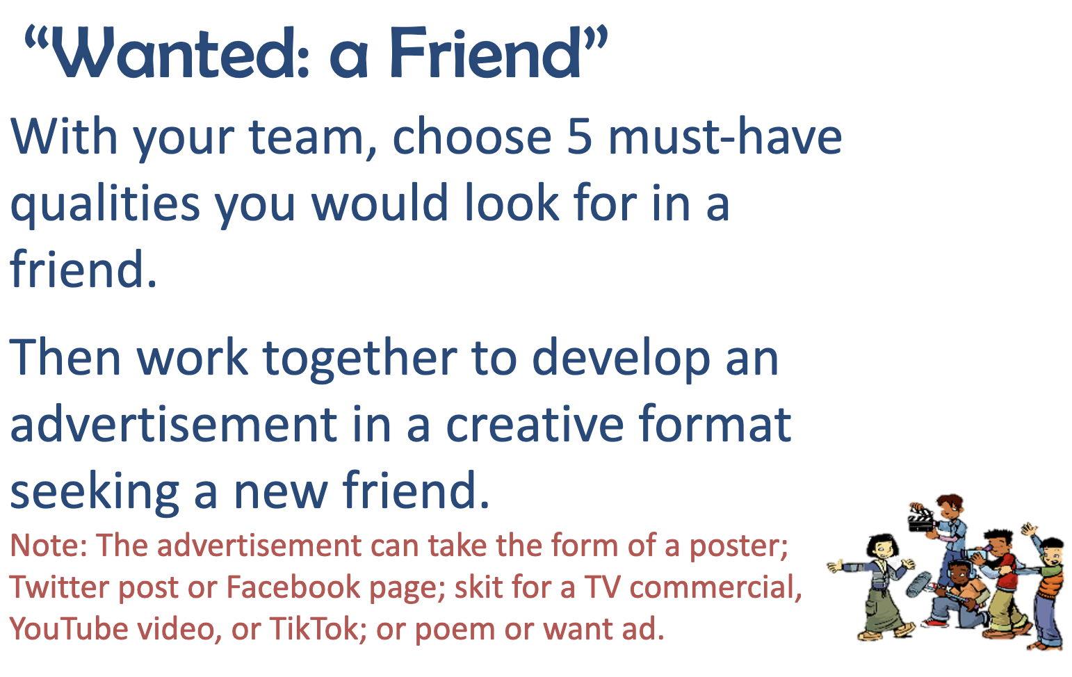
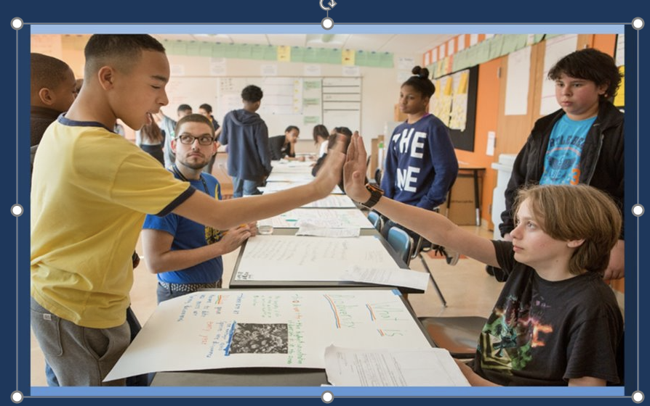
Lesson 3
Friendship
Activity
In a team, students will create an advertisement for a friend and present the advertisements to the whole class.
Note: Manual contains more details about sub-activities.
Notes:
Students will be divided into teams of 3 or 4 for this activity as the goal is to create an advertisement for a friend. The advertisement can be a poster, video, poem, Twitter post, etc.
This activity is connected to the DO Now the students completed at the start of the lesson where they listed the top 5 qualities of a friend.
Teams will collaboratively decide on a top 5 and spend 10 minutes creating their advertisement and 2 minutes per team sharing their advertisement for feedback.
Timing and grouping is up to the teacher. For example, you could give the students more time to create their advertisements and then have them share with a partner team for feedback instead off sharing with the whole group.

Slide 15
Lesson 4 Key Activities
Effective Communication
Objectives: Students will be able to identify the elements of active listening. Students will learn and practice active listening skills. Students will learn how to use I-Messages to share feelings without escalating conflict.
Notes:
Please read the slide or ask a participant to read the slide.

Slide 16
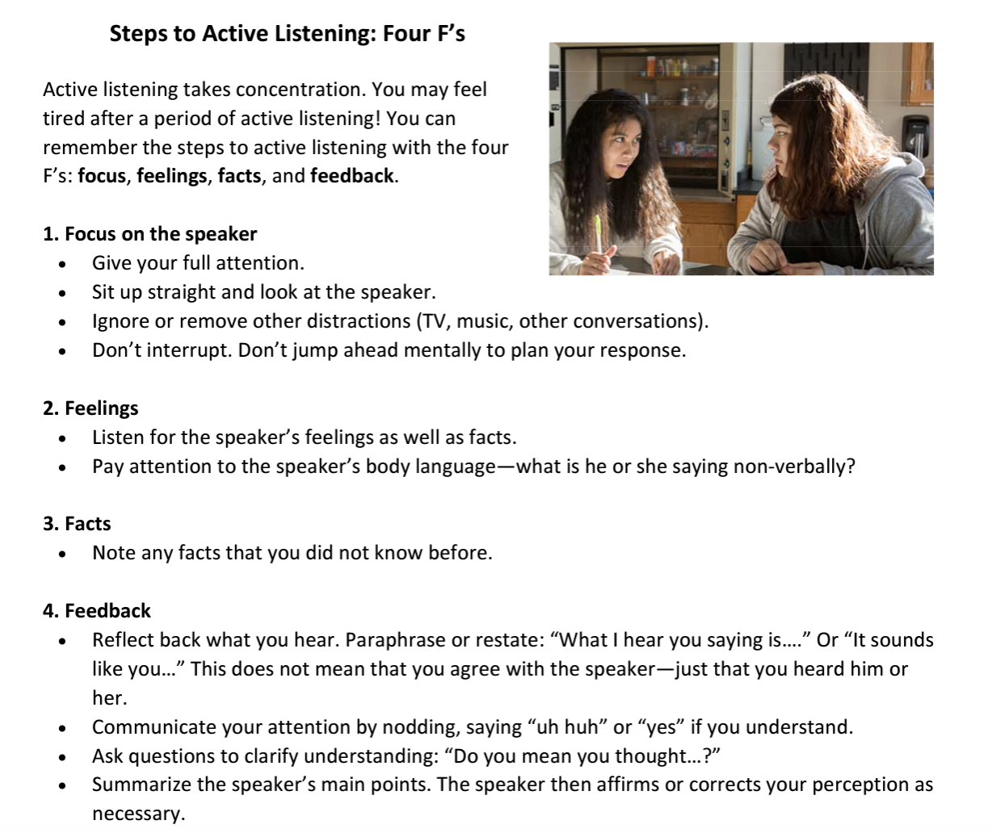
Lesson 4
Effective Communication
Activity 1:
Teacher models
bad example of active listening and then a good example through role play with students. Then teacher introduces
4 F’s of Active Listening:
Focus
Feelings
Facts Feedback
Notes:
This activity involves students watching two role plays by a student and you, the teacher (one where the teacher is a poor listener and one where the teacher is an attentive listener. The class is watching and reflecting the scenes with you using the guiding questions in the 4S Teacher’s Manual on pg. 214.
The second part of the activity involves the introduction of the 4 F’s (Focus, Feelings, Facts and Feedback), which has a handout that students will use with for small group role play listening (pgs. 214-215 4S Teacher’s Manual)
To close out the activity ask some of the questions on pg. 215 of the 4S Teachers Manual as time permits.

Slide 17
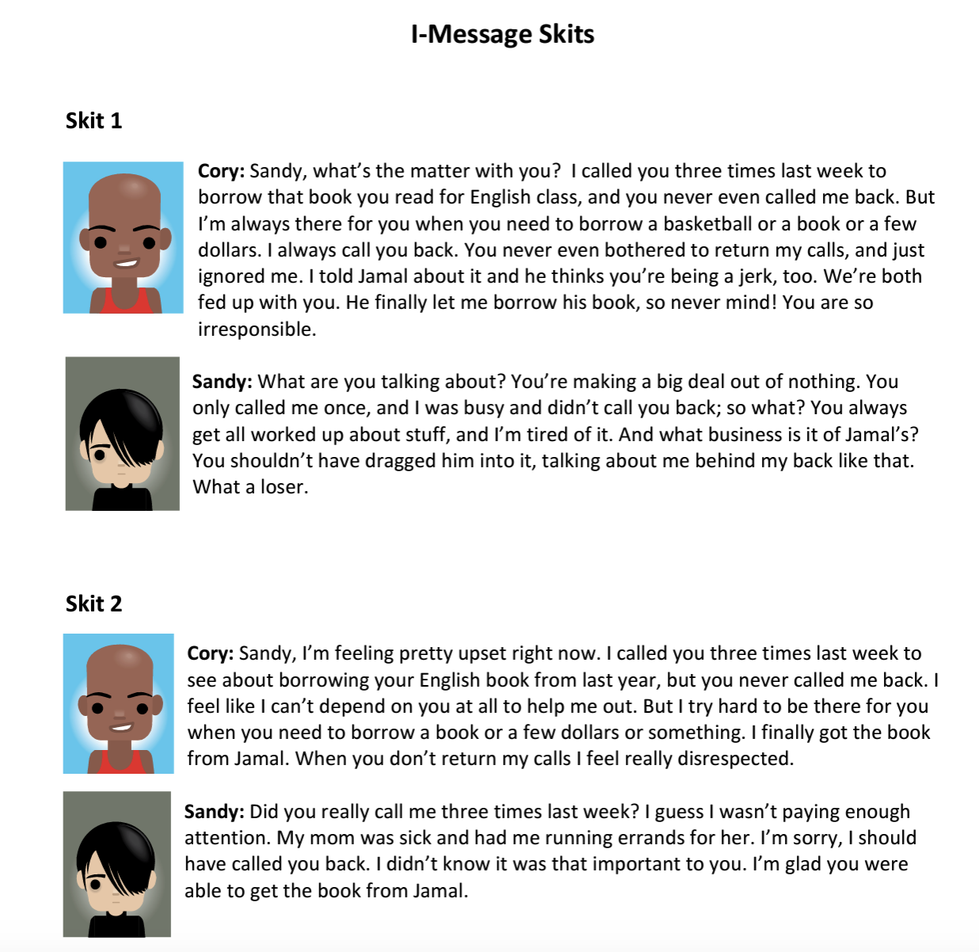
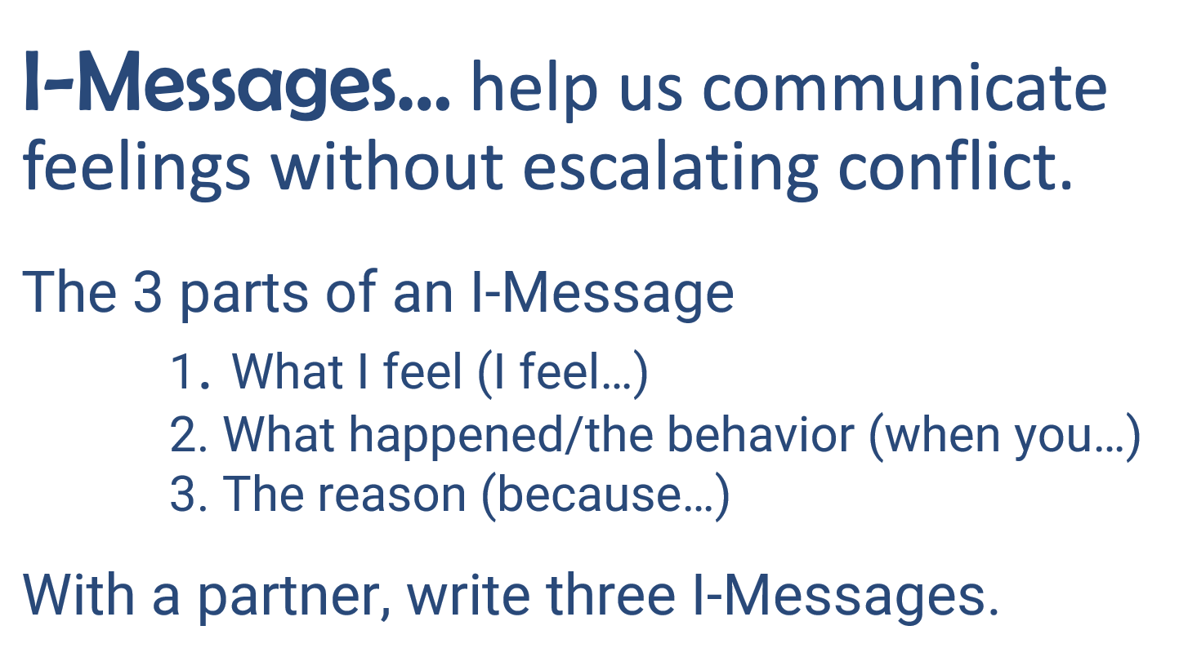
Activity 2:
Students will learn how to communicate their feelings in a way that is respectful using “I-messages.”
Lesson 4
Effective Communication
Notes:
As the teacher, you will explain that I-messages let others know how you feel without assigning blame to others.
There are 3 parts to an I-message
What I feel (“I feel….”)
What happened (the behavior) (“…when you…”)
The reason (“…because….”)
Students will then work in pairs to create 3 I-messages
To finish this activity, the students will read the I message skits and answer some of the questions on page 216 of the 4S Teacher’s Manual as a whole class discussion.

Slide 18
PLC DISCUSSION TIME
How familiar do you think your students will be with the ideas presented and discussed in these first few lessons?
How do you think they will react to these lesson activities? Do you foresee any opportunities as students understand these concepts?
Unit 4
Notes:
Let’s take some time to discuss your reactions to these first two lessons. How familiar will these concepts about stress be for your students?
How do you think they will react to the lesson activities?
Do you foresee any challenges as students interact with these lessons?
What ideas do you have for keeping them engaged?

Slide 19
Lesson 5 Key Activities
Working Together
Objectives: Students will be able to identify attributes of a successful team. Students will learn tips for working together well.
Notes:
Read the slide or ask a participant to read the slide.

Slide 20
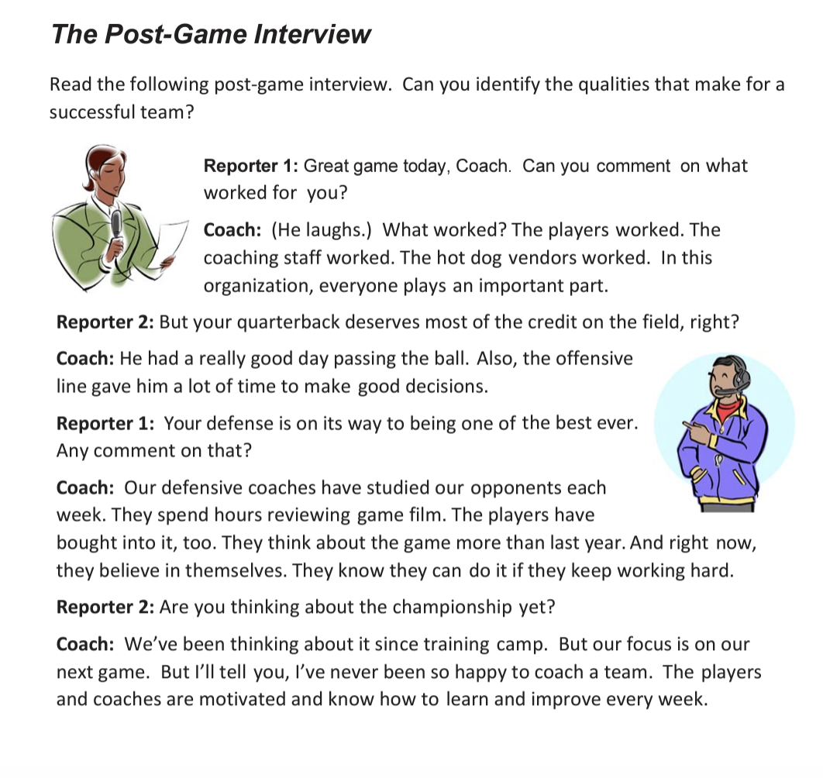
Lesson 5
Working Together
Activity 1: Students read a text and discuss that they learn from it about what makes a successful team.
Notes:
This activity engaged the students in independent reading of the the Post-Game Interview handout followed by a whole class discussion that it recorded by whatever means is best for your class to illicit from the class the characteristics of a successful team.
If time permits, you can engage students in the 4 corners activity to have them process how families, sports, businesses and governments can be teams.

Slide 21
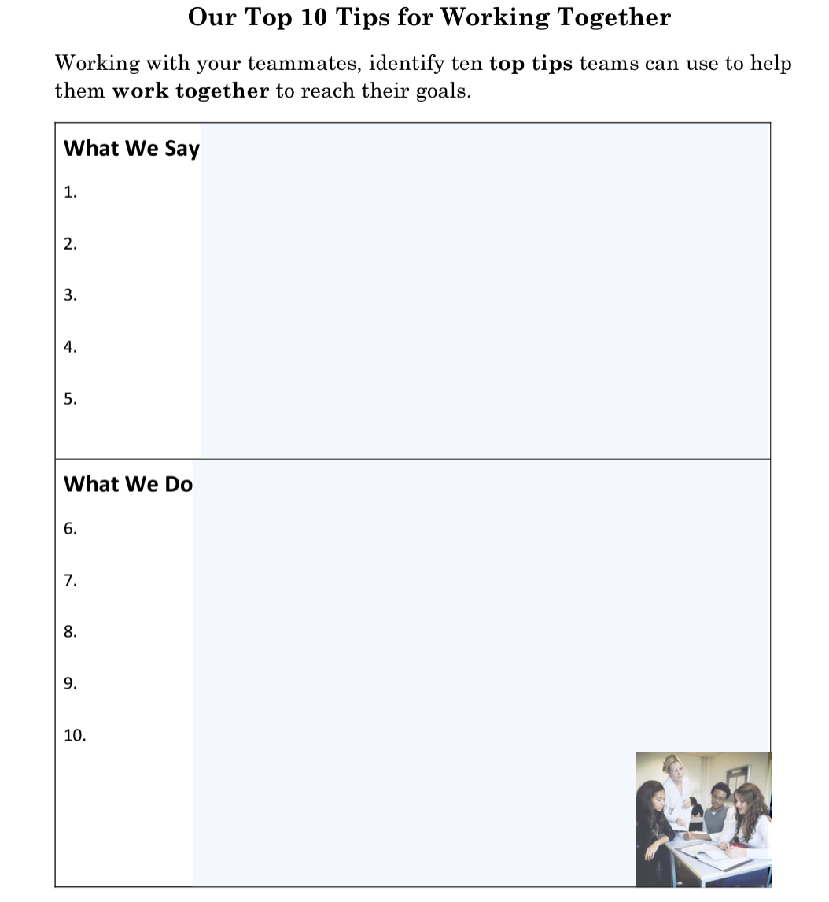
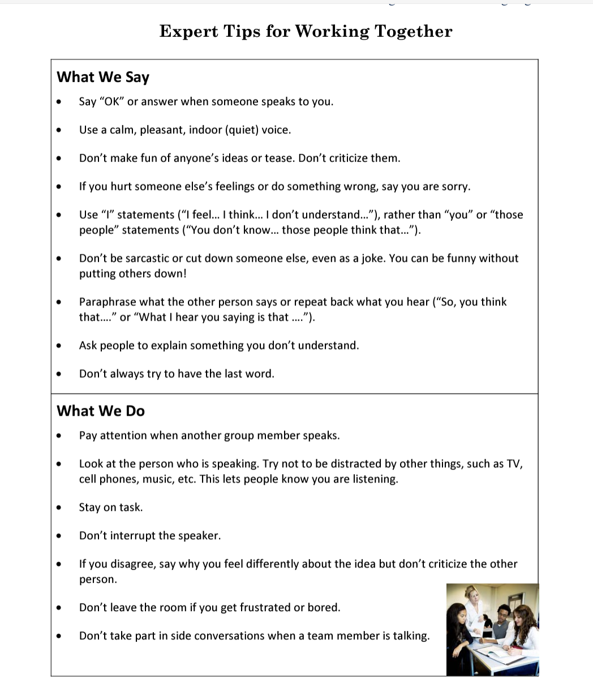
Activity 2: Students will work together to make team decisions.
Lesson 5
Working Together
Notes:
Students will again work in teams to decide on three way to spend $500. As a whole group, the students will engage in a discussion using the questions on page 221 of the 4S Teacher’s Manual.
What worked well in your group?
What did your group have problems with?
How did your group agree on its final choices?
At the conclusion of the discussion, the class will shift to completing the Top 10 Tips for Working Together activity sheet from pg. 224 4S Teachers Manual and read the “Experts Tips for Working Together on pg. 225

Slide 22
Lesson 6 Key Activities
Strengthening Emotional Health
Objectives: Students will broaden their vocabulary to be able to describe their emotions more accurately. Students will learn to handle conflict constructively. Students will select from among nine strategies to develop a self-care plan and commit to using it in daily life.
Notes:
Please read the slide or have a participant read the slide. Ask participants if their students have difficulty expressing their emotions and handling conflicts constructively. Ask if your participants have self-care plans that they use in their daily lives.
Explain that this lesson is designed to build bridges to better understanding our emotions and taking care of ourselves.

Slide 23
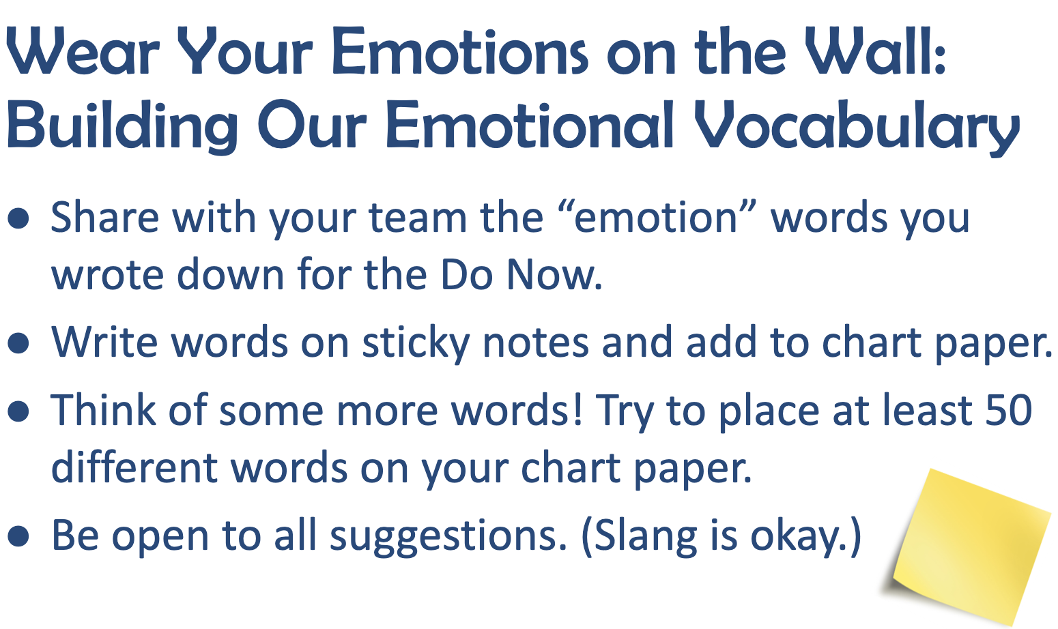
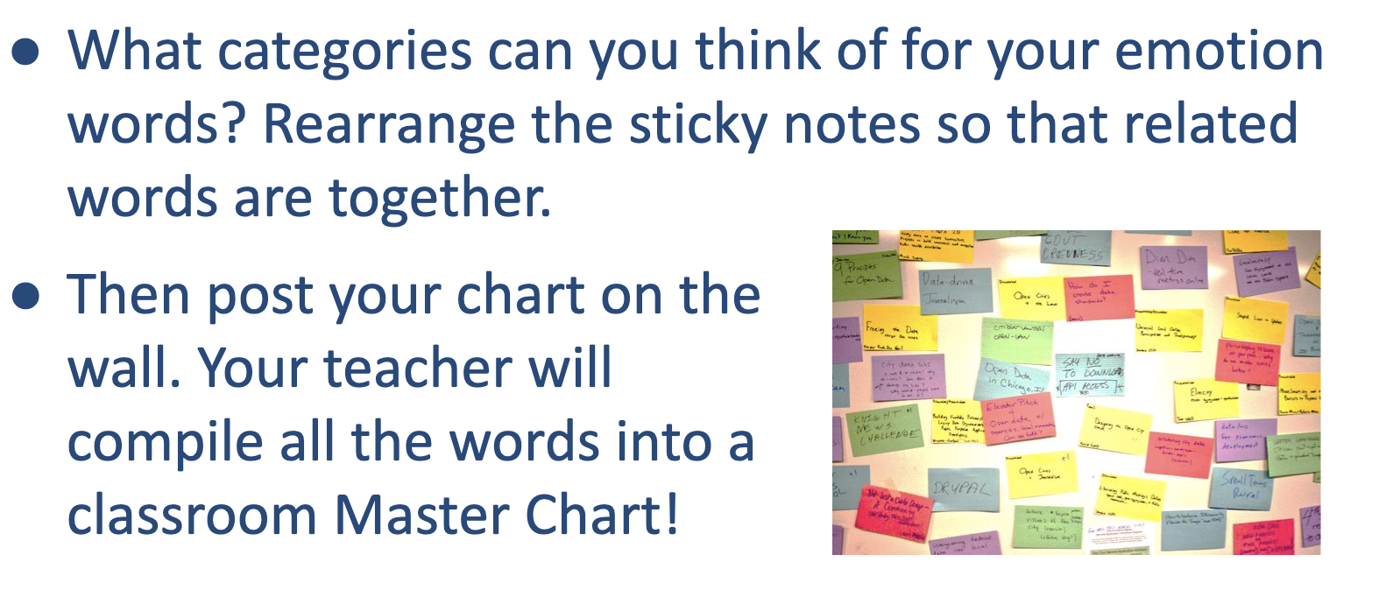
Activity 1: Students will learn how to identify and communicate their feelings to others.
.
Lesson 6
Strengthening Emotional Health
Notes:
This activity is connected to the daily Do Now and the emotion words they wrote on sticky notes. Students will be working in teams to create as many emotion words as they can and add them to a class chart that will be placed on the community wall that was created earlier in this unit. Students will create categories for their word or phrases.

Slide 24
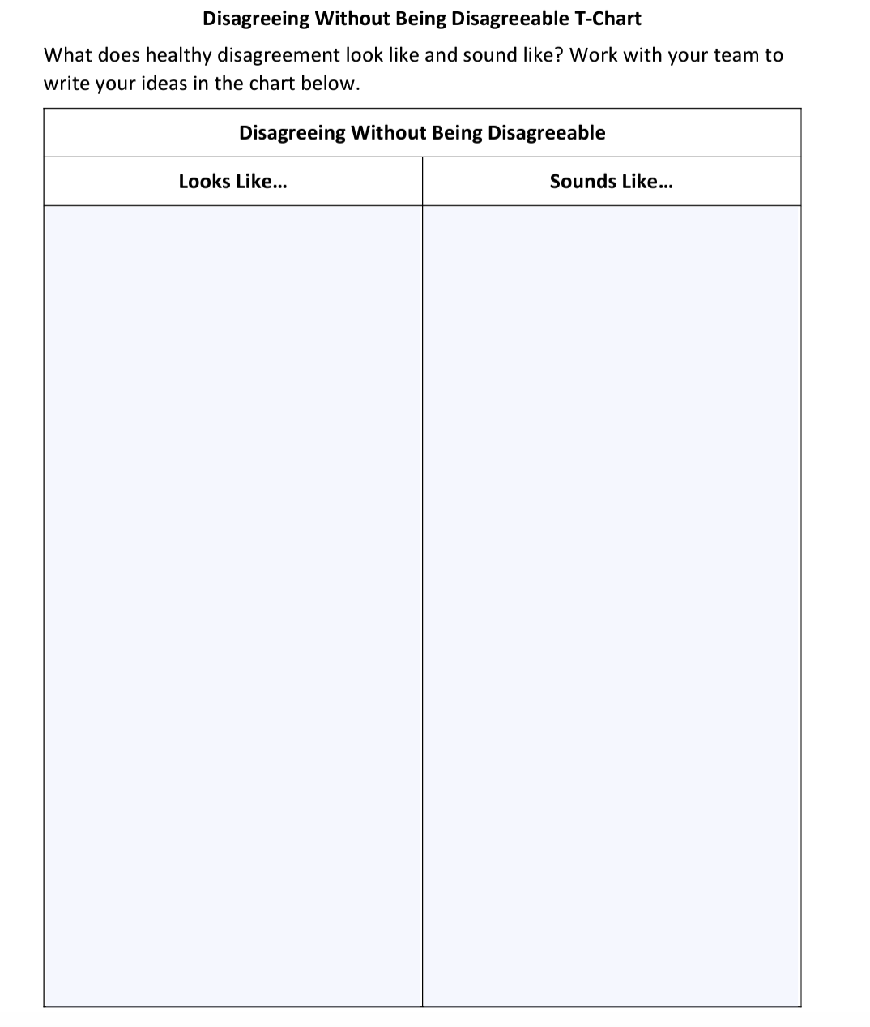
Lesson 6
Strengthening Emotional Health
Activity 2: Students will learn about conflict and how to disagree with people respectfully and honestly.
.
Notes:
This activity is designed to help students understand that when conflict is handled constructively it leads to better outcomes. To help make this point students will work in teams to complete the Disagreeing Without Being Disagreeable T-chart found on page 228 of the 4S Teacher’s Manual. If time allows have the students engage in role playing from conflicts they are dealing with currently.

Slide 25
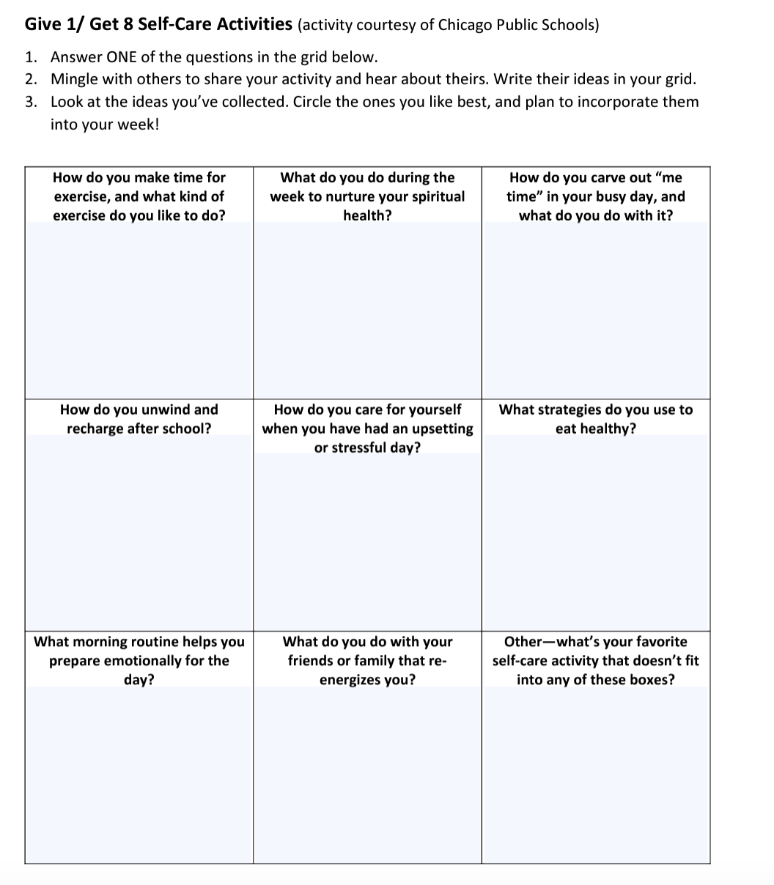
Lesson 6
Strengthening Emotional Health
Activity 3:
Students will learn about self-care practices that will help them cope with the challenges of life in healthy ways that will keep them strong.
.
Notes:
The Give 1/Get 8 handout (pg. 232 4S Teacher’s Manual) will help students identify how they are already taking care of themselves and help them pick up ideas from their friend to add to their repertoire of self-care practices. It is important to have students identify one self-care practice they will start using this week.

Slide 26
Lesson 7 Key Activities
Co-Creating a Caring Community I
Objectives: Students will gain an understanding of empathy. Students will understand and acknowledge their role in community building. Students will identify actionable steps toward creating a caring community.
Notes:
Please read the slide or ask a participant to do so.

Slide 27
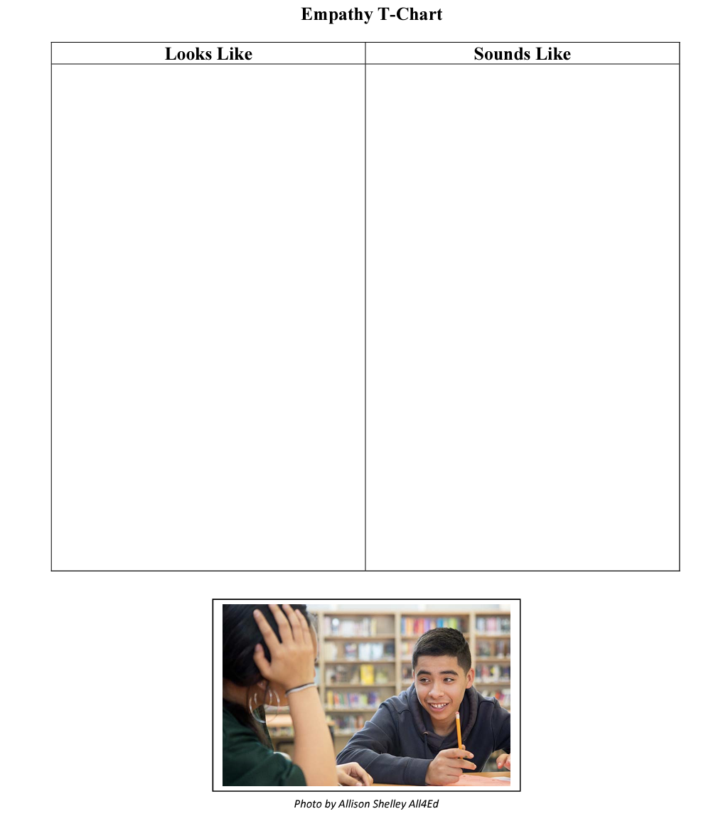
Activity 1: Students work with a partner to develop an Empathy
T-Chart
Lesson 7
Co-Creating a Caring Community I
Notes:
Students will be working with a partner to create an empathy t-chart found on pg. 239 of the 4S Teacher’s Manual. The partner charts will contribute to the creation of a class empathy T-chart that will be placed on the community wall space.

Slide 28
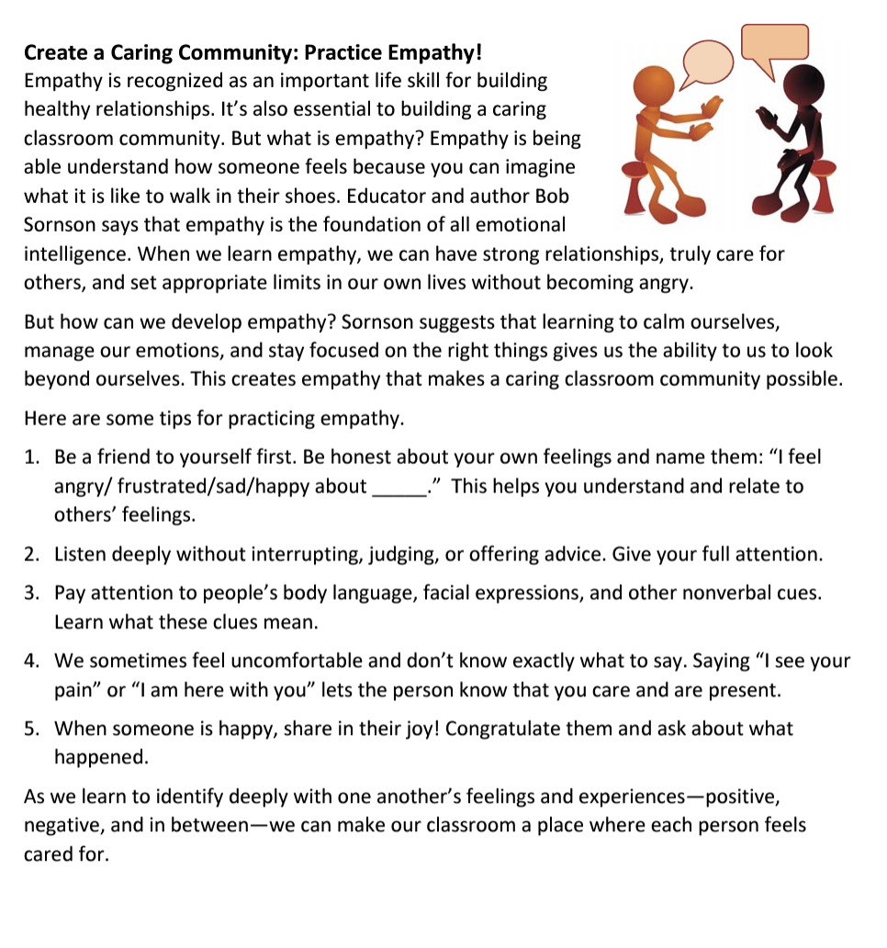
Activity 2: Students read with a partner Create a Caring Community: Practice Empathy. Students will engage in a brief discussion that resurfaces the “big ideas” that emerge in today’s lesson including mindfulness, gratitude, and empathy
Lesson 7
Co-Creating a Caring Community I
Notes:
You can read and discuss the activity description on the slide.

Slide 29
Lesson 8 Key Activities
Co-Creating a Caring Community II
Objectives: Students will connect with a partner through empathy interviews. Students will understand empathy as part of the design thinking cycle. Students will discover their own inner agency as they re-imagine their classroom..
Notes:
Please read the slide or ask a participant to read the slide.

Slide 30
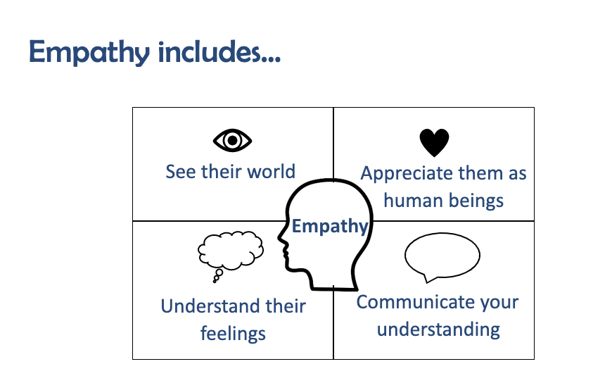
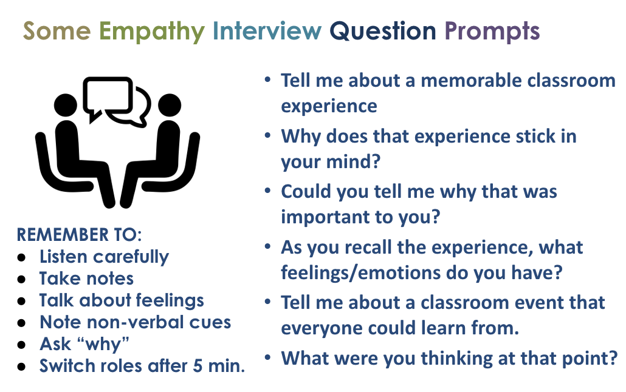
Lesson 8
Co-Creating a Caring Community
II
Activity 1:
Students will conduct an empathy interview
Notes:
Students will receive a copy of the empathy grid to use during their empathy from page 247 of the 4S Teacher’s Manual. Using question prompts from pg. 244 of the 4S Teacher’s Manual.
Tell me about a memorable classroom experience. Could you explain what makes that experience remain in your mind? Could you tell me why that is important to you? As you recall the experience, what feelings/emotions do you have? Walk me through something that happened in your classroom that everyone could learn from. What were you thinking at that point?
Each student will have 5 minutes to ask questions then switch so that each partner has a chance to conduct an interview and be interviewed.

Slide 31
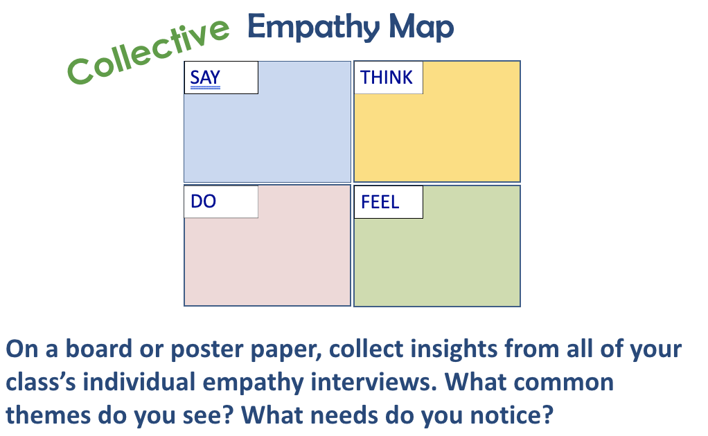
Lesson 8
Co-Creating a Caring Community
II
Activity 2:
Students will create a collective empathy map.
Notes:
The second activity engages with the whole class in a group debrief of their interviews to create a whole class Empathy Map that will result in a collective agreement of one idea to test and refine in the classroom in the following week.

Slide 32


Reflections and Questions
What thoughts or questions are in your mind as you consider how to help your students interact with each other?
Think about share how you might continue to grow some of the practices from this unit in your classroom.
This Photo by Unknown Author is licensed under CC BY-SA
Notes:
Let’s spend the rest of our time together reflecting and discussing any thoughts or questions that have emerged from you as we consider how we will help students learn about confronting challenges in this Unit.
How do your students struggle in having a growth mindset? How do you think these lessons could help? Is there anything you think that is missing that could be helpful to them?

Slide 33


PD Feedback Survey
Your feedback matters to us!
Please check your email now for a link to our feedback survey and complete it now.
Thanks so much!
This Photo by Unknown Author is licensed under CC BY-SA
Notes:
It is very important to our partners at Johns Hopkins to receive our feedback. Please check your email now for a link to the survey about this PD session and take time to complete it now.
Thanks so much!

