Slide 1

Skills for Secondary School Success (4S)
Unit 3: Managing My Learning
This Photo by Unknown Author is licensed under CC BY-NC-ND
Notes:
Welcome to our Professional Development session for Unit 3 of Skills for Secondary School Success: Managing My Learning.

Slide 2

Agenda
Connection Circle/Reflection on Unit 2
Overview of Unit 3 Lessons
Reflections/Questions
Use your copy of the
Teacher’s Manual for
reference throughout the
Session.
Notes:
In our time today we will begin with a Connection Circle to reflect and discuss our experiences with the Unit 2 lessons aimed at helping students deal with stress and other challenges. We will then spend some time getting an overview of the lessons in Unit 3. It will be helpful to have your copy of the Teacher’s Manual to follow along. We will conclude with more time for reflection and discussion as we think about starting Unit 3 with students.

Slide 3
Connection Circle
Reflecting on Experience with 4S
So Far
What growth did you observe in students as they considered careers and created vision boards for their lives?
How are students responding to lessons about dealing with stress and confronting challenges?
What changes in growth mindset are you hoping to see in students? In yourself as a teacher?
Notes:
Facilitator follows the prompt on the slide
5min.

Slide 4
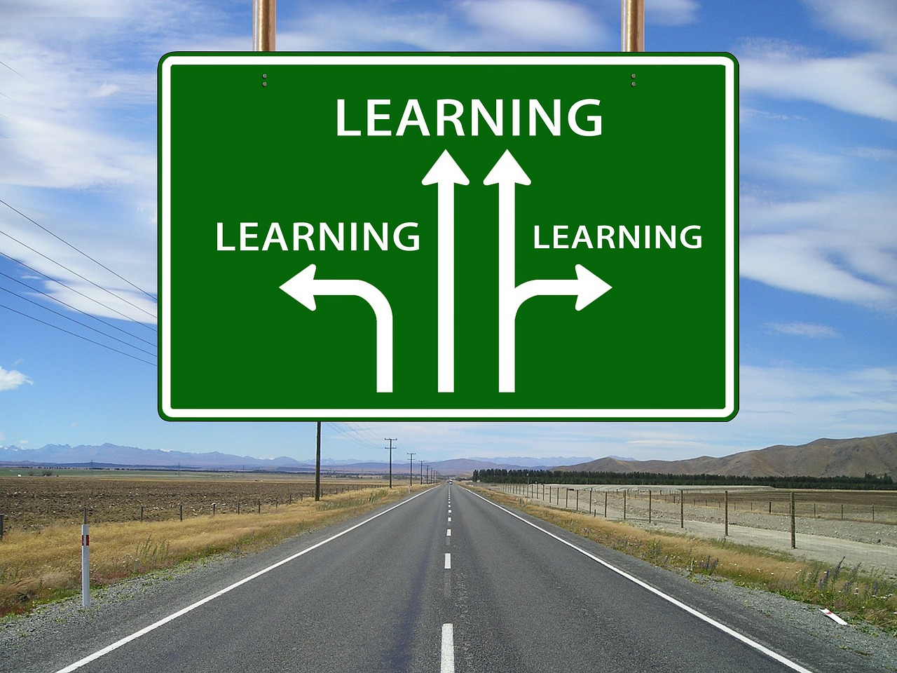
Managing My Learning Road Map
Getting & Staying Organized
Managing Time & Setting Priorities
Planning for Effective Studying
Attentive Reading
Learning to Learn
Taking Useful Notes
Setting S.M.A.R.T. Goals
Measuring My Learning
Notes:
Now we want to spend some time looking at the road map for Unit 3. This slide gives you a list of the lesson titles. The first three deal primarily with organization and self-management skills. There are specific lessons that help with reading skills, using graphic organizing, taking good notes and using outlines. The unit concludes with a lesson on goalsetting.

Slide 5
Unit 3
Essential
Question
How can using effective strategies help me take charge of my learning, both in class and out of class?
Notes:
It will be important to introduce students to the Unit 3 essential question in the first lesson, and remind students frequently of it throughout the unit. We are encouraging students to take responsibility for managing their learning, and giving them the skills and strategies to do this.
IF TIME PERMITS: What might you yourself say in response to this question with respect to your own professional learning? Take a couple of minutes to jot down some thoughts, and we’ll invite you to share out how you would respond.
SHARE OUT
We’ll revisit this again at the end of our session today.

Slide 6
Lesson 1 Key Activities
Staying Organized
Objective: This lesson is designed to introduce students to learning skills they will need in high school, beginning with the need to organize all their materials for different classes.
Notes:
The unit begins with a lesson on staying organized.

Slide 7

Lesson 1: Staying Organized
Unit Overview –
High School Challenges Game
Getting & Staying Organized
Managing Time & Setting Priorities
Planning for Effective Studying
Attentive Reading
Strategies for Remembering Information
Taking Useful Notes
Setting S.M.A.R.T. Goals
Students divided into seven teams, each receiving a short scenario of a student challenge in high school. They decide what the particular challenge is and compete to get their answer on the board first.
Note – For this game 2 lesson titles that will not be immediately clear yet to students have been combined into “Strategies for Remembering Information”
Notes:
Before getting into specifics on the theme of organization, Lesson 1 gives students an overview of the entire Unit 3 through a brief game. You will have printed handouts with different scenarios for each of seven teams. The teams read the short paragraph scenario together and try to match the challenge in the scenario to one of the specific strategies covered in the Unit lessons.

Slide 8
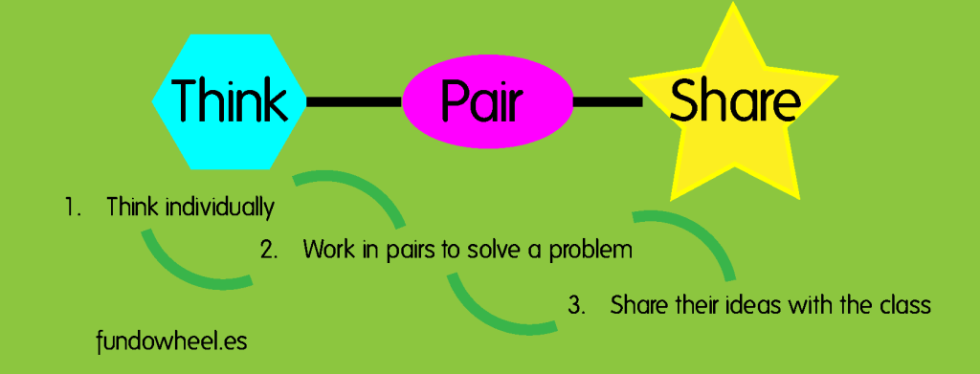
Lesson 1: Staying Organized
Activity 1: Students THINK-PAIR-SHARE with a partner about what they need in class and to take home. This is followed by full class discussion.
Notes:
Then the class dives into the first lesson theme of staying organized. In activity 1 students think-pair-share about what they need to have in class and back at home each day. The class then debriefs together.

Slide 9

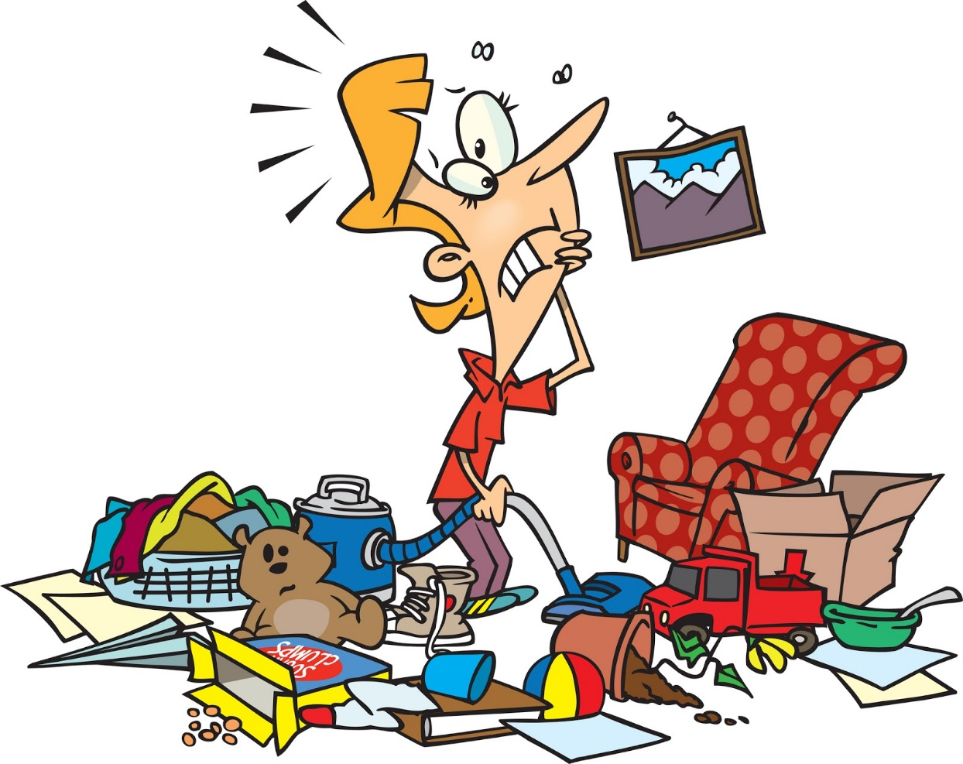
Lesson 1: Staying Organized
Activities 2 & 3
Teacher shares different organizational strategies with students (using binders or folders or notebooks, etc.) and gives students time to sort and organize their current school materials
This Photo by Unknown Author is licensed under CC BY-SA-NC
Notes:
In the next activities, the teacher shares some different organizational strategies with students, and students have time individually to sort and organize their current school materials.

Slide 10
Lesson 2 Key Activities
Managing Time and
Setting Priorities
Objective: This lessons is designed to help students learn to manage and prioritize their time and use a planner to organize assignments and dates.
Notes:
Lesson 2 focuses on time management and setting priorities.

Slide 11
Lesson 2: Managing Time
Activity 1: Students grouped in pairs to read one of two scenarios about a student’s busy life. They then organize the information onto a organizer/planner page.
Notes:
In the first activity, students partner read a scenario about a student’s busy life in high school, and then work together to transfer the information in the paragraph onto a planner page.

Slide 12
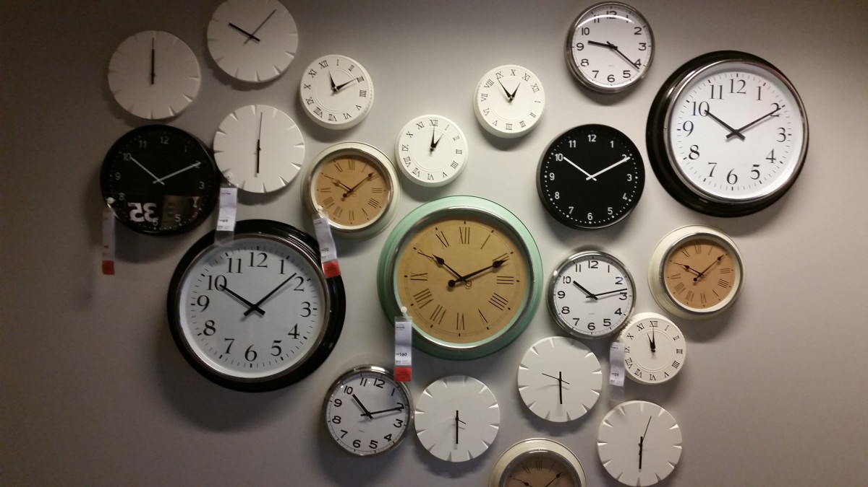
Lesson 2: Managing Time
Activity 2 – What do you do all day? Students individually reflect on their daily schedule and record in a “Daily Log” sheet (in student materials). Then students share in pairs and then class discusses as a whole.
Notes:
In Activity 2 students work individually to write down what they do throughout a typical day. They then share in pairs and as a whole class.

Slide 13

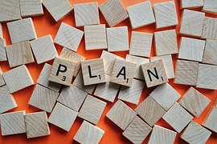
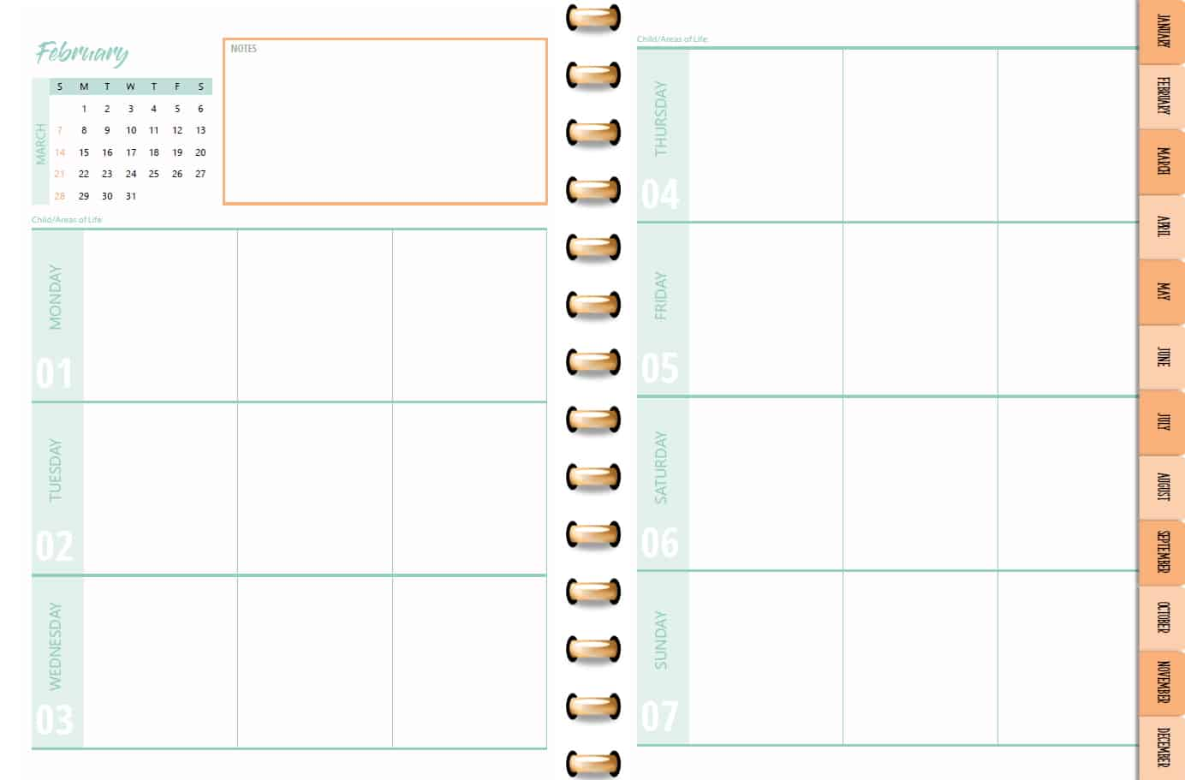
Lesson 2: Managing Time
Activities 3 and 4 – Building Your Planner Teacher discusses with students the things to include in a planner tool and gives students time to practice doing this individually.
This Photo by Unknown Author is licensed under CC BY-SA
Notes:
In the final lesson activities, the teacher uses the ppt slides to discuss with students the things to include as they use a planner. Then students have time to practice doing this individually.

Slide 14
Lesson 3 Key Activities
Planning for Effective Studying:
Maintaining a Study Space and
Minimizing Distractions
Objective: This lessons is designed to help students identify a study space and develop a study routine that minimizes distractions.
Notes:
Lesson 3 helps students plan for the kind of study space and study routine they will need to use to be successful in high school.

Slide 15


Lesson 3: Planning for Effective Studying
Framing:
Teacher shows students a short video clip to help them understand the importance of staying focused.
This Photo by Unknown Author is licensed under CC BY
This Photo by Unknown Author is licensed under CC BY
Notes:
The lesson begins with a short video clip that helps students understand the importance of staying focused.

Slide 16

Lesson 3: Planning for Effective Studying
Activity 1: Students partner read “The Multi-Tasking Brain” text, do a personal multi-tasking inventory, share with partner, followed by short full class discussion
Notes:
In the first activity, students read about the issues with a multi-tasking brain. They do a personal multitasking inventory which they then share with a partner, followed by a short class discussion.

Slide 17




Lesson 3: Planning for Effective Studying
Activity 2: Teacher leads full class discussion about the kinds of things needed in a study space
Notes:
In Activity 2 the teacher uses ppt slides to lead a full class discussion on the kinds of things needed in a good study space.

Slide 18

Lesson 3: Planning for Effective Studying
Activities 3 and 4: Students individually complete Study Habits Inventory, share in full class discussion. Then students have time to complete their own personal study plan
Notes:
In the final lesson activities, students complete a Study Habits Inventory (included in the student materials), and the class discusses together.
Finally, students complete their own personal study plan, guided by questions on the ppt slide for the lesson that the teacher is projecting.

Slide 19
DISCUSSION TIME
How important are these lessons on organization, managing time, and studying for your students? How much other instruction/guidance have they had already on these issues?
How do you think they will react to these lesson activities? What ideas do you have for keeping them engaged?
Unit 3
Notes:
Let’s take some time to discuss your reactions to these first two lessons.
How important are these lessons on organization, managing time, and planning for studying for your students?
How much other instruction or guidance have they had already on these issues?
How do you think they will react to the lesson activities?
Do you foresee any challenges as students interact with these lessons?
What ideas do you have for keeping them engaged?

Slide 20
Lesson 4 Key Activities
Attentive Reading
Objective: This lesson emphasizes the importance of attentive before- and during-reading strategies and provides time for students to practice the strategies.
Notes:
This lesson helps students understand the importance of attentive reading strategies and provides time for them to practice those strategies.

Slide 21

Lesson 4: Attentive Reading
Activity 1a: Teacher leads students in discussion of reading strategies.
Before- and During-Reading Strategies
Set a purpose for reading
Make connections
Activate prior knowledge
Ask questions
Make predictions
Note text features (title, sub-titles,
charts, pictures…)
Visualize (make a mind movie)
Notes:
Activity 1 may be a review for many students, but it is an important reminder about specific strategies that will help them understand and retain what they read. The ppt slides help to guide teacher instruction and class discussion.

Slide 22
Lesson 4: Attentive Reading
Activity 1b:
Teacher models the “Secrets of Effective Readers” as she “thinks aloud” while reading the selection to the class.
Notes:
In this activity the teacher models the kinds of reading strategies that are important for students to use as she reads a text aloud and students follow along.

Slide 23
Lesson 4: Attentive Reading
Activity 2a:
Students work in cooperative learning teams to answer questions about reading strategies from a choice of scenarios. They debrief in whole class discussion.
Notes:
In the next activity students work in teams to answer questions about reading strategies from a choice of scenarios. Then they debrief as a class.

Slide 24
Lesson 4: Attentive Reading
Activity 2b:
Students practice using the reading strategies as the read the text
“Why Reading Matters” with a partner.
Notes:
In the next activity students practice the strategies as they read with a partner.

Slide 25
Lesson 5 Key Activities
Learning How to Learn
Objective: This lesson is designed to help students learn to organize information to learn it more quickly and effectively and use their five senses to help boost their memory.
Notes:
This lessons continues to present reading strategies and helps students use graphic organizers to summarize information in ways that make it easier to memorize.

Slide 26
Lesson 5: Learning How to Learn
Do Now and Introduction:
Students work in teams to brainstorm a list of topics related to professional sports.
Then they continue to work in teams to consider how to organize these in broader categories.
Teacher leads a large group discussion about the categories identified by teams and how they can be organized graphically. Then teacher uses a concept map to share about the rest of the lesson.
Notes:
In this lesson the DO Now activity carries into the introduction and framing. After students have brainstormed topics related to professional sports, they work in teams to try to organize these under broader categories. Then the teacher leads the class to think about how they can represent their categories graphically.

Slide 27
Lesson 5: Learning How to Learn
Activity 1a – “Make the Most of Your Reading with SQ3R”
Teacher guides students through a read-aloud about SQ3R reading strategy:
Survey
Question
Read
Recite
Review
Notes:
In the first part of Activity 1 the teacher guides students through a read-aloud about the SQ3R strategy: Survey, Question, Read, Recite, Review. Students follow along on their sheets that the teacher can print or provide on computer from the student materials.

Slide 28
Lesson 5: Learning How to Learn
Activity 1b: Students work in four teams to organize the information in the SQ3R reading into different graphic organizers.
Sequence Chain
Mind Map
Picture It
Cause & Effect
Notes:
Then students work in four different teams to organize the information from the reading into different graphic organizers (also available in the student materials).

Slide 29

Lesson 5: Learning How to Learn
Activity 2 – Help Your Memory Work Smarter, Not Harder
Teacher guides students through information about the memory.
Students partner read a text about memory and then use a graphic organizer to organize key points. They share their organizer with partner.
This Photo by Unknown Author is licensed under CC BY-SA
Notes:
In Activity 2, the teachers uses the ppt slides to present information about the brain and memory. Then students partner-read a text about memory and use a graphic organizer to organize key points from the reading. Partners share their organizers with each other.

Slide 30
DISCUSSION TIME
What do you think are the most helpful parts of these lessons on attentive reading and using graphic organizers for your students?
Have they had similar instruction in the past? How well are they doing at mastering these skills?
How do you think they will react to these lesson activities? What ideas do you have for keeping them engaged?
Unit 3
Notes:
Let’s take some time to share our reflections on these lessons. (USE QUESTIONS ON SLIDE FOR GROUP DISCUSSION)

Slide 31
Lesson 6 Key Activities
Taking Useful Notes
Objective: This lesson introduces students to the Cornell note-taking method and gives them opportunity to practice it.
Notes:
Lesson 6 is all about notetaking and the Cornell method.

Slide 32
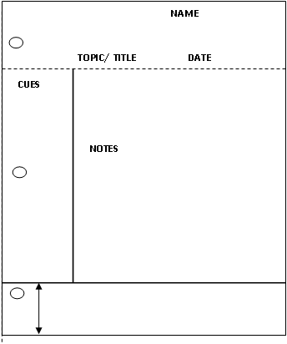


Taking Useful Notes: Concept Map
1. Learn About:
Secrets to Successful Notes
Organize the format
Capture main ideas
Use personal shorthand
Cue & summarize
3.
Practice Round:
“Becoming a Better Student”
2.
Teacher Demo:
“It’s Not Too Soon”
Notes:
This is a concept map of the lesson that the teacher shares at the beginning. First students will learn some secrets to successful notes (from teacher’s ppt presentation). Second, the teacher will demonstrate how to take notes on a short text entitled “It’s Not Too Soon.” Finally, students will have time to practice notetaking on their own from a text on “Becoming a Better Student.”

Slide 33
Lesson 6: Taking Useful Notes
Activity 1 – Introduction to Cornell Notetaking
After introductory whole class discussion on how taking notes is a useful practice for school and for life, teacher explains the Cornell Method:
MAIN IDEAS HERE
CUES HERE
Organize the format
Capture main ideas
Use personal shorthand
Afterward, cue & summarize
SUMMARY HERE
Notes:
In this activity, the teacher uses ppt slides to explain the Cornell notetaking method. The teacher then demonstrates using it on a short text, “It’s Not Too Soon,” included in the student materials for printing a copy for each student to use during the class.

Slide 34
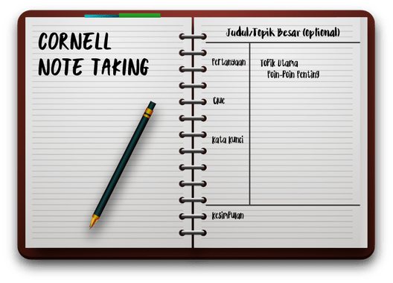
Lesson 6: Taking Useful Notes
Activity 2 – Practice Round: Becoming a Better Student
Students partner read the “Becoming a Better Student” text and practice taking Cornell notes on the text. They share their notes with partner and discuss possible “cues” and “summary” statements.
Notes:
Now it’s the students’ turn to practice. Students partner read another text included in the student materials and practice taking Cornell notes.

Slide 35
Lesson 7 Key Activities
Measuring My Learning
Objective: This lesson is designed to introduce students to outlining and test-taking strategies.
Notes:
Lesson 7 is all about outlining and test-taking strategies.

Slide 36
Lesson 7: Measuring My Learning
Activity 1 – How to Outline
Teacher leads class through process of reading and outlining the “Using Outlines for Success” text.
Notes:
In this first activity the teacher models the process of outlining with a text included in the student materials.

Slide 37
Lesson 7: Measuring My Learning
Activity 2 – Practice Round: Test-Taking Triumph
Students partner read the “Test-Taking Triumph” text and work either independently or in pairs to construct and outline for the text.
Notes:
Then students have time to practice. First they partner read a text on test-taking strategies, and then they work, either independently or in pairs, to outline the text.

Slide 38
DISCUSSION TIME
What do you think will be the most helpful parts of these lessons on notetaking and skills for doing well on tests for your students?
Have they had similar instruction in the past? How well are they doing at mastering these skills?
How do you think they will react to these lesson activities? What ideas do you have for keeping them engaged?
Unit 3
Notes:
Let’s share some reflections on these lessons and how you think students will react to them.

Slide 39
Lesson 8 Key Activities
Setting S.M.A.R.T. Goals
Objective: This lesson guides students through the process of setting S.M.A.R.T. goals.
Notes:
Lesson 8 is all about SMART goals.

Slide 40

Activity 1 – The Value of Goals
Students work in four
teams to discuss brief
bios and quotes
from 4 famous
people on goal-setting
Then they share back
their conclusions to the
full class.
Lesson 8
S.M.A.R.T.
Goals
This Photo by Unknown Author is licensed under CC BY-NC-ND
Notes:
In this first activity students are divided into four teams. Each team reads and discusses a different brief biography and quotation about goals (provided by teacher from student materials). Then the groups report back to the entire class.

Slide 41
Lesson 8
S.M.A.R.T.
Goals
Activity 2 – Setting Goals: How and Why
Students partner read the text on goals and discuss the values of goals and why it is important to write them down.
Then pairs share back with the full class.
This Photo by Unknown Author is licensed under CC BY-NC-ND
Notes:
In Activity 2, students read a text on the importance of setting goals and discuss the text with a partner. Then the class regroups for a full class discussion of their reactions.

Slide 42
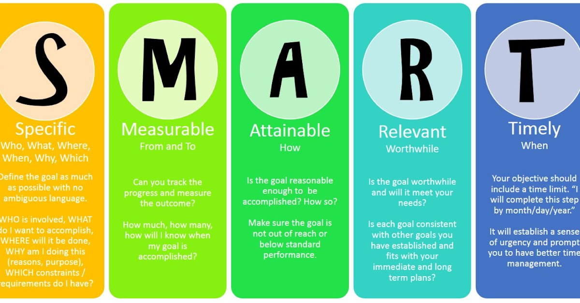
Activity 3: Defining S.M.A.R.T. Goals
Whole class instruction and discussion about the means of SMART GOALS.
Lesson 8
S.M.A.R.T.
Goals
This Photo by Unknown Author is licensed under CC BY-NC-ND
Notes:
In Activity 3 the teacher uses ppt slides to explain what each letter in the SMART acronym means and how this provides a useful framework for goalsetting.

Slide 43
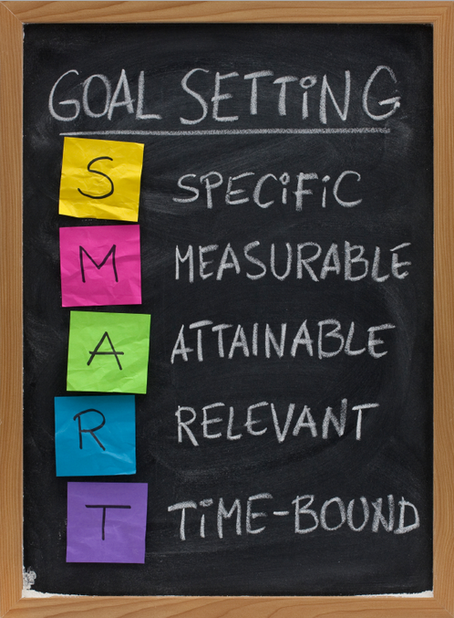
Activity 4 – Goal Planning Time
Students reflect Individually or in pairs on setting
SMART goals for themselves, then share out their work
Lesson 8
S.M.A.R.T.
Goals
This Photo by Unknown Author is licensed under CC BY-NC-ND
Notes:
In Activity 4, students use the SMART Goals Planning Sheet (provided in student materials) to set at least one goal for themselves. They share with partners and/or with entire class.

Slide 44

Reflecting on Unit 3
Take a few minutes to reflect within your professional community on the following questions:
1) What do you envision will be students’ challenges with setting SMART goals? How can you plan ahead to address these challenges?
2) How will these lessons help your students become better prepared for high school?
3) What are your own professional goals as you think ahead to taking students through these Unit 3 lessons?
4) How can you share with students your own personal experience with goal-setting and how it can make a difference?
Notes:
Let’s reflect together on the following questions.

Slide 45


PD Feedback Survey
Your feedback matters to us!
Please check your email now for a link to our feedback survey and complete it now.
Thanks so much!
This Photo by Unknown Author is licensed under CC BY-SA
Notes:
It is very important to our partners at Johns Hopkins to receive our feedback. Please check your email now for a link to the survey about this PD session and take time to complete it now.
Thanks so much!

