Slide 1

Skills for Secondary School Success (4S)
Unit 2: Confronting Challenges
and Developing a Growth Mindset
Notes:
Welcome to our Professional Development session for Unit 2 of Skills for Secondary School Success – Confronting Challenges and Developing a Growth Mindset.

Slide 2
Connection Circle/Reflection on Unit 1
Overview of Unit 2 Lessons
Reflections/Questions
Use your copy of the
Teacher’s Manual for
reference throughout the
Session.
Agenda
Notes:
In our time today we will begin with a Connection Circle to reflect and discuss our experiences with the Unit 1 lessons aimed at helping students to consider their purpose in life and purpose in learning. We will then spend some time getting an overview of the lessons in Unit 2. It will be helpful to have your copy of the Teacher’s Manual to follow along. We will conclude with more time for reflection and discussion as we think about starting Unit 2 with students.

Slide 3
Discussion Time
Connection Circle
Reflecting on Experience with 4S
So Far
What kinds of discoveries are your students making about their talents and strengths and purpose in life?
How is teaching this curriculum influencing your identity as a teacher?
Notes:
I’m thinking about the in-person facilitator and wondering if there should be more instructions for how to facilitate the connection circle. Since they will have done this already, maybe just some “as a reminder” notes.
Let’s take some time to discuss these questions.
5min.

Slide 4
Do Now
Reflection on Lesson Components:
How are things going in Unit 1?
Dedication-Building Belonging
Introduction (Framing/Overview)
Activities
Closure-Exit Ticket
Extensions/Homework
(0ptional)
Notes:
We discussed the various 4S lesson components in our last session. It would be good to discuss briefly how each of these components is working for you.
Facilitator Notes:
The goal of this discussion is to help the group use their observations and interpretations to discuss implications for teaching and student learning. The conversation can center on reflections about Unit 1 specifically, or they can incorporate bigger picture implications for teaching in general.
The discussion can be facilitated in several different ways based on the dynamic of the group and facilitator preference. Some options include:
Each participant writes responses and then shares out
Share in partners first and then report out one key takeaway to the group based on that conversation
Choose one question to answer in depth and move on to other questions only as time allows
Allow each person to pick a question they most want to reflect on
Etc.
Capture the group’s observations on a piece of chart paper
What do you think of the DO NOW activities in Unit 1? How are they working for you and your students?
Could one or two of you share about how the Dedication component is working for your class?
What about the Introduction suggestions provided for each lesson – how are these working?
What activities for student learning have worked particularly well in Unit 1? Are there any that did not work as well for students? Why do you think they were less effective?
What do you think of the closure or exit ticket activities?
Has anyone used any of the homework or extension activities? How has that been going?
Any other reflections on the Lesson Components that anyone wants to share?

Slide 5
What do you think of the DO NOW activities in Unit 1? How are they working for you and your students?
Reflection on Lesson Components:
How are things going in Unit 1?
Share about how the Dedication component is working for your class?
How are the Introduction/Framing/Overview suggestions provided in each lesson working for you?
What student activities have worked particularly well in Unit 1? Are there any that did not work well? Why do you think this was the case?
What do you think of the Closure-Exit Ticket activities?
Has anyone used the optional Extensions/Homework activities? How has that been going?
Any other reflections on lesson components anyone wants to share?
Notes:
We discussed the various 4S lesson components in our last session. It would be good to discuss briefly how each of these components is working for you.
Facilitator Notes:
The goal of this discussion is to help the group use their observations and interpretations to discuss implications for teaching and student learning. The conversation can center on reflections about Unit 1 specifically, or they can incorporate bigger picture implications for teaching in general.
The discussion can be facilitated in several different ways based on the dynamic of the group and facilitator preference. Some options include:
Each participant writes responses and then shares out
Share in partners first and then report out one key takeaway to the group based on that conversation
Choose one question to answer in depth and move on to other questions only as time allows
Allow each person to pick a question they most want to reflect on
Etc.
Capture the group’s observations on a piece of chart paper
What do you think of the DO NOW activities in Unit 1? How are they working for you and your students?
Could one or two of you share about how the Dedication component is working for your class?
What about the Introduction suggestions provided for each lesson – how are these working?
What activities for student learning have worked particularly well in Unit 1? Are there any that did not work as well for students? Why do you think they were less effective?
What do you think of the closure or exit ticket activities?
Has anyone used any of the homework or extension activities? How has that been going?
Any other reflections on the Lesson Components that anyone wants to share?

Slide 6


UNIT 2: Confronting Challenges & Having a Growth Mindset
LESSONS
Managing Stress
Identifying Signs of Stress
Managing Difficult Emotions
Problem Solving
Mindfulness
Having a Growth Mindset: Using Facts from Brain Science to Change Your Life
The Real Difference Having a Growth Mindset Makes
Famous Failures
This Photo by Unknown Author is licensed under CC BY-NC-ND
Notes:
Now we want to spend some time getting an aerial view of Unit 2. This slide gives you a list of the lesson titles. The first five deal with stress and how students can learn to manage stress. The last 3 lessons focus on the idea of growth mindset and the difference it makes for people.

Slide 7
Unit 2
Essential
Question
How can I develop the expertise and mindsets I need to accomplish my most important goals; despite the challenges I face along the way?
Notes:
It will be important to introduce students to the Unit 2 essential question in the first lesson, and remind students frequently of it throughout the unit. We are encouraging students to take responsibility for developing the expertise and mindsets they need to accomplish their goals and confront the challenges they are sure to meet along the way.
IF TIME PERMITS: What might you yourself say in response to this question? Take a couple of minutes to jot down some thoughts, and we’ll invite you to share out how you would respond.
SHARE OUT
We’ll revisit this again at the end of our session today.

Slide 8
Questions to consider for each overview:
Key points I want to remember about this lesson for when I teach it
What else do I need to know to deliver this lesson?
What issues could arise that I need to plan in advance for?
Unit 2
Lesson
Overviews
Notes:
Here are a couple of questions to keep in mind as we go through a brief overview of each lesson. What else might you need to know to deliver the lesson? (All you need can be found in the Teacher’s Manual). You may also want to keep your particular students in mind so you can anticipate how they are likely to react to various activities. It’s important to anticipate issues that could arise so you can be prepared for them. Feel free to jot down questions or ideas as we proceed – either on paper or in your Teacher’s Manual – as we proceed through our overview.

Slide 9

Lesson 1 Key Activities
Managing Stress
Objective: This lesson is designed to introduce students to this unit on confronting challenges and developing a growth mindset while becoming aware of their initial stress levels.
Notes:
Lesson 1 in this unit is all about managing stress. You can see the lesson objective on the slide.

Slide 10


Activity 1 – Overview and Gallery Walk
Lesson 1
Managing Stress
Teacher gives brief overview of Unit 2.
Students are divided into teams for a gallery walk to stations about each of main themes in the unit.
Notes:
The first activity in the lesson gives students their own chance to get an overview of the unit through a gallery walk. You will need to divide the class into six groups to rotate around six different stations. Each station will focus on one of the questions listed on the slide. What is stress? How do you know if you are feeling stress? What causes stress? What do you do to relive stress? What can schools do to help students feel less stressed? What differences do you notice between a fixed and growth mindset? You will have posted these questions at stations around the room in preparation for this activity, using the materials provided in Classroom Materials folder. Most groups will be discussing the questions in a different order than the one listed, but this is ok. The point is to get them talking with each other about stress and growth mindset. It will be good to provide the group with post-it notes so they can leave comments at each station if they like.

Slide 11
Activity 2 – Experience of Stress
and Strategies Inventory
Lesson 1
Managing Stress
Students spend time in individual reflection about their own experience of stress and their ways of coping.
Notes:
The second main activity in this lesson gives students individual time to reflect on their own experience of stress and their strategies for coping. Reflection sheets are provided in the student materials (and there are copies in your manual).

Slide 12
Lesson 2 Key Activities
Identifying Signs of Stress
Objective: This lesson is designed to help students identify what stress looks and feels like within their bodies. Our goal is to help them recognize signs of stress in themselves.
Notes:
Lesson 2 will help students learn to recognize their own symptoms of stress.

Slide 13
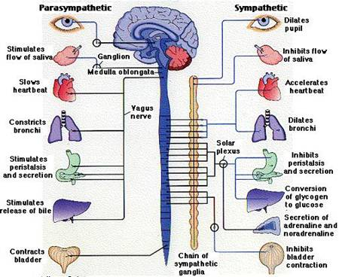
Large group
introductory
instruction about
Parasympathetic
and Sympathetic
nervous systems
and how they
relate to stress
Activity 1 – Identifying Signs of Stress
Lesson 2
Identifying
Signs of Stress
Notes:
The first activity introduces students to the parasympathetic and sympathetic nervous systems and how they relate to stress.

Slide 14

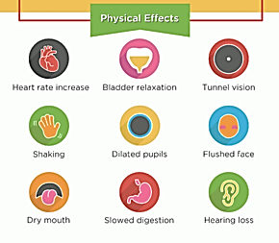
The Sympathetic Nervous System
Activated when we feel stressed
Also called the “fight or flight” system
When activated:
Pupils expand to let in more light
Heart rate increases
Skin flushes
Stop digestion
Notes:
Here’s a brief primer for those of you (like us!) who don’t think about this every day. The sympathetic nervous system is often associated with the “fight or flight” response. You can see all the physical symptoms associated with it on the slide.

Slide 15
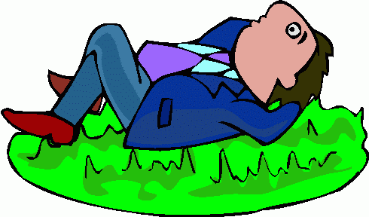
The Parasympathetic Nervous System
Helps us rest and digest
After the stressor has passed, our body returns to baseline
Heart rate slows down
We digest food again
Pupils get smaller
The Rest & Digest Response
After the stressful event has passed, all activated body systems slow down again.
Heart rate and breathing rate decrease.
Pupils constrict.
Digestion resumes.
Calmness and broader focus return.
Notes:
Then there’s the parasympathetic nervous system that helps the body return to a normal restful state.

Slide 16


Activity 2: Symptoms of Stress
Lesson 2
Identifying
Signs of Stress
Small teams work cooperatively to identify signs of stress, and then share out in whole class discussion
This Photo by Unknown Author is licensed under CC BY-SA
Notes:
In Activity 2, students work in small teams to identify various symptoms of stress, and then share them out in large group discussion. The student activity sheets are all provided in the student materials folder.

Slide 17

Activity 3: Causes of Stress
Lesson 2
Identifying
Signs of Stress
Small teams work cooperatively to brainstorm causes of stress among teenagers. Then they work to identify ways schools can support students better.
This Photo by Unknown Author is licensed under CC BY-SA
Notes:
In Activity 3, the same teams brainstorm about causes of stress for teenagers, using another activity sheet you can print from the student materials. They also discuss ways schools can support students better.

Slide 18

Closure: Demonstration of Learning
Lesson 2
Identifying
Signs of Stress
Students work individually to summarize their learning from the lesson and submit as EXIT TICKET
This Photo by Unknown Author is licensed under CC BY-SA
Notes:
The closing exit ticket for this lesson gives students the opportunity to show their learning about the sympathetic and parasympathetic nervous systems.

Slide 19
PLC DISCUSSION TIME
How familiar do you think your students will be with the ideas about stress presented and discussed in these first two lessons?
How do you think they will react to these lesson activities? Do you foresee any challenges as students confront these issues? What ideas do you have for keeping them engaged?
Unit 2
Notes:
Let’s take some time to discuss your reactions to these first two lessons. How familiar will these concepts about stress be for your students?
How do you think they will react to the lesson activities?
Do you foresee any challenges as students interact with these lessons?
What ideas do you have for keeping them engaged?

Slide 20
Lesson 3 Key Activities
Managing Difficult Emotions
Objective: This lesson is designed to help students identify their triggers and learn ways to manage difficult emotions. Students will be introduced to the PEACE acronym as well as other strategies for dealing with intense emotions.
Notes:
This lesson is all about managing difficult emotions. It will help students to identify their triggers and give them strategies for how to respond.

Slide 21



Activity 1 – Recognizing Our Triggers
Lesson 3
Managing Difficult
Emotions
Teacher leads students in large group discussion about emotional triggers
Students work individually to identify their own triggers using checklist in student materials
Teacher leads large group discussion about the kinds of experience in school that can trigger difficult emotions
Notes:
The first activity helps students to begin recognizing the things that trigger difficult emotions for them. Students have time individually to identify their own triggers with a sheet provided in the student materials. Then you will lead a full class discussion about the kinds of things at school that can trigger difficult emotions.

Slide 22

Activity 2a – Remaining CALM
Lesson 3
Managing Difficult
Emotions
Large group discussion about the importance of remaining calm even when emotions are difficult.
Then students pair-share about what
remaining calm looks and sounds like and what strategies they use to keep emotions under control
Notes:
The teacher introduces the second activity with a brief large group discussion about the importance of remaining calm even when your emotions are spinning. Students then pair up to share about what remaining calm looks like and sounds like, using the student activity sheet provided.

Slide 23
Activity 2b – The PEACE Approach
Lesson 3
Managing Difficult
Emotions
Individual student reflection on how they could have used PEACE approach in recent situation
Large group instruction on the PEACE approach
Notes:
The teacher introduces the PEACE acronym and the PEACE approach, and then students have some individual reflection time to think about how they could have used this approach in a recent situation, using the reflection sheet provided in student materials.

Slide 24

Activity 3 – Self-Regulation Strategies
Lesson 3
Managing Difficult
Emotions
Students brainstorm and write Ideas for self-regulation strategies
Notes:
In Activity 3, students have time to brainstorm about their own self-regulation strategies.

Slide 25
Lesson 4 Key Activities
Problem Solving
Objective: This lesson is designed to help students develop their problem solving skills. It presents both effective and ineffective ways of resolving problems and gives students time to practice these.
Notes:
Lesson 4 moves on to helping students develop their problem solving skills.

Slide 26
Activity 1 – Introduction to Problem Solving
Teacher reviews PEACE approach with class and then presents 3 problem solving strategies:
Lesson 4
Problem
Solving
Notes:
In the first activity, the teacher reviews the PEACE approach and then presents 3 problem solving strategies: FLEE FIGHT or FACE
or AVOID ATTACK or ADDRESS

Slide 27
Activity 2a – Strategy Identification Practice
Lesson 4
Problem
Solving
Students work in teams to classify common reactions during conflict into one of the three categories.
Teacher leads full class discussion.
Notes:
Students then work in teams to classify common reactions during conflict into one of the three categories, using the student activity sheet provided. After the teams have worked together on this, they share out their conclusions in a full class discussion.

Slide 28
Activity 2b: Strategy Identification Practice
Lesson 4
Problem
Solving
Students partner-read “Margarita’s Conflict” and work together to
1) classify which approach she is using; 2) evaluate how well strategy is working.
Teacher leads full class discussion of teams’ responses
Notes:
Students then get more practice in sorting through these approaches as they partner-read a brief story and discuss which strategy the main character is using and how well it is working. The class then debriefs in a full class discussion.

Slide 29
Activity 3: Role Play
Lesson 4
Problem
Solving
Students are divided into teams. They select one of the scenarios and act out three different kinds of responses to the conflict.
After role-playing, students discuss (either full-class or in teams) the solutions to conflict they used and what was most effective.
Notes:
In the third activity, students are grouped in teams to role-play these different responses in a specific conflict situation. Students have time to discuss the solutions they saw in action and how effective they were.

Slide 30
Lesson 5 Key Activities
Mindfulness
Objective: This lesson is designed to help students understand what it means to be mindful and how being mindful can affect their mental and physical health. The goal is to give students strategies on how they can practice mindfulness.
Notes:
Lesson 5 helps students to understand mindfulness and practice different strategies for mindfulness.

Slide 31
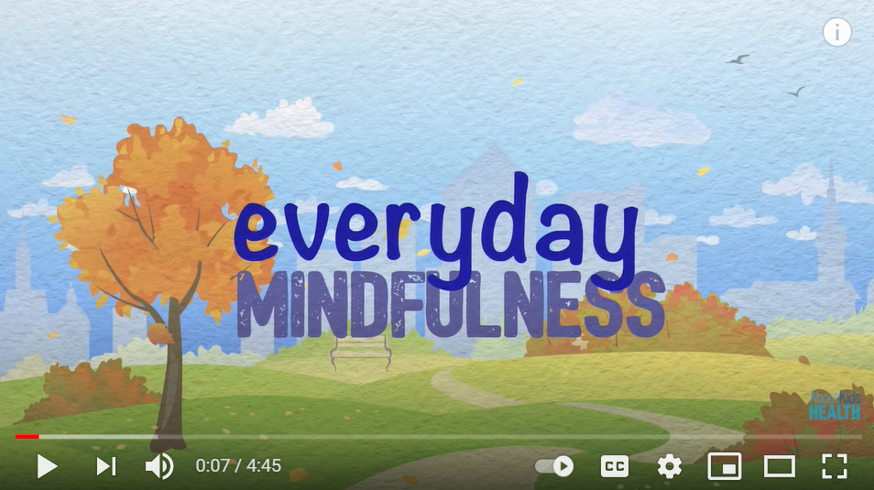


Students watch and reflect on short video on mindfulness
Large group instruction and discussion of mindfulness
about mindfulness are myths or true.
Teacher models and students practice deep breathing and listen to recorded sounds and think about what their senses are experiencing
Students work with a partner to determine whether statements group discussion of other mindfulness practices
Students work in pairs to identify feelings behind specific statements
EXIT TICKET – students reflect becoming more mindful
Activity 1a – Introduction to Mindfulness
Lesson 5
Mindfulness
Students watch a short video clip about mindfulness
This Photo by Unknown Author is licensed under CC BY
Then teacher leads short class discussion on their reactions to video and presents information on mindfulness through the ppt slides provided.
Notes:
This lesson begins with a short video clip about mindfulness. Then the teacher leads a brief discussion of students reactions to the video and presents some background information on mindfulness using the powerpoint slides provided.

Slide 32
Students watch and reflect on short video on mindfulness
Large group instruction and discussion of mindfulness
about mindfulness are myths or true.
Teacher models and students practice deep breathing and listen to recorded sounds and think about what their senses are experiencing
Students work with a partner to determine whether statements group discussion of other mindfulness practices
Students work in pairs to identify feelings behind specific statements
EXIT TICKET – students reflect becoming more mindful
Activity 1b –Mindfulness Myths
Lesson 5
Mindfulness
Students work with a partner to decide which statements about mindfulness are true and which are myths. Review together as a whole class.
Notes:
Students then work with a partner to classify statements about mindfulness as truths or myths. Students then debrief as an entire class.

Slide 33
Students watch and reflect on short video on mindfulness
Large group instruction and discussion of mindfulness
about mindfulness are myths or true.
Teacher models and students practice deep breathing and listen to recorded sounds and think about what their senses are experiencing
Students work with a partner to determine whether statements group discussion of other mindfulness practices
Students work in pairs to identify feelings behind specific statements
EXIT TICKET – students reflect becoming more mindful
Activity 2: Practicing Mindfulness
Lesson 5
Mindfulness
Teacher leads students in one or more mindfulness practices:
Deep breathing
Listening to nature sounds with eyes closed and focusing on body experiences
Mindful coloring
Notes:
In the next activity the teacher leads students in some mindfulness practices. These can include deep breathing, listening to nature sounds and paying attention to their body experiences, or mindful coloring.

Slide 34
Students watch and reflect on short video on mindfulness
Large group instruction and discussion of mindfulness
about mindfulness are myths or true.
Teacher models and students practice deep breathing and listen to recorded sounds and think about what their senses are experiencing
Students work with a partner to determine whether statements group discussion of other mindfulness practices
Students work in pairs to identify feelings behind specific statements
EXIT TICKET – students reflect becoming more mindful
Activity 3: What Might You Really Mean?
Lesson 5
Mindfulness
Students work with a partner on “What You Say vs. What You May Feel” activity to try to identify what the speaker in each example may be feeling.
Notes:
Then students work with a partner to trying to identify the possible feelings behind particular statements they might hear – using the activity sheet provided in the student materials.

Slide 35
PLC DISCUSSION TIME
How familiar do you think your students will be with the ideas about managing difficult emotions, problem solving, and mindfulness presented and discussed in these lessons?
How do you think they will react to these lesson activities? Do you foresee any challenges as students confront these issues? What ideas do you have for keeping them engaged?
Unit 2
Notes:
Let’s spend some time discussing the lessons we’ve just heard about. How familiar do you think your students will be with these ideas about managing difficult emotions, problem solving, and mindfulness? How much do you think they need the kind of practice and reflection time these lessons provide?
How do you think they will react to these activities? Do you foresee any issues you might need to plan in advance for?
Any other thoughts about these particular lessons?

Slide 36
Lesson 6 Key Activities
Having a Growth Mindset
Objective: This lesson acquaints students with brain research showing that: a) the different regions of our brain gain expertise when we “exercise” those regions and, b) we can learn anything, through persistent and strategic effort.
Notes:
With this lesson, we move on to the notion of a growth mindset. The goal is for students to understand that they have the power, through their own effort, to help their brain to grow. They can exercise control over their own learning.

Slide 37
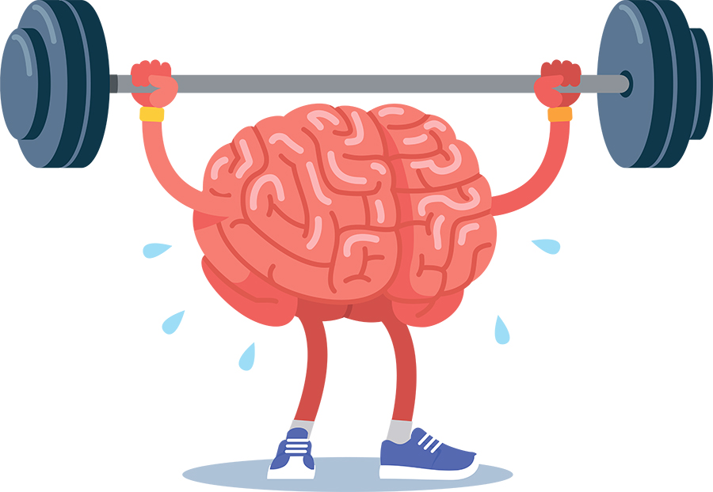
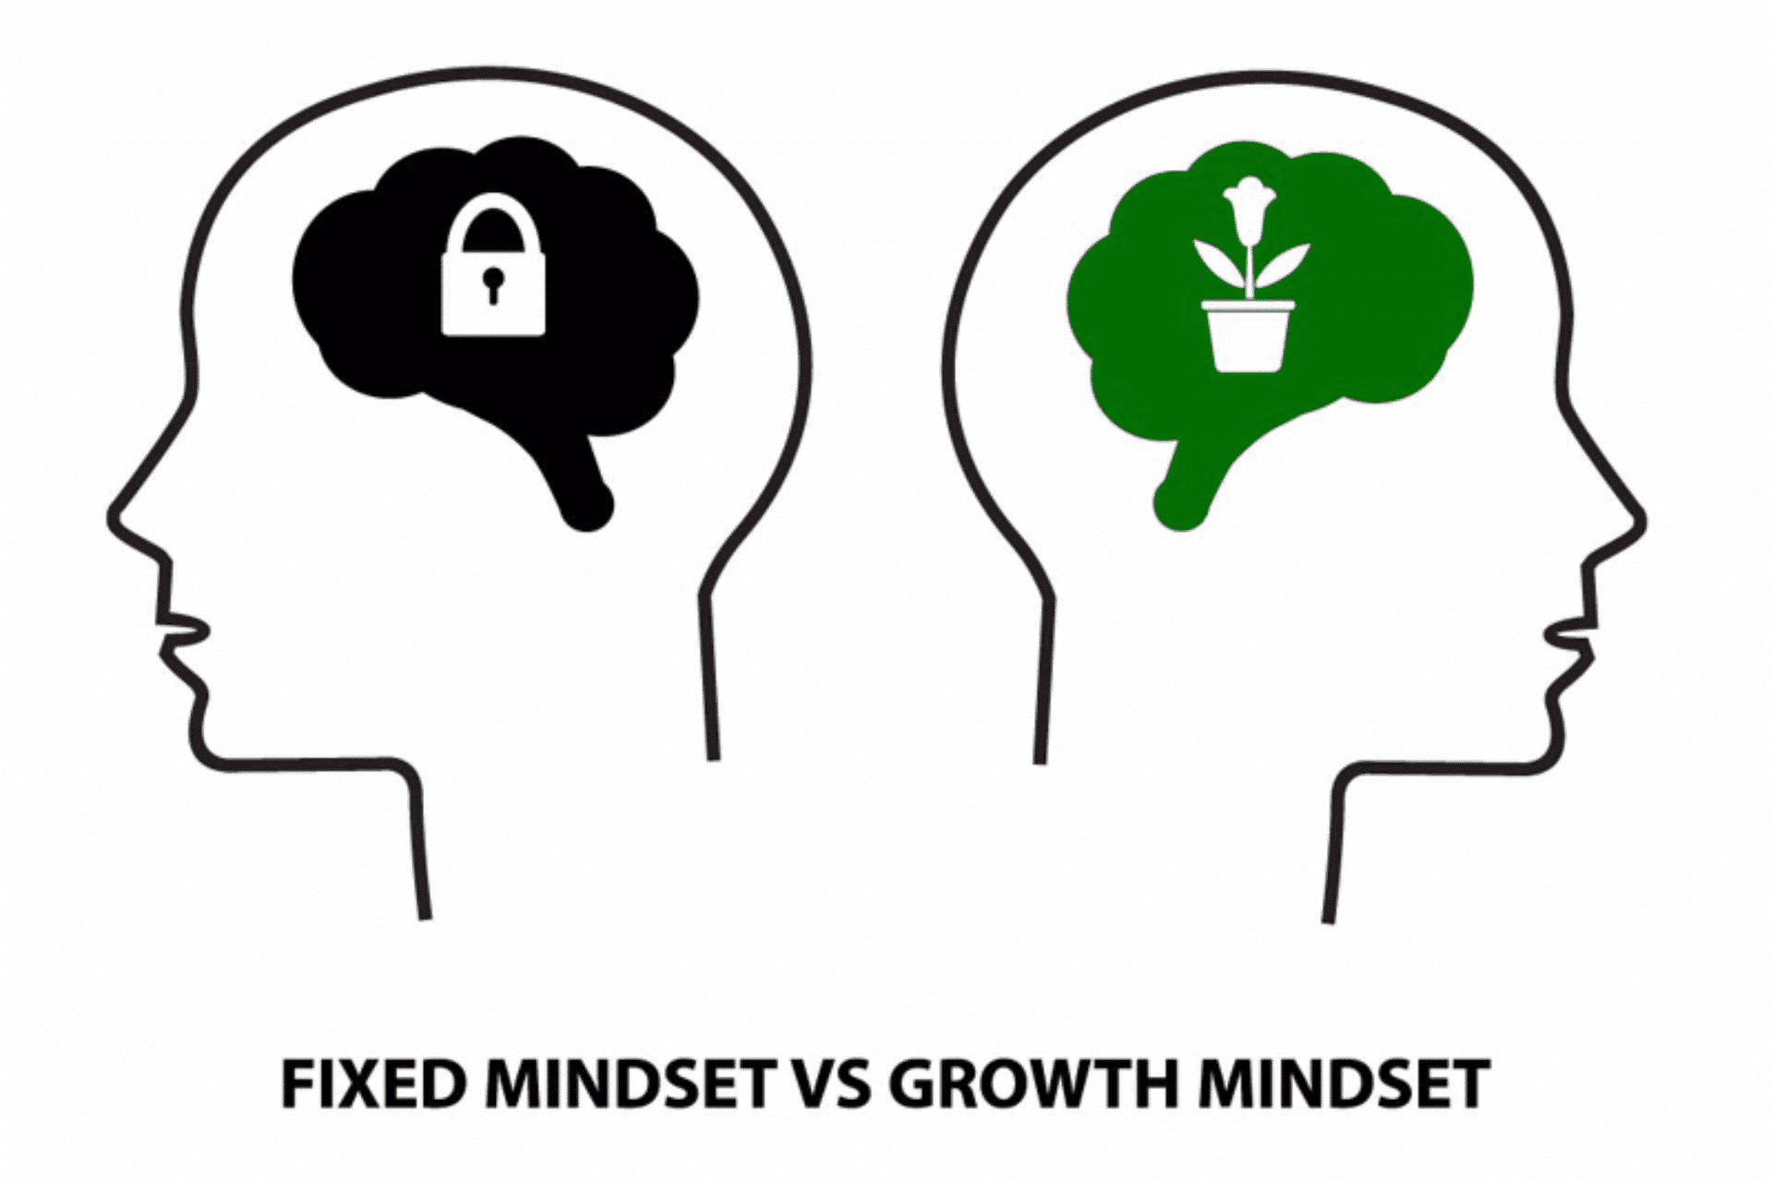
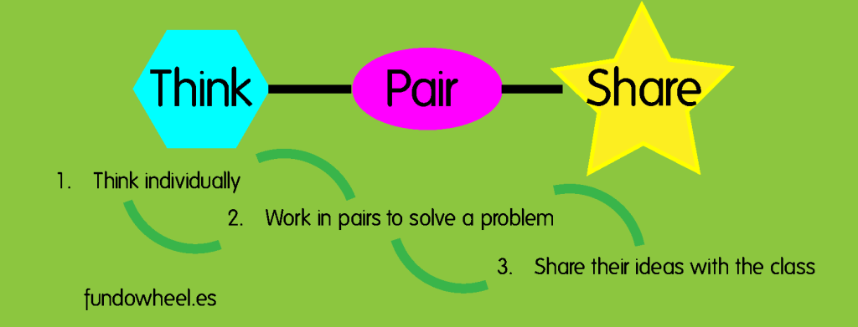
Lesson 6
Having a
Growth
Mindset
Activity 1: Exercising the Brain
Teacher introduces importance of exercising the brain.
Students pair-share on their own experience doing this.
Teacher summarizes main points of how we exercise the brain (in ppt).
Notes:
In the first activity, students learn about the importance of exercising the brain. They pair-share about their own experience doing this. Then the teacher summarizes some main points about how we can exercise our brains (using the ppt slides provided).

Slide 38

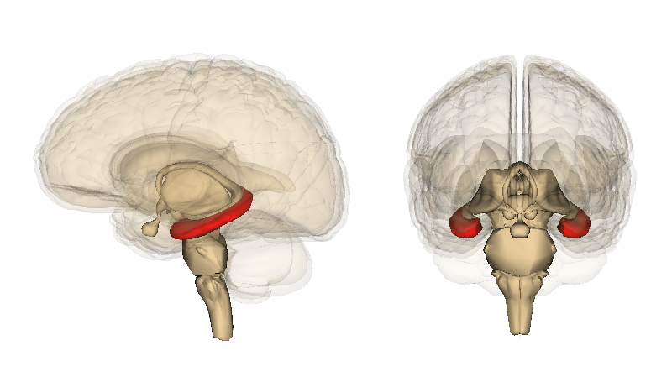
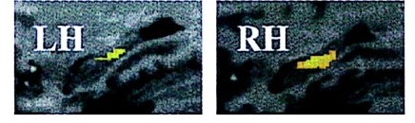
Activity 2:
Taxi Drivers and Their Brains
Lesson 6
Having a
Growth
Mindset
Students watch short video on “Cracking London’s Legendary Taxi Test”
Teacher presents information on the hippocampus area of brain and evidence from research study about how parts of the brain can grow
Notes:
In the second activity students see a video about how taxi drivers’ brains grow because of how they exercise them in learning all the routes they need to know in London. Students hear about an actual research study that showed how a part of the brain grew through mental exercise.

Slide 39
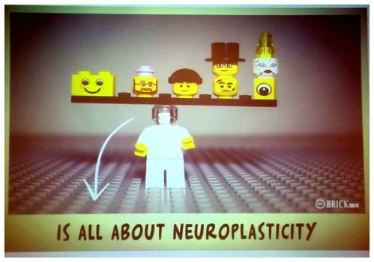


Lesson 6
Having a
Growth
Mindset
Activity 3: Two Videos about the Brain
Students watch two short videos, “The Felicity of Neuroplasticity and “You Can Learn Anything.” They rate videos using the “Rotten Tomatoes” rating system.
Notes:
If you have time, this lesson includes a couple of more short videos about how the brain grows that students can compare and rate.

Slide 40


Lesson 6
Having a
Growth
Mindset
Activity 4: John Legend’s Road to Success
Students watch
“The Power of a Growth Mindset: How I Became a Recording Star” about John Legend and share their reactions.
Notes:
The final activity for students is watching a video about recording artist John Legend and his views on the importance of a growth mindset for success.
This Photo by Unknown Author is licensed under CC BY

Slide 41
Lesson 7 Key Activities
The Real Difference
Having a Growth Mindset Makes
A growth mindset helps us learn successfully by influencing how we tackle difficult tasks, respond to feedback, and what we tell ourselves when confronting challenges.
Notes:
Lesson 7 continues to help students understand the importance of having a growth mindset.

Slide 42
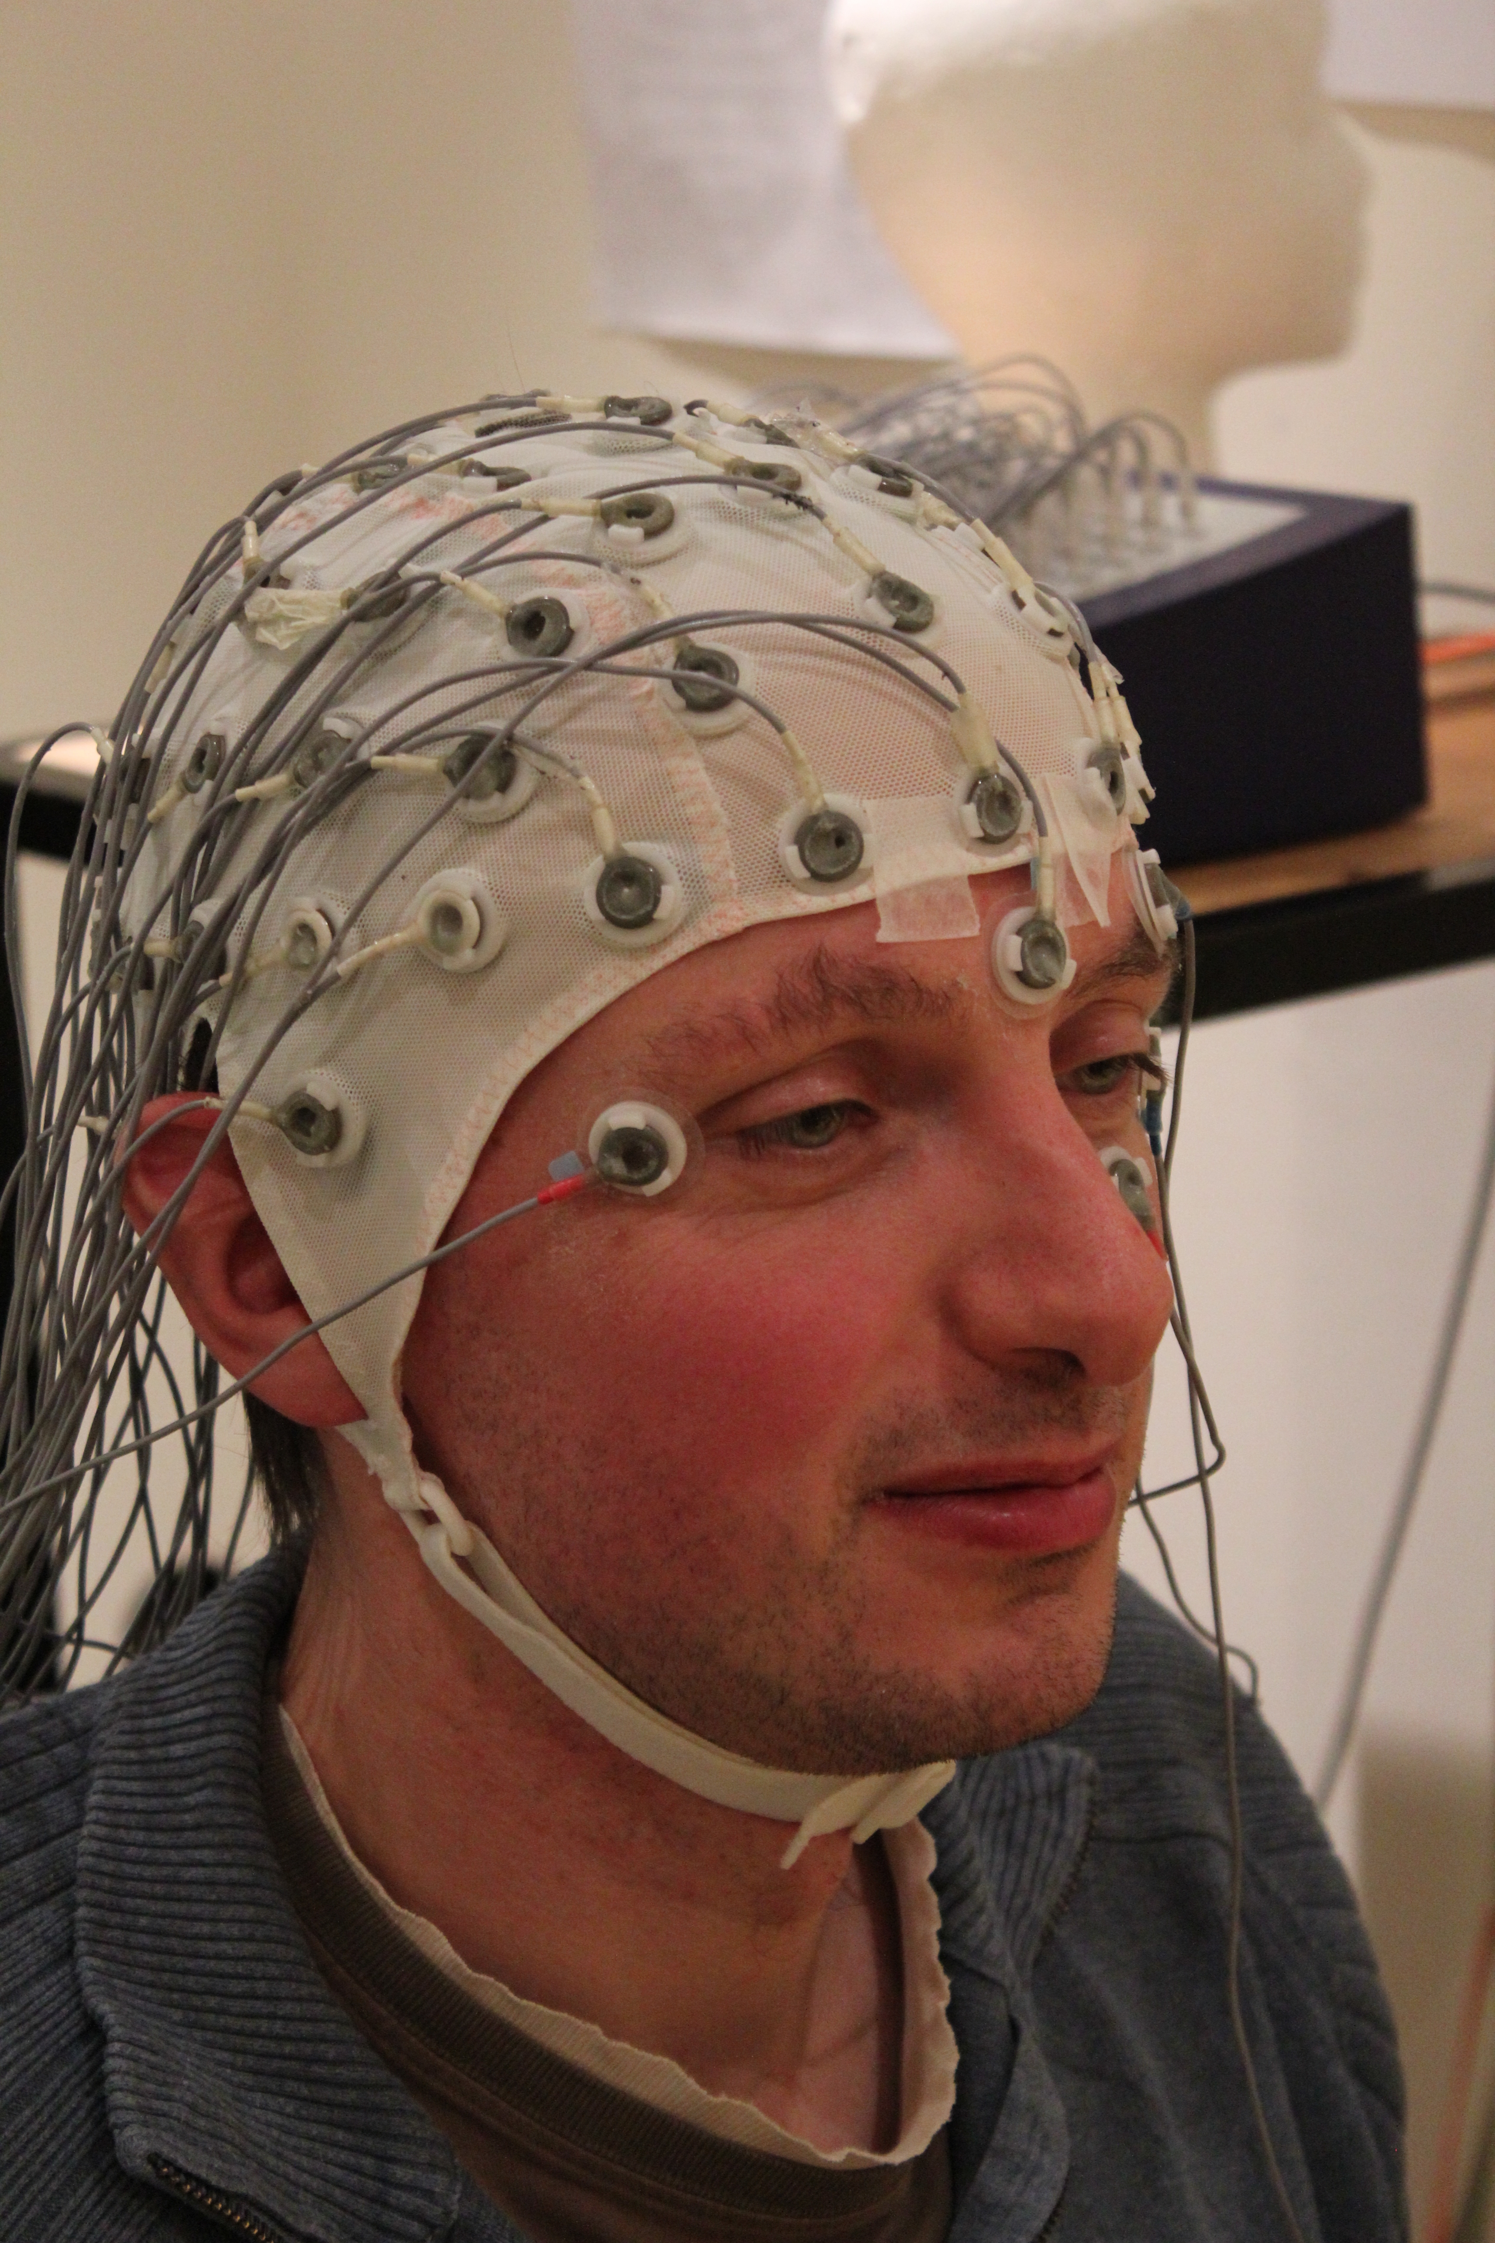
Activity 1: Visiting the Brain Wave Lab
Lesson 7
The Real Difference Having a Growth Mindset Makes
Teacher takes students on a “virtual field trip” to understand an EEG study of the brainwaves of students during a simulated quiz game.
Teacher describes how students whose survey responses indicate a growth mindset showed more focused attempts to learn about the facts they got wrong than those with a fixed mindset.
Notes:
This lesson gives students the chance to understand another research study about growth mindset and how it can make a difference in your learning. This example involves EEG measurements of brainwaves during a simulated quiz game. Students who had a growth mindset prior to the experiment showed more focused attempts to learn the correct answers when they got answers wrong the first time.

Slide 43
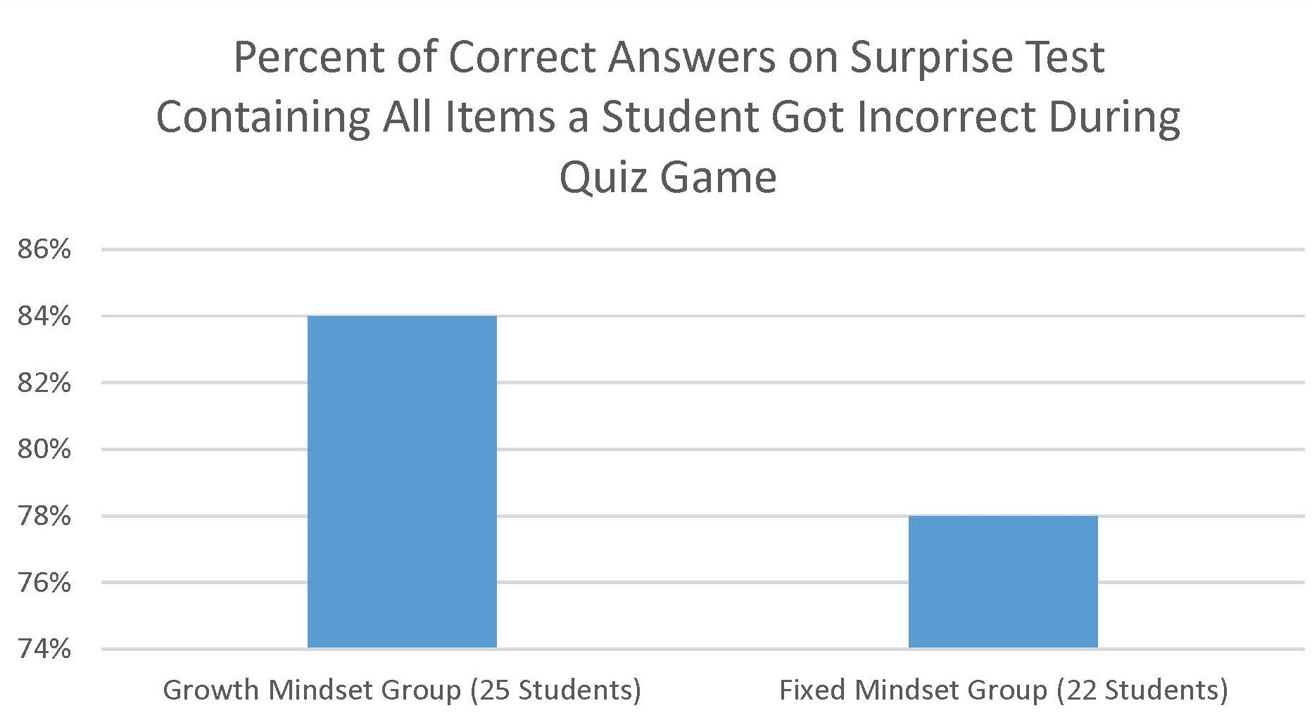
Activity 2a: Examining and Discussing Findings
Lesson 7
The Real Difference Having a Growth Mindset Makes
Teacher explains that the study on which this example based found that on the surprise test on the incorrect items, students with a growth mindset had a higher average score than students with a fixed mindset.
Notes:
The study involved a surprise test at the end for each student on the items they missed. The teacher explains how the study found that students who began with a growth mindset did significantly better on that test. They did better at learning the correct answers to items they had originally missed than students who didn’t have a growth mindset.

Slide 44
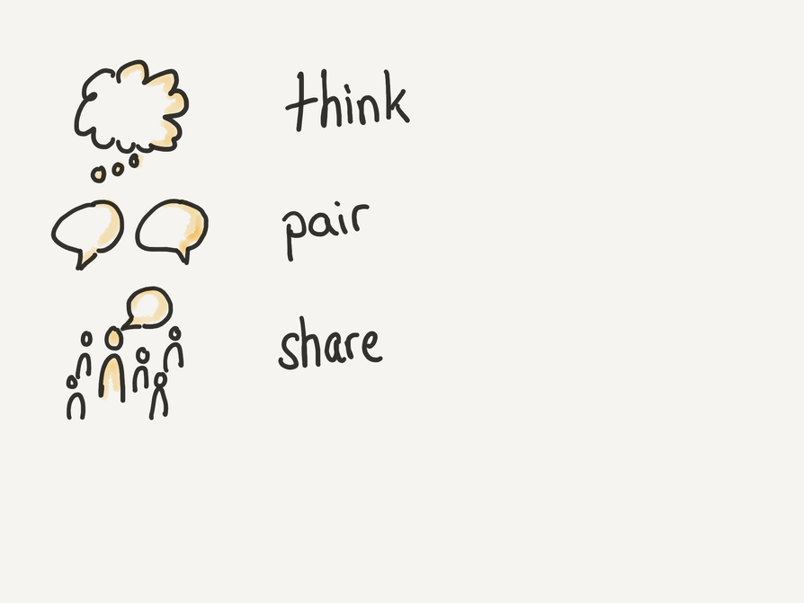

Activity 2a: Examining and Discussing Findings
Lesson 7
The Real Difference Having a Growth Mindset Makes
Teacher has students pair up and develop an hypothesis about why students with a growth mindset had higher post-test scores.
Notes:
At the end of this activity, the teacher pairs students up to work together to develop an hypothesis about why this was the case. How does a belief that you can learn anything if you work hard actually help to improve your performance on tests? After a short time, the teacher invites students to share some hypotheses.

Slide 45
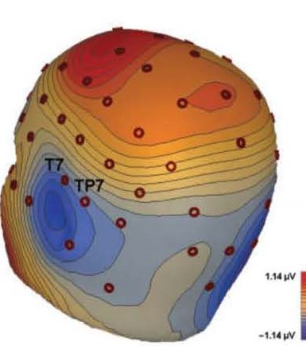
Activity 2b: Examining and Discussing Findings
Lesson 7
The Real Difference Having a Growth Mindset Makes
Teacher explains that the study found evidence of the left temporal lobe neurons in the brain “Saving to Memory”
when the correct answer was revealed during the quiz game. The students with growth mindset may have been exercising their brains more as they got feedback on the correct answer, which helped to store it in memory.
Image from Mangels et al. (2006)
Notes:
Then the teacher explains what the research study found. There was some evidence from the brain measurements that students were “saving to memory” during the time the correct answer was revealed in the quiz game. Students with a growth mindset may have been exercising their brains more as they got feedback on the correct answer, and that helped to store it in memory.

Slide 46
Students partner read a selection on Positive Self-Talk and discuss with class
Activity 3: Practicing Positive Self-Talk
Lesson 7
The Real Difference Having a Growth Mindset Makes
Notes:
In this activity, students partner read a short text on Positive Self Talk. Then they discuss together as a class examples of positive self-talk and disparaging self-talk. Teacher concludes by emphasizing the importance of positive self-talk.

Slide 47
Lesson 8 Key Activities
Famous Failures
Objective: Students learn about examples of famous people who persevered despite failure and were later successful. They consider how they can learn and grow from failure experiences.
Notes:
In this final lesson of Unit 2, students reflect on the ways that famous people experienced failure and kept on going to achieve success. The goal is for students to consider how they themselves can learn from struggles and failure.

Slide 48
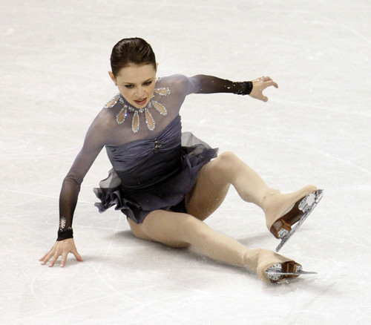
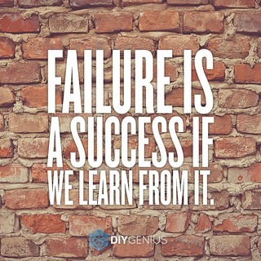
Students watch
and discuss
a short video about
struggles and
learning from failure
Lesson 8
Famous
Failures
Activity 1: Video Inspiration
This Photo by Unknown Author is licensed under CC BY-SA
This Photo by Unknown Author is licensed under CC BY-SA
Notes:
In this first activity students watch a short video about struggles and learning from failure and discuss it as a class.

Slide 49

Lesson 8
Famous
Failures
Activity 2: Partner Exploration
Student pairs read and discuss one biography from
“21 Famous Failures Who Refused to Give Up,” reporting to full class what they learned
21 Famous Failures
Who Refused to Give Up
This Photo by Unknown Author is licensed under CC BY-SA
This Photo by Unknown Author is licensed under CC BY-SA
Notes:
In Activity 2 student pairs read one short biography of a “Famous Failure” and report to the class what they learned.

Slide 50
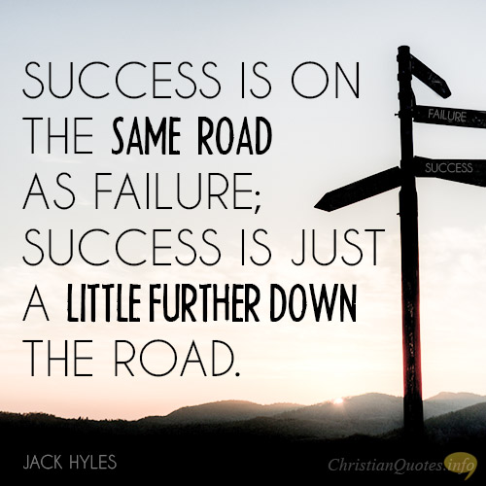
Lesson 8
Famous
Failures
Activity 3: Individual Reflection
Students reflect individually on “Moving On From Failure.” Volunteers share with full class what they have learned from Unit 3.
This Photo by Unknown Author is licensed under CC BY-SA
This Photo by Unknown Author is licensed under CC BY-SA
Notes:
The third activity provides time for students to reflect individually about a personal experience of failure and what they can learn from it to move forward.
Volunteers have the opportunity to share with the class what they have learned from Unit 3.

Slide 51


Reflections and Questions
What thoughts or questions are in your mind as you consider how to help your students learn to confront challenges?
How do your students struggle in having a growth mindset? How do you think these lessons could help?
This Photo by Unknown Author is licensed under CC BY-SA
Notes:
Let’s spend the rest of our time together reflecting and discussing any thoughts or questions that have emerged from you as we consider how we will help students learn about confronting challenges in this Unit.
How do your students struggle in having a growth mindset? How do you think these lessons could help? Is there anything you think that is missing that could be helpful to them?

Slide 52


PD Feedback Survey
Your feedback matters to us!
Please check your email now for a link to our feedback survey and complete it now.
Thanks so much!
This Photo by Unknown Author is licensed under CC BY-SA
Notes:
It is very important to our partners at Johns Hopkins to receive our feedback. Please check your email now for a link to the survey about this PD session and take time to complete it now.
Thanks so much!

