Slide 1

Skills for Secondary School Success (4S)
Unit 1 Learning with a Sense of Purpose
Notes:
Hello, I am …... and today we'll begin an exciting learning journey with lessons in Unit 1 which is about Learning with a Sense of Purpose.

Slide 2

Agenda
Connection Circle
4S Overview/Orientation Reflection
Overview of Lesson Structure
Overview of Unit 1 Lessons
Notes:
In this session, we will learn about the key activities in each lesson. We will review how the whole set of lessons connect. After several lessons, we will engage in dialogue with a few reflection questions.

Slide 3


Building a Sense of Belonging
Belonging – feeling oneself an integral part of the community – is essential to student motivation.
We want to experience this as a learning community ourselves as we seek to build the same kind of community in our classrooms. Engaging in connection circles in which we share our own experience and listen closely to that of others is a key step in this process.
Connection Circle
Notes:
We are starting with a connection circle today and on the right and left sides of the slide we can read about connection circles You can have the participants respond or add to what you have shared and answer any questions.
For the connection circle, we are inviting our minds to travel back in time when we were 15 years old, what would we tell our younger selves about learning with a sense of purpose, with a sense of belonging?
Please choose a prompt to respond to and share your thoughts …...

Slide 4
Circle Discussion Questions
Connection Circle
Finding newness in the sameness
What do you do on a regular basis, that gives you a sense of purpose?
We are all one success story
If you were to write and deliver your very own and current valedictory speech, underscoring the belief that every narrative matters, what might be the one "purposeful learning" you would highlight?
Visiting your 13-year-old self
If you could sit with your 13-year-old self, what would you tell her or him about learning with a sense of purpose and belonging?
Notes:
We are starting with a connection circle today and on the right and left sides of the slide we can read about connection circles You can have the participants respond or add to what you have shared and answer any questions.
For the connection circle, we are inviting our minds to travel back in time when we were 15 years old, what would we tell our younger selves about learning with a sense of purpose, with a sense of belonging?
Please choose a prompt to respond to and share your thoughts …...

Slide 5

When thinking about the 4S Overview PD Session, do you have any clarifying questions, wonderings, etc. before we begin our Unit 1 journey?
4S
Overview
Orientation
Reflection
Notes:
When thinking about the Orientation segment, do you have any clarifying questions, wonderings, etc. before we begin our Unit 1 journey?
Please jot them down We will be answering all posed questions

Slide 6


Materials Check-In
Everyone should have all 4S materials downloaded and arranged in folders. Any questions to discuss? (Check in with facilitator about any access issues.)
Notes:
We are now going to take some time to download the 4S curriculum from SharePoint using the link provided. Some of you may have already downloaded the materials for 4S .
Please let me know you need any assistance with this process or help with troubleshooting technical difficulties.

Slide 7
Unit 1 Learning With a Sense of Purpose
Lesson 1: Introduction to Skills for Secondary School Success
Lessons 6-7: My Future Self Parts I & II
How does my learning at school help me prepare to become the person I want to be and make a difference in my community and in my world?
Lesson 2:
You are the Author of Your Life Story
Lessons 4-5: Career Exploration I & II
Lesson 3: Expressing My Identity Creatively
Notes:
As we read through the lessons of Unit 1 be mindful of the core question sitting at the center, How does my learning at school help me prepare to become the person I want to be and make a difference in my community and in my world?
With time being limited –you might make this a quick view

Slide 8
Unit 1
Essential Question
How does my learning at school help me prepare for the person I want to be and the work I want to do in life?
Notes:
Read the reflection question designed for students as part of Lesson 1.
Let's reflect on our own experiences and answer this question from our personal perspectives and lived experiences

Slide 9
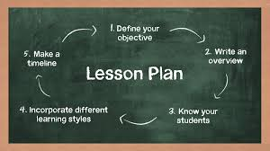
Do Now
Overview of a Lesson
Dedication-Building Belonging
Introduction (Framing/Overview)
Activities
Closure-Exit Ticket
Extensions/Homework
Notes:
This slide presents the routine/procedure that all lessons will follow to build consistency so that you and your students know what to anticipate lesson to lesson and unit to unit.

Slide 10


Do Now
A brief activity (usually 3 to 5 minutes) for students to engage in independently as soon as they enter the classroom. Some Do Now’s involve a quick write or sketch on a half piece of paper, while others invite students to share their thoughts with a classmate or seat partner. Do Now’s are designed to whet students’ interest and help them begin thinking about the topic of the lesson.
Notes:
Have you used "Do Nows"? If you have, kindly share an example of the Do Now you’ve used.
If you have not, no worries we'll get to experience the Do Now in Unit 1 Lesson 1

Slide 11

Dedication
Building Belonging
On the second day of the course, the teacher shares a 30 to 60 second presentation about an inspirational person in his or her life. Each subsequent day, a different student presents the dedication. This brief ritual is intended to center and focus the class while building community.
Learn more at:
https://www.edutopia.org/article/daily-ritual-builds-trust-and-community-among-students/
https://www.youtube.com/watch?v=cIihQ5Edn4w&t=3s
Notes:
A lesson dedication is designed to gradually build our learning community.
Each day students will have the opportunity to present their inspirational person. Now, we will watch the dedication video embedded in the article. Do you have any thoughts or ideas on how to begin this process in your classrooms and Have you used this in the classroom and if yes-What structures or processes did you have in place?
Now it is your turn to model a lesson dedication by sharing with your colleagues today about an inspirational person in your life You will have 30 seconds to share.
Note: If the student has supplied a photo of the person to whom he or she is dedicating today’s lesson, you can add it to the slide, or simply replace the slide with the photo.” Of course, in some instances the student who is doing the dedication will have supplied a photo of the person being honored that has BOTH the honoree and the student in the photo together, which is obviously fine. Of course, it is OK for the student to make a dedication to a fictional character who has inspired them. In those cases, an image may or may not be available.

Slide 12

Introduction
This section can be quite brief or somewhat longer. It often builds on the Do Now activity. Here the teacher highlights the relevance of the day’s topic, presents the agenda, and may introduce important vocabulary.
Notes:
The Introduction Section can be as brief as you want it to be. It essentially builds on the Do Now activity. It is the space to highlight the relevance of the day’s topic, present the agenda, and it may also of.fer the opportunity to introduce important vocabulary.

Slide 13

Activities
Most lessons include two or three multi-faceted activity sections (see below), including a balanced mix of direct instruction, whole-class discussion, partner or team collaboration, and individual exploration.
Notes:
Knowing your students will inform what will work best with them.
Feel free to extend or eliminate activities based on your classroom context and your students.

Slide 14

Closure-Exit Ticket
Each lesson ends with a brief whole-class closure. This often includes an “Exit Ticket” for students to submit as they leave the class.
Notes:
Exit tickets are regularly used to check for understanding after each lesson. Have you used exit tickets?
if yes, share example(s) of how you used them? Have you, perhaps, used something similar in the classroom that was successful and you would feel more comfortable using?
Kindly share your thoughts thoughts, comments, questions

Slide 15

Extensions/Homework
Homework is not required as a component of the 4S course, but suggestions are provided in case the teacher prefers to assign homework, or if more activities are needed to fill a longer class period. In some cases, we have also provided guidance for ways to adapt the lesson if time is short.
Notes:
Homework is not required in the 4S course, and suggestions are provided in case you assign homework, or if more activities are needed in a longer class period.
There is guidance for ways to adapt lessons if time is short.
Any thoughts, questions, comments?

Slide 16
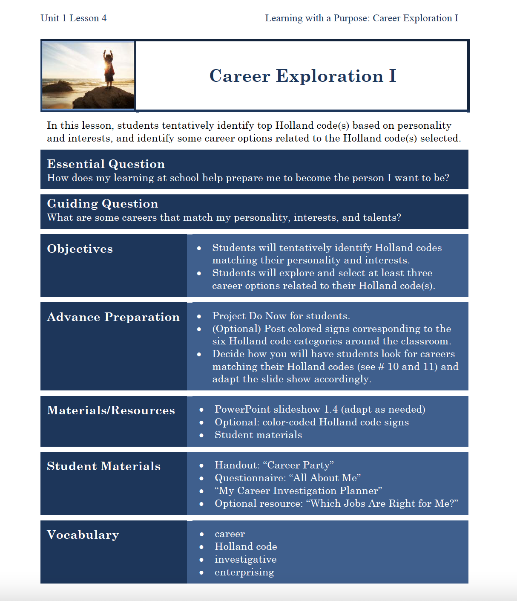
Lesson Design
Notes:
Some lessons offer specific student activity sheets in the hardcopy and e-versions of the teacher’s manual that you'll see when preparing your lessons in advance.
At that point you may opt for duplicating them for students’ use or forward to students as fillable forms, if each student has a laptop.

Slide 17
Lesson 1 Key Activities
Introduction to Skills for Secondary School Success
Objective: Students will begin to build a positive classroom community and will gain an overview of what they will learn and do in the 4S course.
Notes:
Read the slide or have participants read it to themselves

Slide 18
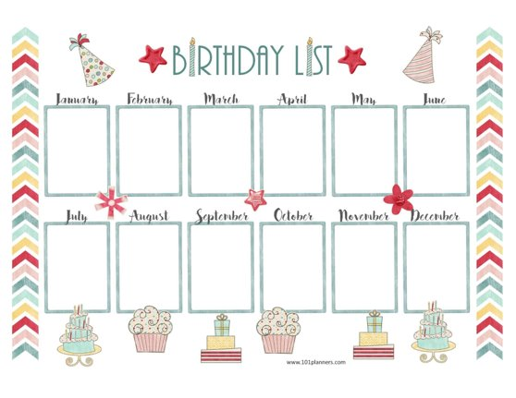
Activity 1: Birthday Lineup Community Building Activity
The goal is for students to line up in order of their birthdays, from Jan. 1 to Dec. 31, as quickly as possible without speaking.
Students can use paper to write messages using
the paper provided.
The teacher then leads the class in a debrief.
Lesson 1:
Introduction to Skills for Secondary Success
Notes:
You can read the slide or have participants read the slide
You can share the following questions designed for the debrief or ask participants what questions they might ask to further help students identify strategies that helped them complete this activity.
What did you notice about strategies you used to make this work?
What steps could have helped us do this faster (besides being able to talk out loud)?
Did you find anyone with a birthday close to yours that you didn’t already know about?

Slide 19

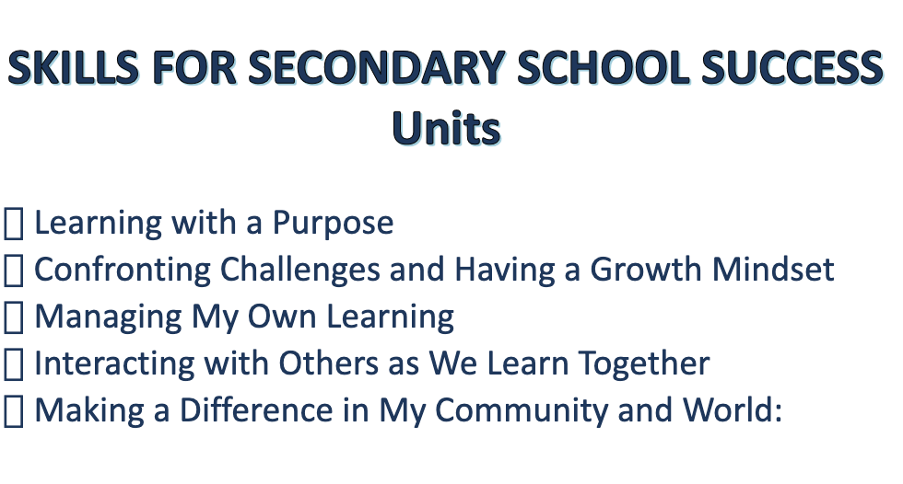
Activity 2:
Student groups do a gallery walk to discover what each unit will focus on. Encourage students to discuss or post responses to the questions at each unit station. Invite students to briefly report on what they noticed. What are they looking forward to most?
Lesson 1:
Introduction to Skills for Secondary Success
Notes:
Explain that this activity is designed to give students an overview of the 4S curriculum and allow them preview what they will be learning and think about how it applies to helping them prepare for high school.
For you the instructor to enact this lesson you will need to have a poster for each unit with the questions for the students to discuss at each station found on pages 5-10 of the Teacher’s Manual.
The students will be divided into five groups by birthday. Groups do a gallery walk to discover what each unit will focus on. Teachers will encourage students to discuss or post responses to the questions at each unit station. Groups spend about 4-5 minutes at each station.
To culminate the activity-invite students to briefly report on what they noticed. Which units do they think will be most interesting? Most fun? Most useful?

Slide 20
Lesson 2
You Are the Author of Your Life Story
Objective: Students will explore their own personality, values, talents, skills, interests and goals.
The next slides give a preview of the powerpoint slides available for Lesson 2
(slides are available for each of the 40 4S lessons)
Notes:
Read the Lesson Objective or have a participant read the slide aloud

Slide 21

Do Now:
Fill out the reflection sheet
“A Few Fast Facts About Me.”
Notes:
Photo https://www.flickr.com/photos/asiandevelopmentbank/8426494962

Slide 22

Learning with a Purpose
Day 2: You Are the Author of Your Life Story
Notes:
Image licensed from iStock https://www.istockphoto.com/photo/young-boy-dressed-as-superhero-at-beach-during-sunset-gm510397386-86226803

Slide 23

Lesson Dedication
Notes:
More on lesson dedication: https://www.edutopia.org/article/daily-ritual-builds-trust-and-community-among-students
Image: https://pixabay.com/id/illustrations/akses-banyak-tangan-933142/
Note: You can add your picture to the slide if you wish! (For future lessons you would add the student’s picture, if available.)

Slide 24
Our Agenda
Dedication
Overview of Essential Question
Partner Reading
Exploring Myself Individual Activity
Partner-Sharing
Whole Group Conclusion

Slide 25
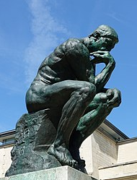
Who am I? What is my purpose?
One of the most important things human beings do
Is to think about –
or contemplate –
    their existence
    their being
    who they are.
We are all philosophers.
Notes:
Photo Wikipedia https://en.wikipedia.org/wiki/The_Thinker#/media/File:Mus%C3%A9e_Rodin_1.jpg

Slide 26
“I am awesomely and wonderfully made.”
An ancient Hebrew poet (about 1000 BC)

Slide 27
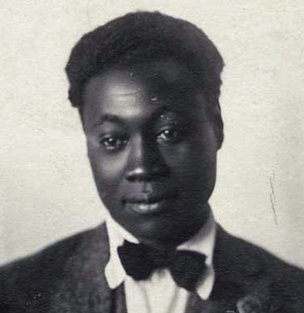
I Know My Soul
I plucked my soul out of its secret place,
And held it to the mirror of my eye,
To see it like a star against the sky,
A twitching body quivering in space,
A spark of passion shining on my face….
Claude McKay, Jamaican-born poet in Harlem, New York, 1922
Notes:
Image courtesy of the Black Past Remembered (adapted; photographer unknown) https://www.flickr.com/photos/washington_area_spark/38344414184

Slide 28

What comes to mind for you when you hear the words:
“I plucked my soul out of its secret place”?
Notes:
PPT’s “Insert online pictures” says this image is CC-licensed, but I can’t find the source.

Slide 29


What do you think McKay means by:
“And held it to the
mirror of my eye”?
Notes:
CC0 https://www.peakpx.com/613028/black-car-side-mirror
CC0 https://pixnio.com/objects/sunglasses-mirror-reflection-object-summer

Slide 30
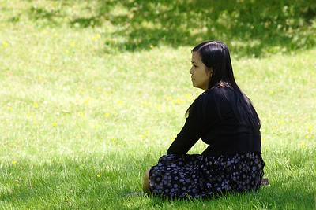
What things does he compare his soul to? When thinking of your soul in these ways, how does it make you feel?
Why do think it is a good thing to spend time looking inward and seeking to know yourself better?
To see it like a star against the sky,
A twitching body quivering in space,
A spark of passion shining on my face….
Notes:
Photo by Glenn Euloth CC BY-NC-ND 2.0 https://www.flickr.com/photos/eulothg/5824971632/

Slide 31

The Starring Role in Your Life Story:
Inviting My Soul to Take the Time to Consider
Who I Am
Notes:
Creative commons Star https://pixabay.com/vectors/star-fractal-gold-shiny-metallic-2858923/

Slide 32
Exploring My …
Personality
Interests
Values
Skills
Talents
Goals

Slide 33
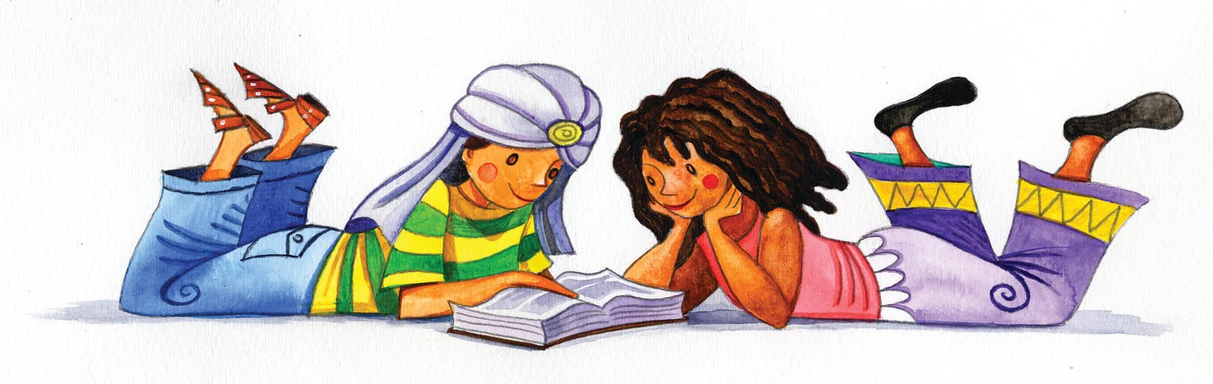
Partner Reading:
“The Starring Role in Your Life Story”
This Photo by Unknown Author is licensed under CC BY-NC-ND
Notes:
PPT’s “Insert online pictures” says this image is a CC license, but I can’t find the source.

Slide 34

Individual Exploration Time
Think through (and fill out!)
“The Starring Role in Your Life Story.”
Notes:
Image CC public domain https://pxhere.com/en/photo/1630674

Slide 35

Partner Sharing Time
Notes:
Sitting by Marian Elisa Torrealba Medina from the Noun Project https://thenounproject.com/search/?q=seated+figure&i=161448

Slide 36

Preview of Coming Attractions…
Tomorrow:
Use your creativity
to celebrate
and showcase
your unique
qualities in a
poem, rap,
or other format!
Personality
Interests
Skills
Talents
Values
Goals
Notes:
http://clipart-library.com/clipart/1733208.htm

Slide 37
PLC DISCUSSION TIME
How familiar do you think your students will be with the ideas presented and discussed in these first two lessons?
How do you think they will react to these lesson activities?
What ideas do you have for keeping them engaged?
Unit 1
Lesson 2 ppt slides
Notes:
If time allows, you can pause for a PLC discussion with your participants using the questions on the slide to guide the discussion.

Slide 38
Lesson 3 Key Activities
Expressing My Identity Creatively
Objective: Students will create a poem, rap, or spoken word to explore their own personality, values, talents, skills, interests and goals.
Notes:
You read the slide or ask for a participant volunteer.

Slide 39
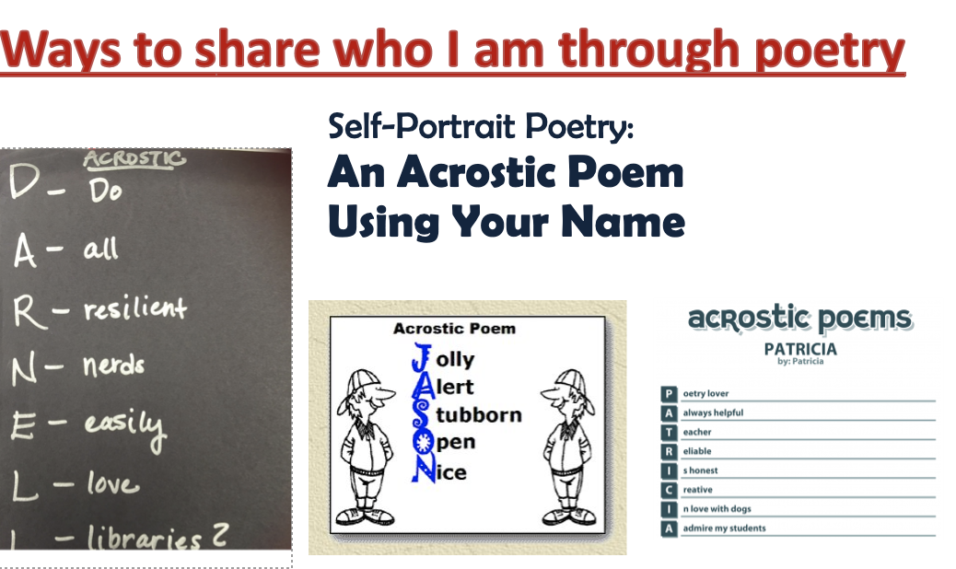
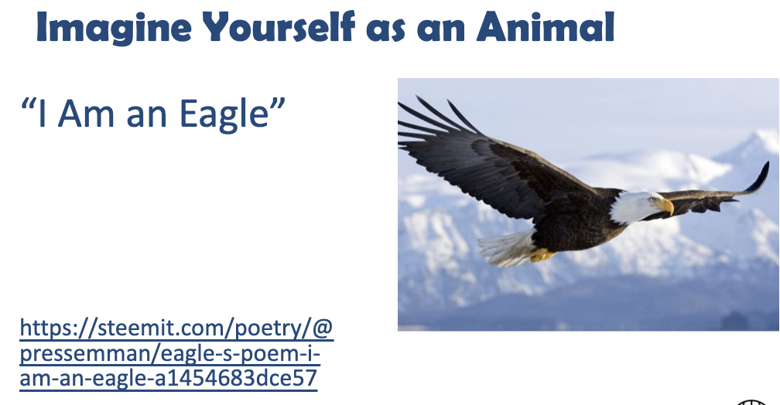
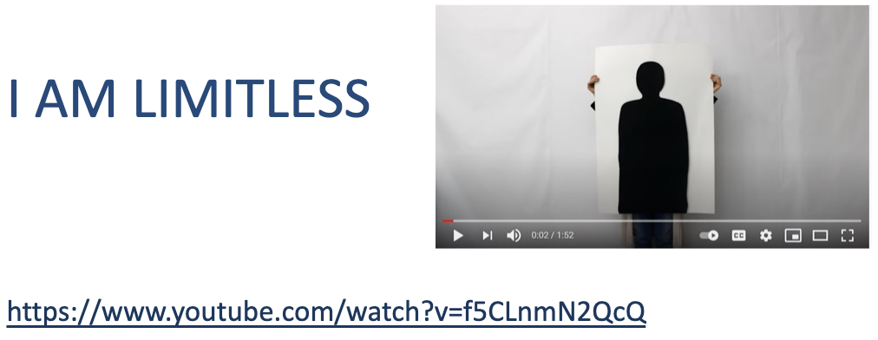
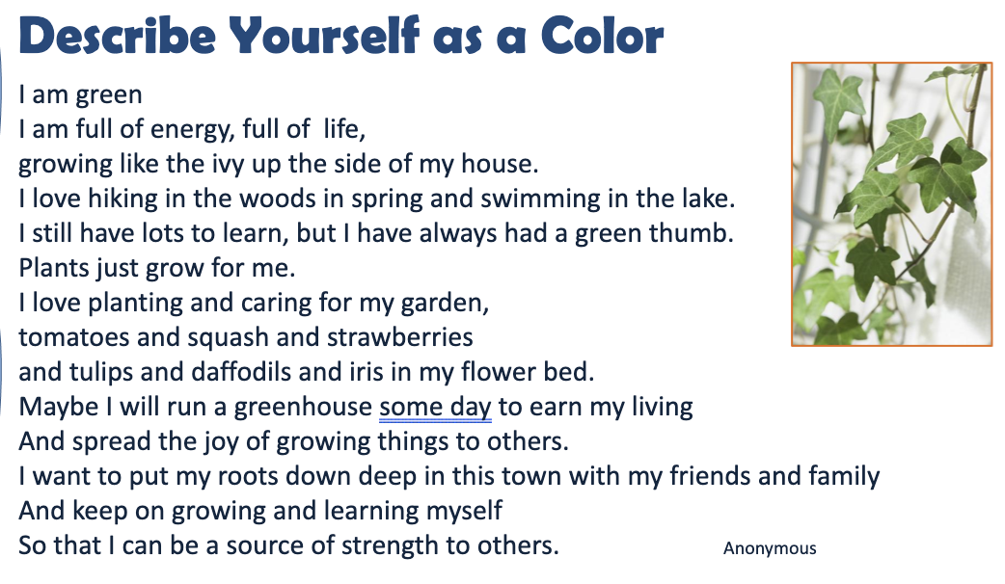
Activity 1: Students create their own poems, raps, or spoken word, having examples available to follow
Lesson 3
Expressing My Identity Creatively
Notes:
As explained on the slide, student volunteers will share their poems, raps or spoken words.

Slide 40
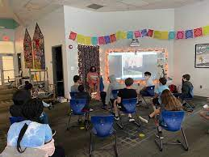

Activity 2: Student volunteers share their poems, raps, or spoken words with the class. (Depending on time and number of volunteers, this could potentially take place in subgroups).
Lesson 3
Expressing My Identity Creatively
Notes:
As explained on the slide, student volunteers will share their poems, raps or spoken words.

Slide 41
Lesson 4 Key Activities
Career Exploration I
Objectives: Students will tentatively identify Holland codes matching their personality and interests. Students will explore and select at least three career options related to their Holland code(s).
Notes:
Read the slide or have a participant volunteer read the slide

Slide 42
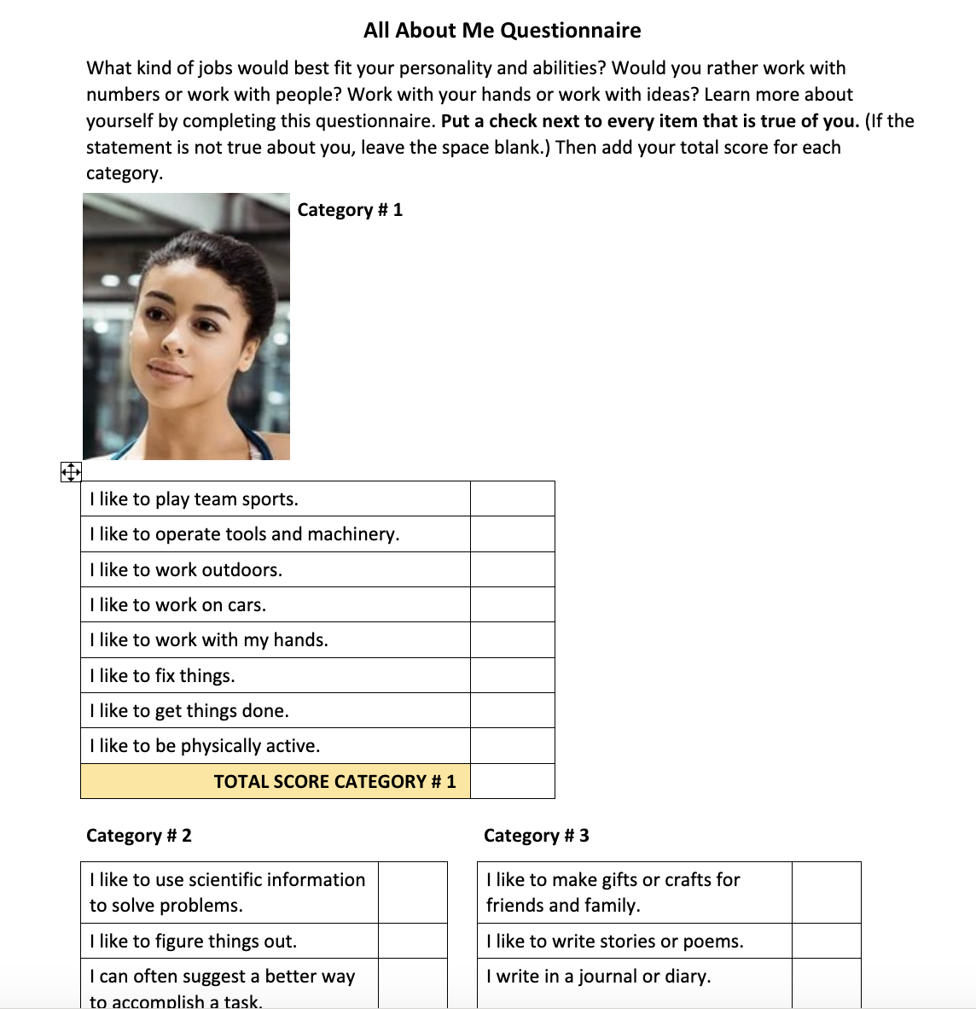
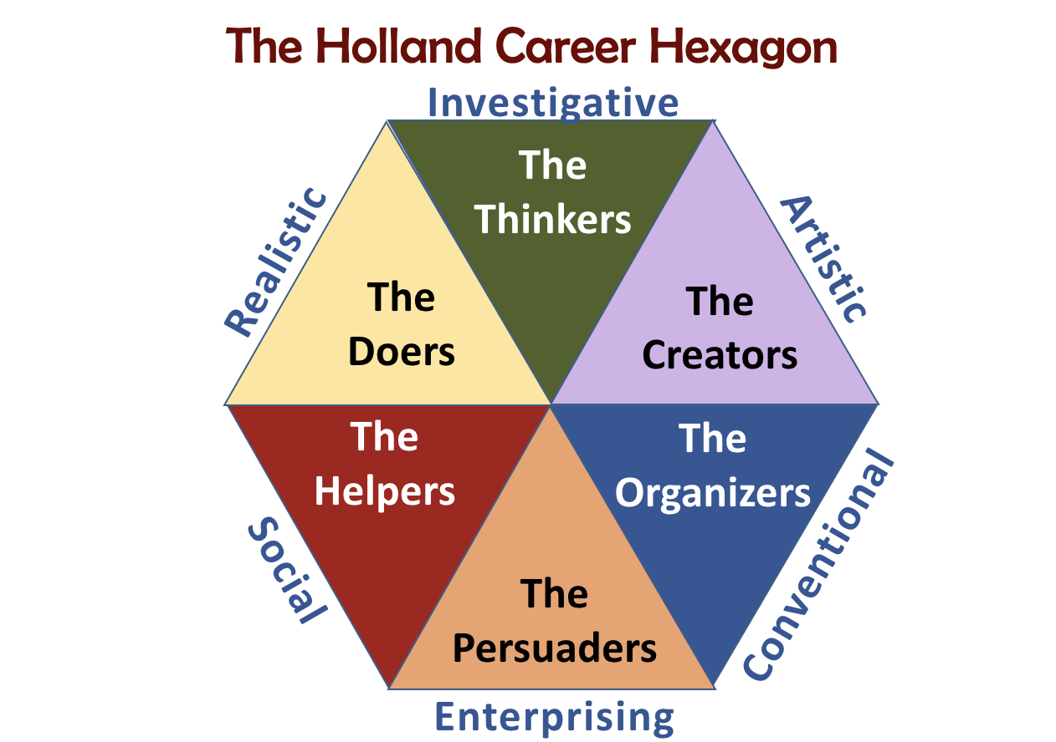
Activity 1: Students explore the Holland Career Codes
Lesson 4
Career Exploration I
Notes:
Ask if any participants are familiar with the Holland codes-if yes-have someone explain what they are to the group
If not-familiarize yourself with the Holland codes by reading pages 24-25 in the Teacher’s Manual.
Holland Career codes were developed in 1958 by psychologist John Holland as a way of putting career options into categories based on the personality types of people who do well in those careers. The Holland career framework is just one way of categorizing different career types, but for many years it has proven useful in helping people identify careers to pursue that they would find satisfying and enjoyable.
Students will complete the All About Me Questionnaire to identify their top two categories.
The second part of the activity engages students with the Holland Career Hexagon to learn about the 6 Holland Codes engaging the students in a discussion about each category using the questions on page 24 of the Teacher’s Manual

Slide 43
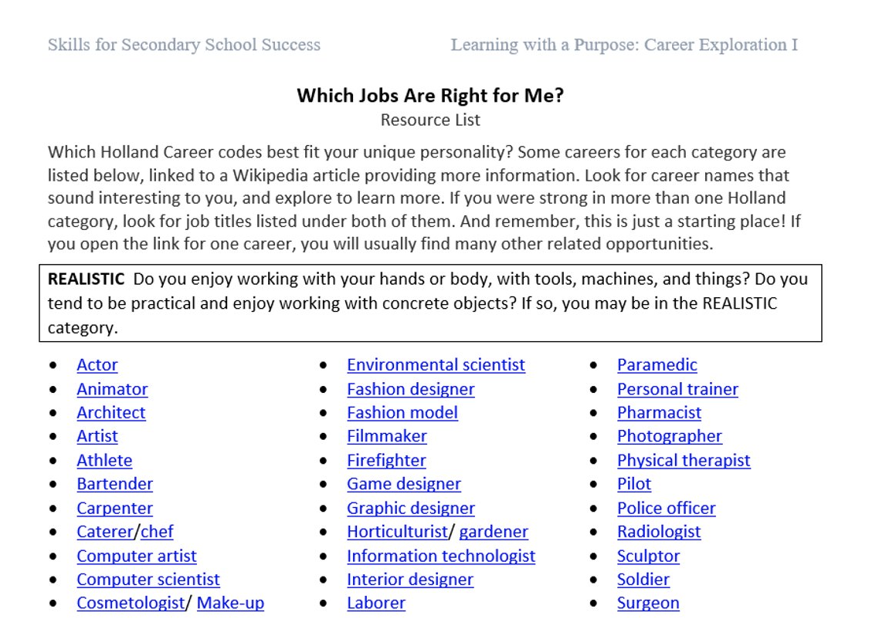
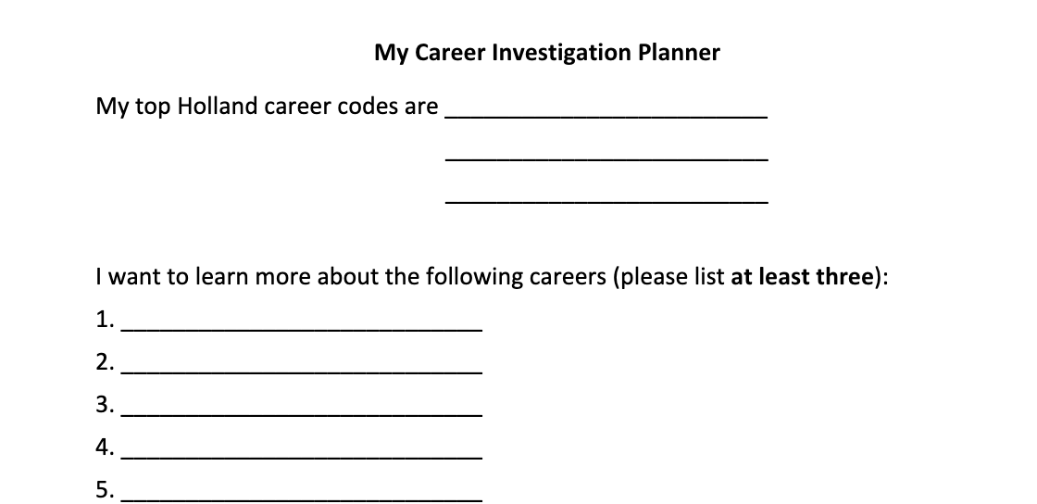

Activity 2: Students find Careers that match their Holland Codes
Lesson 4
Career Exploration I
Notes:
For this activity, students will be working with a partner either on the internet (ONET Online Interests Search) or using the Which Jobs Are Right for Me ppt slide (#10) or printed copy of Teacher’s Manual pg. 31-34 where they can explore careers that might be of interest to them in the future.

Slide 44
Lesson 5 Key Activities
Career Exploration II
Objective: Students further investigate Holland code-related careers of interest, considering job outlooks, lifestyle impacts, and preparation required. Students may explore academic offerings at a local two- or four-year college.
Notes:
Read the slide or ask a participant to read the slide.

Slide 45
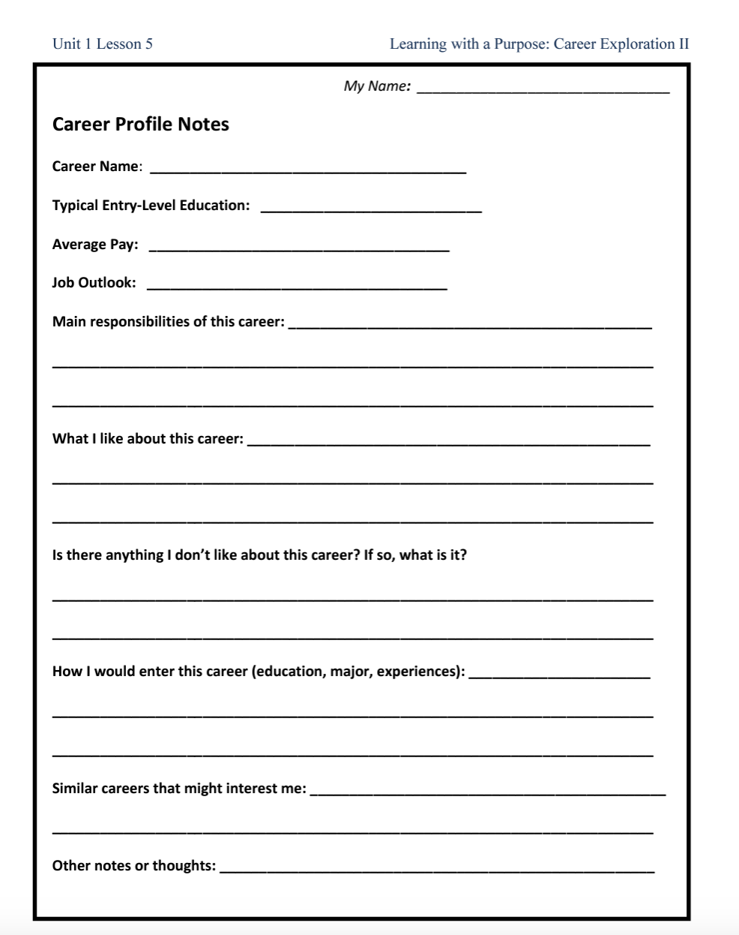
Lesson 5
Career Exploration II
Activity 1:
Students learn more about their career choices
Notes:
For this activity, time will be spent explaining and discussing the terms job security and job outlook, so students are aware of the risks and opportunities they may encounter in selecting a future career. Each student will need at least 3 of the career profile sheets either paper copies or electronically. Use pgs. 37 and 38 in the Teacher’s Manual as your guide or ppt slides 11 and 12 to explain the process of exploring the Occupational Outlook Handbook website to gather the career profile information. This activity will require active circulation by the teacher around the room to assist students as needed.

Slide 46
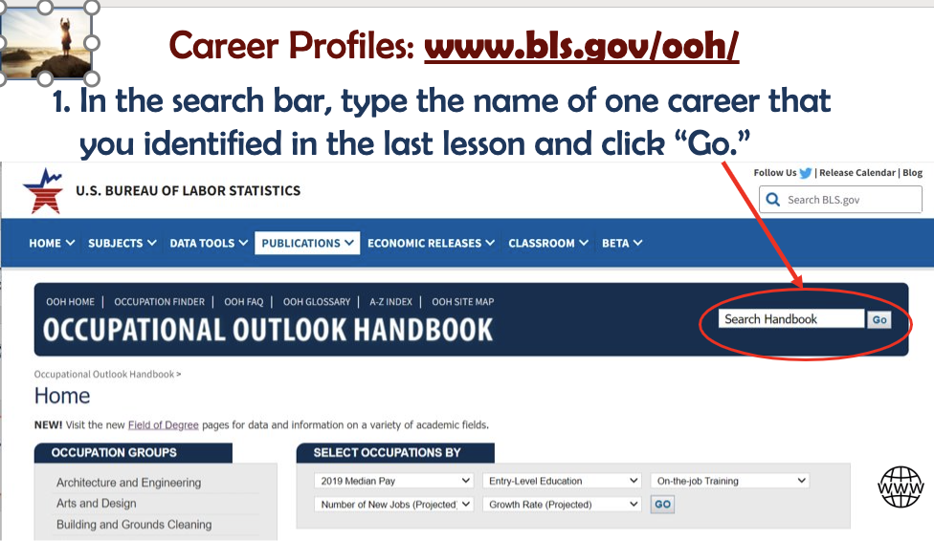

Activity 2:
Students explore education and training opportunities related to their careers.
Lesson 5
Career Exploration II
Notes:
For this activity, students will share what they learned about during their career option exploration. The activity is designed to support students who do and do not have access to the internet, so they can explore the available colleges and training institutes that support their career options.

Slide 47
PLC DISCUSSION TIME
How familiar do you think your students will be with the ideas presented and discussed in these first two lessons?
How do you think they will react to these lesson activities?
What ideas do you have for keeping them engaged?
Unit 1
Lesson 2 ppt slides
Notes:
If time allows, you can pause for a PLC discussion with your participants using the questions on the slide to guide the discussion.

Slide 48
Lesson 6 Key Activities
My Future Self (Part 1)
Objective: Students will understand the importance of having clear direction and a Life’s Blueprint (vision) for their future
Notes:
Read the slide or ask a participant to read the slide

Slide 49
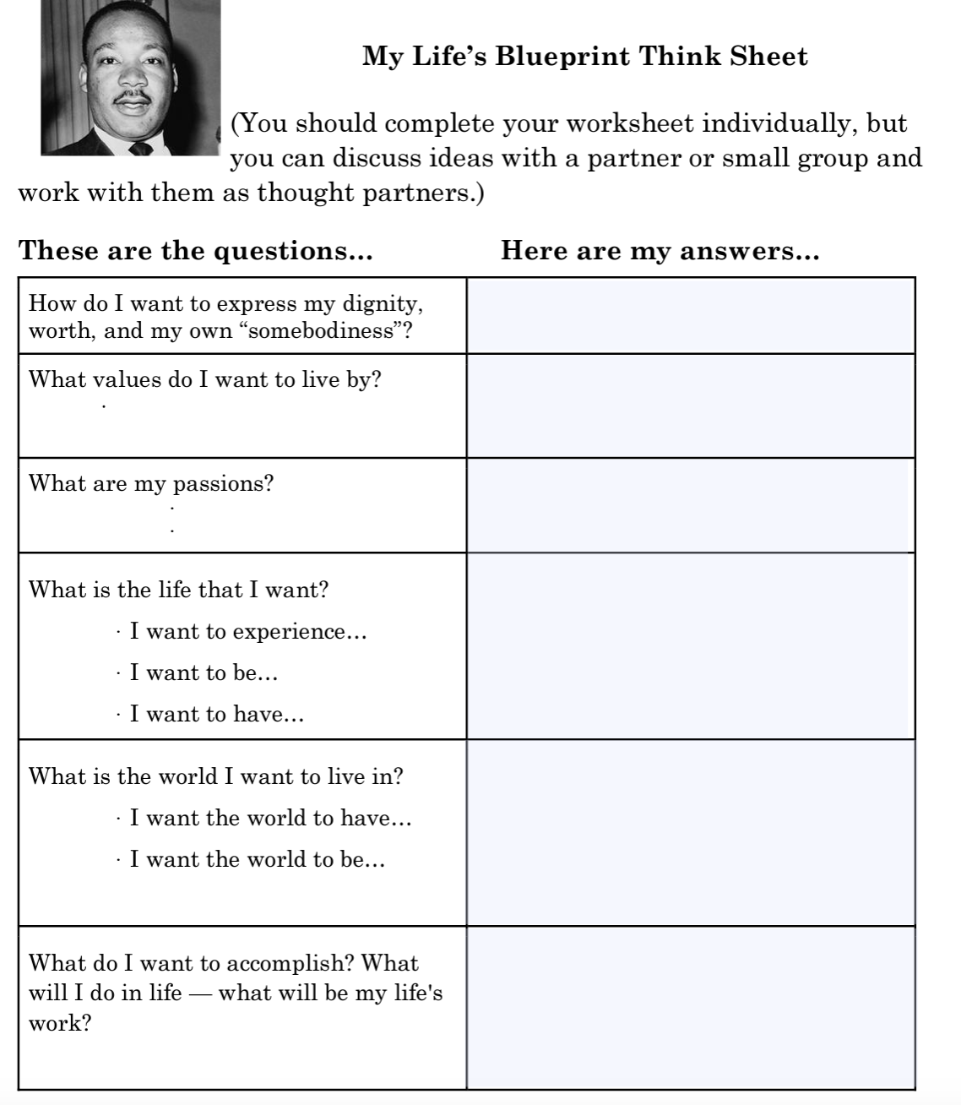
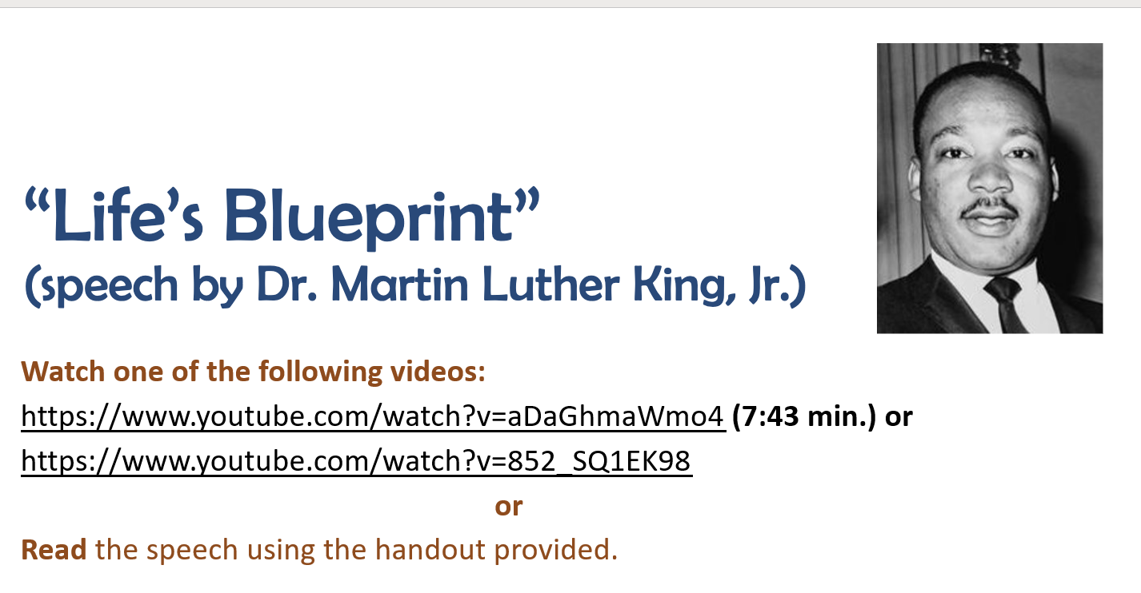
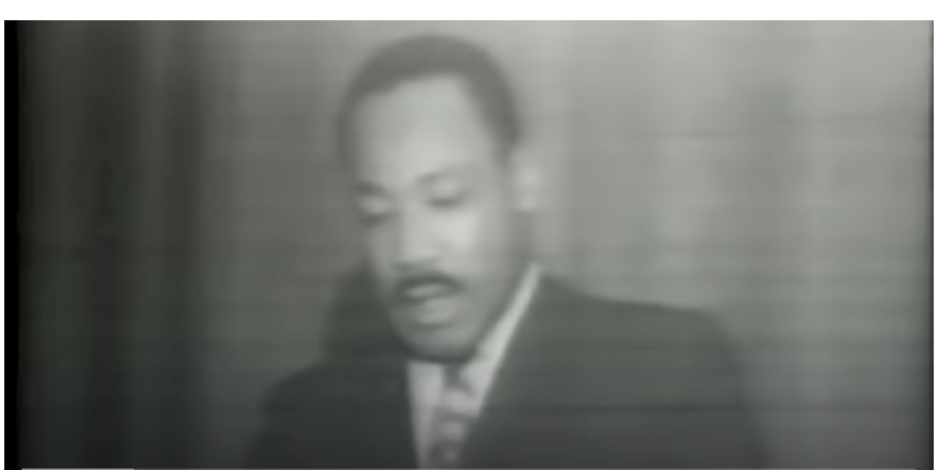
Activity 1: Students will learn about Martin Luther King Jr.’s
Life’s Blueprint speech
Lesson 6
My Future Self (Part 1)
Notes:
As the slide shares, students will learn about Martin Luther King Jr’s Life’s Blueprint speech that they can either read, watch or both. Students will work with partners to identify the 3 things that Dr. King shares are part of a person’s blueprint and will place this information on their record sheets.

Slide 50
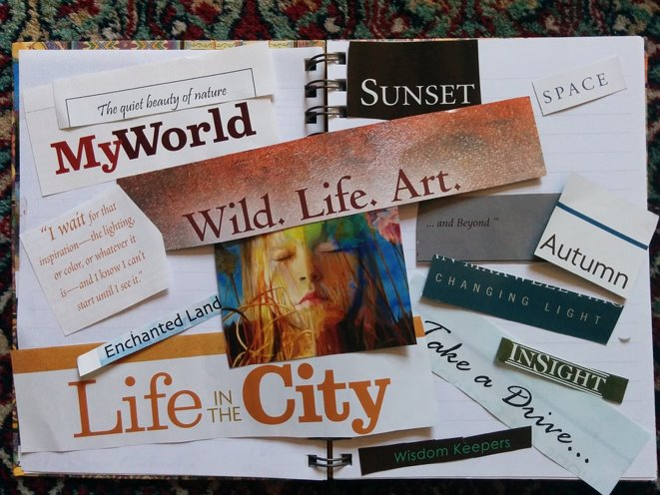
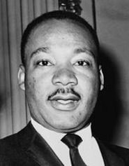
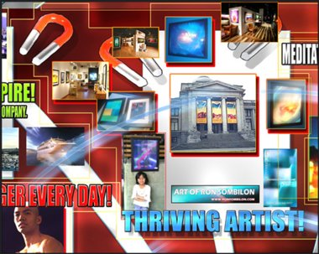
Activity 2: Students explore examples of how they might create or design their own “Life’s Blueprints” by constructing visualization boards or products that represent how they see their future selves (to be completed in next lesson day).
Lesson 6
My Future Self (Part 1)
Notes:
As the slide reads, students will be exploring visions boards using the links you provide in the lesson’s ppt or by accessing the internet and locating samples independently or in pairs. Students will save or record ideas using the same worksheet they used for listing the 3 things that are part of a person’s life’s blueprint. They will search for ideas that are appealing to them to help guide their vision board or vision product creations as part 2 off My Future Self.

Slide 51
Lesson 7 Key Activities
My Future Self (Part 2)
Objective: Students will understand the importance of having clear
direction and a Life’s Blueprint (vision) for their future.
Notes:
Please read the slide or ask a participant to read the slide

Slide 52

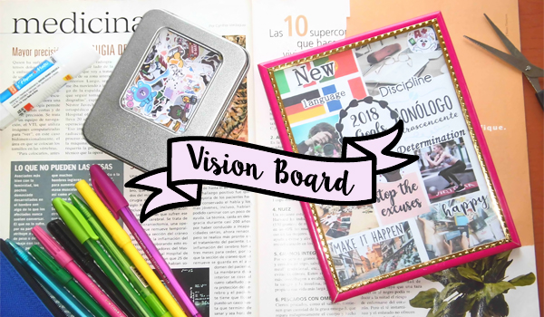
Activity 1: Students create/construct their Life’s Blueprint visualization boards/products.
Lesson 7
My Future Self Part 2
Notes:
Students will create their vision products.

Slide 53

Lesson 7
My Future Self Part 2
Activity 2: Students share their boards or product with their team or a partner.
Notes:
Students will share t.heir vision products.

Slide 54

Reflections and Questions
How will you help students understand how what they are learning and discussing in Unit 1 can help them to be successful in high school and in life after high school? What challenges do you foresee in helping engage students and understand the connections between what they are doing in school now and how it relates to their future? How can you meet those challenges?
Unit 1
Lesson 2 ppt slides
Notes:
If time allows, you can pause for a PLC discussion with your participants using the questions on the slide to guide the discussion.

Slide 55


PD Feedback Survey
Your feedback matters to us!
Please check your email now for a link to our feedback survey and complete it now.
Thanks so much!
This Photo by Unknown Author is licensed under CC BY-SA
Notes:
It is very important to our partners at Johns Hopkins to receive our feedback. Please check your email now for a link to the survey about this PD session and take time to complete it now.
Thanks so much!

